Slide 1
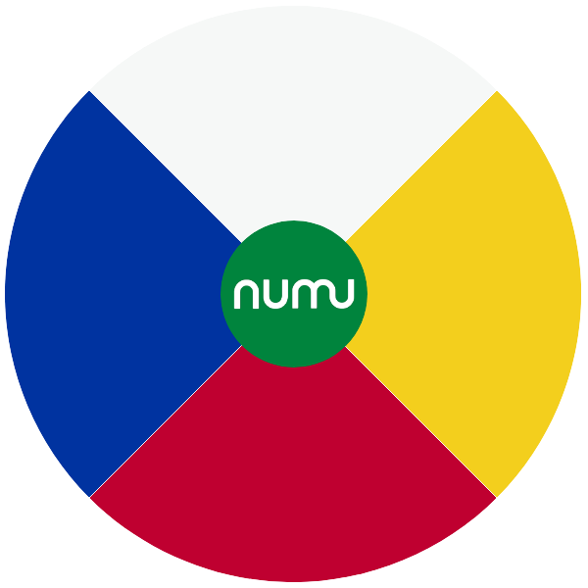

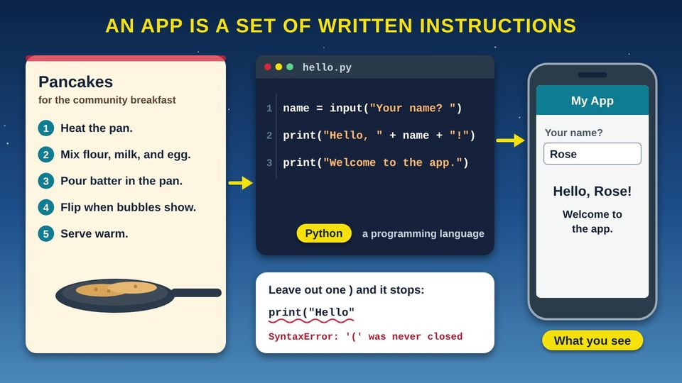
COMMUNITY TECH RESOURCES · COMMUNITY CLASS 7 OF 10
How Do Apps Work?
Source code, compiling and interpreting, how software is built, and blueprints for code
Everyone
35 min
5 pictures
Free class from the Numu Communications Learning Center · www.numu.tech/resources
Notes:
TEACHING THIS CLASS (45 minutes)
Lesson plan:
- 5 min: Start here: read the story and the objectives.
- 15 min: How Software Development Works: pairs write sandwich steps on a card, swap, and follow them exactly. Act out compiling and interpreting, then walk the life cycle loop.
- 10 min: Classes, Objects, and Methods: the blueprint and the houses. Read the code line by line, then do the pickup truck cards.
- 5 min: Inside a Phone App: follow an app from the screen to the server.
- 10 min: Practice and quiz together, then the three Remember cards.
What you need:
- Projector or large TV for the slides
- Printed handouts, one per person
- Index cards and pens for the Be the computer activity
- Optional: bread, a butter knife, and a jar of jam for a live Be the computer demonstration
- Participants' own phones, tablets, or laptops
- Optional: one computer with internet to run the House code in a free online Python editor
Talk about it:
- Which app do you use most? What do you think is stored on your phone, and what is stored on a server far away?
- Who should test an app made for our community before it is released?
- What kind of app would help our community? Walk it through the six steps of the life cycle.
The picture slides have every numbered detail in their speaker notes.
STORY: Taped above the stove at the community center is a handwritten recipe card for pancakes. Anyone who follows it, step by step, gets the same breakfast. Now picture your phone. Every app on it, from the weather to a game, started the same way: as written instructions. People wrote them in a language a computer can follow, tested them, and sent them to your phone. Think of the housing neighborhood, too, where a row of homes went up from one blueprint, each with its own paint color. In this class you will see how code is written, how a computer reads it, how a team builds an app, and why programmers use blueprints too.

Slide 2
What you will learn
✓
Explain that an app is a set of written instructions, called source code, in a programming language
✓
Describe the difference between compiling code ahead of time and interpreting it line by line
✓
Name the six steps of the SDLC (software development life cycle) and explain why it is a loop
✓
Explain classes, objects, properties, and methods using a house blueprint and the homes built from it

Slide 3

The story
Taped above the stove at the community center is a handwritten recipe card for pancakes. Anyone who follows it, step by step, gets the same breakfast. Now picture your phone. Every app on it, from the weather to a game, started the same way: as written instructions. People wrote them in a language a computer can follow, tested them, and sent them to your phone. Think of the housing neighborhood, too, where a row of homes went up from one blueprint, each with its own paint color. In this class you will see how code is written, how a computer reads it, how a team builds an app, and why programmers use blueprints too.
Notes:
Taped above the stove at the community center is a handwritten recipe card for pancakes. Anyone who follows it, step by step, gets the same breakfast. Now picture your phone. Every app on it, from the weather to a game, started the same way: as written instructions. People wrote them in a language a computer can follow, tested them, and sent them to your phone. Think of the housing neighborhood, too, where a row of homes went up from one blueprint, each with its own paint color. In this class you will see how code is written, how a computer reads it, how a team builds an app, and why programmers use blueprints too.

Slide 4
PART 1
How Software Development Works
An app is a set of written instructions. See how people write it, how the computer translates it, and the steps every software team follows.
3 pictures to explore

Slide 5
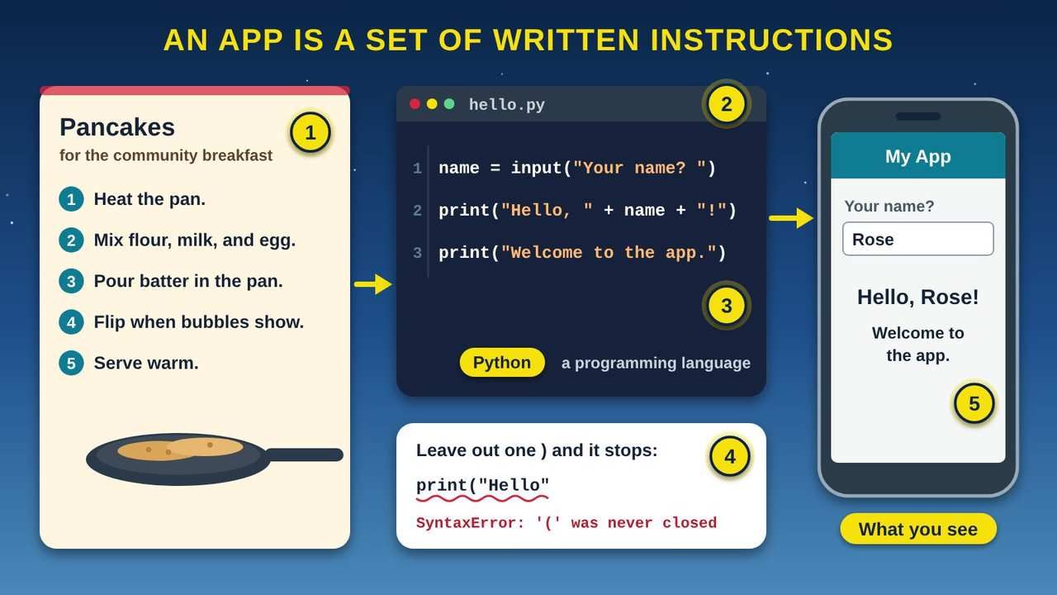
An App Is a Set of Written Instructions
Part 1 · Picture 1 of 5
Notes:
An App Is a Set of Written Instructions
What the picture shows: A pancake recipe card with five numbered steps sits beside a code editor showing three lines of Python that ask for a name and say hello. Below the code, one missing parenthesis causes an error. On the right, a phone shows the result: Hello, Rose!
1. Instructions, in order. A recipe is a list of steps in a set order. Anyone who follows it the same way gets the same pancakes. An app is the same idea: a list of instructions for a computer.
2. Source code. Instructions written for a computer are called source code, or just code. People type it, read it, and fix it, much like a recipe card. This tiny program asks your name and then greets you.
3. A programming language. Code is written in a programming language, a language with strict rules that people and computers can both read. This example uses a language called Python. There are many others, like JavaScript, C, and C++.
4. Computers do not guess. A cook can guess what a smudged recipe means. A computer cannot. Leave out one small mark, like a closing parenthesis, and the program stops with an error. A mistake in code is called a bug.
5. What you see. When the code runs, you see the result on your screen. Every app on your phone, from the weather to games, is built from instructions like these, just many more of them.

Slide 6
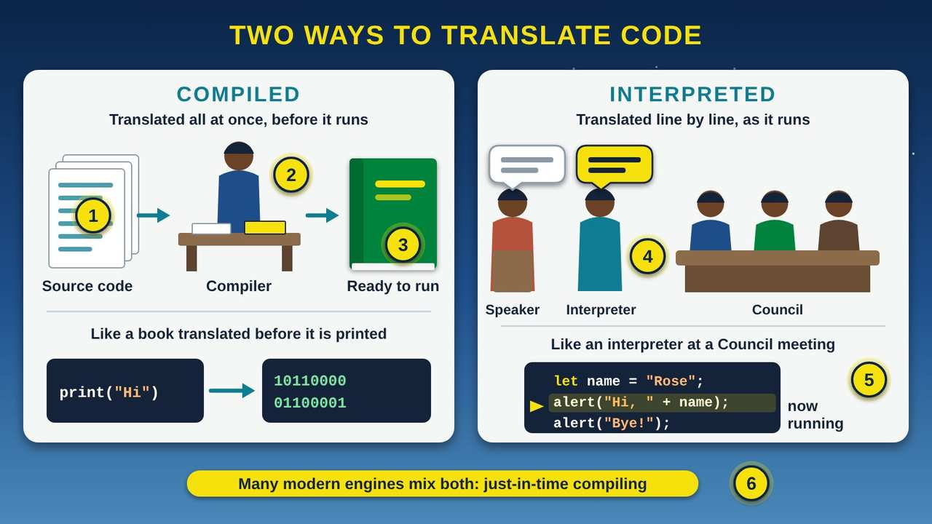
Two Ways to Translate Code: Compiling and Interpreting
Part 1 · Picture 2 of 5
Notes:
Two Ways to Translate Code: Compiling and Interpreting
What the picture shows: On the left, a stack of source code pages goes to a translator at a desk, labeled compiler, and comes out as a finished book, with a line of code turned into ones and zeros. On the right, a speaker at a Council meeting talks while an interpreter repeats each sentence to the Council, and a yellow arrow points to the line of code running now.
1. People write source code. People write code in a programming language that they can read. A computer's chip cannot run it in that form. It has to be translated first, in one of two ways.
2. A compiler translates it all ahead of time. Compiling means changing a program from the language it was written in into another form. A compiler is the program that does this. It translates the whole program before anyone runs it, like a book translated before it is printed.
3. Ready to run, fast. Languages like C and C++ are compiled into machine code, the ones and zeros a computer's chip runs directly. Because the work was done ahead of time, the finished program is ready the moment you open it.
4. An interpreter goes line by line. At a Council meeting, an interpreter listens to one sentence, then says it in the language the listeners understand, then the next sentence. Interpreted code works the same way: it is translated and run from top to bottom, one line at a time, while it runs.
5. JavaScript arrives as text. When you visit a website, your web browser gets its JavaScript code in its original text form and runs it from top to bottom. The yellow arrow shows the line running right now.
6. Both at once. Modern JavaScript engines also use just-in-time compiling: while the code runs, they compile parts of it into a faster form. So the line between the two ways is not as sharp as it used to be.

Slide 7
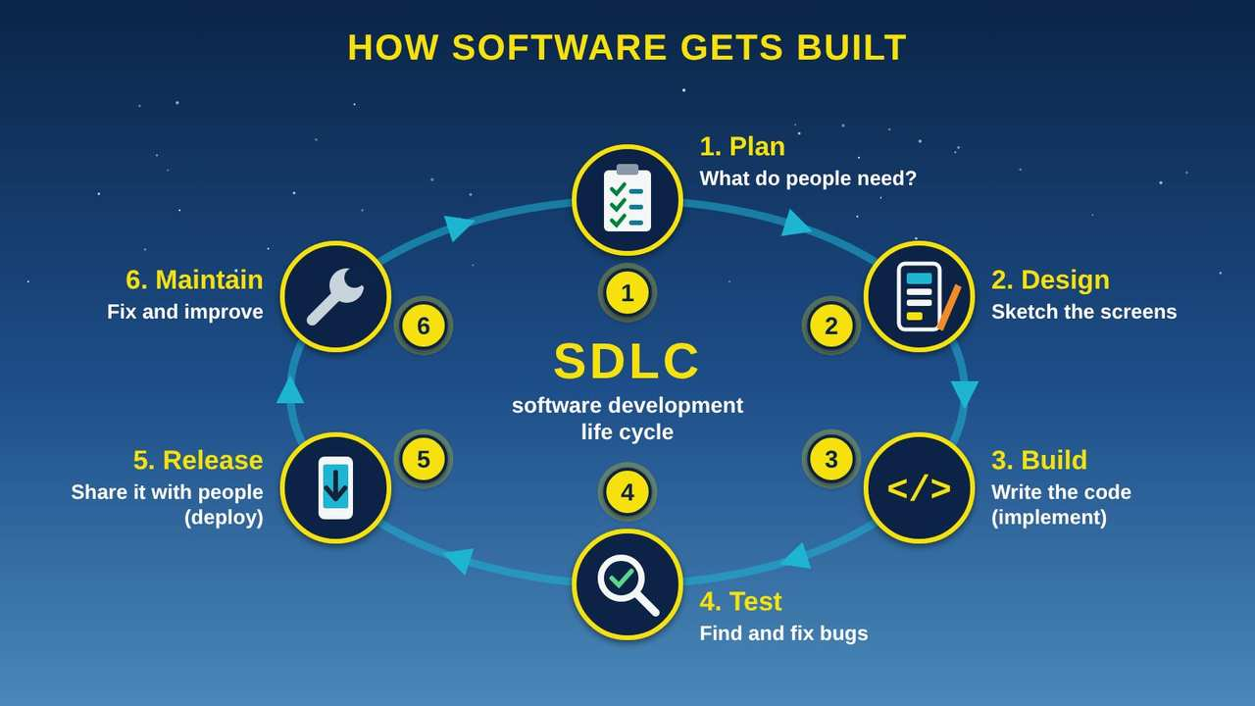
How Software Gets Built: The Software Development Life Cycle
Part 1 · Picture 3 of 5
Notes:
How Software Gets Built: The Software Development Life Cycle
What the picture shows: A loop of six stations around the letters SDLC, software development life cycle: 1 Plan, 2 Design, 3 Build, 4 Test, 5 Release, and 6 Maintain, with arrows leading from Maintain back to Plan.
1. Plan. Every app starts with a question: what do people need? Say the tribal library wants an app that shows its hours and events. The team writes down what the app must do, who will use it, and how much time and money it will take.
2. Design. Next the team sketches the screens and decides how the parts will fit together, the way a builder draws plans before pouring a foundation. Design is cheaper to change on paper than after the code is written.
3. Build. Now programmers write the source code, following the design. Amazon Web Services calls this step Implement. Big apps are built in small pieces, and each piece is checked as it is finished.
4. Test. Testers try the app to find bugs, the mistakes in the code. Good testing includes real people: an Elder with large text turned on, a student on an older phone, someone with a weak signal far out of town.
5. Release. When the app passes its tests, it is shared with the people who will use it, often through an app store. Amazon Web Services calls this step Deploy. It is like opening day for a new community building.
6. Maintain. The work is not done at release. People find new problems and ask for new features. The team fixes and improves the app and sends updates, and new ideas go back to step 1. That is why it is drawn as a loop.

Slide 8
Be the computer
Ask a friend to write the steps for making a sandwich. Then follow them exactly as written, nothing more. If the steps never say to open the jar, you cannot open it. Computers work the same way, and a missing step is a bug.

Slide 9
Compiling and interpreting side by side
 | Compiled | Interpreted
When it is translated | All at once, before the program runs | Line by line, from top to bottom, while it runs
Everyday comparison | A book translated before it is printed | A live interpreter at a Council meeting
What the computer gets | Machine code, ready for the chip | The code in its original text form
Examples | C and C++ | JavaScript in your web browser
Modern JavaScript engines also use just-in-time compiling, which turns parts of the code into a faster form while it runs.

Slide 10
The six steps, with a building project for comparison
Step | In an app | In a building project
1. Plan | Decide what the app must do and who will use it | Decide what the community needs from the building
2. Design | Sketch the screens and how the parts fit | Draw the blueprints
3. Build (implement) | Write the source code | Pour the foundation and frame the walls
4. Test | Find and fix bugs, with real people trying it | Inspect the wiring, plumbing, and roof
5. Release (deploy) | Share it, often through an app store | Opening day
6. Maintain | Send updates with fixes and new features | Repairs, upgrades, and new rooms

Slide 11
PART 2
Classes, Objects, and Methods
Programmers use blueprints, called classes, to build many objects that share the same parts and actions.
1 picture to explore

Slide 12
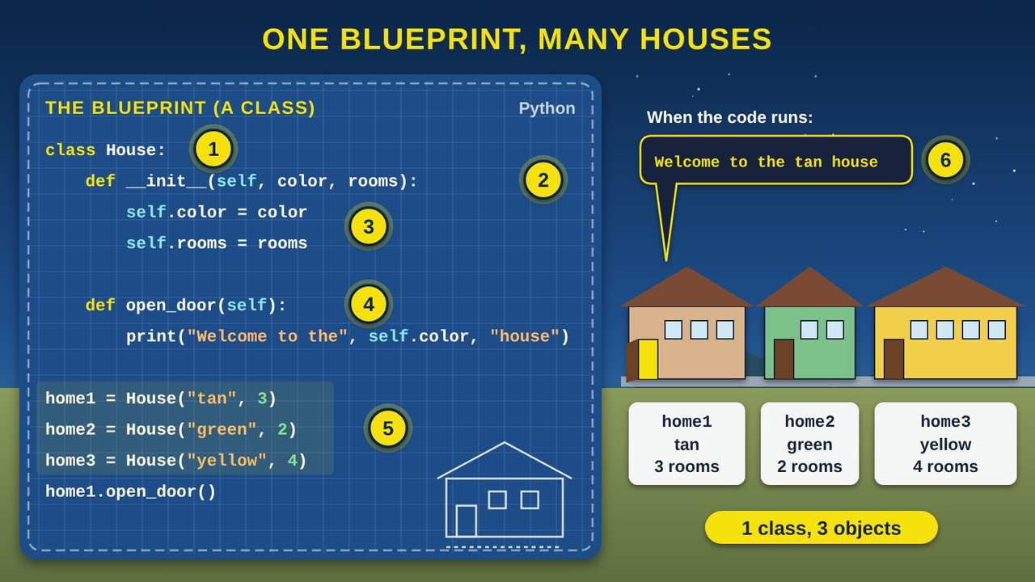
One Blueprint, Many Houses: Classes and Objects
Part 2 · Picture 4 of 5
Notes:
One Blueprint, Many Houses: Classes and Objects
What the picture shows: On the left, a blueprint holds twelve lines of Python code for a class named House, with the properties color and rooms and a method named open_door. On the right, three houses on a street were built from it: a tan house with 3 rooms, a green house with 2 rooms, and a yellow house with 4 rooms. The tan house's door is open, and a speech bubble shows the output: Welcome to the tan house.
1. A class is a blueprint. A class is a plan for making things. Like a housing blueprint, it describes what every house will have, but it is not a house itself. This line starts a class named House.
2. The setup step. This special part, written __init__, runs every time a new house is made. Many languages call it a constructor. It takes the details for one house, its color and its number of rooms.
3. Properties describe each house. self.color and self.rooms are properties: facts that describe one house. The word self means this one house. Every house has a color, but each house can have a different one.
4. Methods are what it can do. open_door is a method: an action that every house built from the blueprint can do. When it runs, it prints a welcome that uses that house's own color.
5. Objects are the real houses. These three lines use the blueprint to make three objects, also called instances: home1, home2, and home3. One class can make as many objects as you need, like a street of homes built from the same plan.
6. Each object keeps its own details. home1.open_door() opens only the tan house's door, so the program prints Welcome to the tan house. The green and yellow houses are not changed. Each object keeps its own details to itself.

Slide 13
The code, line by line
You can type this code into a free online Python editor and run it yourself. It prints one line: Welcome to the tan house.
Line | What it means
class House: | Start a blueprint (a class) named House.
def __init__(self, color, rooms): | The setup step (constructor). It runs each time a new house is made and takes that house's color and number of rooms.
self.color = color | Save this house's color as a property.
self.rooms = rooms | Save this house's number of rooms as a property.
def open_door(self): | Start a method named open_door, something every house can do.

Slide 14
The code, line by line (continued)
Line | What it means
print("Welcome to the", self.color, "house") | When the door opens, show a welcome that uses this house's own color.
home1 = House("tan", 3) | Build the first object (instance) from the blueprint: a tan house with 3 rooms.
home2 = House("green", 2) | Build a second object: a green house with 2 rooms.
home3 = House("yellow", 4) | Build a third object: a yellow house with 4 rooms.
home1.open_door() | Ask only home1 to open its door. The screen shows: Welcome to the tan house
Indents matter in Python. The four spaces show which lines belong inside the class and inside each method.

Slide 15
Another example: pickup trucks
Class: the blueprint
The factory's plan for one model of pickup truck. Every truck built from it has the same parts.
Objects: the trucks
Your red truck and your uncle's white truck. Both were built from the same plan, so each is an object, or instance, of that class.
Properties: what describes it
Color, miles on the odometer, and how much fuel is in the tank. Each truck has its own values.
Methods: what it can do
Start, drive, honk, and haul. Honking your horn does not honk your uncle's.

Slide 16
PART 3
Inside a Phone App
Putting it together: what happens when you tap an app on your phone.
1 picture to explore

Slide 17
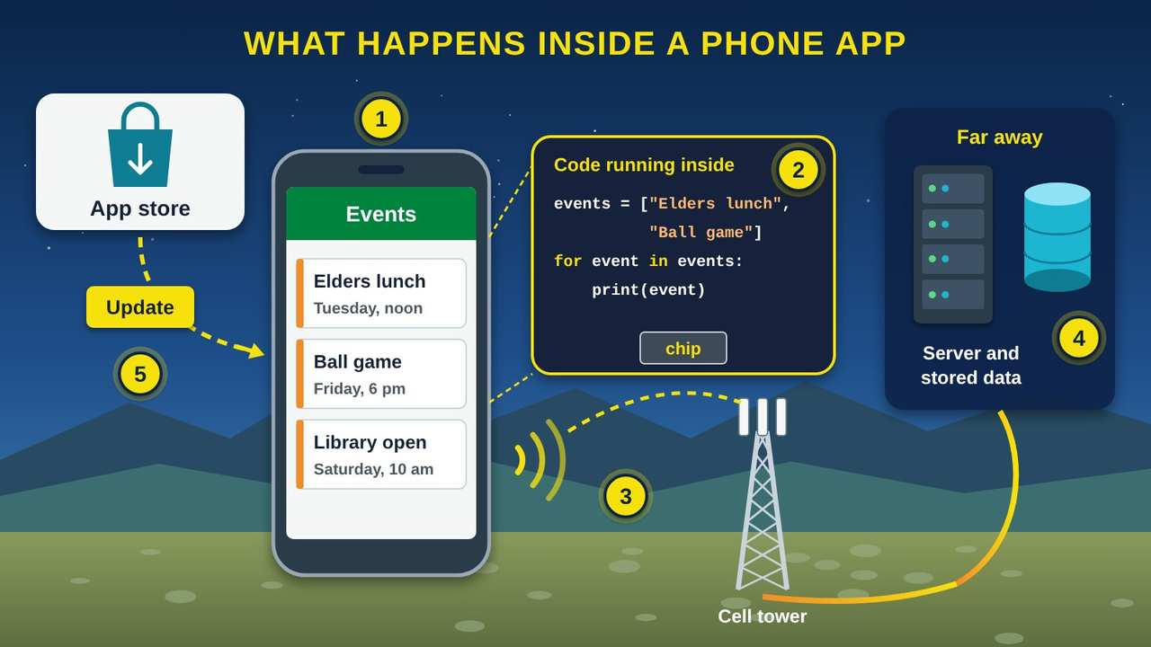
What Happens Inside a Phone App
Part 3 · Picture 5 of 5
Notes:
What Happens Inside a Phone App
What the picture shows: A phone shows an events app with three events. A zoomed panel shows the code running inside on the phone's chip. Signal travels from the phone to a cell tower and over fiber to a far-away data center with a server and stored data. At the top left, an app store sends an update to the phone.
1. The screen you see. The buttons, words, and pictures you tap are the app's user interface (UI). Designers sketched these screens in the design step, long before you ever opened the app.
2. Code that runs on your phone. Behind the screen, the app's code runs on your phone's chip. It decides what to show and what to do when you tap. This tiny example takes a list of events and shows them one at a time.
3. A trip over the network. When the app needs new information, like this week's events, it sends a request over Wi-Fi or the cell network. Numu Communications builds and runs networks like this for tribal and rural communities.
4. Data stored far away. Many apps keep their information, like event lists, accounts, and messages, on a server in a data center that may be far away. That is why some apps do not work, or show old information, without a connection.
5. Updates from the app store. Remember the maintain step? When the team fixes a bug or adds a feature, they send new code through the app store. Installing updates gives you the fixes and keeps the app working well.

Slide 18
Keep your apps updated
Updates are the maintain step of the life cycle. They bring bug fixes and new features. Turn on automatic updates in your app store's settings, or check for updates once a week, so you always have the latest fixes.

Slide 19
Try it at home
Twenty minutes with your own phone, tablet, or computer, and a friend for step 3. Menu names differ a little from device to device.
1
Look at your app list. iPhone: swipe left past your last home screen to see the App Library. Android: swipe up from the bottom of the home screen. Count the apps you used this week.

Slide 20
Try it at home (continued)
2
Find your update history. iPhone: open the App Store and tap your picture in the top right. Android: open Google Play, tap your picture, then Manage apps and device. Open one app's page and read its "What's new" note. Which step of the life cycle made that change?
3
Be the computer. Ask a friend to write the steps for making a sandwich or a cup of coffee. Follow them exactly as written, nothing more. Write down every missing step. Those are bugs.

Slide 21
Try it at home (continued)
4
Try a free beginner coding lesson at Code.org (code.org/learn). Pick an activity for beginners. Notice how each block or line is one instruction.
5
Look around your home or the community for a class and its objects: one plan, many copies. What are their properties, and what can they do?

Slide 22


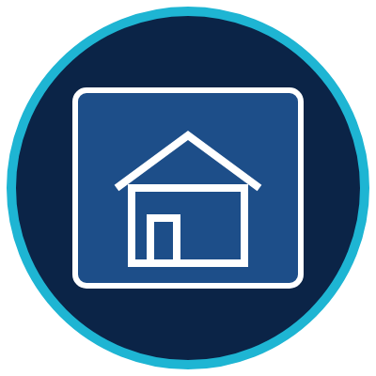
Remember
An app is written instructions called source code
Compilers translate ahead; interpreters translate line by line
A class is a blueprint; objects are houses
Notes:
An app is written instructions called source code
Compilers translate ahead; interpreters translate line by line
A class is a blueprint; objects are houses

Slide 23
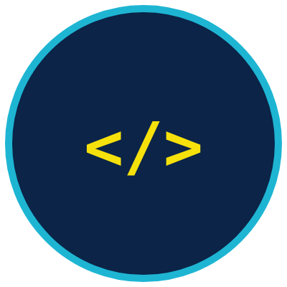
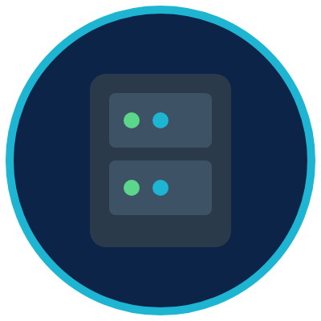

Check what you learned: question 1 of 6
Your niece shows you what she typed in her coding class: print("Hello"). What is she showing you?
A
B
C
Source code, instructions written in a programming language
A server that stores her data
An app store update
Notes:
Your niece shows you what she typed in her coding class: print("Hello"). What is she showing you?
Answer: A. Source code, instructions written in a programming language
People write instructions for a computer in a programming language. Those written instructions are called source code.

Slide 24
Answer: question 1 of 6
Your niece shows you what she typed in her coding class: print("Hello"). What is she showing you?
Source code, instructions written in a programming language
A
✓ Correct
A server that stores her data
B
C
An app store update
Why: People write instructions for a computer in a programming language. Those written instructions are called source code.
Notes:
Your niece shows you what she typed in her coding class: print("Hello"). What is she showing you?
Answer: A. Source code, instructions written in a programming language
People write instructions for a computer in a programming language. Those written instructions are called source code.

Slide 25

Check what you learned: question 2 of 6
At a Council meeting, an interpreter says each sentence in another language right after the speaker says it. Which way of running code is this most like?
A
B
Compiling: translating the whole program ahead of time
Interpreting: translating line by line as it runs
Notes:
At a Council meeting, an interpreter says each sentence in another language right after the speaker says it. Which way of running code is this most like?
Answer: B. Interpreting: translating line by line as it runs
An interpreter works one line at a time, from top to bottom, while the program runs. A compiler translates the whole program before it runs, like a book translated before it is printed.

Slide 26
Answer: question 2 of 6
At a Council meeting, an interpreter says each sentence in another language right after the speaker says it. Which way of running code is this most like?
Compiling: translating the whole program ahead of time
A
B
Interpreting: translating line by line as it runs
✓ Correct
Why: An interpreter works one line at a time, from top to bottom, while the program runs. A compiler translates the whole program before it runs, like a book translated before it is printed.
Notes:
At a Council meeting, an interpreter says each sentence in another language right after the speaker says it. Which way of running code is this most like?
Answer: B. Interpreting: translating line by line as it runs
An interpreter works one line at a time, from top to bottom, while the program runs. A compiler translates the whole program before it runs, like a book translated before it is printed.

Slide 27
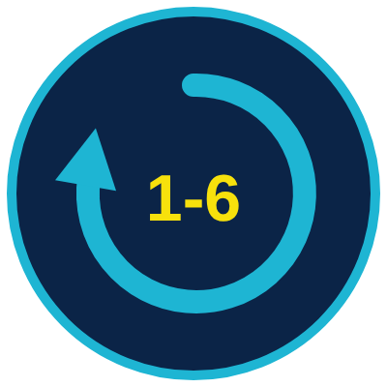


Check what you learned: question 3 of 6
Before a new tribal library app goes out, five Elders try it and find the text is too small to read. Which step of the SDLC (software development life cycle) is this?
A
B
C
Plan
Test
Maintain
Notes:
Before a new tribal library app goes out, five Elders try it and find the text is too small to read. Which step of the SDLC (software development life cycle) is this?
Answer: B. Test
Trying the app to find problems before it is released is testing. Testing with real people catches problems the programmers might miss.

Slide 28
Answer: question 3 of 6
Before a new tribal library app goes out, five Elders try it and find the text is too small to read. Which step of the SDLC (software development life cycle) is this?
A
Plan
B
Test
✓ Correct
C
Maintain
Why: Trying the app to find problems before it is released is testing. Testing with real people catches problems the programmers might miss.
Notes:
Before a new tribal library app goes out, five Elders try it and find the text is too small to read. Which step of the SDLC (software development life cycle) is this?
Answer: B. Test
Trying the app to find problems before it is released is testing. Testing with real people catches problems the programmers might miss.

Slide 29
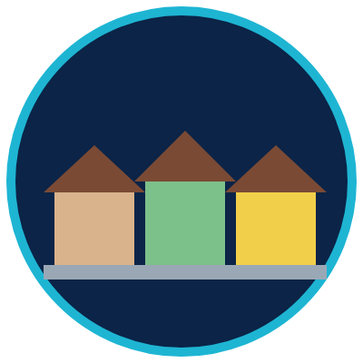

Check what you learned: question 4 of 6
A housing program builds 20 homes from the same blueprint. In programming words, what are the 20 homes?
A
B
C
The class
Objects, or instances, of the class
Methods
Notes:
A housing program builds 20 homes from the same blueprint. In programming words, what are the 20 homes?
Answer: B. Objects, or instances, of the class
The blueprint is the class. Each home built from it is an object, also called an instance. One class can make many objects.

Slide 30
Answer: question 4 of 6
A housing program builds 20 homes from the same blueprint. In programming words, what are the 20 homes?
A
The class
B
Objects, or instances, of the class
✓ Correct
C
Methods
Why: The blueprint is the class. Each home built from it is an object, also called an instance. One class can make many objects.
Notes:
A housing program builds 20 homes from the same blueprint. In programming words, what are the 20 homes?
Answer: B. Objects, or instances, of the class
The blueprint is the class. Each home built from it is an object, also called an instance. One class can make many objects.

Slide 31
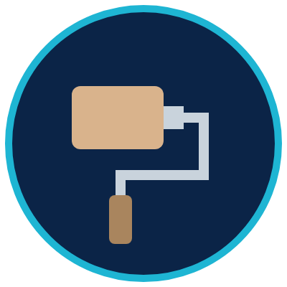
Check what you learned: question 5 of 6
In the House class, open_door() is something every house can do. What is open_door() called?
A
B
A method
A property
Notes:
In the House class, open_door() is something every house can do. What is open_door() called?
Answer: A. A method
Methods are actions an object can do. Properties, like color and rooms, describe the object.

Slide 32
Answer: question 5 of 6
In the House class, open_door() is something every house can do. What is open_door() called?
A
A method
✓ Correct
B
A property
Why: Methods are actions an object can do. Properties, like color and rooms, describe the object.
Notes:
In the House class, open_door() is something every house can do. What is open_door() called?
Answer: A. A method
Methods are actions an object can do. Properties, like color and rooms, describe the object.

Slide 33

Check what you learned: question 6 of 6
Your phone says an update is ready for an app you use every day. What does the update usually bring?
A
B
C
New and fixed code from the app's makers
A copy of everyone's data
A faster internet plan
Notes:
Your phone says an update is ready for an app you use every day. What does the update usually bring?
Answer: A. New and fixed code from the app's makers
Updates are the maintain step of the life cycle. The team fixes bugs and adds features, then sends the new code through the app store.

Slide 34
Answer: question 6 of 6
Your phone says an update is ready for an app you use every day. What does the update usually bring?
A
New and fixed code from the app's makers
✓ Correct
B
A copy of everyone's data
C
A faster internet plan
Why: Updates are the maintain step of the life cycle. The team fixes bugs and adds features, then sends the new code through the app store.
Notes:
Your phone says an update is ready for an app you use every day. What does the update usually bring?
Answer: A. New and fixed code from the app's makers
Updates are the maintain step of the life cycle. The team fixes bugs and adds features, then sends the new code through the app store.

Slide 35
Words to know
App
Short for application. A program, or set of instructions, that does a job on a phone, tablet, or computer.
Source code
The instructions for a program, written by people in a programming language. Often just called code.
Programming language
A language with strict rules that people use to write instructions for a computer, such as Python, JavaScript, C, or C++.
Bug
A mistake in code that makes a program stop or do the wrong thing.

Slide 36
Words to know (continued)
Compiler
A program that translates a whole program into another form, such as machine code, before it runs.
Interpreter
A program that translates and runs code from top to bottom, one line at a time, while it runs.
Machine code
Instructions in ones and zeros that a computer's chip can run directly.
JIT compiling
Just-in-time compiling. Turning parts of code into a faster form while the program runs, used by modern JavaScript engines.

Slide 37
Words to know (continued)
SDLC
Software development life cycle. The steps teams follow to build software: plan, design, build, test, release, and maintain.
OOP
Object-oriented programming. A way of writing code with classes and the objects built from them.
Class
A blueprint, or template, that describes what a kind of object has and can do.
Object
One thing built from a class, also called an instance. One class can make many objects.

Slide 38
Words to know (continued)
Property
A fact that describes an object, like a house's color or number of rooms.
Method
An action an object can do, like a house's open_door.
Constructor
The setup step in a class that runs each time a new object is made. In Python it is written __init__.
UI
User interface. The screens, buttons, words, and pictures you see and tap in an app.

Slide 39
Learn more
Code.org: Learn
Free beginner coding activities for all ages, no experience needed.
https://code.org/learn
Khan Academy: Computing
Free nonprofit lessons on programming and computer science.
https://www.khanacademy.org/computing
MDN Web Docs: Object-oriented programming
Classes, instances, properties, and methods, with examples.
https://developer.mozilla.org/en-US/docs/Learn_web_development/Extensions/Advanced_JavaScript_objects/Object-oriented_programming

Slide 40
Learn more (continued)
Microsoft Learn: Objects, create instances of types
How one class, like a blueprint, makes many objects.
https://learn.microsoft.com/en-us/dotnet/csharp/fundamentals/object-oriented/objects
AWS: What is SDLC?
The six phases of the software development life cycle, from Amazon Web Services.
https://aws.amazon.com/what-is/sdlc/

Slide 41
Teaching this class: lesson plan (45 minutes)
5 min
Start here: read the story and the objectives.
15 min
How Software Development Works: pairs write sandwich steps on a card, swap, and follow them exactly. Act out compiling and interpreting, then walk the life cycle loop.
10 min
Classes, Objects, and Methods: the blueprint and the houses. Read the code line by line, then do the pickup truck cards.
5 min
Inside a Phone App: follow an app from the screen to the server.
10 min
Practice and quiz together, then the three Remember cards.
Notes:
TEACHING THIS CLASS (45 minutes)
Lesson plan:
- 5 min: Start here: read the story and the objectives.
- 15 min: How Software Development Works: pairs write sandwich steps on a card, swap, and follow them exactly. Act out compiling and interpreting, then walk the life cycle loop.
- 10 min: Classes, Objects, and Methods: the blueprint and the houses. Read the code line by line, then do the pickup truck cards.
- 5 min: Inside a Phone App: follow an app from the screen to the server.
- 10 min: Practice and quiz together, then the three Remember cards.
What you need:
- Projector or large TV for the slides
- Printed handouts, one per person
- Index cards and pens for the Be the computer activity
- Optional: bread, a butter knife, and a jar of jam for a live Be the computer demonstration
- Participants' own phones, tablets, or laptops
- Optional: one computer with internet to run the House code in a free online Python editor
Talk about it:
- Which app do you use most? What do you think is stored on your phone, and what is stored on a server far away?
- Who should test an app made for our community before it is released?
- What kind of app would help our community? Walk it through the six steps of the life cycle.
The picture slides have every numbered detail in their speaker notes.
STORY: Taped above the stove at the community center is a handwritten recipe card for pancakes. Anyone who follows it, step by step, gets the same breakfast. Now picture your phone. Every app on it, from the weather to a game, started the same way: as written instructions. People wrote them in a language a computer can follow, tested them, and sent them to your phone. Think of the housing neighborhood, too, where a row of homes went up from one blueprint, each with its own paint color. In this class you will see how code is written, how a computer reads it, how a team builds an app, and why programmers use blueprints too.

Slide 42
Teaching this class: materials and discussion
What you need
Projector or large TV for the slides
Printed handouts, one per person
Index cards and pens for the Be the computer activity
Optional: bread, a butter knife, and a jar of jam for a live Be the computer demonstration
Participants' own phones, tablets, or laptops
Notes:
TEACHING THIS CLASS (45 minutes)
Lesson plan:
- 5 min: Start here: read the story and the objectives.
- 15 min: How Software Development Works: pairs write sandwich steps on a card, swap, and follow them exactly. Act out compiling and interpreting, then walk the life cycle loop.
- 10 min: Classes, Objects, and Methods: the blueprint and the houses. Read the code line by line, then do the pickup truck cards.
- 5 min: Inside a Phone App: follow an app from the screen to the server.
- 10 min: Practice and quiz together, then the three Remember cards.
What you need:
- Projector or large TV for the slides
- Printed handouts, one per person
- Index cards and pens for the Be the computer activity
- Optional: bread, a butter knife, and a jar of jam for a live Be the computer demonstration
- Participants' own phones, tablets, or laptops
- Optional: one computer with internet to run the House code in a free online Python editor
Talk about it:
- Which app do you use most? What do you think is stored on your phone, and what is stored on a server far away?
- Who should test an app made for our community before it is released?
- What kind of app would help our community? Walk it through the six steps of the life cycle.
The picture slides have every numbered detail in their speaker notes.
STORY: Taped above the stove at the community center is a handwritten recipe card for pancakes. Anyone who follows it, step by step, gets the same breakfast. Now picture your phone. Every app on it, from the weather to a game, started the same way: as written instructions. People wrote them in a language a computer can follow, tested them, and sent them to your phone. Think of the housing neighborhood, too, where a row of homes went up from one blueprint, each with its own paint color. In this class you will see how code is written, how a computer reads it, how a team builds an app, and why programmers use blueprints too.

Slide 43
Teaching this class: materials and discussion (continued)
Optional: one computer with internet to run the House code in a free online Python editor
Talk about it
Which app do you use most? What do you think is stored on your phone, and what is stored on a server far away?
Who should test an app made for our community before it is released?
What kind of app would help our community? Walk it through the six steps of the life cycle.
Notes:
TEACHING THIS CLASS (45 minutes)
Lesson plan:
- 5 min: Start here: read the story and the objectives.
- 15 min: How Software Development Works: pairs write sandwich steps on a card, swap, and follow them exactly. Act out compiling and interpreting, then walk the life cycle loop.
- 10 min: Classes, Objects, and Methods: the blueprint and the houses. Read the code line by line, then do the pickup truck cards.
- 5 min: Inside a Phone App: follow an app from the screen to the server.
- 10 min: Practice and quiz together, then the three Remember cards.
What you need:
- Projector or large TV for the slides
- Printed handouts, one per person
- Index cards and pens for the Be the computer activity
- Optional: bread, a butter knife, and a jar of jam for a live Be the computer demonstration
- Participants' own phones, tablets, or laptops
- Optional: one computer with internet to run the House code in a free online Python editor
Talk about it:
- Which app do you use most? What do you think is stored on your phone, and what is stored on a server far away?
- Who should test an app made for our community before it is released?
- What kind of app would help our community? Walk it through the six steps of the life cycle.
The picture slides have every numbered detail in their speaker notes.
STORY: Taped above the stove at the community center is a handwritten recipe card for pancakes. Anyone who follows it, step by step, gets the same breakfast. Now picture your phone. Every app on it, from the weather to a game, started the same way: as written instructions. People wrote them in a language a computer can follow, tested them, and sent them to your phone. Think of the housing neighborhood, too, where a row of homes went up from one blueprint, each with its own paint color. In this class you will see how code is written, how a computer reads it, how a team builds an app, and why programmers use blueprints too.

Slide 44
Free from the Numu Communications Learning Center, www.numu.tech/resources.
Free to use and adapt; please keep this credit.
Questions? info@numu.tech · +1-888-686-5830

Slide 45
References
Amazon Web Services. (n.d.). What is SDLC? https://aws.amazon.com/what-is/sdlc/
MDN contributors. (n.d.-a). Compile. MDN Web Docs. https://developer.mozilla.org/en-US/docs/Glossary/Compile
MDN contributors. (n.d.-b). Object-oriented programming. MDN Web Docs. https://developer.mozilla.org/en-US/docs/Learn_web_development/Extensions/Advanced_JavaScript_objects/Object-oriented_programming
MDN contributors. (n.d.-c). What is JavaScript? MDN Web Docs. https://developer.mozilla.org/en-US/docs/Learn_web_development/Core/Scripting/What_is_JavaScript
Microsoft. (n.d.). Objects: Create instances of types. Microsoft Learn. https://learn.microsoft.com/en-us/dotnet/csharp/fundamentals/object-oriented/objects
Oracle. (n.d.). What is a class? The Java Tutorials. https://docs.oracle.com/javase/tutorial/java/concepts/class.html

