Slide 1


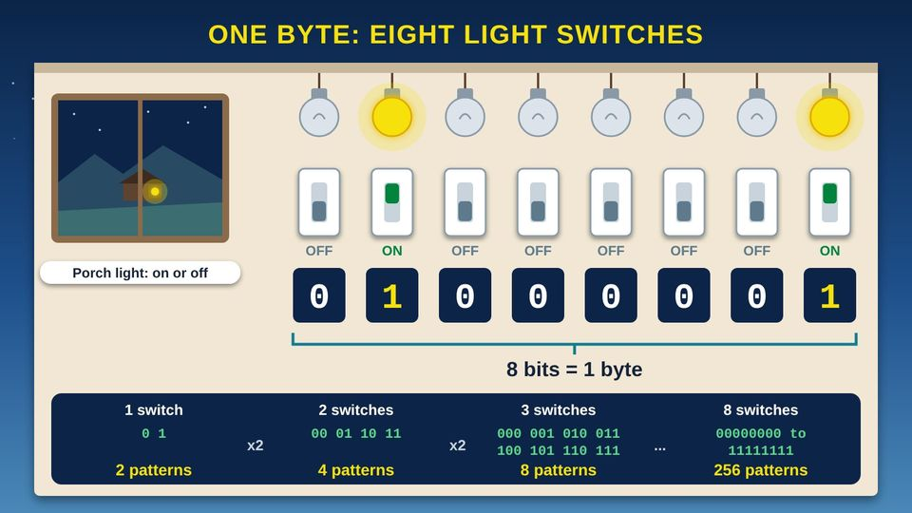
COMMUNITY TECH RESOURCES · COMMUNITY CLASS 5 OF 10
What Language Do Computers Speak?
Bits and bytes, binary numbers, letters as numbers, Unicode, and file sizes
Everyone
30 min
5 pictures
Free class from the Numu Communications Learning Center · www.numu.tech/resources
Notes:
TEACHING THIS CLASS (45 minutes)
Lesson plan:
- 5 min: Start here: read the story and the objectives.
- 10 min: Binary: eight volunteers stand in a row holding plates. Flip plates to show 01000001 and add up 64 + 1 together.
- 8 min: Bits and Bytes: how big is a byte. Find phone storage in Settings and compare it to the box or receipt.
- 12 min: Character Mapping: everyone writes their initials in binary using the chart, then a partner checks the math.
- 10 min: Practice and quiz together, then the three Remember cards.
What you need:
- Projector or large TV for the pictures
- Printed handouts with the place value chart and character map, one per person
- Paper and pencils
- Eight paper plates or large cards, yellow on one side for on and gray on the other for off
- Participants' own phones, and the phone box or receipt if they have it
Talk about it:
- Before everyone had a cell phone, how did families here send simple signals, like come home for supper?
- Have you ever gotten a text where a letter or emoji showed up as a box or a question mark? What do you think happened?
- What would you want to keep on a phone: photos, videos, or recordings of family stories? How much space do you think you would need?
The picture slides have every numbered detail in their speaker notes.
STORY: Picture a clear night in the valley. Across the way, your aunt's porch light is on. Everyone in the family knows what that means: supper is ready, come on over. When the light is off, it means not tonight. One light can only say two things. With two porch lights, the family could say four different things, and with three lights, eight. Computers talk the same way. Inside every phone and computer are tiny switches, and each one is either on or off. Line up enough of them, and they can stand for any number, any letter, a photo, or a song. This class shows how, one picture at a time.

Slide 2
What you will learn
✓
Explain how computers store everything as bits, 0s and 1s, and why 8 bits (one byte) make 256 patterns
✓
Count in binary using place values, and turn a number like 65 into 01000001
✓
Describe how ASCII (American Standard Code for Information Interchange) and Unicode give every letter, mark, and emoji a number
✓
Explain kilobytes, megabytes, and gigabytes, and why a 64 GB (gigabyte) phone can show a little less space

Slide 3

The story
Picture a clear night in the valley. Across the way, your aunt's porch light is on. Everyone in the family knows what that means: supper is ready, come on over. When the light is off, it means not tonight. One light can only say two things. With two porch lights, the family could say four different things, and with three lights, eight. Computers talk the same way. Inside every phone and computer are tiny switches, and each one is either on or off. Line up enough of them, and they can stand for any number, any letter, a photo, or a song. This class shows how, one picture at a time.
Notes:
Picture a clear night in the valley. Across the way, your aunt's porch light is on. Everyone in the family knows what that means: supper is ready, come on over. When the light is off, it means not tonight. One light can only say two things. With two porch lights, the family could say four different things, and with three lights, eight. Computers talk the same way. Inside every phone and computer are tiny switches, and each one is either on or off. Line up enough of them, and they can stand for any number, any letter, a photo, or a song. This class shows how, one picture at a time.

Slide 4
PART 1
Binary
Computers store everything as switches that are on or off, written as 1 and 0. Counting with only two digits is called binary.
2 pictures to explore

Slide 5
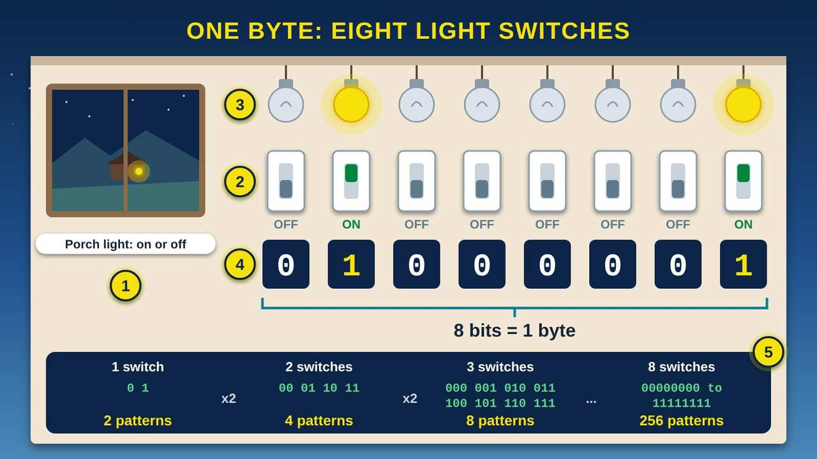
One Byte: Eight Light Switches
Part 1 · Picture 1 of 5
Notes:
One Byte: Eight Light Switches
What the picture shows: A community center wall with a row of eight light switches under eight ceiling bulbs. The second and last are on, so the bits read 0 1 0 0 0 0 0 1, labeled 8 bits = 1 byte. A window shows a porch light across a valley, and a strip below shows that 1, 2, 3, and 8 switches make 2, 4, 8, and 256 patterns.
1. One light, two messages. A porch light is either on or off, so it can send two messages across the valley: come on over, or not tonight. Computers are built from tiny switches that work the same way.
2. A bit is one switch. Each switch is one bit. NIST (the National Institute of Standards and Technology) defines a bit as a binary digit: 0 or 1. Binary means there are only two choices.
3. On is 1, off is 0. When a switch is on, we write 1. When it is off, we write 0. The switches inside a computer are far too small to see, but the idea is the same.
4. Eight bits make a byte. NIST (the National Institute of Standards and Technology) defines a byte as a sequence of eight bits. This row of eight switches is one byte. Its pattern, 01000001, stands for the capital letter A. The next two pictures show why.
5. More switches, more patterns. Each switch you add doubles the number of patterns. One switch makes 2, two make 4, and three make 8. Eight switches, one byte, make 256 different patterns, from 00000000 to 11111111.

Slide 6
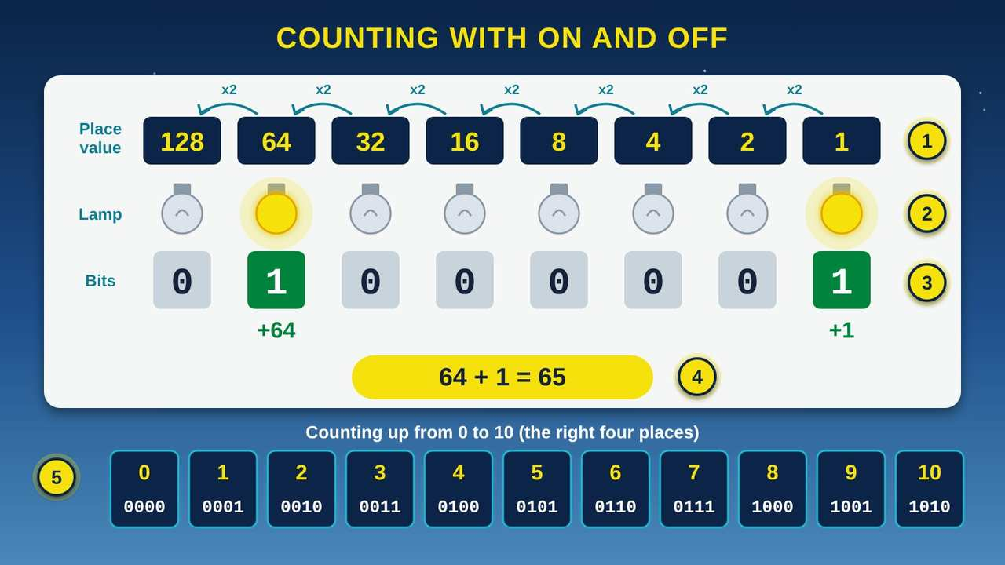
Counting with On and Off
Part 1 · Picture 2 of 5
Notes:
Counting with On and Off
What the picture shows: A chart of eight lamps under place values 128, 64, 32, 16, 8, 4, 2, and 1, each twice the one to its right. The 64 and 1 lamps are lit, the bits read 01000001, and 64 + 1 = 65. Below, the numbers 0 to 10 are shown in four-bit binary, from 0000 to 1010.
1. Place values. Each switch has a place value. Starting at the right, the places are worth 1, 2, 4, 8, 16, 32, 64, and 128. Each place is worth 2 times the place to its right. It works like the ones, tens, and hundreds places you learned in school, but with twos.
2. Lit lamps count. To read a byte, add up the place values of the lamps that are on. Lamps that are off count as nothing.
3. The bits. Here only the 64 lamp and the 1 lamp are on, so the bits read 01000001, the same pattern as the light switches in the last picture.
4. 64 + 1 = 65. 64 plus 1 is 65, so the pattern 01000001 means the number 65. In the next picture you will see that 65 stands for the capital letter A.
5. Counting up. Binary counting works like a car's odometer with only 0 and 1 on each wheel. After 1 comes 10, which means 2. With all eight lamps on, 11111111 means 255, the biggest number one byte can hold. 0 to 255 makes 256 patterns.

Slide 7
Turn any number from 0 to 255 into bits
Use the place values 128, 64, 32, 16, 8, 4, 2, 1. Here is the number 65 as an example.
1
Start at the left, with 128
Is your number at least 128? 65 is not, so write 0.
2
Move to 64
65 is at least 64, so write 1 and take 64 away. That leaves 1.

Slide 8
Turn any number from 0 to 255 into bits (continued)
3
Keep going to the right
1 is smaller than 32, 16, 8, 4, and 2, so write 0 under each of them.
4
Finish at 1
You have 1 left, so write 1. Your bits read 01000001.
5
Check your work
Add the place values that have a 1 under them: 64 + 1 = 65.

Slide 9
PART 2
Bits and Bytes
One switch is a bit. Eight bits make a byte. Then the bytes add up: kilobytes, megabytes, and gigabytes.
1 picture to explore

Slide 10
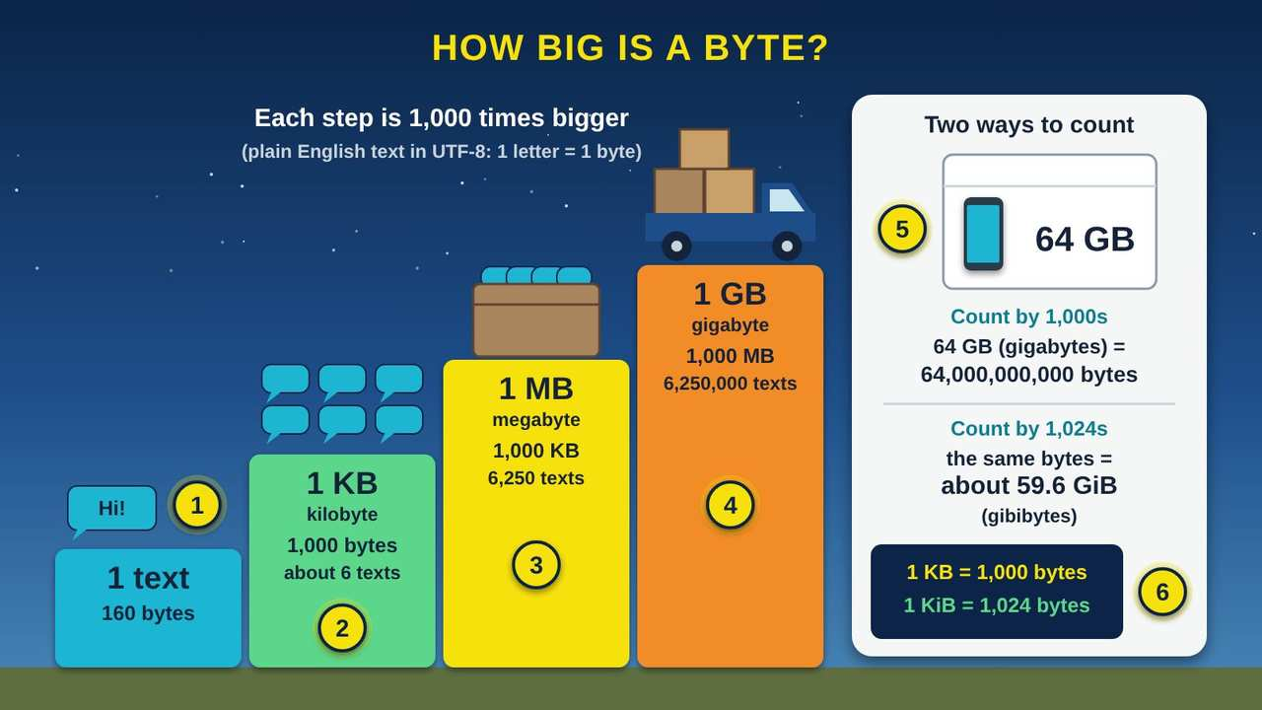
How Big Is a Byte?
Part 2 · Picture 3 of 5
Notes:
How Big Is a Byte?
What the picture shows: Four steps rise from left to right, each 1,000 times bigger: one 160-character text is 160 bytes, 1 KB is 1,000 bytes or about 6 texts, 1 MB is 6,250 texts, and 1 GB, shown as a pickup truck full of boxes, is 6,250,000 texts. A panel shows a phone box marked 64 GB: 64,000,000,000 bytes counted by 1,000s, or about 59.6 GiB counted by 1,024s.
1. One text message. In UTF-8 (Unicode Transformation Format, 8-bit), each plain English letter, space, or period takes 1 byte. So a text with 160 characters takes 160 bytes. That is 1,280 bits, because each byte is 8 bits.
2. Kilobyte. A KB (kilobyte) is 1,000 bytes. Kilo means 1,000, the same as in kilometer. One kilobyte holds about 6 of those 160-character texts.
3. Megabyte. An MB (megabyte) is 1,000 kilobytes, or 1,000,000 bytes. That is room for 6,250 of those texts.
4. Gigabyte. A GB (gigabyte) is 1,000 megabytes, or 1,000,000,000 bytes. That is room for 6,250,000 of those texts. Each step up is 1,000 times bigger than the last.
5. Why a 64 GB phone shows a little less. The box counts by 1,000s, so 64 GB (gigabytes) means 64,000,000,000 bytes. Some devices count by 1,024s instead. Counted that way, the same space comes to about 59.6 GiB (gibibytes), which some devices show as 59.6 GB. Part of the space also holds the phone's own software.
6. Kibibytes. NIST (the National Institute of Standards and Technology) lists separate names for counting by 1,024s: a KiB (kibibyte) is 1,024 bytes, a MiB (mebibyte) is 1,024 KiB, and a GiB (gibibyte) is 1,024 MiB. The IEC (International Electrotechnical Commission) approved these names in December 1998.

Slide 11
Two ways to count bytes
The units on the box count by 1,000s. Their cousins with an i in the short name count by 1,024s.
Unit | Bytes
1 KB (kilobyte) | 1,000
1 KiB (kibibyte) | 1,024
1 MB (megabyte) | 1,000,000
1 MiB (mebibyte) | 1,048,576
1 GB (gigabyte) | 1,000,000,000
1 GiB (gibibyte) | 1,073,741,824
The names that count by 1,024s were approved by the IEC (International Electrotechnical Commission) in December 1998. NIST (the National Institute of Standards and Technology) notes they are not part of the SI (International System of Units), the metric system.

Slide 12
PART 3
Character Mapping
Every letter, number, and emoji has its own number. That shared map is why a text looks the same on every phone.
2 pictures to explore

Slide 13
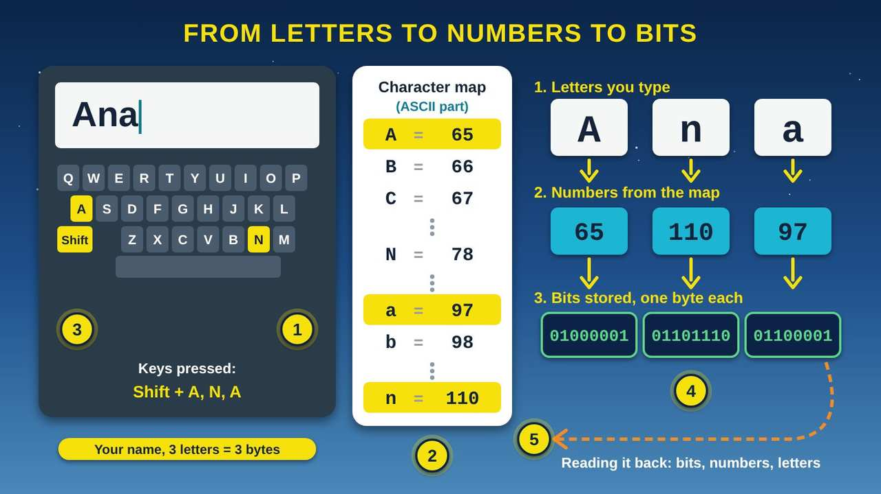
From Letters to Numbers to Bits
Part 3 · Picture 4 of 5
Notes:
From Letters to Numbers to Bits
What the picture shows: Someone types the name Ana on a keyboard. A character map shows A = 65, B = 66, C = 67, N = 78, a = 97, b = 98, and n = 110. Arrows turn the letters A, n, a into the numbers 65, 110, 97, then into the bits 01000001, 01101110, and 01100001. A dashed arrow shows the computer reading it back.
1. You press a key. When you type your name, the keyboard tells the computer which key you pressed. Here someone types a capital A using the Shift key, then n, then a.
2. The character map. The computer looks up each character in a character map, a list that gives every character a number. An older map called ASCII (American Standard Code for Information Interchange) uses 7 bits to hold 128 characters: English letters, digits, spaces, and marks like the period.
3. Capital and small letters. A capital A and a small a are different characters, so they get different numbers: A is 65 and a is 97. Each small letter's number is 32 more than its capital.
4. Numbers become bits. Each number is stored as one byte of bits. 65 is 01000001, 110 is 01101110, and 97 is 01100001. A three-letter name takes three bytes.
5. Reading it back. To show your name, the computer works the other way. It reads the bits, turns them into numbers, looks up each number in the map, and draws the letters on the screen.

Slide 14
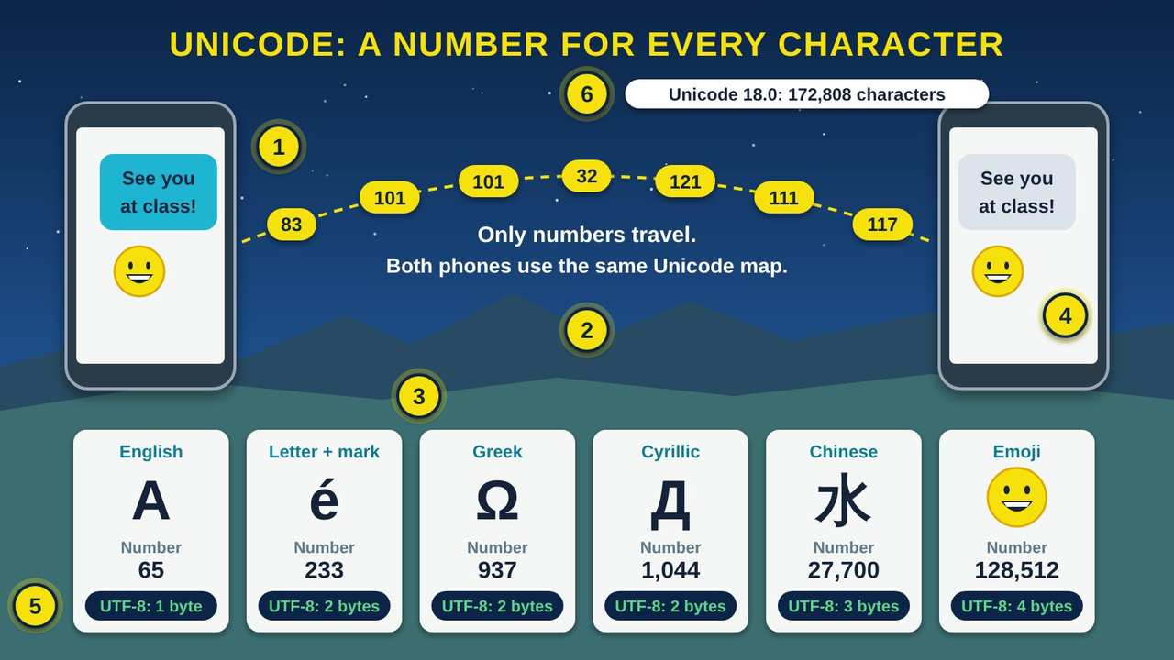
Unicode: A Number for Every Character
Part 3 · Picture 5 of 5
Notes:
Unicode: A Number for Every Character
What the picture shows: Two phones across a valley share the message See you at class with a grinning face. Between them the numbers 83, 101, 101, 32, 121, 111, 117 travel in an arc. Six cards show characters with their Unicode numbers and UTF-8 sizes: A 65 (1 byte), e with an accent 233 (2 bytes), Greek Omega 937 (2 bytes), Cyrillic De 1,044 (2 bytes), the Chinese character for water 27,700 (3 bytes), and the grinning face emoji 128,512 (4 bytes).
1. Every character gets a number. Unicode is a huge character map that computers and phones around the world share. The Unicode Consortium says Unicode provides a unique number for every character. It keeps the old ASCII (American Standard Code for Information Interchange) numbers, so A is still 65.
2. Numbers travel, letters arrive. Your phone sends the numbers, not the shapes of the letters. Because both phones use the same Unicode numbers, the message arrives looking the same, even on a different brand of phone.
3. Every writing system. Unicode gives numbers to the letters and marks of writing systems around the world, like Greek, Cyrillic, and Chinese. A letter with a mark has a Unicode number too, so words written with special letters can travel from phone to phone.
4. Emoji are characters too. Emoji, the small pictures in texts, are encoded in Unicode with their own numbers. The grinning face is number 128,512. Once an emoji is added, Unicode says it will never be removed.
5. UTF-8: storing the numbers. UTF-8 (Unicode Transformation Format, 8-bit) is the most common way to store text on the web. Each character takes 1 to 4 bytes. Its first 128 characters match ASCII (American Standard Code for Information Interchange) exactly, so plain English text takes 1 byte per letter.
6. Still growing. Unicode keeps adding characters. Version 18.0, released September 16, 2026, added 13,007 characters for a total of 172,808, including nine new emoji.

Slide 15
Character map for capital letters
Use this chart for the activity below. For a small letter, add 32: a is 97, b is 98, and so on up to z, which is 122.
Letter | Number | Bits
A | 65 | 01000001
B | 66 | 01000010
C | 67 | 01000011
D | 68 | 01000100
E | 69 | 01000101
Letter | Number | Bits
F | 70 | 01000110
G | 71 | 01000111
H | 72 | 01001000
I | 73 | 01001001

Slide 16
Character map for capital letters (continued)
Letter | Number | Bits
J | 74 | 01001010
K | 75 | 01001011
L | 76 | 01001100
M | 77 | 01001101
N | 78 | 01001110
Letter | Number | Bits
O | 79 | 01001111
P | 80 | 01010000
Q | 81 | 01010001
R | 82 | 01010010

Slide 17
Character map for capital letters (continued)
Letter | Number | Bits
S | 83 | 01010011
T | 84 | 01010100
U | 85 | 01010101
V | 86 | 01010110
Letter | Number | Bits
W | 87 | 01010111
X | 88 | 01011000
Y | 89 | 01011001
Z | 90 | 01011010

Slide 18
Why a text can look the same on every phone
Phones send numbers, not the shapes of letters. Because phones and computers share the same Unicode numbers, a letter with a mark, a word in another writing system, or an emoji arrives as the same character on the other end.

Slide 19
Try it at home
Fifteen minutes with paper, a pencil, your hands, and your phone.
1
Copy the place values across the top of a sheet of paper: 128, 64, 32, 16, 8, 4, 2, 1.
2
Write your initials in binary. Find each letter's number in the character map chart above, then use the steps under Part 1 to turn it into eight bits. Check your work by adding up the place values with a 1 under them.

Slide 20
Try it at home (continued)
3
Count to 10 on your fingers in binary. Hold up one hand closed in a fist. Your thumb is worth 1, your pointer finger 2, your middle finger 4, your ring finger 8, and your little finger 16. Raise the fingers that add up to each number: 1 is the thumb, 2 is the pointer, 3 is both, and so on up to 10, which is the pointer and ring fingers.
4
Find your phone's storage. iPhone: Settings, then General, then iPhone Storage. Android: Settings, then Storage. Write down the total it shows.

Slide 21
Try it at home (continued)
5
Compare that total to the storage size printed on the box, the receipt, or the store page. Is it a little less? Think about the two reasons from the last picture.
6
Send a family member a text with a letter that has a mark, like the e in cafe with an accent, and an emoji. Ask them if it arrived looking the same.

Slide 22

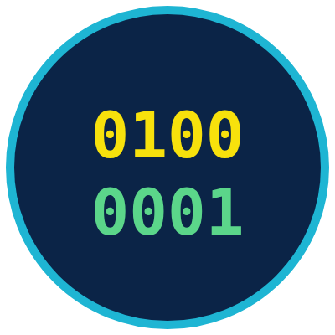

Remember
Computers store everything as bits: 0 or 1
Eight bits make a byte: 256 patterns
Unicode gives every character a number
Notes:
Computers store everything as bits: 0 or 1
Eight bits make a byte: 256 patterns
Unicode gives every character a number

Slide 23

Check what you learned: question 1 of 5
Your class at the community center uses a row of 8 light switches as one byte. How many different on and off patterns can the row make?
A
B
C
8 patterns
16 patterns
256 patterns
Notes:
Your class at the community center uses a row of 8 light switches as one byte. How many different on and off patterns can the row make?
Answer: C. 256 patterns
Each switch you add doubles the patterns: 2, 4, 8, 16, 32, 64, 128, 256. One byte, 8 bits, makes 256 patterns.

Slide 24
Answer: question 1 of 5
Your class at the community center uses a row of 8 light switches as one byte. How many different on and off patterns can the row make?
A
8 patterns
B
16 patterns
256 patterns
C
✓ Correct
Why: Each switch you add doubles the patterns: 2, 4, 8, 16, 32, 64, 128, 256. One byte, 8 bits, makes 256 patterns.
Notes:
Your class at the community center uses a row of 8 light switches as one byte. How many different on and off patterns can the row make?
Answer: C. 256 patterns
Each switch you add doubles the patterns: 2, 4, 8, 16, 32, 64, 128, 256. One byte, 8 bits, makes 256 patterns.

Slide 25
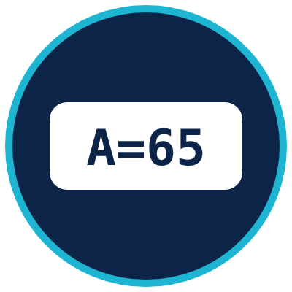
Check what you learned: question 2 of 5
On your binary chart, the lamps under 8, 2, and 1 are on and the rest are off. What number does that byte stand for?
A
B
C
3
11
821
Notes:
On your binary chart, the lamps under 8, 2, and 1 are on and the rest are off. What number does that byte stand for?
Answer: B. 11
Add the place values of the lamps that are on: 8 + 2 + 1 = 11. The byte reads 00001011.

Slide 26
Answer: question 2 of 5
On your binary chart, the lamps under 8, 2, and 1 are on and the rest are off. What number does that byte stand for?
A
3
B
11
✓ Correct
821
C
Why: Add the place values of the lamps that are on: 8 + 2 + 1 = 11. The byte reads 00001011.
Notes:
On your binary chart, the lamps under 8, 2, and 1 are on and the rest are off. What number does that byte stand for?
Answer: B. 11
Add the place values of the lamps that are on: 8 + 2 + 1 = 11. The byte reads 00001011.

Slide 27


Check what you learned: question 3 of 5
Your cousin texts you a word with an accented letter and a grinning face emoji from a different brand of phone. Why does it look the same on your phone?
A
B
C
The text went through the same cell tower
Your phone guesses the letters from the picture
Both phones use the same Unicode number for each character
Notes:
Your cousin texts you a word with an accented letter and a grinning face emoji from a different brand of phone. Why does it look the same on your phone?
Answer: C. Both phones use the same Unicode number for each character
Phones send numbers, not shapes. Unicode gives every character, including emoji, its own number, so both phones show the same character.

Slide 28
Answer: question 3 of 5
Your cousin texts you a word with an accented letter and a grinning face emoji from a different brand of phone. Why does it look the same on your phone?
A
The text went through the same cell tower
B
Your phone guesses the letters from the picture
Both phones use the same Unicode number for each character
C
✓ Correct
Why: Phones send numbers, not shapes. Unicode gives every character, including emoji, its own number, so both phones show the same character.
Notes:
Your cousin texts you a word with an accented letter and a grinning face emoji from a different brand of phone. Why does it look the same on your phone?
Answer: C. Both phones use the same Unicode number for each character
Phones send numbers, not shapes. Unicode gives every character, including emoji, its own number, so both phones show the same character.

Slide 29

Check what you learned: question 4 of 5
You write a 160-character text using only plain English letters, spaces, and periods. How much space does it take in UTF-8 (Unicode Transformation Format, 8-bit)?
A
B
C
160 bytes
160 KB (kilobytes)
8 bytes
Notes:
You write a 160-character text using only plain English letters, spaces, and periods. How much space does it take in UTF-8 (Unicode Transformation Format, 8-bit)?
Answer: A. 160 bytes
In UTF-8, each plain English character takes 1 byte, so 160 characters take 160 bytes. A kilobyte is 1,000 bytes, so the text is much smaller than one KB.

Slide 30
Answer: question 4 of 5
You write a 160-character text using only plain English letters, spaces, and periods. How much space does it take in UTF-8 (Unicode Transformation Format, 8-bit)?
A
160 bytes
✓ Correct
B
160 KB (kilobytes)
C
8 bytes
Why: In UTF-8, each plain English character takes 1 byte, so 160 characters take 160 bytes. A kilobyte is 1,000 bytes, so the text is much smaller than one KB.
Notes:
You write a 160-character text using only plain English letters, spaces, and periods. How much space does it take in UTF-8 (Unicode Transformation Format, 8-bit)?
Answer: A. 160 bytes
In UTF-8, each plain English character takes 1 byte, so 160 characters take 160 bytes. A kilobyte is 1,000 bytes, so the text is much smaller than one KB.

Slide 31

Check what you learned: question 5 of 5
Your new phone's box says 64 GB (gigabytes), but Settings shows a little less. What is the most likely reason?
A
B
C
The phone is broken and losing storage
Some devices count by 1,024s, and the phone's software uses some space
Text messages from the store filled it up
Notes:
Your new phone's box says 64 GB (gigabytes), but Settings shows a little less. What is the most likely reason?
Answer: B. Some devices count by 1,024s, and the phone's software uses some space
The box counts by 1,000s: 64,000,000,000 bytes. Counted by 1,024s, that is about 59.6 gibibytes (GiB), and the phone's own software is stored there too.

Slide 32
Answer: question 5 of 5
Your new phone's box says 64 GB (gigabytes), but Settings shows a little less. What is the most likely reason?
A
The phone is broken and losing storage
Some devices count by 1,024s, and the phone's software uses some space
B
✓ Correct
C
Text messages from the store filled it up
Why: The box counts by 1,000s: 64,000,000,000 bytes. Counted by 1,024s, that is about 59.6 gibibytes (GiB), and the phone's own software is stored there too.
Notes:
Your new phone's box says 64 GB (gigabytes), but Settings shows a little less. What is the most likely reason?
Answer: B. Some devices count by 1,024s, and the phone's software uses some space
The box counts by 1,000s: 64,000,000,000 bytes. Counted by 1,024s, that is about 59.6 gibibytes (GiB), and the phone's own software is stored there too.

Slide 33
Words to know
Bit
Binary digit. The smallest piece of computer data: a 0 or a 1, like one switch that is off or on.
Byte
A group of eight bits. One byte can make 256 different patterns, enough for one plain English letter.
Binary
A way of counting with only two digits, 0 and 1. Each place is worth 2 times the place to its right.
Place value
What a digit is worth because of where it sits. In a byte, the places are worth 128, 64, 32, 16, 8, 4, 2, and 1.

Slide 34
Words to know (continued)
Character
One letter, digit, space, punctuation mark, or emoji.
Character map
A list that gives every character a number, so a computer can store letters as numbers and bits. Also called a character set or encoding.
ASCII
American Standard Code for Information Interchange. An older character map that uses 7 bits for 128 characters. The capital letter A is 65.
Unicode
A worldwide character map that gives a unique number to every character, in every writing system, including emoji.

Slide 35
Words to know (continued)
UTF-8
Unicode Transformation Format, 8-bit. The most common way to store text on the web. Each character takes 1 to 4 bytes, and plain ASCII text is already UTF-8.
Emoji
Small pictures used in texts, like a grinning face. Each one is a character with its own Unicode number.
KB
Kilobyte. 1,000 bytes.
MB
Megabyte. 1,000,000 bytes, or 1,000 kilobytes.

Slide 36
Words to know (continued)
GB
Gigabyte. 1,000,000,000 bytes, or 1,000 megabytes.
KiB, MiB, GiB
Kibibyte, mebibyte, and gibibyte. Units that count by 1,024s: 1 KiB is 1,024 bytes, 1 MiB is 1,048,576 bytes, and 1 GiB is 1,073,741,824 bytes.

Slide 37
Learn more
Code.org: How Computers Work and How the Internet Works videos
Short, friendly videos, including one on binary and data.
https://code.org/videos
Khan Academy: Computers and the Internet
Free lessons on how computers store information as bits.
https://www.khanacademy.org/computing/computers-and-internet
Unicode Consortium: What is Unicode?
The group that keeps the Unicode character map explains what it does.
https://www.unicode.org/standard/WhatIsUnicode.html

Slide 38
Learn more (continued)
MDN Web Docs: UTF-8
A short definition of UTF-8, the most common way to store text on the web.
https://developer.mozilla.org/en-US/docs/Glossary/UTF-8
NIST (National Institute of Standards and Technology): Prefixes for binary multiples
The official names for counting by 1,000s and by 1,024s.
https://physics.nist.gov/cuu/Units/binary.html

Slide 39
Teaching this class: lesson plan (45 minutes)
5 min
Start here: read the story and the objectives.
10 min
Binary: eight volunteers stand in a row holding plates. Flip plates to show 01000001 and add up 64 + 1 together.
8 min
Bits and Bytes: how big is a byte. Find phone storage in Settings and compare it to the box or receipt.
12 min
Character Mapping: everyone writes their initials in binary using the chart, then a partner checks the math.
10 min
Practice and quiz together, then the three Remember cards.
Notes:
TEACHING THIS CLASS (45 minutes)
Lesson plan:
- 5 min: Start here: read the story and the objectives.
- 10 min: Binary: eight volunteers stand in a row holding plates. Flip plates to show 01000001 and add up 64 + 1 together.
- 8 min: Bits and Bytes: how big is a byte. Find phone storage in Settings and compare it to the box or receipt.
- 12 min: Character Mapping: everyone writes their initials in binary using the chart, then a partner checks the math.
- 10 min: Practice and quiz together, then the three Remember cards.
What you need:
- Projector or large TV for the pictures
- Printed handouts with the place value chart and character map, one per person
- Paper and pencils
- Eight paper plates or large cards, yellow on one side for on and gray on the other for off
- Participants' own phones, and the phone box or receipt if they have it
Talk about it:
- Before everyone had a cell phone, how did families here send simple signals, like come home for supper?
- Have you ever gotten a text where a letter or emoji showed up as a box or a question mark? What do you think happened?
- What would you want to keep on a phone: photos, videos, or recordings of family stories? How much space do you think you would need?
The picture slides have every numbered detail in their speaker notes.
STORY: Picture a clear night in the valley. Across the way, your aunt's porch light is on. Everyone in the family knows what that means: supper is ready, come on over. When the light is off, it means not tonight. One light can only say two things. With two porch lights, the family could say four different things, and with three lights, eight. Computers talk the same way. Inside every phone and computer are tiny switches, and each one is either on or off. Line up enough of them, and they can stand for any number, any letter, a photo, or a song. This class shows how, one picture at a time.

Slide 40
Teaching this class: materials and discussion
What you need
Projector or large TV for the pictures
Printed handouts with the place value chart and character map, one per person
Paper and pencils
Eight paper plates or large cards, yellow on one side for on and gray on the other for off
Participants' own phones, and the phone box or receipt if they have it
Notes:
TEACHING THIS CLASS (45 minutes)
Lesson plan:
- 5 min: Start here: read the story and the objectives.
- 10 min: Binary: eight volunteers stand in a row holding plates. Flip plates to show 01000001 and add up 64 + 1 together.
- 8 min: Bits and Bytes: how big is a byte. Find phone storage in Settings and compare it to the box or receipt.
- 12 min: Character Mapping: everyone writes their initials in binary using the chart, then a partner checks the math.
- 10 min: Practice and quiz together, then the three Remember cards.
What you need:
- Projector or large TV for the pictures
- Printed handouts with the place value chart and character map, one per person
- Paper and pencils
- Eight paper plates or large cards, yellow on one side for on and gray on the other for off
- Participants' own phones, and the phone box or receipt if they have it
Talk about it:
- Before everyone had a cell phone, how did families here send simple signals, like come home for supper?
- Have you ever gotten a text where a letter or emoji showed up as a box or a question mark? What do you think happened?
- What would you want to keep on a phone: photos, videos, or recordings of family stories? How much space do you think you would need?
The picture slides have every numbered detail in their speaker notes.
STORY: Picture a clear night in the valley. Across the way, your aunt's porch light is on. Everyone in the family knows what that means: supper is ready, come on over. When the light is off, it means not tonight. One light can only say two things. With two porch lights, the family could say four different things, and with three lights, eight. Computers talk the same way. Inside every phone and computer are tiny switches, and each one is either on or off. Line up enough of them, and they can stand for any number, any letter, a photo, or a song. This class shows how, one picture at a time.

Slide 41
Teaching this class: materials and discussion (continued)
Talk about it
Before everyone had a cell phone, how did families here send simple signals, like come home for supper?
Have you ever gotten a text where a letter or emoji showed up as a box or a question mark? What do you think happened?
What would you want to keep on a phone: photos, videos, or recordings of family stories? How much space do you think you would need?
Notes:
TEACHING THIS CLASS (45 minutes)
Lesson plan:
- 5 min: Start here: read the story and the objectives.
- 10 min: Binary: eight volunteers stand in a row holding plates. Flip plates to show 01000001 and add up 64 + 1 together.
- 8 min: Bits and Bytes: how big is a byte. Find phone storage in Settings and compare it to the box or receipt.
- 12 min: Character Mapping: everyone writes their initials in binary using the chart, then a partner checks the math.
- 10 min: Practice and quiz together, then the three Remember cards.
What you need:
- Projector or large TV for the pictures
- Printed handouts with the place value chart and character map, one per person
- Paper and pencils
- Eight paper plates or large cards, yellow on one side for on and gray on the other for off
- Participants' own phones, and the phone box or receipt if they have it
Talk about it:
- Before everyone had a cell phone, how did families here send simple signals, like come home for supper?
- Have you ever gotten a text where a letter or emoji showed up as a box or a question mark? What do you think happened?
- What would you want to keep on a phone: photos, videos, or recordings of family stories? How much space do you think you would need?
The picture slides have every numbered detail in their speaker notes.
STORY: Picture a clear night in the valley. Across the way, your aunt's porch light is on. Everyone in the family knows what that means: supper is ready, come on over. When the light is off, it means not tonight. One light can only say two things. With two porch lights, the family could say four different things, and with three lights, eight. Computers talk the same way. Inside every phone and computer are tiny switches, and each one is either on or off. Line up enough of them, and they can stand for any number, any letter, a photo, or a song. This class shows how, one picture at a time.

Slide 42
Free from the Numu Communications Learning Center, www.numu.tech/resources.
Free to use and adapt; please keep this credit.
Questions? info@numu.tech · +1-888-686-5830

Slide 43
References
MDN contributors. (n.d.-a). ASCII. MDN Web Docs. https://developer.mozilla.org/en-US/docs/Glossary/ASCII
MDN contributors. (n.d.-b). UTF-8. MDN Web Docs. https://developer.mozilla.org/en-US/docs/Glossary/UTF-8
National Institute of Standards and Technology. (n.d.-a). Bit. CSRC Glossary. https://csrc.nist.gov/glossary/term/bit
National Institute of Standards and Technology. (n.d.-b). Byte. CSRC Glossary. https://csrc.nist.gov/glossary/term/byte
National Institute of Standards and Technology. (n.d.-c). Prefixes for binary multiples. https://physics.nist.gov/cuu/Units/binary.html
Unicode Consortium. (n.d.-a). C0 controls and basic Latin [Code chart]. https://www.unicode.org/charts/PDF/U0000.pdf
Unicode Consortium. (n.d.-b). Emoji and dingbats FAQ. https://www.unicode.org/faq/emoji_dingbats.html
Unicode Consortium. (n.d.-c). What is Unicode? https://www.unicode.org/standard/WhatIsUnicode.html
Unicode Consortium. (2026, September 16). Announcing the Unicode Standard, version 18.0. https://blog.unicode.org/2026/09/announcing-unicode-standard-version-180.html

