Slide 1
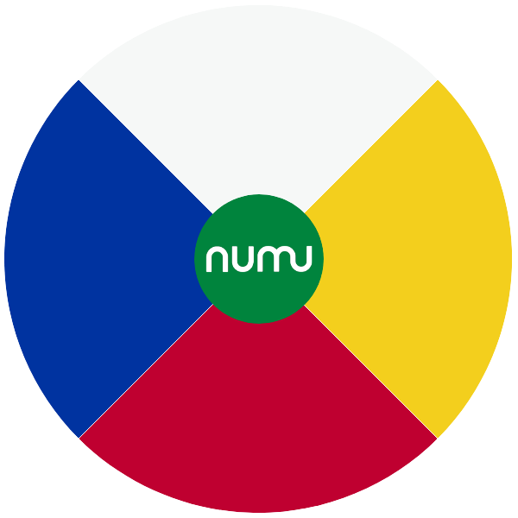

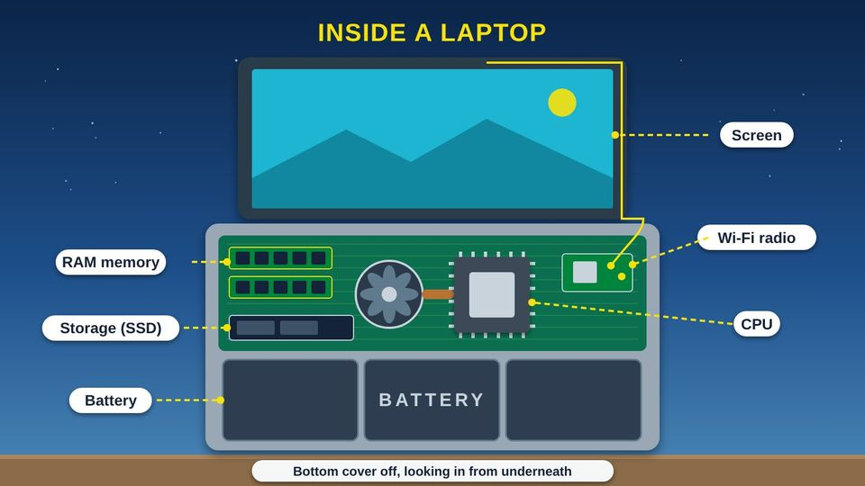
COMMUNITY TECH RESOURCES · COMMUNITY CLASS 4 OF 10
What's in Your Computer, Tablet, and Phone?
The parts inside, memory and storage, spec sheets, and battery care
Everyone
30 min
5 pictures
Free class from the Numu Communications Learning Center · www.numu.tech/resources
Notes:
TEACHING THIS CLASS (45 minutes)
Lesson plan:
- 5 min: Open with the community kitchen story. Ask: who in the kitchen is the cook, what is the counter, and what is the pantry?
- 10 min: Part 1: explore the laptop and kitchen pictures. Act it out: one volunteer is the cook, the cutting board is the counter, the box is the pantry. Clear the board to show a restart.
- 5 min: Part 2: the phone picture. Ask people to point out where their own phone uses each radio and sensor.
- 10 min: Part 3: read the spec sheet together, then match a device to school, a telehealth visit, and a job search. Look at battery cycles.
- 10 min: Do steps 1, 3, and 4 of Try it at home. Pair people up so they can help each other find Settings.
- 5 min: Quiz together with a show of hands, then the three Remember cards.
What you need:
- Projector or large TV for the slides
- Printed handouts, one per person
- Kitchen props: a cutting board for the counter and a box of cans for the pantry
- Optional: an old laptop or phone with the back cover off, unplugged, to pass around
- Participants' own phones, tablets, or laptops
Talk about it:
- What do you use your phone or computer for most? Which spec line matters most for that job?
- Has your phone ever said storage is full? What did you do?
- Who in our community needs a device that fits their needs better, and how could we help?
The picture slides have every numbered detail in their speaker notes.
STORY: Picture the kitchen at the community center on the morning of a big dinner. One cook does the work. She brings flour, beans, and potatoes out of the pantry and sets them on the counter, where they are close and quick to reach. The counter is small, so she puts things away when she is done. At the end of the night the counter is wiped clean, but the pantry keeps everything for next time. Your computer, tablet, and phone work the same way. This class opens them up one picture at a time, so you can understand what is inside and choose a device that fits your needs.

Slide 2
What you will learn
✓
Name the main parts inside a computer, tablet, or phone and say what each one does
✓
Explain the difference between memory and storage, and why restarting a device often helps
✓
Read a device spec sheet and choose a device that fits a job like school, a doctor visit, or a job search
✓
Care for a battery and find your device's storage and battery health in Settings

Slide 3

The story
Picture the kitchen at the community center on the morning of a big dinner. One cook does the work. She brings flour, beans, and potatoes out of the pantry and sets them on the counter, where they are close and quick to reach. The counter is small, so she puts things away when she is done. At the end of the night the counter is wiped clean, but the pantry keeps everything for next time. Your computer, tablet, and phone work the same way. This class opens them up one picture at a time, so you can understand what is inside and choose a device that fits your needs.
Notes:
Picture the kitchen at the community center on the morning of a big dinner. One cook does the work. She brings flour, beans, and potatoes out of the pantry and sets them on the counter, where they are close and quick to reach. The counter is small, so she puts things away when she is done. At the end of the night the counter is wiped clean, but the pantry keeps everything for next time. Your computer, tablet, and phone work the same way. This class opens them up one picture at a time, so you can understand what is inside and choose a device that fits your needs.

Slide 4
PART 1
Your Computer
Open up a laptop and meet the main parts, then see why memory and storage are not the same thing.
2 pictures to explore

Slide 5
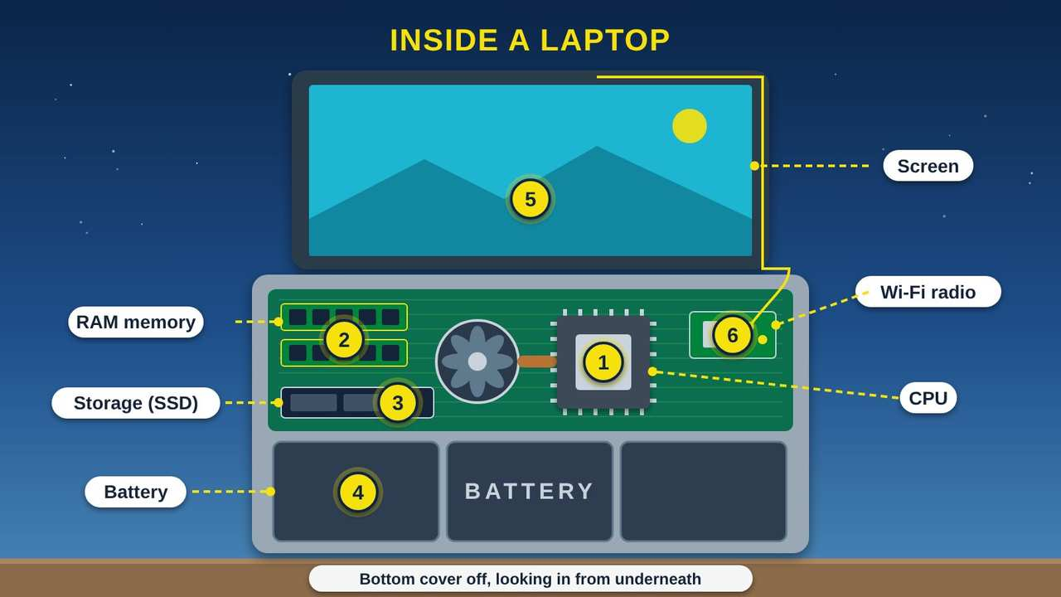
Inside a Laptop
Part 1 · Picture 1 of 5
Notes:
Inside a Laptop
What the picture shows: A laptop with its bottom cover removed. Labels point to two RAM memory sticks, a storage chip called an SSD, the CPU chip with a fan and heat pipe, a Wi-Fi radio card with an antenna wire running up into the screen, and a large battery across the front.
1. CPU: the brain. The CPU (Central Processing Unit) does the thinking. Microsoft says it acts like the device's brain, telling the other parts what to do. It gets warm, so a small fan and a copper pipe carry the heat away.
2. RAM: short-term memory. RAM (Random Access Memory) holds what you are working on right now: the open apps, web pages, and documents. It is very fast, but everything in it is erased when the device restarts or turns off.
3. Storage: keeps your things. Storage keeps your photos, files, and apps, even with the power off. This laptop uses an SSD (Solid State Drive), which keeps data on memory chips with no moving parts.
4. Battery. The battery takes up a big part of the inside. It powers everything when you are away from an outlet. Laptops, tablets, and phones use lithium-ion batteries.
5. Screen. The screen shows you what the CPU has made: words, pictures, and video.
6. Radios. A small radio card lets the laptop talk to Wi-Fi and to Bluetooth gadgets like a wireless mouse. Thin wires run from the card up to antennas hidden around the screen.

Slide 6
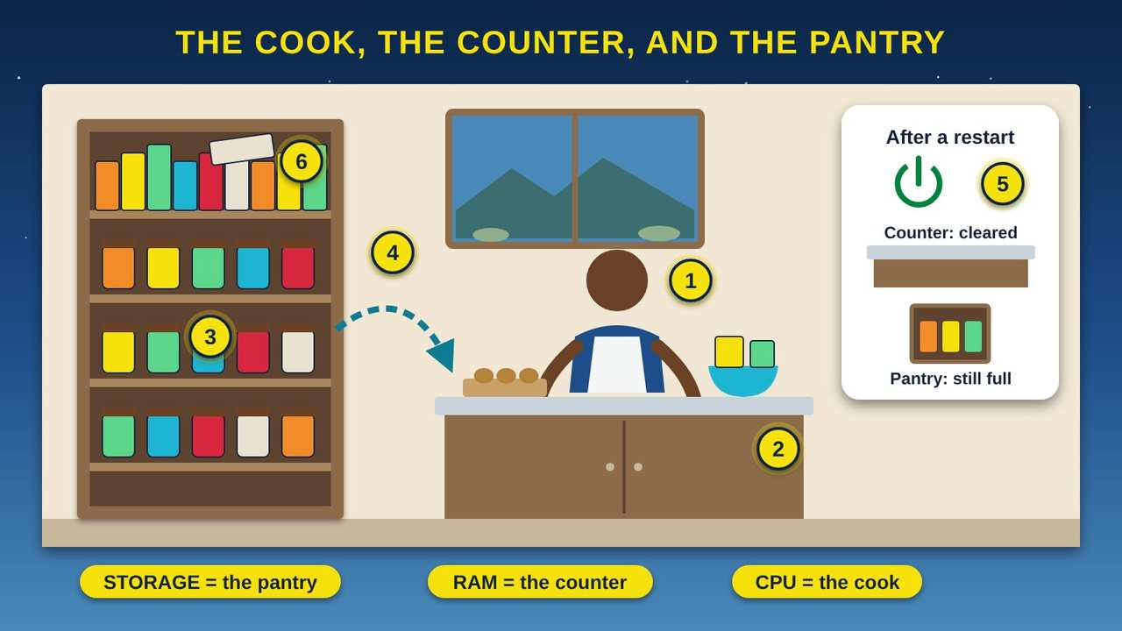
The Cook, the Counter, and the Pantry
Part 1 · Picture 2 of 5
Notes:
The Cook, the Counter, and the Pantry
What the picture shows: A cut-away community center kitchen. A cook stands at a counter with food on it, labeled RAM and CPU. A tall pantry full of jars, with a crammed top shelf, is labeled storage. A dashed arrow carries food from the pantry to the counter. An inset shows that after a restart the counter is cleared but the pantry is still full.
1. The cook is the CPU. The CPU (Central Processing Unit) is the cook. It does all the work: following the recipe, chopping, and mixing. A faster cook gets more done, but only with room to work and food to work with.
2. The counter is RAM. RAM (Random Access Memory) is the counter. Everything the cook is working on right now sits there, close and quick to reach. A bigger counter lets you keep more apps and web pages open at once without slowing down.
3. The pantry is storage. Storage is the pantry. It is much bigger than the counter but slower to reach. It keeps your photos, apps, and files, even when the power is off, just like food stays on the shelf overnight.
4. Opening an app. When you open an app or a photo, the device carries it from the pantry to the counter so the cook can work on it. That is why an app takes a moment to open the first time.
5. Why restarting helps. When you restart or turn off a device, the counter is wiped clean, but the pantry keeps everything. Over time, apps leave clutter on the counter. A restart clears it, so things often run smoother afterward.
6. A crowded pantry. When storage is full, there is no room to save a new photo, install an app, or download an update. Moving old videos to a computer or cloud account, or deleting apps you never use, makes room again.

Slide 7
Try a restart first
When a device feels slow or an app is stuck, restart it before anything else. A restart clears the counter (RAM, or Random Access Memory) and gives every app a fresh start. Your photos and files stay safe in storage.

Slide 8
PART 2
Your Tablet and Phone
Phones and tablets pack most of the same parts into one chip, plus radios and sensors.
1 picture to explore

Slide 9
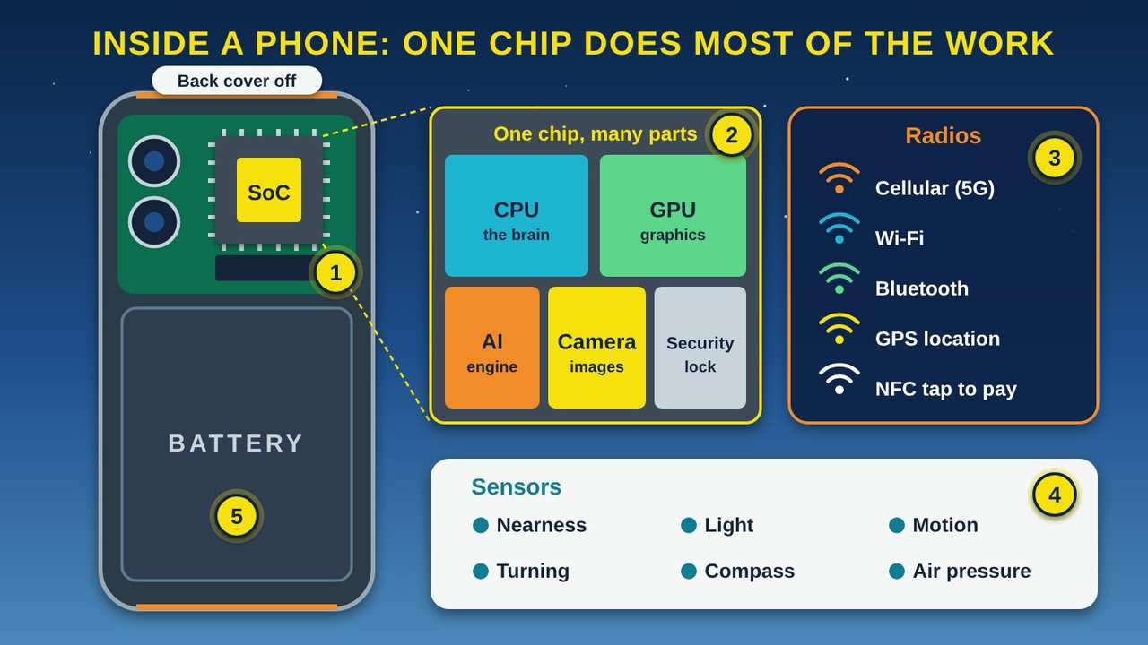
Inside a Phone: One Chip Does Most of the Work
Part 2 · Picture 3 of 5
Notes:
Inside a Phone: One Chip Does Most of the Work
What the picture shows: A phone with its back removed shows a small board with cameras and one main chip labeled SoC above a large battery. A zoomed view of the chip shows blocks for the CPU, GPU, AI engine, camera, and security. Side panels list the phone's radios (cellular, Wi-Fi, Bluetooth, GPS, NFC) and its sensors.
1. A system on a chip. A phone has no room for separate parts, so most of them are built into one chip, called an SoC (System on a Chip). Apple's M1 chip, for example, combines many parts into a single chip with 16 billion tiny switches called transistors. Tablets are built the same way.
2. What is inside the chip. Google's Tensor chip holds a CPU (Central Processing Unit) for general work, a GPU (Graphics Processing Unit) for pictures and games, a TPU (Tensor Processing Unit) for AI (artificial intelligence) tasks, an image processor for the camera, and a security core that guards your private data. Some chips, like Apple's M1, also hold the RAM (Random Access Memory) in the same package, right beside the chip.
3. Radios. Your phone carries several radios: cellular (5G, the fifth generation) to reach the tower, Wi-Fi for home internet, Bluetooth for earbuds, GPS (Global Positioning System) to find your location from satellites, and NFC (Near Field Communication) for tapping to pay.
4. Sensors. Sensors let the phone notice the world. A proximity sensor turns the screen off when you hold the phone to your ear. A light sensor dims the screen in the dark. Motion and turning sensors flip the picture sideways. A compass points the map, and a barometer measures air pressure.
5. The battery. The battery takes up most of the space inside a phone. Everything else is packed tightly around it.

Slide 10
PART 3
Choosing and Caring for a Device
Read a spec sheet, match a device to the job, and make the battery last.
2 pictures to explore

Slide 11
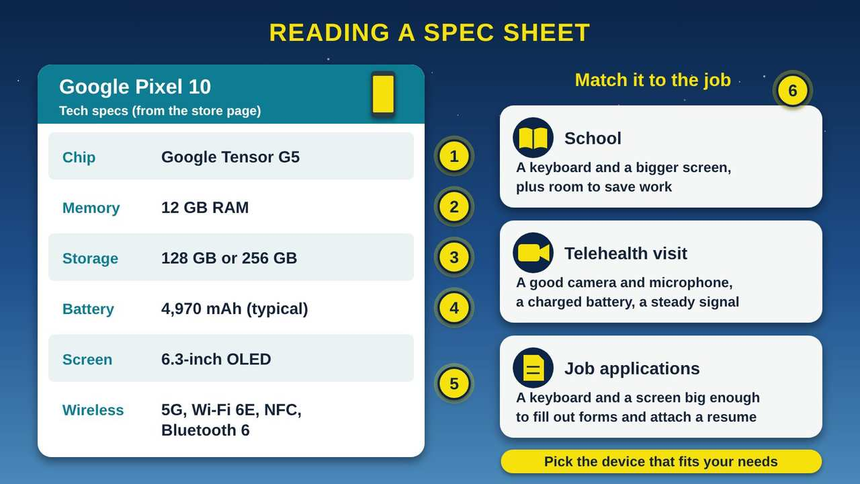
Reading a Spec Sheet
Part 3 · Picture 4 of 5
Notes:
Reading a Spec Sheet
What the picture shows: A spec sheet for the Google Pixel 10 lists the chip (Tensor G5), 12 GB of RAM memory, 128 or 256 GB of storage, a typical 4,970 mAh battery, a 6.3-inch OLED screen, and 5G, Wi-Fi 6E, NFC, and Bluetooth 6. Beside it, three cards match devices to jobs: school, a telehealth visit, and job applications.
1. Chip. This line names the main chip, the SoC (System on a Chip) that holds the CPU (Central Processing Unit). Pixel 10 uses Google's Tensor G5. Chip names are hard to compare. For everyday use, the other lines tell you more.
2. Memory (RAM). RAM (Random Access Memory) is the counter space. It is measured in GB (gigabytes). Pixel 10 has 12 GB. More RAM lets you keep more apps and web pages open without the device slowing down.
3. Storage. Storage is the pantry. Pixel 10 comes with 128 GB or 256 GB, and you choose when you buy. If you take a lot of photos and videos, pick the bigger size. Before you buy, check whether you can add more storage later.
4. Battery. Battery size is measured in mAh (milliamp-hours). A bigger number means the battery holds more charge. Pixel 10's battery is listed as typical 4,970 mAh. How long it lasts also depends on the screen and how you use it.
5. Screen and wireless. The screen is 6.3 inches, measured corner to corner, and is OLED (Organic Light-Emitting Diode). The wireless line lists its radios: 5G (fifth generation cellular), Wi-Fi 6E, NFC (Near Field Communication), and Bluetooth version 6. A higher Wi-Fi number is a newer version.
6. Match it to the job. The National Digital Inclusion Alliance (NDIA) says digital inclusion includes devices that meet the needs of the user. So start with the job. School and job applications are easier with a keyboard and bigger screen. A telehealth visit with your doctor needs a good camera, microphone, and charged battery.

Slide 12
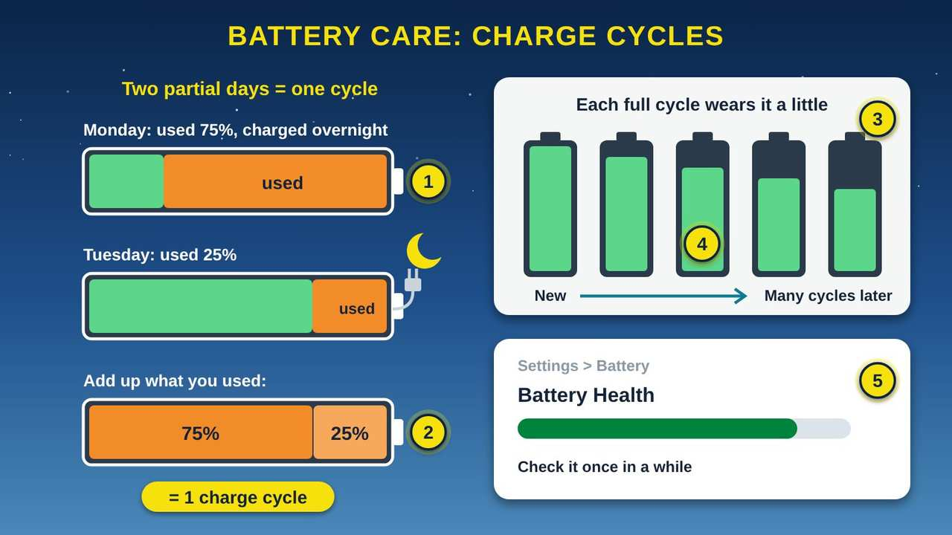
Battery Care: Charge Cycles
Part 3 · Picture 5 of 5
Notes:
Battery Care: Charge Cycles
What the picture shows: On the left, a battery used 75% on Monday and 25% on Tuesday adds up to one charge cycle. On the right, five batteries hold a little less charge from new to years later, and a settings screen shows Battery Health.
1. Partial charges. You do not have to run the battery all the way down. If you use 75% on Monday, charge it overnight, then use 25% on Tuesday, you have used one charge cycle in total.
2. One charge cycle. Apple explains that one charge cycle means using 100% of the battery's capacity, even if it happens over several partial charges. A quick top-up is only part of a cycle, so charge whenever it is handy.
3. Lithium-ion batteries. Phones, tablets, and laptops use lithium-ion batteries. They charge fast, last a long time, and hold a lot of power for their small size.
4. Slow, normal wear. A lithium-ion battery holds a little less with each full charge cycle. This is normal for every device.
5. Check battery health. Many phones and laptops show battery health in Settings. If it is low and the battery runs out fast, ask the maker or a trusted repair shop about a new battery.

Slide 13
What each line on a spec sheet tells you
Line on the sheet | What it is | A bigger number means
Chip or processor | The CPU (Central Processing Unit), the cook, often inside an SoC (System on a Chip) | Chip names are hard to compare; the other lines tell you more
Memory or RAM | Short-term memory for what is open now (the counter) | More apps and tabs open without slowing down
Storage | Long-term space for photos, apps, and files (the pantry) | Room for more photos, videos, and apps
Battery (mAh) | Stored power, in milliamp-hours | More charge to use before you plug in
Wireless | The radios: cellular, Wi-Fi, Bluetooth, NFC (Near Field Communication) | A higher Wi-Fi number is a newer version

Slide 14
Before you choose a device
Write down the jobs you need it for: school, a doctor visit by video, job applications, staying in touch with family.
Decide if you need a keyboard and a bigger screen (laptop) or something easy to carry (phone or tablet).
If you take lots of photos and videos, choose more storage.

Slide 15
Before you choose a device (continued)
If you keep many apps or tabs open, choose more RAM.
Check that it has a good camera and microphone if you will use video calls.
Ask whether the battery can be replaced later, and how.

Slide 16
Try it at home
Fifteen minutes with your own phone, tablet, or computer. Menu names differ a little from device to device.
1
Find your storage. iPhone or iPad: Settings, then General, then iPhone Storage or iPad Storage. Android: Settings, then Storage. Windows: Settings, then System, then Storage. Write down how much is used and how much is free.

Slide 17
Try it at home (continued)
2
Look at what takes the most room. Back up or delete old videos, and remove apps you never use.
3
Find your memory (RAM, or Random Access Memory). Windows: Settings, then System, then About, and look for Installed RAM. Mac: the Apple menu, then About This Mac, and look for Memory. iPhones and many Android phones do not show it, so look up your model's spec sheet instead.

Slide 18
Try it at home (continued)
4
Find your battery health. iPhone: Settings, then Battery, then Battery Health. On many Android phones, look in Settings, then Battery. Write down what it says.
5
Restart your device. Notice whether apps feel quicker afterward.
6
Search the web for your device's model name plus the word "specs." Find the chip, memory, storage, and battery lines.

Slide 19
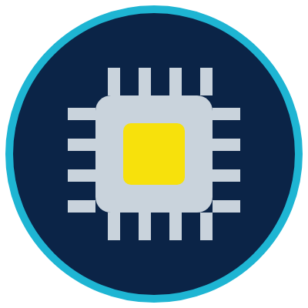


Remember
The CPU is the cook doing the work
RAM is the counter; a restart clears it
Storage is the pantry; keep some room free
Notes:
The CPU is the cook doing the work
RAM is the counter; a restart clears it
Storage is the pantry; keep some room free

Slide 20



Check what you learned: question 1 of 5
Your tablet has been slow all week and an app keeps freezing. What is a good first thing to try?
A
B
C
Restart the tablet
Delete all your photos
Turn the screen brightness up
Notes:
Your tablet has been slow all week and an app keeps freezing. What is a good first thing to try?
Answer: A. Restart the tablet
A restart clears RAM (Random Access Memory), the counter, and gives every app a fresh start. Your photos stay safe in storage, so there is no need to delete them.

Slide 21
Answer: question 1 of 5
Your tablet has been slow all week and an app keeps freezing. What is a good first thing to try?
A
Restart the tablet
✓ Correct
B
Delete all your photos
C
Turn the screen brightness up
Why: A restart clears RAM (Random Access Memory), the counter, and gives every app a fresh start. Your photos stay safe in storage, so there is no need to delete them.
Notes:
Your tablet has been slow all week and an app keeps freezing. What is a good first thing to try?
Answer: A. Restart the tablet
A restart clears RAM (Random Access Memory), the counter, and gives every app a fresh start. Your photos stay safe in storage, so there is no need to delete them.

Slide 22
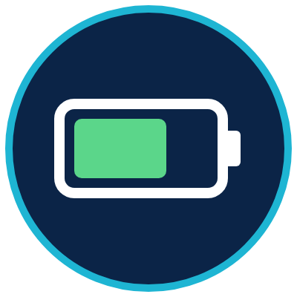
Check what you learned: question 2 of 5
At your grandson's ball game, your phone says "Storage almost full" and will not take a picture. What will help?
A
B
C
Restart the phone
Back up or delete old videos and unused apps
Charge the battery
Notes:
At your grandson's ball game, your phone says "Storage almost full" and will not take a picture. What will help?
Answer: B. Back up or delete old videos and unused apps
Storage is the pantry, and a restart does not empty it. Moving or deleting big videos and apps you never use frees up room for new photos.

Slide 23
Answer: question 2 of 5
At your grandson's ball game, your phone says "Storage almost full" and will not take a picture. What will help?
A
Restart the phone
B
Back up or delete old videos and unused apps
✓ Correct
C
Charge the battery
Why: Storage is the pantry, and a restart does not empty it. Moving or deleting big videos and apps you never use frees up room for new photos.
Notes:
At your grandson's ball game, your phone says "Storage almost full" and will not take a picture. What will help?
Answer: B. Back up or delete old videos and unused apps
Storage is the pantry, and a restart does not empty it. Moving or deleting big videos and apps you never use frees up room for new photos.

Slide 24
Check what you learned: question 3 of 5
Two laptops cost the same. Your niece will keep a video class, a document, and many web pages open at once. Which spec line matters most for that?
A
B
C
Memory (RAM)
Storage
Battery mAh (milliamp-hours)
Notes:
Two laptops cost the same. Your niece will keep a video class, a document, and many web pages open at once. Which spec line matters most for that?
Answer: A. Memory (RAM)
Everything open right now sits in RAM (Random Access Memory), the counter. More RAM lets her keep more open without slowing down.

Slide 25
Answer: question 3 of 5
Two laptops cost the same. Your niece will keep a video class, a document, and many web pages open at once. Which spec line matters most for that?
A
Memory (RAM)
✓ Correct
B
Storage
C
Battery mAh (milliamp-hours)
Why: Everything open right now sits in RAM (Random Access Memory), the counter. More RAM lets her keep more open without slowing down.
Notes:
Two laptops cost the same. Your niece will keep a video class, a document, and many web pages open at once. Which spec line matters most for that?
Answer: A. Memory (RAM)
Everything open right now sits in RAM (Random Access Memory), the counter. More RAM lets her keep more open without slowing down.

Slide 26

Check what you learned: question 4 of 5
During a phone call, your screen turns off when you hold the phone to your ear. Which part makes that happen?
A
B
C
The GPS (Global Positioning System) radio
A proximity sensor
The battery
Notes:
During a phone call, your screen turns off when you hold the phone to your ear. Which part makes that happen?
Answer: B. A proximity sensor
A proximity sensor notices when something is close to the screen, so your cheek does not tap buttons during a call.

Slide 27
Answer: question 4 of 5
During a phone call, your screen turns off when you hold the phone to your ear. Which part makes that happen?
A
The GPS (Global Positioning System) radio
B
A proximity sensor
✓ Correct
C
The battery
Why: A proximity sensor notices when something is close to the screen, so your cheek does not tap buttons during a call.
Notes:
During a phone call, your screen turns off when you hold the phone to your ear. Which part makes that happen?
Answer: B. A proximity sensor
A proximity sensor notices when something is close to the screen, so your cheek does not tap buttons during a call.

Slide 28
Check what you learned: question 5 of 5
You charge your phone to full, use half on Monday, top it up, then use half again on Tuesday. How many charge cycles is that?
A
B
One cycle
Two cycles
Notes:
You charge your phone to full, use half on Monday, top it up, then use half again on Tuesday. How many charge cycles is that?
Answer: A. One cycle
One charge cycle means using 100% of the battery's capacity, even over several partial charges. Half plus half is one cycle.

Slide 29
Answer: question 5 of 5
You charge your phone to full, use half on Monday, top it up, then use half again on Tuesday. How many charge cycles is that?
A
One cycle
✓ Correct
B
Two cycles
Why: One charge cycle means using 100% of the battery's capacity, even over several partial charges. Half plus half is one cycle.
Notes:
You charge your phone to full, use half on Monday, top it up, then use half again on Tuesday. How many charge cycles is that?
Answer: A. One cycle
One charge cycle means using 100% of the battery's capacity, even over several partial charges. Half plus half is one cycle.

Slide 30
Words to know
CPU
Central Processing Unit. The chip that does the work and tells the other parts what to do, like the cook in a kitchen.
GPU
Graphics Processing Unit. A part of the chip that draws pictures, video, and games on the screen.
RAM
Random Access Memory. Fast, short-term memory for the apps and files open right now. It is cleared when the device restarts or turns off.
Storage
Long-term space for photos, apps, and files. It keeps everything when the power is off, like a pantry.

Slide 31
Words to know (continued)
SSD
Solid State Drive. A storage device that keeps data on memory chips with no moving parts.
SoC
System on a Chip. One chip that holds the CPU, graphics, and other parts together. Phones and tablets use them to save space.
GB
Gigabyte. A unit used to measure memory and storage. More GB means more room.
mAh
Milliamp-hour. A unit for how much charge a battery holds. A bigger number holds more.

Slide 32
Words to know (continued)
Lithium-ion battery
The kind of rechargeable battery used in phones, tablets, and laptops. It charges fast and holds a lot of power for its size.
Charge cycle
Using 100% of a battery's capacity, whether all at once or over several partial charges.
Battery health
A setting on many devices that shows how much charge the battery can still hold compared to when it was new.
OLED
Organic Light-Emitting Diode. A kind of screen where each tiny dot makes its own light.

Slide 33
Words to know (continued)
NFC
Near Field Communication. A very short-range radio for tapping your phone to pay or to share.
Sensor
A small part that notices the world around the device, such as light, motion, direction, or air pressure.
Spec sheet
Short for specification sheet. A list of the parts and numbers inside a device, used to compare and choose.
Digital inclusion
Making sure everyone can use technology, including affordable internet, devices that meet their needs, and skills training.

Slide 34
Learn more
DigitalLearn: free lessons for beginners
Free, self-paced lessons on using a computer, a phone, and the internet.
https://www.digitallearn.org
Microsoft: All about computer memory
Plain-language help on the difference between memory and storage.
https://support.microsoft.com/en-US/Windows/experience/compatibility/all-about-computer-memory
Microsoft: Common PC and device terms
Short definitions of the parts inside a computer.
https://support.microsoft.com/en-US/Windows/Hardware/common-pc-and-device-terms

Slide 35
Learn more (continued)
Apple: Batteries, why lithium-ion?
How lithium-ion batteries work and what a charge cycle means.
https://www.apple.com/batteries/why-lithium-ion/
Google Store: Pixel 10 specs
A real spec sheet to practice reading.
https://store.google.com/product/pixel_10_specs?hl=en-US
NDIA: Definitions
What digital inclusion means, including devices that meet your needs.
https://www.digitalinclusion.org/definitions/

Slide 36
Teaching this class: lesson plan (45 minutes)
5 min
Open with the community kitchen story. Ask: who in the kitchen is the cook, what is the counter, and what is the pantry?
10 min
Part 1: explore the laptop and kitchen pictures. Act it out: one volunteer is the cook, the cutting board is the counter, the box is the pantry. Clear the board to show a restart.
5 min
Part 2: the phone picture. Ask people to point out where their own phone uses each radio and sensor.
Notes:
TEACHING THIS CLASS (45 minutes)
Lesson plan:
- 5 min: Open with the community kitchen story. Ask: who in the kitchen is the cook, what is the counter, and what is the pantry?
- 10 min: Part 1: explore the laptop and kitchen pictures. Act it out: one volunteer is the cook, the cutting board is the counter, the box is the pantry. Clear the board to show a restart.
- 5 min: Part 2: the phone picture. Ask people to point out where their own phone uses each radio and sensor.
- 10 min: Part 3: read the spec sheet together, then match a device to school, a telehealth visit, and a job search. Look at battery cycles.
- 10 min: Do steps 1, 3, and 4 of Try it at home. Pair people up so they can help each other find Settings.
- 5 min: Quiz together with a show of hands, then the three Remember cards.
What you need:
- Projector or large TV for the slides
- Printed handouts, one per person
- Kitchen props: a cutting board for the counter and a box of cans for the pantry
- Optional: an old laptop or phone with the back cover off, unplugged, to pass around
- Participants' own phones, tablets, or laptops
Talk about it:
- What do you use your phone or computer for most? Which spec line matters most for that job?
- Has your phone ever said storage is full? What did you do?
- Who in our community needs a device that fits their needs better, and how could we help?
The picture slides have every numbered detail in their speaker notes.
STORY: Picture the kitchen at the community center on the morning of a big dinner. One cook does the work. She brings flour, beans, and potatoes out of the pantry and sets them on the counter, where they are close and quick to reach. The counter is small, so she puts things away when she is done. At the end of the night the counter is wiped clean, but the pantry keeps everything for next time. Your computer, tablet, and phone work the same way. This class opens them up one picture at a time, so you can understand what is inside and choose a device that fits your needs.

Slide 37
Teaching this class: lesson plan (45 minutes) (continued)
10 min
Part 3: read the spec sheet together, then match a device to school, a telehealth visit, and a job search. Look at battery cycles.
10 min
Do steps 1, 3, and 4 of Try it at home. Pair people up so they can help each other find Settings.
5 min
Quiz together with a show of hands, then the three Remember cards.
Notes:
TEACHING THIS CLASS (45 minutes)
Lesson plan:
- 5 min: Open with the community kitchen story. Ask: who in the kitchen is the cook, what is the counter, and what is the pantry?
- 10 min: Part 1: explore the laptop and kitchen pictures. Act it out: one volunteer is the cook, the cutting board is the counter, the box is the pantry. Clear the board to show a restart.
- 5 min: Part 2: the phone picture. Ask people to point out where their own phone uses each radio and sensor.
- 10 min: Part 3: read the spec sheet together, then match a device to school, a telehealth visit, and a job search. Look at battery cycles.
- 10 min: Do steps 1, 3, and 4 of Try it at home. Pair people up so they can help each other find Settings.
- 5 min: Quiz together with a show of hands, then the three Remember cards.
What you need:
- Projector or large TV for the slides
- Printed handouts, one per person
- Kitchen props: a cutting board for the counter and a box of cans for the pantry
- Optional: an old laptop or phone with the back cover off, unplugged, to pass around
- Participants' own phones, tablets, or laptops
Talk about it:
- What do you use your phone or computer for most? Which spec line matters most for that job?
- Has your phone ever said storage is full? What did you do?
- Who in our community needs a device that fits their needs better, and how could we help?
The picture slides have every numbered detail in their speaker notes.
STORY: Picture the kitchen at the community center on the morning of a big dinner. One cook does the work. She brings flour, beans, and potatoes out of the pantry and sets them on the counter, where they are close and quick to reach. The counter is small, so she puts things away when she is done. At the end of the night the counter is wiped clean, but the pantry keeps everything for next time. Your computer, tablet, and phone work the same way. This class opens them up one picture at a time, so you can understand what is inside and choose a device that fits your needs.

Slide 38
Teaching this class: materials and discussion
What you need
Projector or large TV for the slides
Printed handouts, one per person
Kitchen props: a cutting board for the counter and a box of cans for the pantry
Optional: an old laptop or phone with the back cover off, unplugged, to pass around
Notes:
TEACHING THIS CLASS (45 minutes)
Lesson plan:
- 5 min: Open with the community kitchen story. Ask: who in the kitchen is the cook, what is the counter, and what is the pantry?
- 10 min: Part 1: explore the laptop and kitchen pictures. Act it out: one volunteer is the cook, the cutting board is the counter, the box is the pantry. Clear the board to show a restart.
- 5 min: Part 2: the phone picture. Ask people to point out where their own phone uses each radio and sensor.
- 10 min: Part 3: read the spec sheet together, then match a device to school, a telehealth visit, and a job search. Look at battery cycles.
- 10 min: Do steps 1, 3, and 4 of Try it at home. Pair people up so they can help each other find Settings.
- 5 min: Quiz together with a show of hands, then the three Remember cards.
What you need:
- Projector or large TV for the slides
- Printed handouts, one per person
- Kitchen props: a cutting board for the counter and a box of cans for the pantry
- Optional: an old laptop or phone with the back cover off, unplugged, to pass around
- Participants' own phones, tablets, or laptops
Talk about it:
- What do you use your phone or computer for most? Which spec line matters most for that job?
- Has your phone ever said storage is full? What did you do?
- Who in our community needs a device that fits their needs better, and how could we help?
The picture slides have every numbered detail in their speaker notes.
STORY: Picture the kitchen at the community center on the morning of a big dinner. One cook does the work. She brings flour, beans, and potatoes out of the pantry and sets them on the counter, where they are close and quick to reach. The counter is small, so she puts things away when she is done. At the end of the night the counter is wiped clean, but the pantry keeps everything for next time. Your computer, tablet, and phone work the same way. This class opens them up one picture at a time, so you can understand what is inside and choose a device that fits your needs.

Slide 39
Teaching this class: materials and discussion (continued)
Participants' own phones, tablets, or laptops
Talk about it
What do you use your phone or computer for most? Which spec line matters most for that job?
Has your phone ever said storage is full? What did you do?
Who in our community needs a device that fits their needs better, and how could we help?
Notes:
TEACHING THIS CLASS (45 minutes)
Lesson plan:
- 5 min: Open with the community kitchen story. Ask: who in the kitchen is the cook, what is the counter, and what is the pantry?
- 10 min: Part 1: explore the laptop and kitchen pictures. Act it out: one volunteer is the cook, the cutting board is the counter, the box is the pantry. Clear the board to show a restart.
- 5 min: Part 2: the phone picture. Ask people to point out where their own phone uses each radio and sensor.
- 10 min: Part 3: read the spec sheet together, then match a device to school, a telehealth visit, and a job search. Look at battery cycles.
- 10 min: Do steps 1, 3, and 4 of Try it at home. Pair people up so they can help each other find Settings.
- 5 min: Quiz together with a show of hands, then the three Remember cards.
What you need:
- Projector or large TV for the slides
- Printed handouts, one per person
- Kitchen props: a cutting board for the counter and a box of cans for the pantry
- Optional: an old laptop or phone with the back cover off, unplugged, to pass around
- Participants' own phones, tablets, or laptops
Talk about it:
- What do you use your phone or computer for most? Which spec line matters most for that job?
- Has your phone ever said storage is full? What did you do?
- Who in our community needs a device that fits their needs better, and how could we help?
The picture slides have every numbered detail in their speaker notes.
STORY: Picture the kitchen at the community center on the morning of a big dinner. One cook does the work. She brings flour, beans, and potatoes out of the pantry and sets them on the counter, where they are close and quick to reach. The counter is small, so she puts things away when she is done. At the end of the night the counter is wiped clean, but the pantry keeps everything for next time. Your computer, tablet, and phone work the same way. This class opens them up one picture at a time, so you can understand what is inside and choose a device that fits your needs.

Slide 40
Free from the Numu Communications Learning Center, www.numu.tech/resources.
Free to use and adapt; please keep this credit.
Questions? info@numu.tech · +1-888-686-5830

Slide 41
References
Apple. (n.d.). Batteries: Why lithium-ion? https://www.apple.com/batteries/why-lithium-ion/
Apple. (2020, November 10). Apple unleashes M1 [Press release]. https://www.apple.com/newsroom/2020/11/apple-unleashes-m1/
Google. (n.d.). Google Pixel 10 specs & hardware. Google Store. https://store.google.com/product/pixel_10_specs?hl=en-US
Gupta, M. (2021, October 19). Google Tensor is a milestone for machine learning. Google. https://blog.google/products/pixel/introducing-google-tensor/
Microsoft. (n.d.-a). All about computer memory. Microsoft Support. https://support.microsoft.com/en-US/Windows/experience/compatibility/all-about-computer-memory
Microsoft. (n.d.-b). Common PC and device terms. Microsoft Support. https://support.microsoft.com/en-US/Windows/Hardware/common-pc-and-device-terms
National Digital Inclusion Alliance. (n.d.). Definitions. https://www.digitalinclusion.org/definitions/
National Institute of Standards and Technology. (n.d.). Solid state drive (SSD). CSRC Glossary. https://csrc.nist.gov/glossary/term/solid_state_drive

