Slide 1


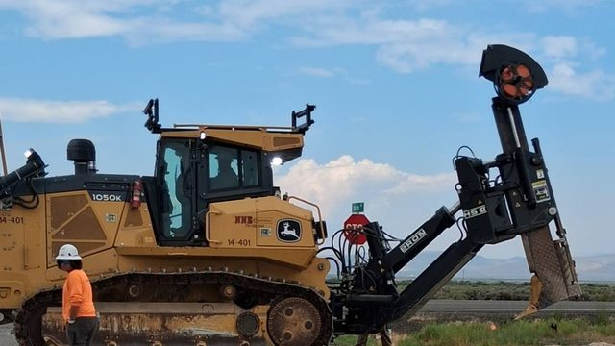
COMMUNITY TECH RESOURCES · COMMUNITY CLASS 2 OF 10
How Does a Fiber Optic Network Work?
Glass, light, ocean cables, and the fiber that reaches your home
Everyone
50 min
11 pictures
Free class from the Numu Communications Learning Center · www.numu.tech/resources
Notes:
TEACHING THIS CLASS (50 minutes)
Lesson plan:
- 5 min: Start here: read the story. Ask: has anyone seen a fiber crew working on your road?
- 12 min: What Is Fiber Optic Cable?: pass around a sample cable. Compare a fiber to a hair, then flash a flashlight on and off to spell out 1 0 1 1.
- 10 min: Fiber Is Everywhere: the town, the Oregon coast cables, and Mackay Stadium. Ask who has been to a Wolf Pack game, and how many screens, cameras, and phones were working at once.
- 10 min: The BroadbandUSA Highway Example: draw I-80 as the interstate, U.S. 95 from Winnemucca to McDermitt as the middle mile, and local streets as the last mile, then show how fiber gets built.
- 8 min: What a Fiber Network Looks Like: follow the light from the OLT to the ONT. Have four volunteers act out homes taking turns.
- 5 min: Practice and quiz together, then the three Remember cards and fiber safety.
What you need:
- Projector or large TV for the slides
- Printed handouts, one per person
- Optional: a short piece of fiber patch cord or a sample cable to pass around (never shine a light source through it)
- Optional: a flashlight and a clear plastic bottle of water to show light bending and bouncing
Talk about it:
- Where have you seen fiber being built around here, on poles or in the ground?
- What would change for families, Elders, or students here if every home had fiber?
- Why might a tribe want to own the fiber in its community?
The picture slides have every numbered detail in their speaker notes.
STORY: A crew rolls a cable plow along the highway shoulder, laying an orange pipe into the ground. Weeks later, a technician pulls a strand of glass, about as thin as a human hair, through that pipe. It ends in a small white box on the wall of a home miles away. When the family starts a video call with a grandchild across the country, their words travel as flashes of light through that same kind of glass, across the state, maybe under an ocean, and back again, in less time than it takes to blink. Numu Communications builds and runs networks like this for tribal and rural communities. This class follows the light in four parts: what fiber optic cable is, where fiber is used, the highway system it travels on, and what a fiber network to your home looks like.

Slide 2
What you will learn
✓
Describe what an optical fiber is made of and how light stays inside it
✓
Give three examples of places fiber is used, including the Pacific cables that land in Oregon and the network at Mackay Stadium
✓
Explain the backbone, middle mile, and last mile using the highway example
✓
Trace a fiber network from the OLT (Optical Line Terminal) through a splitter to the ONT (Optical Network Terminal) on a home

Slide 3

The story
A crew rolls a cable plow along the highway shoulder, laying an orange pipe into the ground. Weeks later, a technician pulls a strand of glass, about as thin as a human hair, through that pipe. It ends in a small white box on the wall of a home miles away. When the family starts a video call with a grandchild across the country, their words travel as flashes of light through that same kind of glass, across the state, maybe under an ocean, and back again, in less time than it takes to blink. Numu Communications builds and runs networks like this for tribal and rural communities. This class follows the light in four parts: what fiber optic cable is, where fiber is used, the highway system it travels on, and what a fiber network to your home looks like.
Notes:
A crew rolls a cable plow along the highway shoulder, laying an orange pipe into the ground. Weeks later, a technician pulls a strand of glass, about as thin as a human hair, through that pipe. It ends in a small white box on the wall of a home miles away. When the family starts a video call with a grandchild across the country, their words travel as flashes of light through that same kind of glass, across the state, maybe under an ocean, and back again, in less time than it takes to blink. Numu Communications builds and runs networks like this for tribal and rural communities. This class follows the light in four parts: what fiber optic cable is, where fiber is used, the highway system it travels on, and what a fiber network to your home looks like.

Slide 4
PART 1
What Is Fiber Optic Cable?
Fiber is a strand of very pure glass that carries data as flashes of light. Start with what it is made of and why the light stays inside.
3 pictures to explore

Slide 5
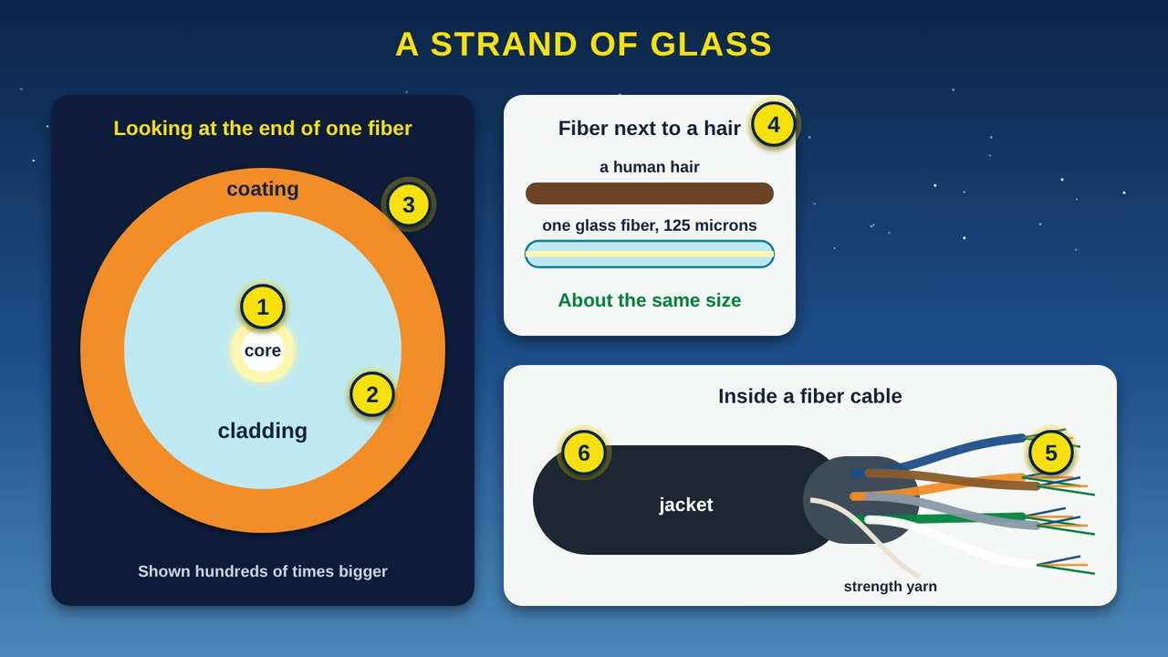
A Strand of Glass
Part 1 · Picture 1 of 11
Notes:
A Strand of Glass
What the picture shows: An enlarged end view of one optical fiber showing the bright glass core, the cladding around it, and the plastic coating. A side panel compares a fiber to a human hair. A cable cutaway shows the black jacket, color-coded tubes of fibers, and strength yarn.
1. The core carries the light. The core is the very center of the fiber, a thread of extremely pure glass. In the fiber used for long-distance and home internet, called single-mode fiber, the core is only about 9 microns across. A micron is one millionth of a meter.
2. The cladding keeps the light in. The cladding is a layer of slightly different glass wrapped around the core. Because the two glasses bend light differently, light that hits the edge of the core bounces back in instead of leaking out.
3. The coating protects the glass. A thin plastic coating keeps out water and scratches. Installers strip it off only when they join two fibers together.
4. Thinner than you would think. Most glass fibers are 125 microns across, about 5 thousandths of an inch. That is a bit larger than a typical human hair. You can bend it gently without breaking it.
5. Many fibers in one cable. A cable holds many fibers, from a few to hundreds or more. They sit in color-coded tubes so a technician can find fiber number 37 of 144, in the field, in the dark, years later.
6. The jacket and strength yarn. The outer jacket keeps out sun, water, and rodents. Strong yarn or rods inside take the pulling force when the cable is installed, so the glass does not have to.

Slide 6
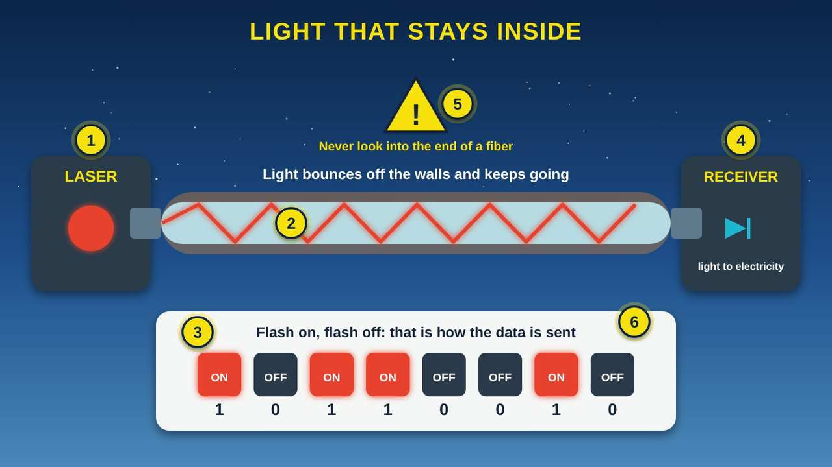
Light That Stays Inside
Part 1 · Picture 2 of 11
Notes:
Light That Stays Inside
What the picture shows: A laser on the left sends red light into a long glass fiber. The light zigzags, bouncing off the walls of the core, to a receiver on the right. Below, eight squares show the light flashing on and off to send the bits 1 0 1 1 0 0 1 0. A yellow warning sign says never look into the end of a fiber.
1. A tiny laser sends the signal. At one end, a small laser turns electrical data into flashes of light. Most fiber systems use infrared light that our eyes cannot see.
2. Light bounces and stays inside. When light hits the edge of the core at a low angle, it reflects back in, like a skipping stone that never leaves the water. Scientists call this total internal reflection. It is why the light can follow the fiber around gentle bends.
3. Flashes are ones and zeros. Light on means 1. Light off means 0. These are the same bits from our class on how computers speak. Fiber equipment flashes billions of times every second.
4. The receiver turns light back into electricity. At the far end, a light sensor turns the flashes back into electrical signals that a computer, phone, or router can use.
5. Safety: never look into a fiber. The light is usually invisible, but it can still harm your eyes. Never look into the end of a fiber or a fiber port, even if it seems dark. Leave fiber connections to trained technicians.
6. Why glass works so well. In 1970, scientists at Corning made glass so clear that light could travel a long way through it. Modern fiber is clear enough that signals can travel miles before they need a boost.

Slide 7
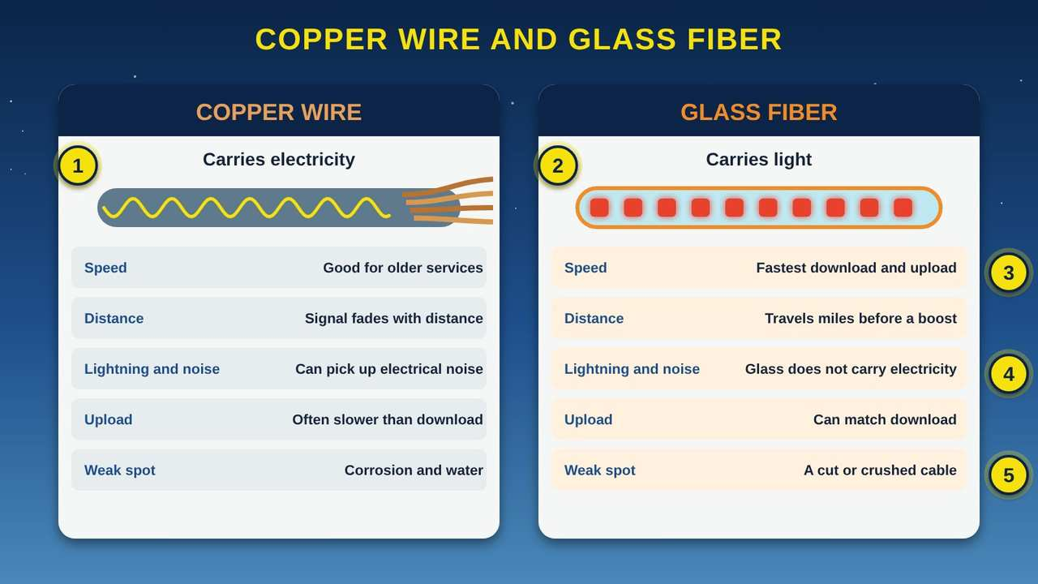
Copper Wire and Glass Fiber
Part 1 · Picture 3 of 11
Notes:
Copper Wire and Glass Fiber
What the picture shows: Two side-by-side panels. Copper wire carries electricity, shown as a wave on a gray cable. Glass fiber carries light, shown as red flashes in a clear cable. A five-row comparison covers speed, distance, lightning and noise, delay, and weak spots.
1. Copper came first. Telephone lines and cable TV lines are made of copper. They carry data as electricity. DSL (Digital Subscriber Line) internet runs over old phone lines, and many cable internet systems mix fiber with copper coaxial cable.
2. Fiber carries light instead. Fiber sends data as pulses of light through glass. The federal BroadbandUSA program describes fiber as having the fastest download and upload speeds on average, with very low delay.
3. Fast both ways. Many copper services are fast for downloading but slow for uploading. Fiber can be fast in both directions, which matters for video calls, telehealth, online classes, and sending big files.
4. Lightning and electrical noise. Glass does not conduct electricity, so lightning, power lines, and motors do not add noise to the light the way they can on copper.
5. The weak spot is the cable itself. Fiber is very reliable, but a backhoe, a falling tree, or a fire can cut or crush a cable. That is why careful network builders plan a second path where they can.

Slide 8
PART 2
Fiber Is Everywhere
Fiber connects cell towers, schools, and clinics, crosses the Pacific to the Oregon coast, and runs through Mackay Stadium in Reno. Here are three places to see it.
3 pictures to explore

Slide 9
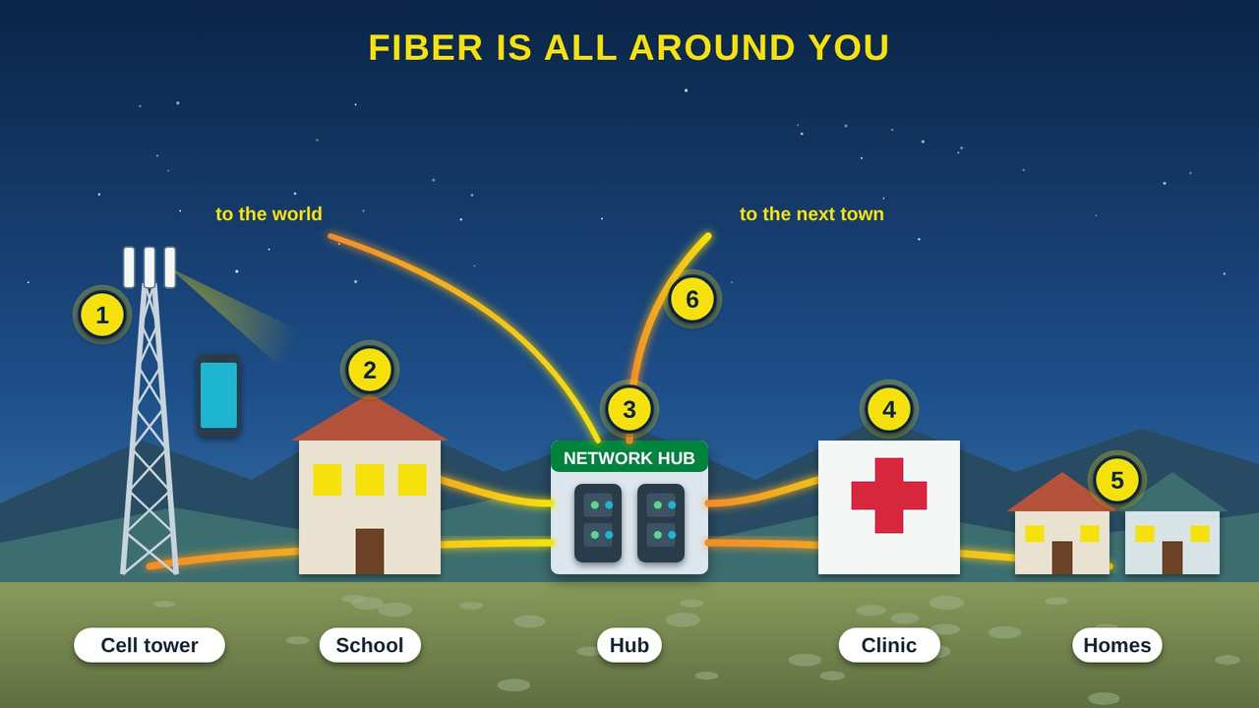
Fiber Is All Around You
Part 2 · Picture 4 of 11
Notes:
Fiber Is All Around You
What the picture shows: A small town where glowing orange fiber lines run from a network hub to a cell tower, a school and library, a clinic, and homes, with more lines heading off to the next town and the rest of the world.
1. Cell towers. Your phone talks to the cell tower by radio. Then the tower's traffic often rides a fiber line back to the network, called backhaul. So a phone call may travel most of the way on fiber.
2. Schools and libraries. Schools and libraries often have their own fiber connection, so hundreds of students can be online at once. They are called community anchor institutions.
3. The network hub. Fibers from across town meet in a small building or cabinet full of equipment. From here, traffic heads out to the rest of the internet.
4. Clinics and hospitals. Telehealth visits, X-ray images, and medical records move over fast, reliable connections, very often fiber.
5. Homes and businesses. Fiber to the home, also called FTTH (Fiber to the Home) or FTTP (Fiber to the Premises), runs glass all the way to the side of the house.
6. Town to town. Bigger fiber cables connect one town to the next, and to the large cables that cross the country and the oceans. We will follow those in the next part.

Slide 10
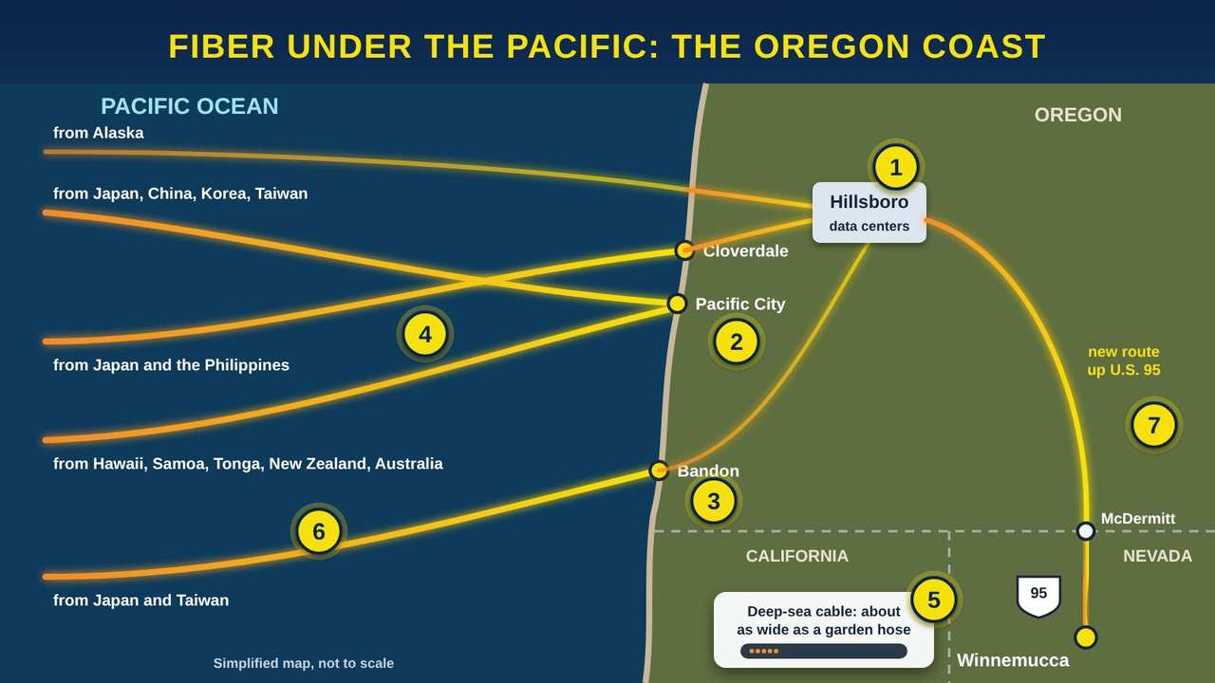
Fiber Under the Pacific: The Oregon Coast
Part 2 · Picture 5 of 11
Notes:
Fiber Under the Pacific: The Oregon Coast
What the picture shows: A simplified map. Glowing fiber cables cross the Pacific Ocean from Asia, Alaska, Hawaii, and the South Pacific and come ashore on the Oregon coast at Cloverdale, Pacific City, and Bandon. Land fiber links them to data centers in Hillsboro, near Portland, and on to a new fiber route along U.S. 95 that runs south from McDermitt at the Oregon line to Winnemucca, Nevada. A panel compares a deep-sea cable to a garden hose.
1. Hillsboro: Oregon's cable hub. The city of Hillsboro, near Portland, calls itself the center of six trans-Pacific cables. Its data centers hold the equipment that receives the light from the ocean cables and hands the traffic to networks on land.
2. Pacific City and Cloverdale. Two cables come ashore here on the north Oregon coast. New Cross Pacific (2018) connects Oregon with China, Japan, South Korea, and Taiwan. JUPITER (2020), owned by a group of companies including Amazon Web Services and Meta, lands at nearby Cloverdale and connects to Japan and the Philippines. The Hawaiki cable to Hawaii and the South Pacific also comes ashore at Pacific City.
3. Bandon. On the south Oregon coast, the FASTER cable (2016), owned by a group that includes Google, connects Bandon with Japan and Taiwan.
4. Across the Pacific. These cables are long. JUPITER is about 14,557 kilometers, more than 9,000 miles. Hawaiki is about 14,000 kilometers and reaches Hawaii, American Samoa, Tonga, New Zealand, and Australia.
5. About as thick as a garden hose. In the deep ocean, a cable is about as wide as a garden hose, and the glass fibers inside are as thin as a hair. Near shore, where ships anchor and fish, it gets extra armor and is buried under the seabed.
6. More than 99 percent of the traffic. Ocean cables carry more than 99 percent of the data that travels between continents. Worldwide, more than 600 cables are in service or planned. There are about 200 cable faults a year, about two-thirds caused by fishing boats and dragging anchors.
7. The new route up U.S. 95. From the coast, fiber on land carries the traffic across the West. In northern Nevada, a new middle-mile fiber route runs along U.S. 95 from Winnemucca north to McDermitt and the Fort McDermitt Indian Reservation at the Oregon line. It is part of the state's High Speed Nevada middle mile network. The photo at the top of this class shows a crew plowing in conduit on that route. A video call from Winnemucca to family in Japan can ride land fiber to a cable station, cross the Pacific, and come back in a fraction of a second.

Slide 11
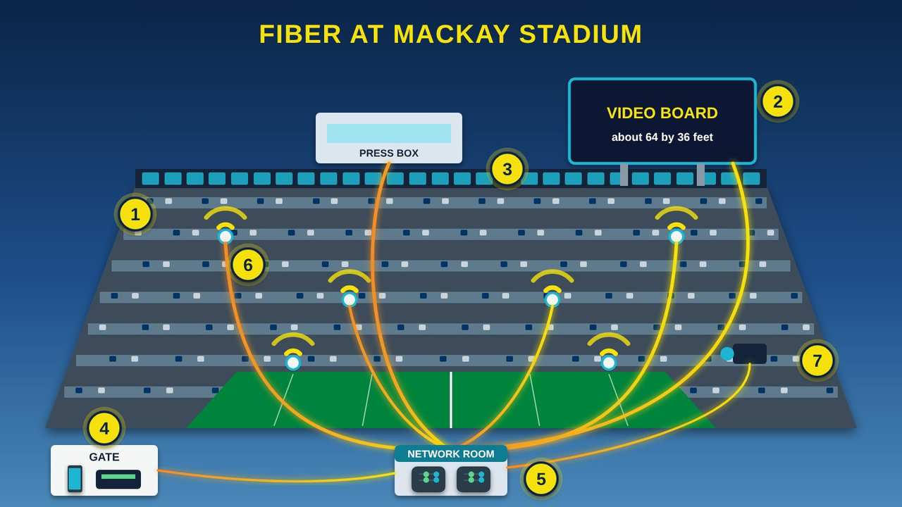
Fiber at Mackay Stadium
Part 2 · Picture 6 of 11
Notes:
Fiber at Mackay Stadium
What the picture shows: A cutaway of a college football stadium with blue and silver seats, a row of suites, a press box, a green field, and a video board on posts above the end zone. Glowing fiber lines run from a network room under the field to Wi-Fi radios in the stands, the video board, the press box, a sideline camera, and a gate where a fan scans a ticket on a phone.
1. A small city on game day. Mackay Stadium at the University of Nevada, Reno, seats 30,000 people. The record crowd was 33,391 in 1995, more than the population of most towns in northern Nevada. On game day, most of them carry a phone.
2. The video board. In 2016 Mackay got a new video and sound system. The plan called for a high-definition video board about 64 feet wide and 36 feet tall, plus a 250-foot ribbon board along the east upper deck. Live replays and graphics need a fast, steady connection from the control room to the screen.
3. TV in the suites, over the network. In 2021, Mackay's suite TV system was rebuilt to send 4K video over the computer network. Within two days of installation, all 57 suites were up and running.
4. Tickets on your phone. Fans download their tickets to their phones, and scanners at each gate check them. The gates, the ticket scanners, and the food and drink stands all need a working network.
5. Why fiber is the backbone. In large venues, fiber usually carries the long links from the network room to the video board, the press box, the suites, and the Wi-Fi radios in each section. Fiber carries huge amounts of data over long runs and does not pick up electrical noise from stadium lights and motors.
6. Wi-Fi and cell signal for the crowd. When thousands of people post photos at the same moment, the network needs many radios close to the fans. Each one needs a fast connection back to the network room.
7. For scale: an NFL stadium. The biggest new stadiums go much further. Mercedes-Benz Stadium in Atlanta, which opened in 2017, was built with nearly 4,000 miles of fiber and nearly 2,000 Wi-Fi access points, using a passive optical network, the same design you will see in part 4.

Slide 12
PART 3
The BroadbandUSA Highway Example
BroadbandUSA, the federal broadband office, explains internet networks with a highway system: interstates, state highways, and city streets. Our middle mile example is the High Speed Nevada fiber route along U.S. 95 from McDermitt to Winnemucca. Then see how the roads get built.
2 pictures to explore

Slide 13
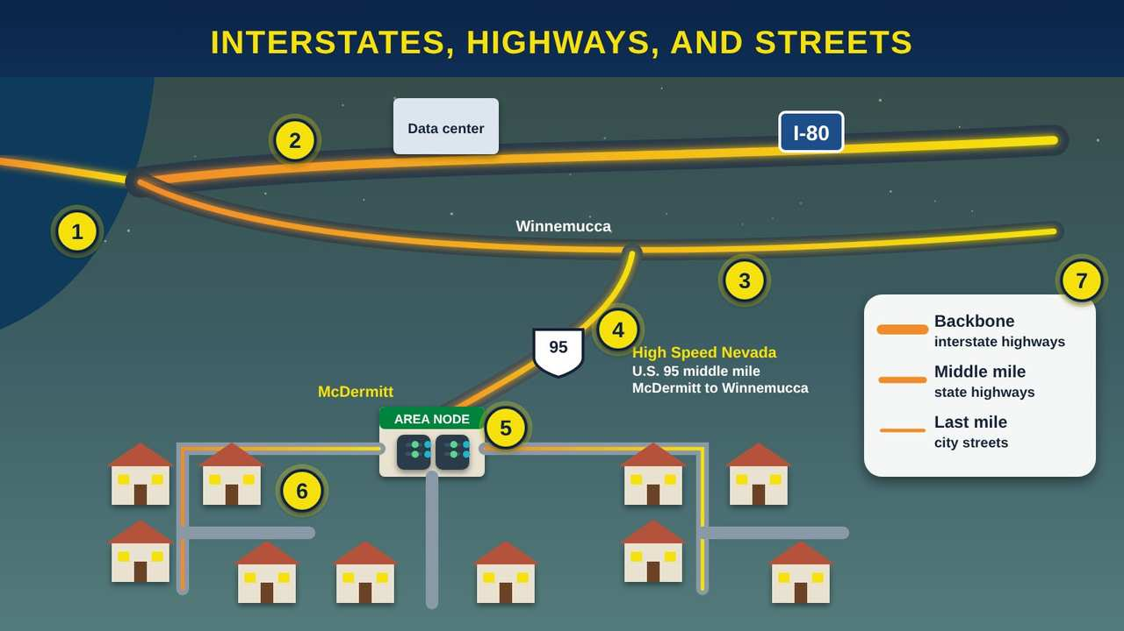
Interstates, Highways, and Streets
Part 3 · Picture 7 of 11
Notes:
Interstates, Highways, and Streets
What the picture shows: A map. Two thick fiber interstates cross the top, one coming from an ocean cable, labeled backbone. A state highway called middle mile branches down to an area node in a town. Small city streets called last mile spread out from the node to houses. A legend matches backbone to interstate highways, middle mile to state highways, and last mile to city streets.
1. Under the ocean. The backbone reaches other continents through the ocean cables from Part 2.
2. The backbone: interstate highways. BroadbandUSA, the federal broadband office, compares the internet backbone to interstate highways. Large fiber cables carry data across the country and around the world. They are usually owned by large telecommunications companies.
3. Two roads are better than one. Good networks have more than one path, called path diversity. If a backhoe cuts one fiber, traffic takes the other road and people stay online.
4. The middle mile: state highways. The middle mile carries data within a state or region. It connects a local area to the backbone, usually with fiber and sometimes with wireless links, and it needs enough room for everyone's traffic at the busiest time of day. Here is a real example from northern Nevada. Through the High Speed Nevada program, the Governor's Office of Science, Innovation and Technology (OSIT) is building the Nevada Middle Mile Network, about 2,500 miles of open-access fiber. One of its routes follows U.S. 95 for about 75 miles, from McDermitt at the Oregon line south to Winnemucca. At Winnemucca it meets the large fiber route along I-80, which leads to Reno and the rest of the internet. That U.S. 95 route is the middle mile for Numu's network.
5. The area node. A local building or cabinet where the middle mile meets the last mile. In our example, the U.S. 95 middle mile ends at McDermitt and the Fort McDermitt Indian Reservation, and the local network fans out from there to homes and tribal buildings.
6. The last mile: city streets. The last mile is the final stretch to homes, businesses, and anchor institutions such as schools and clinics. It can be fiber, cable, wireless, or satellite. It is often the most expensive part to build, especially where homes are far apart.
7. Who builds the roads. Some providers build all three pieces. Others share. For example, the Dakota Carrier Network is a middle mile network started in 1996 by 15 local telephone cooperatives and companies in North Dakota, so local providers could reach the backbone together.

Slide 14
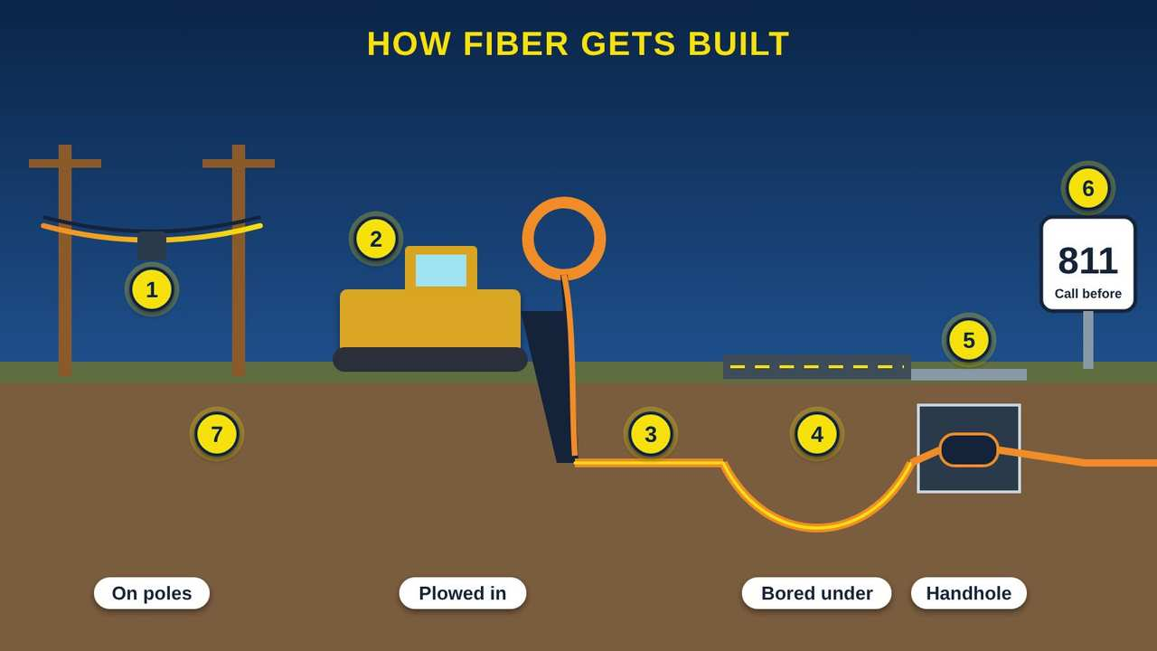
How Fiber Gets Built
Part 3 · Picture 8 of 11
Notes:
How Fiber Gets Built
What the picture shows: A side view of the ground. On the left, fiber hangs between two utility poles. In the middle, a cable plow pulls orange conduit into the ground from a reel. On the right, the conduit dips under a road by directional boring and comes up in a buried handhole with a splice case. A sign reads 811, call before you dig.
1. On utility poles. Aerial fiber hangs from utility poles, tied to a steel support wire. It is often quicker and less costly to build where poles already exist, but more exposed to wind, ice, fire, and falling trees.
2. Plowed into the ground. In open country, a cable plow cuts a narrow slot and lays plastic pipe called conduit, or the cable itself, in one pass. The photo at the top of this class shows a crew plowing in fiber conduit along U.S. 95 in Nevada.
3. Conduit protects the cable. Fiber is often pulled or blown through plastic conduit. The conduit protects the glass and makes it easier to add or replace cable later without digging again.
4. Boring under roads and rivers. To cross a road, a creek, or a driveway, crews use a drill that steers underground, called directional boring, so they do not have to cut the road.
5. Handholes and splicing. Every so often the cable comes up into a buried box called a handhole or vault. Inside, technicians join fibers by melting their ends together with an electric spark, called fusion splicing, and seal the joints in a weatherproof case.
6. Call 811 before you dig. 811 is the free national call-before-you-dig number. Utilities mark their buried lines so a shovel or post-hole digger does not cut a fiber, gas, or power line.
7. Most of the cost is the digging. BroadbandUSA notes that most of the money in a fiber build goes to civil work: digging, plowing, and permits. Rights-of-way across tribal trust land also need permission. See our guide on the BIA rights-of-way process.

Slide 15
PART 4
What a Fiber Network Looks Like
Most fiber-to-the-home networks use a design called a PON (Passive Optical Network). Follow it from the OLT in the fiber hut, through the splitter, to the ONT on your wall.
3 pictures to explore

Slide 16
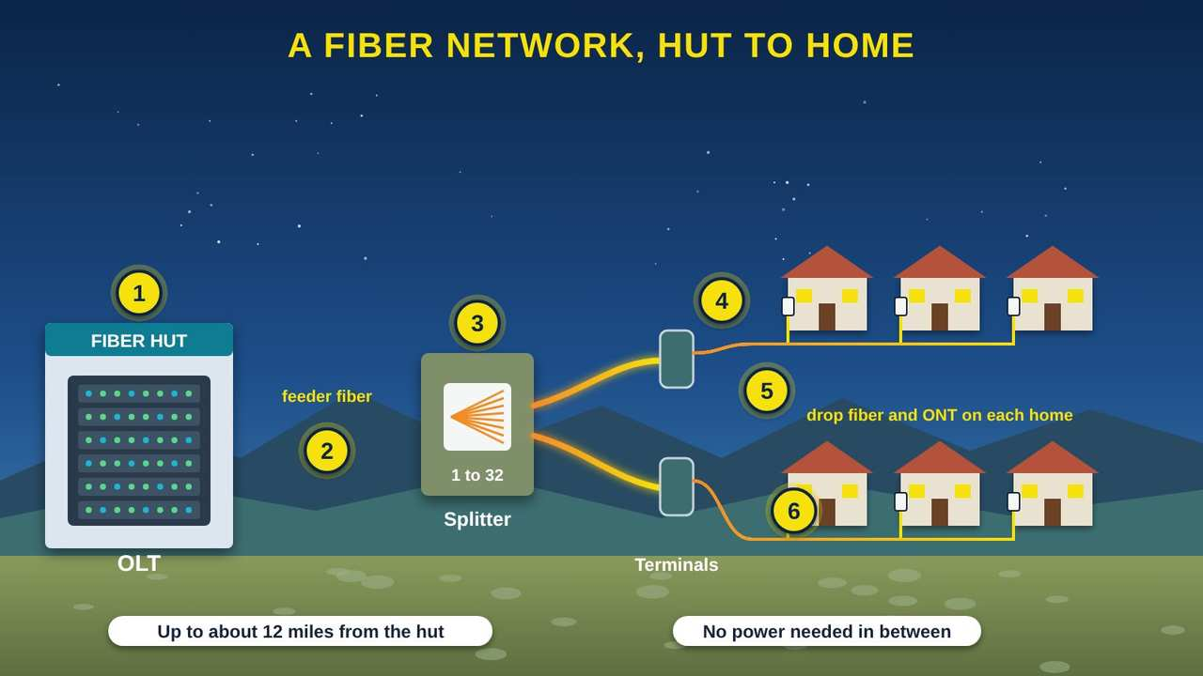
A Fiber Network, Hut to Home
Part 4 · Picture 9 of 11
Notes:
A Fiber Network, Hut to Home
What the picture shows: Left to right: a fiber hut holding the OLT, one feeder fiber to a green cabinet with a 1 to 32 splitter, distribution fibers to two terminals, and thin drop fibers to six houses, each with a small ONT box on the wall. Labels say up to about 12 miles from the hut and no power needed in between.
1. The OLT in the fiber hut. The OLT (Optical Line Terminal) is the main fiber equipment at the provider's end. It sits in a central office or a small fiber hut. Each port on it sends light down one fiber toward a neighborhood.
2. The feeder fiber. One feeder fiber carries everyone's data from the OLT out to the neighborhood. Basic systems reach about 20 kilometers, about 12 miles, from the OLT.
3. The splitter: one fiber becomes many. A splitter is a small piece of glass, with no power and no moving parts, that copies one fiber's light onto many fibers. A common size is 1 to 32: one fiber in, 32 out. Because nothing in the field needs electricity, it is called a PON (Passive Optical Network).
4. Terminals near the homes. Distribution fibers run from the splitter to small boxes on poles or in green pedestals near the road. Technicians connect each new customer here.
5. The drop fiber. A thin drop fiber runs from the terminal to the side of the house, on a pole line or in a small buried conduit.
6. The ONT on the home. The ONT (Optical Network Terminal) is the box that ends the fiber at your home. It turns the light into regular electrical signals your router can use.

Slide 17
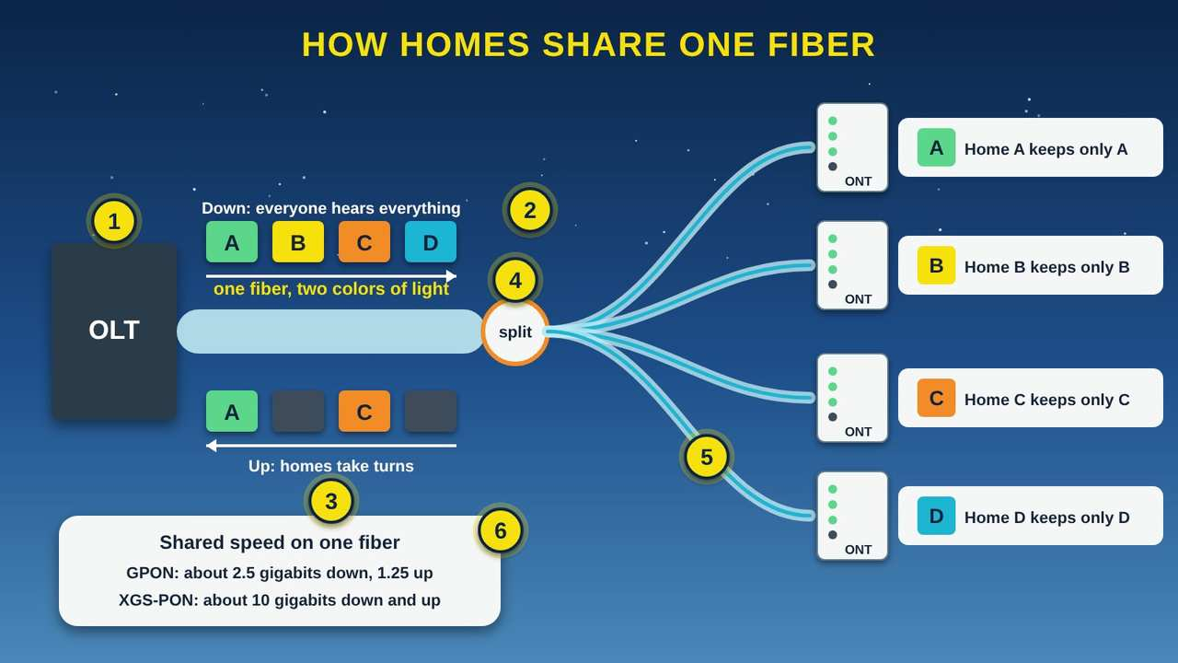
How Homes Share One Fiber
Part 4 · Picture 10 of 11
Notes:
How Homes Share One Fiber
What the picture shows: An OLT sends blue light down one fiber and receives red light coming back. Colored data blocks labeled A, B, C, and D travel down to a splitter, which copies the light to four homes. Each home's ONT keeps only its own letter. Coming back up, homes take turns. A panel lists shared speeds for GPON and XGS-PON.
1. Two colors on one strand. Light going down to homes and light coming back up use different colors, or wavelengths, so both can share one glass strand at the same time without bumping into each other.
2. Downstream: one message to everyone. The OLT sends one stream of data down the fiber, and the splitter copies it to every home. Each ONT picks out only the pieces addressed to it, a little like a mail carrier calling out names.
3. Upstream: taking turns. Going back up, the homes take turns in tiny time slots that the OLT assigns, so their signals do not collide in the shared fiber. It happens so fast you never notice.
4. Private, even though shared. Every home's ONT receives the light, but each one's data is encrypted. Your neighbor's ONT cannot read your data.
5. Why sharing works. Most of the time, most homes are not using their full speed at once. Sharing one fiber among many homes keeps the cost of building fiber down while still giving each home very fast service.
6. Shared speeds. GPON (Gigabit Passive Optical Network) shares about 2.5 gigabits per second down and 1.25 up. XGS-PON (10-Gigabit Symmetrical PON) shares about 10 gigabits each way. Newer systems reach about 50 gigabits.

Slide 18
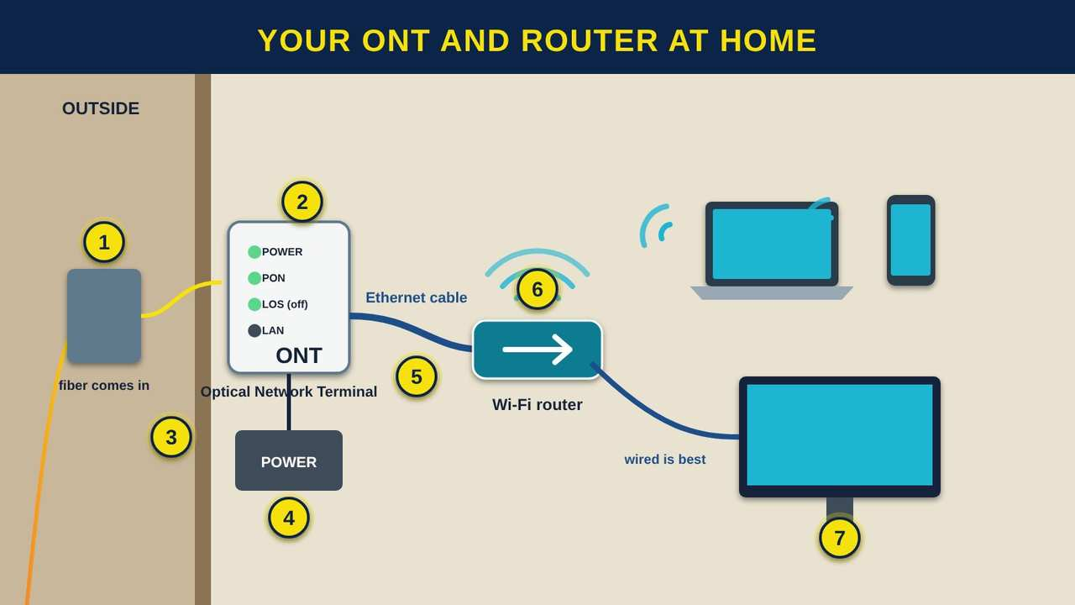
Your ONT and Router at Home
Part 4 · Picture 11 of 11
Notes:
Your ONT and Router at Home
What the picture shows: Inside a home. The fiber enters through the outside wall into a small white ONT box with status lights labeled power, PON, LOS, and LAN. A power supply sits below it. A blue Ethernet cable runs to a Wi-Fi router, which connects to a laptop and phone by Wi-Fi and to a TV by cable.
1. The fiber comes in. Outside, the drop fiber ends in a small box on the wall. A thin fiber cord comes through the wall to the ONT inside. Do not bend, pinch, or staple it: glass can crack if it bends too tightly.
2. The ONT turns light into data. The ONT (Optical Network Terminal) changes the light signals into electrical signals for your router. In most cases your provider owns and manages it.
3. Reading the lights. Most ONTs have a few status lights. A steady light marked PON or similar usually means the fiber link is up. A red light marked LOS (Loss of Signal) usually means no light is arriving, often a cut or unplugged fiber. Labels vary by brand, so check your provider's guide.
4. Keep it powered. The ONT needs electricity. If the power goes out, the internet goes out too, unless the ONT has a battery backup. Ask your provider what backup options they offer.
5. The Ethernet cable. An Ethernet cable connects the ONT to your router. This is the hand-off point between the provider's equipment and yours.
6. The router and Wi-Fi. The router shares the connection with every device in your home, by Wi-Fi or by cable. A fiber connection can be faster than your Wi-Fi, so router placement matters.
7. Plug in for the best speed. For speed tests, online classes, and video calls, plug the computer or TV into the router with an Ethernet cable when you can. Wi-Fi speed drops through walls and with distance.

Slide 19
The parts of a fiber network at a glance
Part | Where it is | What it does
OLT (Optical Line Terminal) | Central office or fiber hut | Sends and receives light for many homes
Feeder fiber | From the hut to the neighborhood | Carries everyone's data on one fiber
Splitter | Cabinet or closure in the field | Copies one fiber's light to many fibers, with no power

Slide 20
The parts of a fiber network at a glance (continued)
Part | Where it is | What it does
Terminal | Pole or pedestal near the road | Where a technician connects your drop
Drop fiber | Terminal to your home | Brings fiber to the side of your house
ONT (Optical Network Terminal) | On or inside your home | Turns light into signals for your router
Router | Inside your home | Shares the connection by Wi-Fi and cable

Slide 21
Getting fiber installed at home: what to expect
1
Check if fiber is available
Ask local providers, or look up your address on the FCC (Federal Communications Commission) National Broadband Map to see who reports fiber service there.

Slide 22
Getting fiber installed at home: what to expect (continued)
2
Plan where the fiber comes in
The installer will ask where the ONT should go. Pick an indoor spot near a power outlet, close to where you want the router, and out of reach of kids and pets.
3
Mark your own buried lines
811 marks utility lines, but not private ones such as a sprinkler pipe or a line to a shed. Show the crew where those are before they bury the drop.

Slide 23
Getting fiber installed at home: what to expect (continued)
4
Installation day
The technician runs the drop fiber, mounts the ONT, connects your router, and tests the light level and speed. Ask them to show you the lights on the ONT.
5
Test it yourself
Plug a computer into the router with an Ethernet cable and run a speed test. Compare the result with the plan you are paying for.

Slide 24
Fiber safety at home
Never look into the end of a fiber or into an empty fiber port on the ONT, even if it looks dark. The light is usually invisible and can hurt your eyes.
Do not bend, staple, or pinch the thin fiber cord, and do not unplug it to troubleshoot. Restart the router first, then call your provider.

Slide 25
Try it at home
A few things to look for this week:
1
Look up at the utility poles on your road. Can you spot a black cable with a small box or a loop of extra cable on it? That is often fiber.
2
Walk your road and look for green pedestals or orange and white marker posts that say fiber optic cable. Do not open them.
3
If you have fiber, find your ONT. Write down which lights are on and their colors when everything works, so you can compare when it does not.

Slide 26
Try it at home (continued)
4
Open the free submarine cable map at submarinecablemap.com, zoom in on the Oregon coast, and find the cables that land at Bandon and Pacific City. Where do they go?
5
Search your address on the FCC National Broadband Map and see whether any provider reports fiber service there.
6
Open the Nevada Middle Mile Network map from the state's High Speed Nevada program and follow U.S. 95 from Winnemucca north to McDermitt.

Slide 27



Remember
Fiber is hair-thin glass that carries data as flashes of light
Backbone, middle mile, last mile: interstates, highways, and streets
In a PON, one fiber is split to many homes, and the ONT ends it at yours
Notes:
Fiber is hair-thin glass that carries data as flashes of light
Backbone, middle mile, last mile: interstates, highways, and streets
In a PON, one fiber is split to many homes, and the ONT ends it at yours

Slide 28

Check what you learned: question 1 of 6
What actually carries the data inside a fiber optic cable?
A
B
Flashes of light in glass
Electricity in copper wire
Notes:
What actually carries the data inside a fiber optic cable?
Answer: A. Flashes of light in glass
Fiber carries data as pulses of light through very pure glass. Light on means 1, light off means 0.

Slide 29
Answer: question 1 of 6
What actually carries the data inside a fiber optic cable?
A
Flashes of light in glass
✓ Correct
B
Electricity in copper wire
Why: Fiber carries data as pulses of light through very pure glass. Light on means 1, light off means 0.
Notes:
What actually carries the data inside a fiber optic cable?
Answer: A. Flashes of light in glass
Fiber carries data as pulses of light through very pure glass. Light on means 1, light off means 0.

Slide 30


Check what you learned: question 2 of 6
About how much of the data traveling between continents goes through cables on the ocean floor?
A
B
About half
More than 99 percent
Notes:
About how much of the data traveling between continents goes through cables on the ocean floor?
Answer: B. More than 99 percent
Submarine cables carry more than 99 percent of intercontinental data. Satellites carry only a small share.

Slide 31
Answer: question 2 of 6
About how much of the data traveling between continents goes through cables on the ocean floor?
A
About half
B
More than 99 percent
✓ Correct
Why: Submarine cables carry more than 99 percent of intercontinental data. Satellites carry only a small share.
Notes:
About how much of the data traveling between continents goes through cables on the ocean floor?
Answer: B. More than 99 percent
Submarine cables carry more than 99 percent of intercontinental data. Satellites carry only a small share.

Slide 32


Check what you learned: question 3 of 6
In the BroadbandUSA highway example, what is the middle mile?
A
B
The state highways that connect a local area to the backbone
The driveway to one house
Notes:
In the BroadbandUSA highway example, what is the middle mile?
Answer: A. The state highways that connect a local area to the backbone
The backbone is like the interstates, the middle mile like state highways, and the last mile like city streets.

Slide 33
Answer: question 3 of 6
In the BroadbandUSA highway example, what is the middle mile?
The state highways that connect a local area to the backbone
A
✓ Correct
The driveway to one house
B
Why: The backbone is like the interstates, the middle mile like state highways, and the last mile like city streets.
Notes:
In the BroadbandUSA highway example, what is the middle mile?
Answer: A. The state highways that connect a local area to the backbone
The backbone is like the interstates, the middle mile like state highways, and the last mile like city streets.

Slide 34


Check what you learned: question 4 of 6
What does the splitter in a PON (Passive Optical Network) do?
A
B
Boosts the signal with electricity
Copies one fiber's light onto many fibers, with no power
Notes:
What does the splitter in a PON (Passive Optical Network) do?
Answer: B. Copies one fiber's light onto many fibers, with no power
A splitter is passive: no power and no moving parts. That is where the word passive in PON comes from.

Slide 35
Answer: question 4 of 6
What does the splitter in a PON (Passive Optical Network) do?
A
Boosts the signal with electricity
Copies one fiber's light onto many fibers, with no power
B
✓ Correct
Why: A splitter is passive: no power and no moving parts. That is where the word passive in PON comes from.
Notes:
What does the splitter in a PON (Passive Optical Network) do?
Answer: B. Copies one fiber's light onto many fibers, with no power
A splitter is passive: no power and no moving parts. That is where the word passive in PON comes from.

Slide 36


Check what you learned: question 5 of 6
Your ONT shows a red light marked LOS (Loss of Signal). What is the most likely problem?
A
B
No light is reaching the ONT, often a cut or unplugged fiber
Your Wi-Fi password changed
Notes:
Your ONT shows a red light marked LOS (Loss of Signal). What is the most likely problem?
Answer: A. No light is reaching the ONT, often a cut or unplugged fiber
LOS usually means the ONT is not receiving light. Do not look into the fiber. Call your provider, who can test the line.

Slide 37
Answer: question 5 of 6
Your ONT shows a red light marked LOS (Loss of Signal). What is the most likely problem?
No light is reaching the ONT, often a cut or unplugged fiber
A
✓ Correct
Your Wi-Fi password changed
B
Why: LOS usually means the ONT is not receiving light. Do not look into the fiber. Call your provider, who can test the line.
Notes:
Your ONT shows a red light marked LOS (Loss of Signal). What is the most likely problem?
Answer: A. No light is reaching the ONT, often a cut or unplugged fiber
LOS usually means the ONT is not receiving light. Do not look into the fiber. Call your provider, who can test the line.

Slide 38


Check what you learned: question 6 of 6
Why should you never look into the end of a fiber?
A
B
It will reset the network
The light is usually invisible but can still hurt your eyes
Notes:
Why should you never look into the end of a fiber?
Answer: B. The light is usually invisible but can still hurt your eyes
Fiber systems mostly use infrared light you cannot see. Leave fiber connections to trained technicians.

Slide 39
Answer: question 6 of 6
Why should you never look into the end of a fiber?
A
It will reset the network
The light is usually invisible but can still hurt your eyes
B
✓ Correct
Why: Fiber systems mostly use infrared light you cannot see. Leave fiber connections to trained technicians.
Notes:
Why should you never look into the end of a fiber?
Answer: B. The light is usually invisible but can still hurt your eyes
Fiber systems mostly use infrared light you cannot see. Leave fiber connections to trained technicians.

Slide 40
Words to know
ISP
Internet Service Provider. The company or tribal utility that connects your home to the internet.
IXP
Internet Exchange Point. A building where many networks plug into each other to trade traffic.
Mbps
Megabits per second. How fast data moves. 100 Mbps is 100 million bits every second.
Broadband
Fast internet that is always on, as opposed to old dial-up service.

Slide 41
Words to know (continued)
NTIA
National Telecommunications and Information Administration. The federal agency that runs BEAD and TBCP and manages federal radio spectrum.
FCC
Federal Communications Commission. The U.S. agency that licenses radio, TV, and cell frequencies and assigns call signs.
Fiber optic cable
A cable of thin glass strands that carry data as pulses of light.
Core
The center of an optical fiber, where the light travels.

Slide 42
Words to know (continued)
Cladding
The layer of glass around the core that keeps the light inside by reflecting it back in.
Single-mode fiber
Fiber with a very small core, about 9 microns, used for long distances and fiber to the home.
Multimode fiber
Fiber with a larger core, used for short runs inside buildings.
Total internal reflection
How light bounces off the inside edge of the core and stays in the fiber.

Slide 43
Words to know (continued)
Wavelength (light)
The color of light. Fiber uses different invisible infrared colors to send data in each direction.
Submarine cable
A fiber cable laid on the ocean floor between countries and continents.
Backbone
The very large networks that carry data between cities, countries, and continents. Like interstate highways.
Middle mile
The part of a network that connects a local area to the backbone. Like state highways.

Slide 44
Words to know (continued)
Last mile
The final connection from a local network to homes and businesses. Like city streets.
Path diversity
Having more than one route, so traffic can go around a cut cable.
Backhaul
The connection that carries a cell tower's traffic back to the main network, often on fiber.
FTTH / FTTP
Fiber to the Home and Fiber to the Premises. Fiber all the way to a home or building.

Slide 45
Words to know (continued)
PON
Passive Optical Network. A fiber network that uses unpowered splitters to share one fiber among many homes.
GPON
Gigabit Passive Optical Network. A common PON standard that shares about 2.5 gigabits per second down and 1.25 up.
XGS-PON
10-Gigabit Symmetrical Passive Optical Network. A PON standard that shares about 10 gigabits per second in each direction.
OLT
Optical Line Terminal. The provider's fiber equipment in the central office or fiber hut.

Slide 46
Words to know (continued)
ONT
Optical Network Terminal. The box at your home that turns light into signals for your router.
Splitter
An unpowered device that copies the light from one fiber onto many fibers.
Drop
The short fiber that runs from the road to one home.
Conduit
Plastic pipe buried in the ground to protect fiber cable.

Slide 47
Words to know (continued)
Handhole
A buried box with a lid where fiber cable can be reached, stored, and spliced.
Fusion splicing
Joining two fibers by melting their ends together with an electric arc.
Directional boring
Drilling a steerable path underground to place conduit under a road or river without digging a trench.
LOS
Loss of Signal. A warning light on an ONT that usually means no light is arriving.

Slide 48
Words to know (continued)
811
The free national phone number to call before you dig, so buried utility lines are marked.

Slide 49
Learn more
BroadbandUSA: Broadband primer (slides)
The federal highway example: backbone, middle mile, and last mile.
https://broadbandusa.ntia.gov/sites/default/files/2022-03/22-03-08%20Broadband%20Primer%20Orientation%20vFINAL.pdf
Submarine Cable Map
A free interactive map of the cables on the ocean floor, from TeleGeography.
https://www.submarinecablemap.com
The Fiber Optic Association: Reference guide
A free technical reference on how optical fiber works.
https://www.foa.org/tech/ref/basic/fiber.html

Slide 50
Learn more (continued)
FCC National Broadband Map
See which providers report fiber and other service at your address.
https://broadbandmap.fcc.gov
Nevada Middle Mile Network map (High Speed Nevada)
The state's map of middle mile fiber routes, including U.S. 95 from Winnemucca to McDermitt.
https://experience.arcgis.com/experience/339765dfab624307a477b63408dd3724/
Call 811 before you dig
How to get buried utility lines marked for free.
https://call811.com/

Slide 51
Teaching this class: lesson plan (50 minutes)
5 min
Start here: read the story. Ask: has anyone seen a fiber crew working on your road?
12 min
What Is Fiber Optic Cable?: pass around a sample cable. Compare a fiber to a hair, then flash a flashlight on and off to spell out 1 0 1 1.
10 min
Fiber Is Everywhere: the town, the Oregon coast cables, and Mackay Stadium. Ask who has been to a Wolf Pack game, and how many screens, cameras, and phones were working at once.
Notes:
TEACHING THIS CLASS (50 minutes)
Lesson plan:
- 5 min: Start here: read the story. Ask: has anyone seen a fiber crew working on your road?
- 12 min: What Is Fiber Optic Cable?: pass around a sample cable. Compare a fiber to a hair, then flash a flashlight on and off to spell out 1 0 1 1.
- 10 min: Fiber Is Everywhere: the town, the Oregon coast cables, and Mackay Stadium. Ask who has been to a Wolf Pack game, and how many screens, cameras, and phones were working at once.
- 10 min: The BroadbandUSA Highway Example: draw I-80 as the interstate, U.S. 95 from Winnemucca to McDermitt as the middle mile, and local streets as the last mile, then show how fiber gets built.
- 8 min: What a Fiber Network Looks Like: follow the light from the OLT to the ONT. Have four volunteers act out homes taking turns.
- 5 min: Practice and quiz together, then the three Remember cards and fiber safety.
What you need:
- Projector or large TV for the slides
- Printed handouts, one per person
- Optional: a short piece of fiber patch cord or a sample cable to pass around (never shine a light source through it)
- Optional: a flashlight and a clear plastic bottle of water to show light bending and bouncing
Talk about it:
- Where have you seen fiber being built around here, on poles or in the ground?
- What would change for families, Elders, or students here if every home had fiber?
- Why might a tribe want to own the fiber in its community?
The picture slides have every numbered detail in their speaker notes.
STORY: A crew rolls a cable plow along the highway shoulder, laying an orange pipe into the ground. Weeks later, a technician pulls a strand of glass, about as thin as a human hair, through that pipe. It ends in a small white box on the wall of a home miles away. When the family starts a video call with a grandchild across the country, their words travel as flashes of light through that same kind of glass, across the state, maybe under an ocean, and back again, in less time than it takes to blink. Numu Communications builds and runs networks like this for tribal and rural communities. This class follows the light in four parts: what fiber optic cable is, where fiber is used, the highway system it travels on, and what a fiber network to your home looks like.

Slide 52
Teaching this class: lesson plan (50 minutes) (continued)
10 min
The BroadbandUSA Highway Example: draw I-80 as the interstate, U.S. 95 from Winnemucca to McDermitt as the middle mile, and local streets as the last mile, then show how fiber gets built.
8 min
What a Fiber Network Looks Like: follow the light from the OLT to the ONT. Have four volunteers act out homes taking turns.
5 min
Practice and quiz together, then the three Remember cards and fiber safety.
Notes:
TEACHING THIS CLASS (50 minutes)
Lesson plan:
- 5 min: Start here: read the story. Ask: has anyone seen a fiber crew working on your road?
- 12 min: What Is Fiber Optic Cable?: pass around a sample cable. Compare a fiber to a hair, then flash a flashlight on and off to spell out 1 0 1 1.
- 10 min: Fiber Is Everywhere: the town, the Oregon coast cables, and Mackay Stadium. Ask who has been to a Wolf Pack game, and how many screens, cameras, and phones were working at once.
- 10 min: The BroadbandUSA Highway Example: draw I-80 as the interstate, U.S. 95 from Winnemucca to McDermitt as the middle mile, and local streets as the last mile, then show how fiber gets built.
- 8 min: What a Fiber Network Looks Like: follow the light from the OLT to the ONT. Have four volunteers act out homes taking turns.
- 5 min: Practice and quiz together, then the three Remember cards and fiber safety.
What you need:
- Projector or large TV for the slides
- Printed handouts, one per person
- Optional: a short piece of fiber patch cord or a sample cable to pass around (never shine a light source through it)
- Optional: a flashlight and a clear plastic bottle of water to show light bending and bouncing
Talk about it:
- Where have you seen fiber being built around here, on poles or in the ground?
- What would change for families, Elders, or students here if every home had fiber?
- Why might a tribe want to own the fiber in its community?
The picture slides have every numbered detail in their speaker notes.
STORY: A crew rolls a cable plow along the highway shoulder, laying an orange pipe into the ground. Weeks later, a technician pulls a strand of glass, about as thin as a human hair, through that pipe. It ends in a small white box on the wall of a home miles away. When the family starts a video call with a grandchild across the country, their words travel as flashes of light through that same kind of glass, across the state, maybe under an ocean, and back again, in less time than it takes to blink. Numu Communications builds and runs networks like this for tribal and rural communities. This class follows the light in four parts: what fiber optic cable is, where fiber is used, the highway system it travels on, and what a fiber network to your home looks like.

Slide 53
Teaching this class: materials and discussion
What you need
Projector or large TV for the slides
Printed handouts, one per person
Optional: a short piece of fiber patch cord or a sample cable to pass around (never shine a light source through it)
Optional: a flashlight and a clear plastic bottle of water to show light bending and bouncing
Notes:
TEACHING THIS CLASS (50 minutes)
Lesson plan:
- 5 min: Start here: read the story. Ask: has anyone seen a fiber crew working on your road?
- 12 min: What Is Fiber Optic Cable?: pass around a sample cable. Compare a fiber to a hair, then flash a flashlight on and off to spell out 1 0 1 1.
- 10 min: Fiber Is Everywhere: the town, the Oregon coast cables, and Mackay Stadium. Ask who has been to a Wolf Pack game, and how many screens, cameras, and phones were working at once.
- 10 min: The BroadbandUSA Highway Example: draw I-80 as the interstate, U.S. 95 from Winnemucca to McDermitt as the middle mile, and local streets as the last mile, then show how fiber gets built.
- 8 min: What a Fiber Network Looks Like: follow the light from the OLT to the ONT. Have four volunteers act out homes taking turns.
- 5 min: Practice and quiz together, then the three Remember cards and fiber safety.
What you need:
- Projector or large TV for the slides
- Printed handouts, one per person
- Optional: a short piece of fiber patch cord or a sample cable to pass around (never shine a light source through it)
- Optional: a flashlight and a clear plastic bottle of water to show light bending and bouncing
Talk about it:
- Where have you seen fiber being built around here, on poles or in the ground?
- What would change for families, Elders, or students here if every home had fiber?
- Why might a tribe want to own the fiber in its community?
The picture slides have every numbered detail in their speaker notes.
STORY: A crew rolls a cable plow along the highway shoulder, laying an orange pipe into the ground. Weeks later, a technician pulls a strand of glass, about as thin as a human hair, through that pipe. It ends in a small white box on the wall of a home miles away. When the family starts a video call with a grandchild across the country, their words travel as flashes of light through that same kind of glass, across the state, maybe under an ocean, and back again, in less time than it takes to blink. Numu Communications builds and runs networks like this for tribal and rural communities. This class follows the light in four parts: what fiber optic cable is, where fiber is used, the highway system it travels on, and what a fiber network to your home looks like.

Slide 54
Teaching this class: materials and discussion (continued)
Talk about it
Where have you seen fiber being built around here, on poles or in the ground?
What would change for families, Elders, or students here if every home had fiber?
Why might a tribe want to own the fiber in its community?
Notes:
TEACHING THIS CLASS (50 minutes)
Lesson plan:
- 5 min: Start here: read the story. Ask: has anyone seen a fiber crew working on your road?
- 12 min: What Is Fiber Optic Cable?: pass around a sample cable. Compare a fiber to a hair, then flash a flashlight on and off to spell out 1 0 1 1.
- 10 min: Fiber Is Everywhere: the town, the Oregon coast cables, and Mackay Stadium. Ask who has been to a Wolf Pack game, and how many screens, cameras, and phones were working at once.
- 10 min: The BroadbandUSA Highway Example: draw I-80 as the interstate, U.S. 95 from Winnemucca to McDermitt as the middle mile, and local streets as the last mile, then show how fiber gets built.
- 8 min: What a Fiber Network Looks Like: follow the light from the OLT to the ONT. Have four volunteers act out homes taking turns.
- 5 min: Practice and quiz together, then the three Remember cards and fiber safety.
What you need:
- Projector or large TV for the slides
- Printed handouts, one per person
- Optional: a short piece of fiber patch cord or a sample cable to pass around (never shine a light source through it)
- Optional: a flashlight and a clear plastic bottle of water to show light bending and bouncing
Talk about it:
- Where have you seen fiber being built around here, on poles or in the ground?
- What would change for families, Elders, or students here if every home had fiber?
- Why might a tribe want to own the fiber in its community?
The picture slides have every numbered detail in their speaker notes.
STORY: A crew rolls a cable plow along the highway shoulder, laying an orange pipe into the ground. Weeks later, a technician pulls a strand of glass, about as thin as a human hair, through that pipe. It ends in a small white box on the wall of a home miles away. When the family starts a video call with a grandchild across the country, their words travel as flashes of light through that same kind of glass, across the state, maybe under an ocean, and back again, in less time than it takes to blink. Numu Communications builds and runs networks like this for tribal and rural communities. This class follows the light in four parts: what fiber optic cable is, where fiber is used, the highway system it travels on, and what a fiber network to your home looks like.

Slide 55
Free from the Numu Communications Learning Center, www.numu.tech/resources.
Free to use and adapt; please keep this credit.
Questions? info@numu.tech · +1-888-686-5830

Slide 56
References
AV Network. (2022, March 29). Visionary AV solutions enhance connectivity at Nevada's Mackay Stadium. https://www.avnetwork.com/news/visionary-av-solutions-enhance-connectivity-at-nevadas-mackay-stadium
Barrington, D., & Brown, J. (2017, August 17). In fight for fans, IBM tricks out Mercedes-Benz Stadium. CIO Dive. https://www.ciodive.com/news/in-fight-for-fans-ibm-tricks-out-mercedes-benz-stadium/449512/
Cisco Systems. (n.d.). What is passive optical networking (PON)? https://www.cisco.com/c/en/us/products/switches/what-is-passive-optical-networking.html
City of Hillsboro. (n.d.). Infrastructure and utilities. https://www.hillsboro-oregon.gov/our-city/departments/economic-development/choose-hillsboro/infrastructure-utilities
Common Ground Alliance. (n.d.). Know what's below: Call 811 before you dig. https://call811.com/
Engineering and Technology History Wiki. (n.d.). Milestones: World's first low-loss optical fiber for telecommunications, 1970. IEEE History Center. https://ethw.org/Milestones:World%27s_First_Low-Loss_Optical_Fiber_for_Telecommunications,_1970
EXFO. (n.d.). Fiber-to-the-home (FTTH). https://www.exfo.com/en/resources/glossary/fiber-home-ftth/
Fiber Optic Association. (n.d.). The FOA reference for fiber optics: Optical fiber. https://www.foa.org/tech/ref/basic/fiber.html
Goldsmith, L. (2017, August 22). Atlanta's new Mercedes-Benz Stadium connected by 4,000 miles of fiber. Structured Cabling News. https://structuredcablingnews.com/2017/08/22/atlanta-s-new-mercedes-benz-stadium-connected-by-4000-miles-of-fiber/
International Telecommunication Union. (2021a). G.984 gigabit passive optical networks [Flyer]. ITU-T Study Group 15. https://www.itu.int/en/ITU-T/studygroups/2017-2020/15/Documents/flyers/Flyer_ITU-T_G.984.pdf
International Telecommunication Union. (2021b). ITU-T passive optical network solutions [Flyer]. ITU-T Study Group 15. https://www.itu.int/en/ITU-T/studygroups/2017-2020/15/Documents/flyers/Flyer_ITU-T_PON_Overview.pdf
Lavergne, M. (2016, September 7). Mackay Stadium shows off new improvements. KUNR Public Radio. https://www.kunr.org/sports-and-recreation/2016-09-07/mackay-stadium-shows-off-new-improvements
Mauldin, A. (2023, May 4). Do submarine cables account for over 99% of intercontinental data traffic? TeleGeography. https://resources.telegeography.com/2023-mythbusting-part-3

Slide 57
References (continued)
Murray, C. (2020, June 15). Among other changes, Mackay Stadium will have reduced capacity this season. Nevada Sports Net. https://nevadasportsnet.com/news/reporters/among-other-changes-mackay-stadium-will-have-reduced-capacity-this-season
National Telecommunications and Information Administration. (n.d.). Publications. BroadbandUSA. https://broadbandusa.ntia.gov/resources/publications
National Telecommunications and Information Administration. (2022a). Broadband network deployment engineering: An overview. BroadbandUSA. https://broadbandusa.ntia.gov/sites/default/files/2022-03/Broadband%20Network%20Deployment%20Engineering%20PDF.pdf
National Telecommunications and Information Administration. (2022b, March 9). Broadband network engineering and economics: Broadband primer orientation [Presentation slides]. BroadbandUSA. https://broadbandusa.ntia.gov/sites/default/files/2022-03/22-03-08%20Broadband%20Primer%20Orientation%20vFINAL.pdf
Nevada Governor's Office of Science, Innovation and Technology. (2024). The Nevada Middle Mile Network map: HSNV Phases 1 & 2 [Interactive map]. ArcGIS Experience. https://experience.arcgis.com/experience/339765dfab624307a477b63408dd3724/
Nevada Governor's Office of Science, Innovation and Technology. (2026, April 20). Broadband investments across Nevada's counties: High-Speed NV Phase I, II & III [Presentation to the Nevada Association of Counties]. https://nvnaco.org/wp-content/uploads/2026-04-20-NACO-OSIT-PPTX.pdf
Nevada System of Higher Education. (2016, April 22). University of Nevada, Reno: Mackay Stadium and Lawlor Events Center video and sound improvement project [Board of Regents briefing paper BOR-5]. https://nshe.nevada.edu/tasks/sites/Nshe/assets/File/BoardOfRegents/Agendas/2016/apr-mtgs/bor-refs/BOR-5.pdf
Staff Writer. (2013, November 18). Hawaiki cable secures US landing site. IT Brief New Zealand. https://itbrief.co.nz/story/hawaiki-cable-secures-us-landing-site
TeleGeography. (n.d.-a). FASTER. Submarine Cable Map. https://www.submarinecablemap.com/submarine-cable/faster
TeleGeography. (n.d.-b). Hawaiki. Submarine Cable Map. https://www.submarinecablemap.com/submarine-cable/hawaiki
TeleGeography. (n.d.-c). JUPITER. Submarine Cable Map. https://www.submarinecablemap.com/submarine-cable/jupiter
TeleGeography. (n.d.-d). New Cross Pacific (NCP) cable system. Submarine Cable Map. https://www.submarinecablemap.com/submarine-cable/new-cross-pacific-ncp-cable-system

Slide 58
References (continued)
TeleGeography. (2026). Submarine cable frequently asked questions. https://www2.telegeography.com/submarine-cable-faqs-frequently-asked-questions
University of Nevada Athletics. (n.d.). Mackay Stadium. https://nevadawolfpack.com/facilities/mackay-stadium/14

