Slide 1


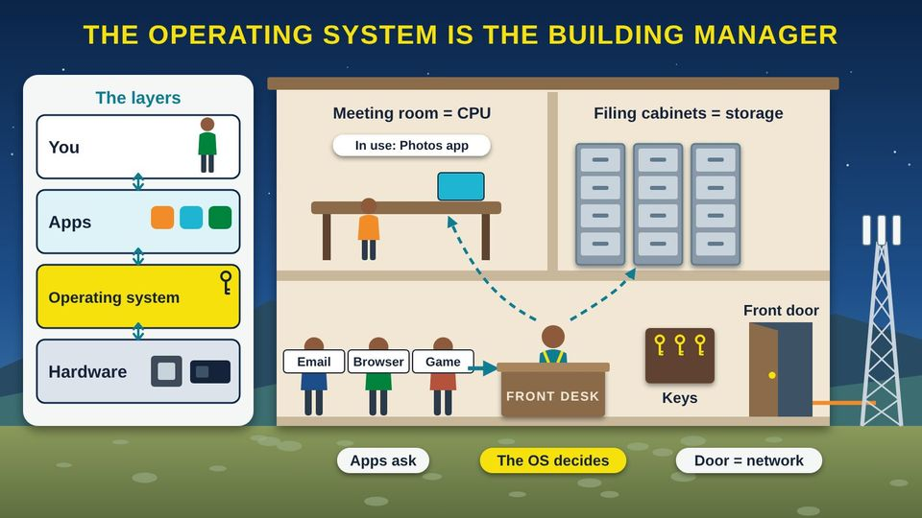
COMMUNITY TECH RESOURCES · COMMUNITY CLASS 6 OF 10
What Is an Operating System?
Windows, UNIX, Linux, macOS, ChromeOS, Android, and iOS, and why updates matter
Everyone
30 min
5 pictures
Free class from the Numu Communications Learning Center · www.numu.tech/resources
Notes:
TEACHING THIS CLASS (45 minutes)
Lesson plan:
- 5 min: Open with the building manager story. Ask: who keeps our administration building running, and what would happen without them?
- 10 min: Part 1: act it out. One volunteer is the manager with the keys. Three volunteers are apps holding signs (Email, Browser, Game) who must ask the manager before using the meeting room, the files, or the front door.
- 10 min: Part 2: walk through the family tree and the side-by-side picture. Ask people which systems they have seen at home, school, work, or the clinic.
- 5 min: Part 3: the phone picture. Have everyone hold up their phone: who has Android and who has an iPhone?
- 10 min: Part 4 and Try it at home: everyone finds their system and version and turns on automatic updates. Pair people up so they can help each other.
- 5 min: Quiz together with a show of hands, then the three Remember cards.
What you need:
- Projector or large TV for the slides
- Printed handouts, one per person
- Props for the building manager game: a ring of keys, a few folders, and paper signs that say Meeting room, Filing cabinet, and Front door
- Participants' own phones, tablets, or laptops, charged
- Optional: one Windows laptop, one Chromebook, and one Mac or iPad to pass around
Talk about it:
- Which operating systems do you use in a normal week, at home, at work, at school, or at the clinic?
- Has an update ever surprised you or got in your way? How could you plan for updates instead?
- Who in our community might still be using an old computer that no longer gets updates, and how could we help them?
The picture slides have every numbered detail in their speaker notes.
STORY: Think about the tribal administration building on a busy Monday. Programs need the meeting room, staff need records from the filing cabinets, and visitors come and go through the front door. One person keeps it all running: the building manager. The manager books the meeting room so groups take turns, knows which drawer holds each record, and keeps the keys. Nobody walks into a locked office without the manager saying yes. Your computer and phone have a manager like this too. It is called the operating system, and this class shows you what it does, where it came from, and how to keep it up to date.

Slide 2
What you will learn
✓
Explain what an operating system (OS) does for your apps, your files, and your safety
✓
Tell how Windows, UNIX, and Linux differ, and how macOS, ChromeOS, Android, iOS, and iPadOS fit in the family tree
✓
Find which operating system and version your phone and computer run
✓
Turn on automatic updates and know what it means when support for a system ends

Slide 3

The story
Think about the tribal administration building on a busy Monday. Programs need the meeting room, staff need records from the filing cabinets, and visitors come and go through the front door. One person keeps it all running: the building manager. The manager books the meeting room so groups take turns, knows which drawer holds each record, and keeps the keys. Nobody walks into a locked office without the manager saying yes. Your computer and phone have a manager like this too. It is called the operating system, and this class shows you what it does, where it came from, and how to keep it up to date.
Notes:
Think about the tribal administration building on a busy Monday. Programs need the meeting room, staff need records from the filing cabinets, and visitors come and go through the front door. One person keeps it all running: the building manager. The manager books the meeting room so groups take turns, knows which drawer holds each record, and keeps the keys. Nobody walks into a locked office without the manager saying yes. Your computer and phone have a manager like this too. It is called the operating system, and this class shows you what it does, where it came from, and how to keep it up to date.

Slide 4
PART 1
What an Operating System Does
The operating system is the building manager between you, your apps, and the hardware.
1 picture to explore

Slide 5
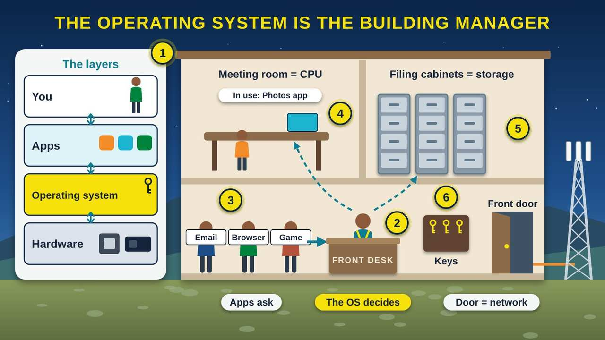
The Operating System Is the Building Manager
Part 1 · Picture 1 of 5
Notes:
The Operating System Is the Building Manager
What the picture shows: On the left, four layers stacked from top to bottom: you, apps, the operating system, and hardware. On the right, a cut-away tribal office building: apps wait at the front desk, where a manager sends work up to the meeting room (the CPU) and the filing cabinets (storage), and keeps the keys beside the front door that leads to the network.
1. Layers: you, apps, the OS, hardware. Think of your device in layers. You use apps. Apps ask the operating system (OS) for what they need. The OS works the hardware, the parts inside the box. The OS sits in the middle, so apps do not have to know every part.
2. The manager. The National Institute of Standards and Technology (NIST) calls an OS the software that manages the hardware and gives programs common services. It is the first program to load when you turn the device on, and it runs everything after that, like a building manager.
3. Apps ask first. An app, also called a program, cannot grab the processor, files, or internet on its own. It asks the operating system, like a visitor checking in at the front desk. The OS takes turns so every app gets what it needs.
4. Meeting room: the processor. The CPU (Central Processing Unit) is the meeting room where work gets done. The OS books it in tiny time slots, switching between apps so fast that they all seem to run at once.
5. Filing cabinets: storage and files. The OS keeps track of every file and folder in storage, like a building manager who knows which drawer holds each record. When you save a photo, the OS picks where it goes and remembers it.
6. Keys and the front door. The OS keeps the keys. It checks your password or fingerprint, gives each person in the house their own account, and decides which apps may go out the front door to the internet, the network.

Slide 6
The manager's five jobs
Runs the hardware
Turns on the parts inside and gives each app a turn on the CPU (Central Processing Unit) and memory.
Runs your apps
Starts, stops, and switches between the apps you open.
Keeps your files
Knows where every photo, document, and folder is stored.
Guards the door
Checks passwords, keeps each person's account separate, and controls who reaches the network.

Slide 7
The manager's five jobs (continued)
Gets updates
Brings in fixes from the maker to close security holes and repair problems.

Slide 8
PART 2
Windows, UNIX, and Linux
Where each one came from, who makes it, where you meet it, and how they differ.
2 pictures to explore

Slide 9
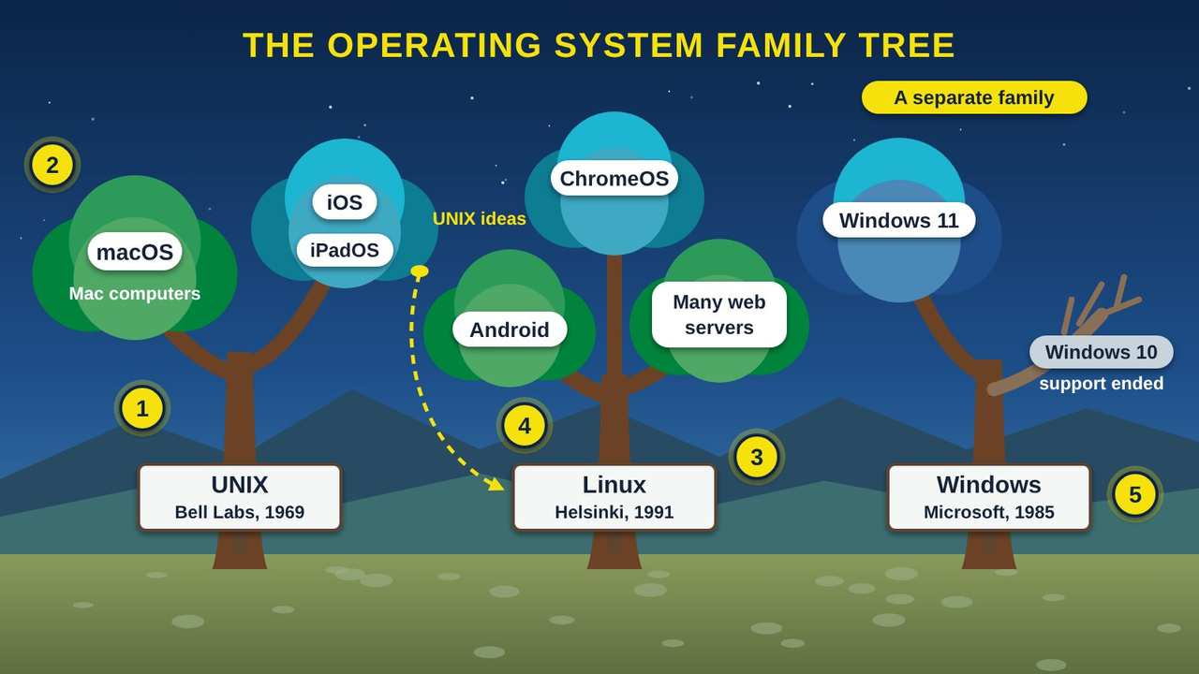
The Operating System Family Tree
Part 2 · Picture 2 of 5
Notes:
The Operating System Family Tree
What the picture shows: Three trees stand in a sagebrush valley. The UNIX tree from Bell Labs, 1969, has branches for macOS, iOS, and iPadOS. A seed of UNIX ideas grows a second tree, Linux from 1991, with branches for Android, many web servers, and ChromeOS. A separate Windows tree from 1985 has a green Windows 11 branch and a bare Windows 10 branch whose support has ended.
1. UNIX: the old root. UNIX was written in 1969 at AT&T Bell Labs by Kenneth Thompson and Dennis Ritchie, on a spare minicomputer. Many of today's systems grew from it or borrowed its ideas.
2. Apple's branch. Apple's macOS, the system on Mac computers, is certified as UNIX by The Open Group. Apple also makes iOS for the iPhone. In 2019 Apple announced iPadOS for the iPad, built on the same foundation as iOS.
3. Linux: a new tree from UNIX ideas. In 1991, a student in Finland named Linus Torvalds began writing a free operating system, Linux. The Linux part is the kernel, the core that talks to the hardware. A distribution wraps the kernel with apps and tools into a complete Linux system.
4. Linux branches out. Android phones run on a kernel based on Linux. Many web servers that send you websites run Linux too. Google also makes ChromeOS for Chromebooks, and in 2026 announced Googlebook OS, which brings together ChromeOS and Android technology.
5. Windows: its own family. Microsoft announced Windows in 1983, and Windows 1.0 came out in 1985. It is a separate family, not built from UNIX. Windows 11 came out in 2021. Windows 10 support ended on October 14, 2025, so that branch no longer grows.

Slide 10
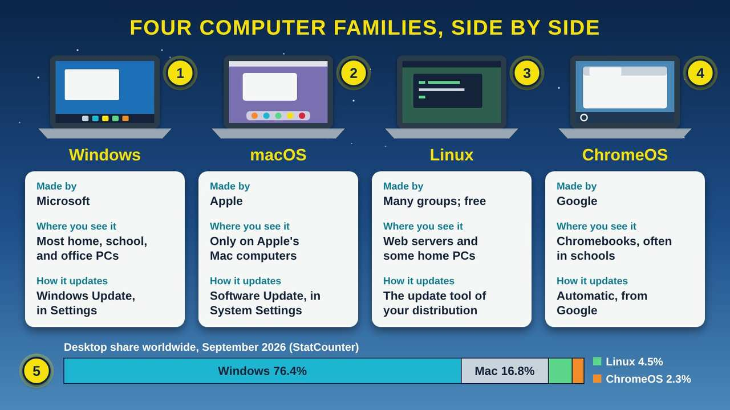
Four Computer Families, Side by Side
Part 2 · Picture 3 of 5
Notes:
Four Computer Families, Side by Side
What the picture shows: Four laptops with different screens, labeled Windows, macOS, Linux, and ChromeOS. Under each, a card says who makes it, where you see it, and how it updates. A bar at the bottom shows worldwide desktop share for September 2026: Windows 76.4%, Mac 16.8%, Linux 4.5%, ChromeOS 2.3%.
1. Windows. Microsoft makes Windows. You find it on most home, school, and office PCs (personal computers), made by many different brands. The cost of Windows is usually part of the price of the computer. Updates come through Windows Update in Settings.
2. macOS. Apple makes macOS, and it comes on Apple's Mac computers. Apple makes both the computer and the operating system. Updates come through Software Update in System Settings.
3. Linux. Linux is free to download and use. Many groups, from volunteers to companies, put together their own distributions, which are complete Linux systems. It runs many web servers and some home and office computers.
4. ChromeOS. Google makes ChromeOS for Chromebooks, laptops made by many brands and common in schools. Most of the work happens in the web browser. Google says today's Chromebooks will keep getting updates through mid-2034.
5. Who uses what. StatCounter's worldwide numbers for September 2026 give Windows about 76% of desktop and laptop use. Apple Mac computers have about 17% (StatCounter lists them under two names, OS X and macOS), Linux about 4.5%, and ChromeOS about 2.3%.

Slide 11
Windows, UNIX, and Linux at a glance
 | Windows | UNIX (and macOS) | Linux
Started | Announced 1983, first released 1985 | 1969, at AT&T Bell Labs | 1991, by Linus Torvalds in Finland
Who makes it | Microsoft | UNIX began at Bell Labs; today Apple's macOS is a certified UNIX | Volunteers and companies; many groups make their own distributions
Cost in general | Usually part of the price of a new PC (personal computer) | macOS comes with Apple's Mac computers | Free to download and use
Where you meet it | Most home, school, and office PCs | Mac computers | Many web servers, Android phones (its kernel), and some PCs

Slide 12
PART 3
Phones and Tablets
Android and iOS run almost every phone, and both grew from the same families.
1 picture to explore

Slide 13
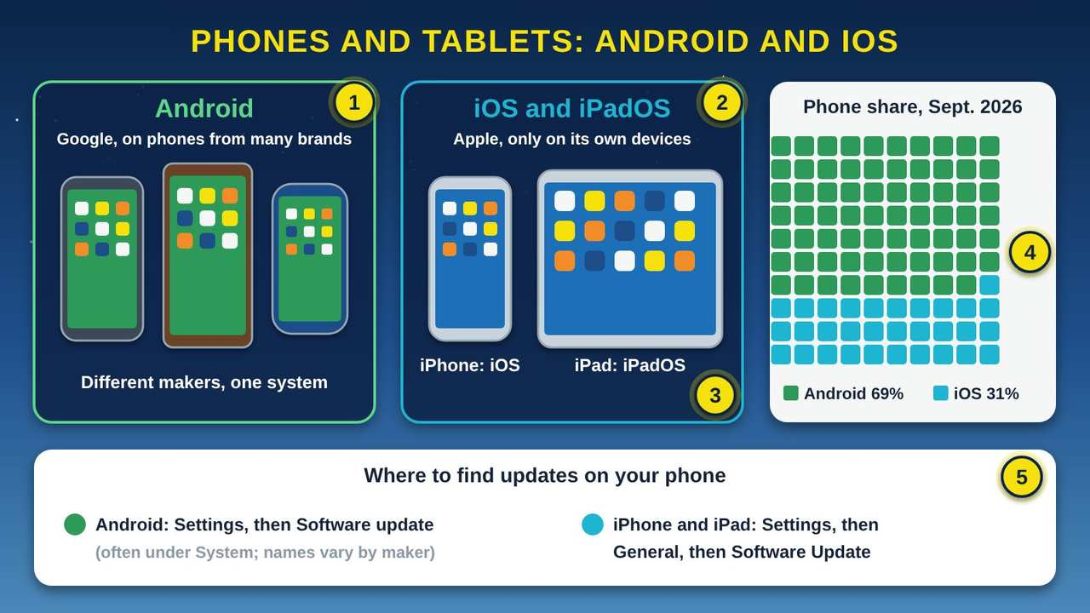
Phones and Tablets: Android and iOS
Part 3 · Picture 4 of 5
Notes:
Phones and Tablets: Android and iOS
What the picture shows: On the left, three Android phones from different makers. In the middle, an iPhone running iOS and an iPad running iPadOS. On the right, a grid of 100 squares shows worldwide phone share from StatCounter for September 2026: 69 green squares for Android and 31 blue for iOS. A card at the bottom shows where to find software updates on each kind of phone.
1. Android. Google makes Android, and many brands sell phones and tablets that run it. Android is built on a kernel based on Linux. Because each brand adds its own touches, menus can look a little different from phone to phone.
2. iOS on iPhone. Apple makes iOS, and it runs only on Apple's iPhone. Apple makes both the phone and the operating system, so updates come straight from Apple.
3. iPadOS on iPad. In 2019 Apple announced iPadOS for the iPad. Apple says it is built on the same foundation as iOS, with extra features for the bigger screen. If you know an iPhone, an iPad will feel familiar.
4. About 7 in 10 phones are Android. StatCounter's worldwide numbers for September 2026 show Android at 69.17% of mobile use and iOS at 30.81%. In the picture, each small square stands for 1%: about 69 squares for Android and 31 for iOS.
5. Find your updates. On an Android phone, open Settings and look for Software update, often under System. On an iPhone or iPad, open Settings, then General, then Software Update. Turn on automatic updates while you are there.

Slide 14
PART 4
Updates and End of Support
Why updates matter, and what to do when a system stops getting them.
1 picture to explore

Slide 15
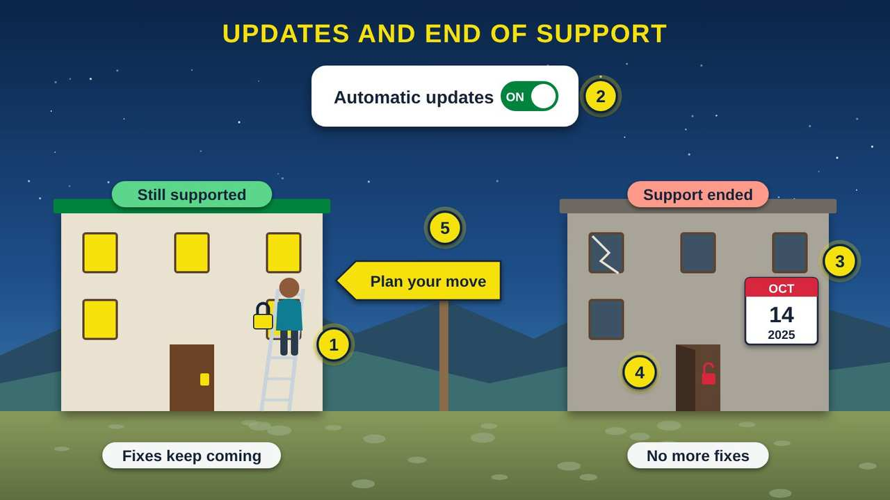
Updates and End of Support
Part 4 · Picture 5 of 5
Notes:
Updates and End of Support
What the picture shows: Two office buildings in a valley. On the left, a supported building with lit windows, where the manager on a ladder adds a new lock, under a card showing automatic updates turned on. On the right, a dim building with a cracked window and an open red lock, with a calendar showing October 14, 2025, when Windows 10 support ended. A yellow sign between them says Plan your move.
1. What an update does. An update is the maker sending a fix. Most updates close security holes that thieves could use, fix problems, or add new features. It is like the building manager putting a stronger lock on a window.
2. Turn on automatic updates. The Cybersecurity and Infrastructure Security Agency (CISA) says to turn on automatic updates. Then fixes arrive on their own, often overnight. Keep the device plugged in and restart it when it asks.
3. End of support. Every operating system version has an end date. Microsoft ended support for Windows 10 on October 14, 2025. After that date, the maker stops sending fixes, even though the computer still turns on.
4. Why it matters. Without updates, new security holes stay open, like a broken window nobody comes to fix. The longer a system goes without fixes, the more open holes it has.
5. Plan your move. Check what version you run and when its support ends. The newest Windows is Windows 11, version 26H2, released on September 29, 2026. Google says today's Chromebooks get updates through mid-2034. Plan an upgrade or a new device before your date arrives.

Slide 16
Still on Windows 10?
Microsoft ended support for Windows 10 on October 14, 2025. The computer still turns on, but Microsoft no longer sends it fixes. Check Settings, then System, then About. If it says Windows 10, ask a trusted helper about moving to Windows 11 or to a newer device, and move your important files and passwords first.

Slide 17
Try it at home
Fifteen minutes with your own phone and computer. Menu names differ a little from device to device.
1
Find your phone's system. iPhone: Settings, then General, then About, and look for iOS Version. Android: Settings, then About phone, and look for Android version (sometimes under Software information).

Slide 18
Try it at home (continued)
2
Find your computer's system. Windows: Settings, then System, then About, and look under Windows specifications for Edition and Version. Mac: the Apple menu, then About This Mac. Chromebook: Settings, then About ChromeOS.
3
Write down each name and version number. If your computer says Windows 10, its support ended on October 14, 2025, so make a plan to move.

Slide 19
Try it at home (continued)
4
Turn on automatic updates. iPhone or iPad: Settings, then General, then Software Update, then Automatic Updates. Android: Settings, then Software update (often under System). Windows: Settings, then Windows Update. Mac: System Settings, then General, then Software Update.
5
Install any update that is waiting. Plug the device in first, and let it restart when it asks.

Slide 20
Try it at home (continued)
6
Open your app store and update your apps too. They get security fixes just like the operating system.

Slide 21



Remember
The OS is the manager between apps and hardware
UNIX, Linux, and Windows are different families
Turn on automatic updates; know your end date
Notes:
The OS is the manager between apps and hardware
UNIX, Linux, and Windows are different families
Turn on automatic updates; know your end date

Slide 22


Check what you learned: question 1 of 5
Your granddaughter has a game, a web browser, and a photo app open on the family laptop. What decides which app gets to use the processor next?
A
B
C
The operating system
The Wi-Fi router
The web browser
Notes:
Your granddaughter has a game, a web browser, and a photo app open on the family laptop. What decides which app gets to use the processor next?
Answer: A. The operating system
The operating system (OS) is the manager. It gives each app a turn on the CPU (Central Processing Unit), so they all seem to run at once. The router and browser do not run other apps.

Slide 23
Answer: question 1 of 5
Your granddaughter has a game, a web browser, and a photo app open on the family laptop. What decides which app gets to use the processor next?
A
The operating system
✓ Correct
B
The Wi-Fi router
C
The web browser
Why: The operating system (OS) is the manager. It gives each app a turn on the CPU (Central Processing Unit), so they all seem to run at once. The router and browser do not run other apps.
Notes:
Your granddaughter has a game, a web browser, and a photo app open on the family laptop. What decides which app gets to use the processor next?
Answer: A. The operating system
The operating system (OS) is the manager. It gives each app a turn on the CPU (Central Processing Unit), so they all seem to run at once. The router and browser do not run other apps.

Slide 24



Check what you learned: question 2 of 5
Your aunt's laptop runs Windows 10. It still turns on and works fine. What is the real risk?
A
B
C
It no longer gets security fixes, so new holes stay open
It will stop turning on soon
Her files will be deleted
Notes:
Your aunt's laptop runs Windows 10. It still turns on and works fine. What is the real risk?
Answer: A. It no longer gets security fixes, so new holes stay open
Microsoft ended Windows 10 support on October 14, 2025. The laptop keeps working, but no more fixes arrive, so new security holes are never closed.

Slide 25
Answer: question 2 of 5
Your aunt's laptop runs Windows 10. It still turns on and works fine. What is the real risk?
It no longer gets security fixes, so new holes stay open
A
✓ Correct
It will stop turning on soon
B
C
Her files will be deleted
Why: Microsoft ended Windows 10 support on October 14, 2025. The laptop keeps working, but no more fixes arrive, so new security holes are never closed.
Notes:
Your aunt's laptop runs Windows 10. It still turns on and works fine. What is the real risk?
Answer: A. It no longer gets security fixes, so new holes stay open
Microsoft ended Windows 10 support on October 14, 2025. The laptop keeps working, but no more fixes arrive, so new security holes are never closed.

Slide 26


Check what you learned: question 3 of 5
The youth center is buying phones from three different brands, none of them Apple. Which operating system will those phones most likely run?
A
B
C
Android
iOS
macOS
Notes:
The youth center is buying phones from three different brands, none of them Apple. Which operating system will those phones most likely run?
Answer: A. Android
Many brands make Android phones. iOS runs only on Apple's iPhone, and macOS only on Apple's Mac computers.

Slide 27
Answer: question 3 of 5
The youth center is buying phones from three different brands, none of them Apple. Which operating system will those phones most likely run?
A
Android
✓ Correct
B
iOS
macOS
C
Why: Many brands make Android phones. iOS runs only on Apple's iPhone, and macOS only on Apple's Mac computers.
Notes:
The youth center is buying phones from three different brands, none of them Apple. Which operating system will those phones most likely run?
Answer: A. Android
Many brands make Android phones. iOS runs only on Apple's iPhone, and macOS only on Apple's Mac computers.

Slide 28

Check what you learned: question 4 of 5
You are typing a letter when your computer says an update is ready. What is the best choice?
A
B
C
Save your work, then let it update now or tonight
Turn updates off so it stops asking
Keep clicking Later for a few months
Notes:
You are typing a letter when your computer says an update is ready. What is the best choice?
Answer: A. Save your work, then let it update now or tonight
Updates close security holes. The Cybersecurity and Infrastructure Security Agency (CISA) says to turn on automatic updates. Saving first keeps your letter safe while the computer restarts.

Slide 29
Answer: question 4 of 5
You are typing a letter when your computer says an update is ready. What is the best choice?
A
Save your work, then let it update now or tonight
✓ Correct
B
Turn updates off so it stops asking
C
Keep clicking Later for a few months
Why: Updates close security holes. The Cybersecurity and Infrastructure Security Agency (CISA) says to turn on automatic updates. Saving first keeps your letter safe while the computer restarts.
Notes:
You are typing a letter when your computer says an update is ready. What is the best choice?
Answer: A. Save your work, then let it update now or tonight
Updates close security holes. The Cybersecurity and Infrastructure Security Agency (CISA) says to turn on automatic updates. Saving first keeps your letter safe while the computer restarts.

Slide 30
Check what you learned: question 5 of 5
Your cousin wants a free operating system she can download for a computer she built herself. Which one fits?
A
B
C
Linux
macOS
iOS
Notes:
Your cousin wants a free operating system she can download for a computer she built herself. Which one fits?
Answer: A. Linux
Linux is free to download and use, and many groups package it as a complete system called a distribution. macOS comes on Apple's Mac computers, and iOS runs on the iPhone.

Slide 31
Answer: question 5 of 5
Your cousin wants a free operating system she can download for a computer she built herself. Which one fits?
A
Linux
✓ Correct
B
macOS
iOS
C
Why: Linux is free to download and use, and many groups package it as a complete system called a distribution. macOS comes on Apple's Mac computers, and iOS runs on the iPhone.
Notes:
Your cousin wants a free operating system she can download for a computer she built herself. Which one fits?
Answer: A. Linux
Linux is free to download and use, and many groups package it as a complete system called a distribution. macOS comes on Apple's Mac computers, and iOS runs on the iPhone.

Slide 32
Words to know
Operating system (OS)
Operating system. The main software that manages a device's hardware, runs apps, keeps files, and guards security. It is the first program to load when you turn the device on.
App
Short for application. A program that does one job for you, like email, photos, or a web browser. Apps ask the operating system for what they need.
Hardware
The physical parts of a device you could touch, like the processor, memory, storage, screen, and radios.
Kernel
The core of an operating system. It talks directly to the hardware and decides which app gets the processor and memory.

Slide 33
Words to know (continued)
UNIX
An operating system written in 1969 at AT&T Bell Labs. Many later systems grew from it or borrowed its ideas, and Apple's macOS is a certified UNIX.
Linux
A free operating system kernel started by Linus Torvalds in 1991. It runs many web servers, and Android's kernel is based on it.
Distribution
A complete Linux system: the Linux kernel plus the apps, tools, and settings that make it ready to use.
Windows
Microsoft's operating system for personal computers, first released in 1985. The current version is Windows 11.

Slide 34
Words to know (continued)
macOS
Apple's operating system for Mac computers. It is certified as UNIX.
ChromeOS
Google's operating system for Chromebook laptops, where most work happens in the web browser.
Android
Google's operating system for phones and tablets, sold by many brands. Its kernel is based on Linux.
iOS
Apple's operating system for the iPhone.

Slide 35
Words to know (continued)
iPadOS
Apple's operating system for the iPad, announced in 2019 and built on the same foundation as iOS.
Software update
A fix or improvement sent by the maker. Most updates close security holes, repair problems, or add features.
End of support
The date a maker stops sending updates for a version of its software. The device still works, but no new fixes arrive.
CISA
Cybersecurity and Infrastructure Security Agency. The United States government agency that helps people and organizations stay safe online.

Slide 36
Learn more
CISA: Update software
Why updates matter and how to turn on automatic updates.
https://www.cisa.gov/secure-our-world/update-software
Microsoft: Windows 10 support has ended
What the end of Windows 10 support means and what you can do.
https://support.microsoft.com/en-us/windows/deployment/updates-lifecycle/windows-10-support-has-ended-on-october-14-2025
Microsoft: Windows 11 release information
Every Windows 11 version and its release date.
https://learn.microsoft.com/en-us/windows/release-health/windows11-release-information

Slide 37
Learn more (continued)
Google: Googlebook OS and ChromeOS updates
How long today's Chromebooks will keep getting updates.
https://support.google.com/chrome/a/answer/16634428?hl=en
Computer History Museum: The earliest UNIX code
The story of how UNIX began at Bell Labs in 1969.
https://computerhistory.org/blog/the-earliest-unix-code-an-anniversary-source-code-release/
Linux Foundation: It's not just the Linux operating system
How Linux started in 1991 and where it is used today.
https://www.linuxfoundation.org/blog/blog/the-linux-foundation-its-not-just-the-linux-operating-system

Slide 38
Teaching this class: lesson plan (45 minutes)
5 min
Open with the building manager story. Ask: who keeps our administration building running, and what would happen without them?
10 min
Part 1: act it out. One volunteer is the manager with the keys. Three volunteers are apps holding signs (Email, Browser, Game) who must ask the manager before using the meeting room, the files, or the front door.
10 min
Part 2: walk through the family tree and the side-by-side picture. Ask people which systems they have seen at home, school, work, or the clinic.
Notes:
TEACHING THIS CLASS (45 minutes)
Lesson plan:
- 5 min: Open with the building manager story. Ask: who keeps our administration building running, and what would happen without them?
- 10 min: Part 1: act it out. One volunteer is the manager with the keys. Three volunteers are apps holding signs (Email, Browser, Game) who must ask the manager before using the meeting room, the files, or the front door.
- 10 min: Part 2: walk through the family tree and the side-by-side picture. Ask people which systems they have seen at home, school, work, or the clinic.
- 5 min: Part 3: the phone picture. Have everyone hold up their phone: who has Android and who has an iPhone?
- 10 min: Part 4 and Try it at home: everyone finds their system and version and turns on automatic updates. Pair people up so they can help each other.
- 5 min: Quiz together with a show of hands, then the three Remember cards.
What you need:
- Projector or large TV for the slides
- Printed handouts, one per person
- Props for the building manager game: a ring of keys, a few folders, and paper signs that say Meeting room, Filing cabinet, and Front door
- Participants' own phones, tablets, or laptops, charged
- Optional: one Windows laptop, one Chromebook, and one Mac or iPad to pass around
Talk about it:
- Which operating systems do you use in a normal week, at home, at work, at school, or at the clinic?
- Has an update ever surprised you or got in your way? How could you plan for updates instead?
- Who in our community might still be using an old computer that no longer gets updates, and how could we help them?
The picture slides have every numbered detail in their speaker notes.
STORY: Think about the tribal administration building on a busy Monday. Programs need the meeting room, staff need records from the filing cabinets, and visitors come and go through the front door. One person keeps it all running: the building manager. The manager books the meeting room so groups take turns, knows which drawer holds each record, and keeps the keys. Nobody walks into a locked office without the manager saying yes. Your computer and phone have a manager like this too. It is called the operating system, and this class shows you what it does, where it came from, and how to keep it up to date.

Slide 39
Teaching this class: lesson plan (45 minutes) (continued)
5 min
Part 3: the phone picture. Have everyone hold up their phone: who has Android and who has an iPhone?
10 min
Part 4 and Try it at home: everyone finds their system and version and turns on automatic updates. Pair people up so they can help each other.
5 min
Quiz together with a show of hands, then the three Remember cards.
Notes:
TEACHING THIS CLASS (45 minutes)
Lesson plan:
- 5 min: Open with the building manager story. Ask: who keeps our administration building running, and what would happen without them?
- 10 min: Part 1: act it out. One volunteer is the manager with the keys. Three volunteers are apps holding signs (Email, Browser, Game) who must ask the manager before using the meeting room, the files, or the front door.
- 10 min: Part 2: walk through the family tree and the side-by-side picture. Ask people which systems they have seen at home, school, work, or the clinic.
- 5 min: Part 3: the phone picture. Have everyone hold up their phone: who has Android and who has an iPhone?
- 10 min: Part 4 and Try it at home: everyone finds their system and version and turns on automatic updates. Pair people up so they can help each other.
- 5 min: Quiz together with a show of hands, then the three Remember cards.
What you need:
- Projector or large TV for the slides
- Printed handouts, one per person
- Props for the building manager game: a ring of keys, a few folders, and paper signs that say Meeting room, Filing cabinet, and Front door
- Participants' own phones, tablets, or laptops, charged
- Optional: one Windows laptop, one Chromebook, and one Mac or iPad to pass around
Talk about it:
- Which operating systems do you use in a normal week, at home, at work, at school, or at the clinic?
- Has an update ever surprised you or got in your way? How could you plan for updates instead?
- Who in our community might still be using an old computer that no longer gets updates, and how could we help them?
The picture slides have every numbered detail in their speaker notes.
STORY: Think about the tribal administration building on a busy Monday. Programs need the meeting room, staff need records from the filing cabinets, and visitors come and go through the front door. One person keeps it all running: the building manager. The manager books the meeting room so groups take turns, knows which drawer holds each record, and keeps the keys. Nobody walks into a locked office without the manager saying yes. Your computer and phone have a manager like this too. It is called the operating system, and this class shows you what it does, where it came from, and how to keep it up to date.

Slide 40
Teaching this class: materials and discussion
What you need
Projector or large TV for the slides
Printed handouts, one per person
Props for the building manager game: a ring of keys, a few folders, and paper signs that say Meeting room, Filing cabinet, and Front door
Participants' own phones, tablets, or laptops, charged
Optional: one Windows laptop, one Chromebook, and one Mac or iPad to pass around
Notes:
TEACHING THIS CLASS (45 minutes)
Lesson plan:
- 5 min: Open with the building manager story. Ask: who keeps our administration building running, and what would happen without them?
- 10 min: Part 1: act it out. One volunteer is the manager with the keys. Three volunteers are apps holding signs (Email, Browser, Game) who must ask the manager before using the meeting room, the files, or the front door.
- 10 min: Part 2: walk through the family tree and the side-by-side picture. Ask people which systems they have seen at home, school, work, or the clinic.
- 5 min: Part 3: the phone picture. Have everyone hold up their phone: who has Android and who has an iPhone?
- 10 min: Part 4 and Try it at home: everyone finds their system and version and turns on automatic updates. Pair people up so they can help each other.
- 5 min: Quiz together with a show of hands, then the three Remember cards.
What you need:
- Projector or large TV for the slides
- Printed handouts, one per person
- Props for the building manager game: a ring of keys, a few folders, and paper signs that say Meeting room, Filing cabinet, and Front door
- Participants' own phones, tablets, or laptops, charged
- Optional: one Windows laptop, one Chromebook, and one Mac or iPad to pass around
Talk about it:
- Which operating systems do you use in a normal week, at home, at work, at school, or at the clinic?
- Has an update ever surprised you or got in your way? How could you plan for updates instead?
- Who in our community might still be using an old computer that no longer gets updates, and how could we help them?
The picture slides have every numbered detail in their speaker notes.
STORY: Think about the tribal administration building on a busy Monday. Programs need the meeting room, staff need records from the filing cabinets, and visitors come and go through the front door. One person keeps it all running: the building manager. The manager books the meeting room so groups take turns, knows which drawer holds each record, and keeps the keys. Nobody walks into a locked office without the manager saying yes. Your computer and phone have a manager like this too. It is called the operating system, and this class shows you what it does, where it came from, and how to keep it up to date.

Slide 41
Teaching this class: materials and discussion (continued)
Talk about it
Which operating systems do you use in a normal week, at home, at work, at school, or at the clinic?
Has an update ever surprised you or got in your way? How could you plan for updates instead?
Who in our community might still be using an old computer that no longer gets updates, and how could we help them?
Notes:
TEACHING THIS CLASS (45 minutes)
Lesson plan:
- 5 min: Open with the building manager story. Ask: who keeps our administration building running, and what would happen without them?
- 10 min: Part 1: act it out. One volunteer is the manager with the keys. Three volunteers are apps holding signs (Email, Browser, Game) who must ask the manager before using the meeting room, the files, or the front door.
- 10 min: Part 2: walk through the family tree and the side-by-side picture. Ask people which systems they have seen at home, school, work, or the clinic.
- 5 min: Part 3: the phone picture. Have everyone hold up their phone: who has Android and who has an iPhone?
- 10 min: Part 4 and Try it at home: everyone finds their system and version and turns on automatic updates. Pair people up so they can help each other.
- 5 min: Quiz together with a show of hands, then the three Remember cards.
What you need:
- Projector or large TV for the slides
- Printed handouts, one per person
- Props for the building manager game: a ring of keys, a few folders, and paper signs that say Meeting room, Filing cabinet, and Front door
- Participants' own phones, tablets, or laptops, charged
- Optional: one Windows laptop, one Chromebook, and one Mac or iPad to pass around
Talk about it:
- Which operating systems do you use in a normal week, at home, at work, at school, or at the clinic?
- Has an update ever surprised you or got in your way? How could you plan for updates instead?
- Who in our community might still be using an old computer that no longer gets updates, and how could we help them?
The picture slides have every numbered detail in their speaker notes.
STORY: Think about the tribal administration building on a busy Monday. Programs need the meeting room, staff need records from the filing cabinets, and visitors come and go through the front door. One person keeps it all running: the building manager. The manager books the meeting room so groups take turns, knows which drawer holds each record, and keeps the keys. Nobody walks into a locked office without the manager saying yes. Your computer and phone have a manager like this too. It is called the operating system, and this class shows you what it does, where it came from, and how to keep it up to date.

Slide 42
Free from the Numu Communications Learning Center, www.numu.tech/resources.
Free to use and adapt; please keep this credit.
Questions? info@numu.tech · +1-888-686-5830

Slide 43
References
Android Open Source Project. (n.d.). Kernel overview. https://source.android.com/docs/core/architecture/kernel
Apple. (2019, June 3). The new iPadOS powers unique experiences designed for iPad [Press release]. https://www.apple.com/newsroom/2019/06/the-new-ipados-powers-unique-experiences-designed-for-ipad/
Brock, D. C. (2019, October 17). The earliest Unix code: An anniversary source code release. Computer History Museum. https://computerhistory.org/blog/the-earliest-unix-code-an-anniversary-source-code-release/
Computer History Museum. (n.d.-a). 1969 timeline of computer history. https://www.computerhistory.org/timeline/1969/
Computer History Museum. (n.d.-b). What happened on November 10th. This Day in History. https://www.computerhistory.org/tdih/November/10/
Cybersecurity and Infrastructure Security Agency. (n.d.). Update software. https://www.cisa.gov/secure-our-world/update-software
Google. (2026). Googlebook OS and ChromeOS updates. Google Chrome Enterprise Help. https://support.google.com/chrome/a/answer/16634428?hl=en
Microsoft. (2025). Windows 10 support has ended on October 14, 2025. Microsoft Support. https://support.microsoft.com/en-us/windows/deployment/updates-lifecycle/windows-10-support-has-ended-on-october-14-2025
Microsoft. (2026). Windows 11 release information. Microsoft Learn. https://learn.microsoft.com/en-us/windows/release-health/windows11-release-information
National Institute of Standards and Technology. (n.d.). Operating system. CSRC Glossary. https://csrc.nist.gov/glossary/term/operating_system
Perlow, J. (2020, March 2). The Linux Foundation: It's not just the Linux operating system. Linux Foundation. https://www.linuxfoundation.org/blog/blog/the-linux-foundation-its-not-just-the-linux-operating-system
StatCounter. (2026a). Desktop operating system market share worldwide. https://gs.statcounter.com/os-market-share/desktop/worldwide
StatCounter. (2026b). Mobile operating system market share worldwide. https://gs.statcounter.com/os-market-share/mobile/worldwide
The Linux Kernel Organization. (n.d.). About Linux kernel. The Linux Kernel Archives. https://www.kernel.org/linux.html
The Open Group. (2025). Open Brand register: macOS version 26.0 Tahoe. https://www.opengroup.org/openbrand/register/brand3725.htm

