Slide 1


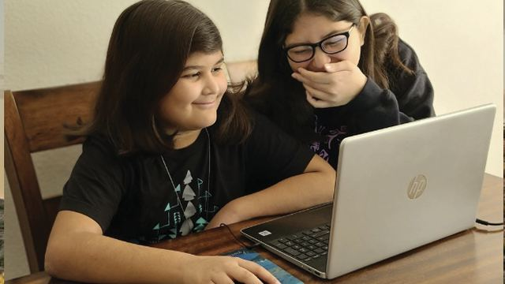
COMMUNITY TECH RESOURCES · COMMUNITY CLASS 8 OF 10
How Does a Website Work?
Domain names, hosting, browsers, and what happens when you press Enter
Everyone
35 min
6 pictures
Free class from the Numu Communications Learning Center · www.numu.tech/resources
Notes:
TEACHING THIS CLASS (45 minutes)
Lesson plan:
- 5 min: Start here: read the story. Ask: what website would you want for a program or business here?
- 10 min: Website: DNS and the request. Have two volunteers act out the browser and the server.
- 12 min: Domain: renting a name and hosting, then read a web address together. Hand out the planning steps.
- 10 min: Browser Page Example: open a real page and point out each part, then view its source.
- 8 min: Practice and quiz together and the three Remember cards.
What you need:
- Projector or large TV for the slides
- Printed handouts
- A computer with a browser for a live demonstration
- Optional: sticky notes for the address-reading activity
Talk about it:
- What information do people here have trouble finding online?
- Who should own a program's website name, and how do you keep it from being lost?
- How can you tell if a website is the real one before you type personal information?
The picture slides have every numbered detail in their speaker notes.
STORY: The Lakeview Community Center wants a website so families can see the events calendar from home. The director has three questions: What name should we use, and who do we pay for it? Where do the pages live? And what happens when someone types our address and presses Enter? In about a second, the visitor's browser reads the address, finds the right computer, asks for the page, and builds it on the screen. This class answers the director's questions one picture at a time.

Slide 2
What you will learn
✓
Explain what a domain name is, why it is rented every year, and what a web host does
✓
Read a web address and say what each part means
✓
Describe the four steps your browser takes when you press Enter
✓
Point out the parts of a web page and the three languages that build it

Slide 3

The story
The Lakeview Community Center wants a website so families can see the events calendar from home. The director has three questions: What name should we use, and who do we pay for it? Where do the pages live? And what happens when someone types our address and presses Enter? In about a second, the visitor's browser reads the address, finds the right computer, asks for the page, and builds it on the screen. This class answers the director's questions one picture at a time.
Notes:
The Lakeview Community Center wants a website so families can see the events calendar from home. The director has three questions: What name should we use, and who do we pay for it? Where do the pages live? And what happens when someone types our address and presses Enter? In about a second, the visitor's browser reads the address, finds the right computer, asks for the page, and builds it on the screen. This class answers the director's questions one picture at a time.

Slide 4
PART 1
Website
What happens in the second after you press Enter: your browser finds the right computer and asks it for the page.
2 pictures to explore

Slide 5
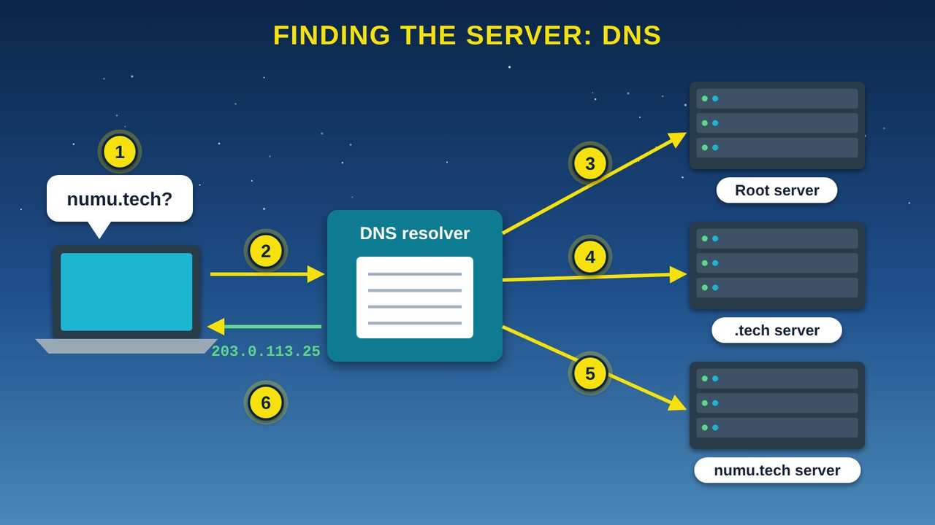
Finding the Server: DNS
Part 1 · Picture 1 of 6
Notes:
Finding the Server: DNS
What the picture shows: A laptop asks a DNS resolver for numu.tech. The resolver asks a root server, then a .tech server, then the numu.tech server, and returns the IP address 203.0.113.25 to the laptop.
1. You type a name. Computers find each other by number, but people remember names. When you type numu.tech, your device first has to find that site's number, its IP (Internet Protocol) address. The system that does this is called DNS, the Domain Name System.
2. Ask the resolver. Your device asks a DNS resolver, usually run by your internet service provider (ISP). Think of it as a librarian who knows where to look things up.
3. The root. If the librarian does not already know, it asks a root server. The root does not know the answer, but it knows who handles every name ending in .tech.
4. The .tech server. The .tech server points to the name server that holds the official records for numu.tech.
5. The final answer. The numu.tech name server answers with the IP address, such as 203.0.113.25.
6. Back to you, and remembered. The resolver hands the address to your browser, which can now contact the website. The answer is saved for a while, so the next visit skips most of these steps.

Slide 6
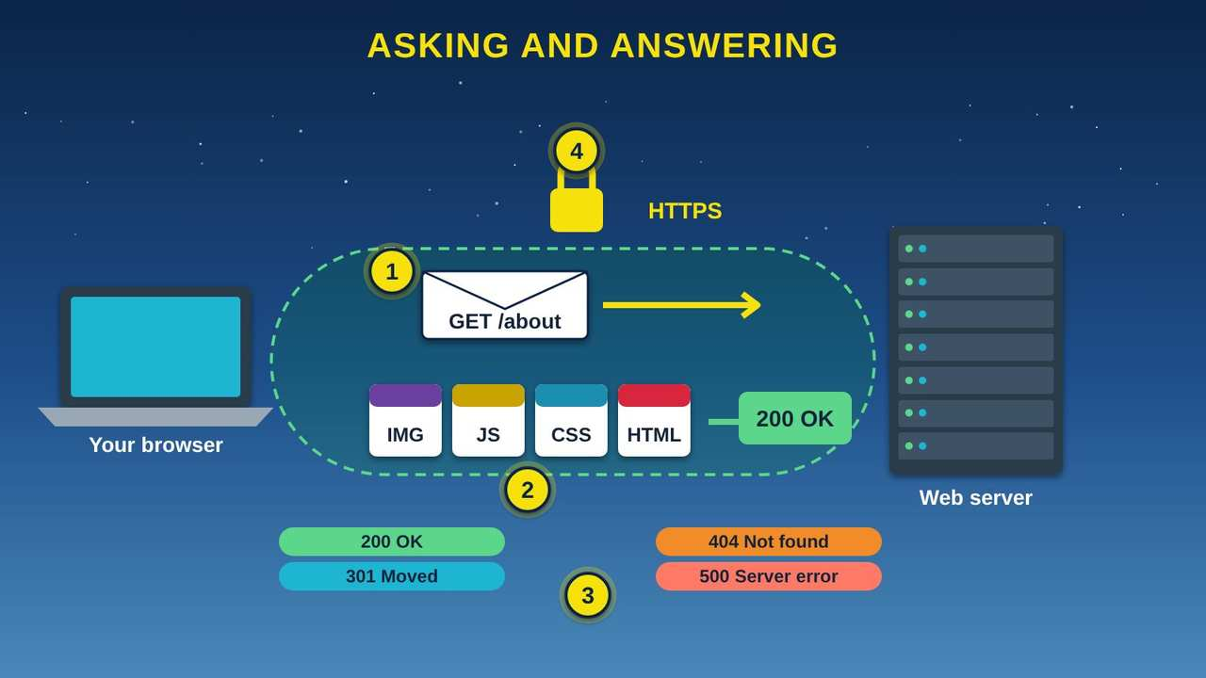
Asking and Answering: HTTP
Part 1 · Picture 2 of 6
Notes:
Asking and Answering: HTTP
What the picture shows: A browser sends a GET /about request through a locked HTTPS tunnel to a web server, which answers with HTML, CSS, JavaScript, and image files and the status 200 OK. Badges show 200, 301, 404, and 500 codes.
1. The request. Your browser sends the web server a short message, like "GET /about," which means "please send me the About page." This shared language is called HTTP (Hypertext Transfer Protocol), and GET is its word for "send me."
2. The answer. The server sends back the files that make up the page: HTML (HyperText Markup Language), CSS (Cascading Style Sheets), JavaScript (JS), and images (IMG). A big page can be dozens of files.
3. Status codes. Every answer starts with a three-digit code. 200 means OK. 301 means the page moved. 404 means not found. Codes in the 500s mean something went wrong on the server's side.
4. The padlock. HTTPS (the secure version of HTTP) seals the conversation like a locked envelope, so others on the network cannot read or change it. The padlock means the connection is private. It does not prove the website itself is honest, so still be careful where you type passwords.

Slide 7
PART 2
Domain
Every website needs a name people can remember and a computer that stores its files. Here is how to get both.
2 pictures to explore

Slide 8
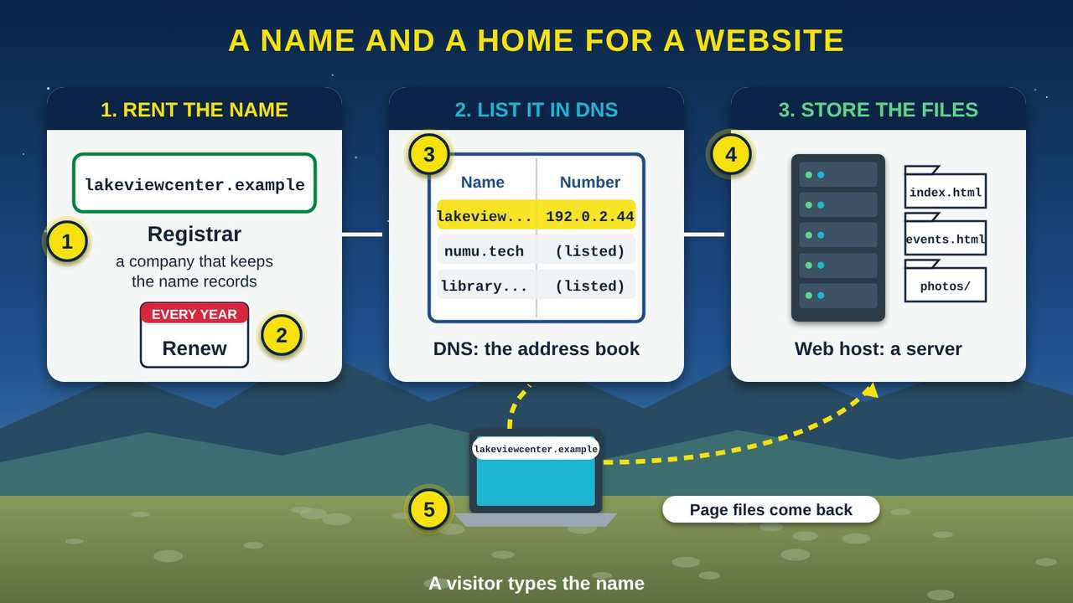
A Name and a Home for a Website
Part 2 · Picture 3 of 6
Notes:
A Name and a Home for a Website
What the picture shows: Three panels: renting a domain name from a registrar every year, a DNS address book matching the name to a number, and a web host server storing page files. A visitor's laptop asks DNS, then the server.
1. Pick a domain name. A domain name is the easy-to-remember name of a website. Our example, lakeviewcenter.example, uses the .example ending, which is set aside for teaching. Real names end in .com, .org, .tech, .gov, and many others. ICANN (Internet Corporation for Assigned Names and Numbers) keeps the list of these endings.
2. You rent it, every year. You cannot buy a domain name forever. You pay a registrar for the right to use it for one or more years, then renew. If nobody renews it, someone else can take it, so put the renewal date on the office calendar.
3. DNS points the name to a number. DNS (Domain Name System) is like an address book for websites. It matches each name to the number address, called an IP (Internet Protocol) address, of the computer that holds the site.
4. The web host stores the files. A web server is both a computer that stores a website's files and the software that sends them out. Hosting means putting your files on that server, often in a data center that runs day and night.
5. A visitor arrives. When someone types the name, their computer asks DNS for the number, then asks that server for the page. The pages come back in small pieces called packets.

Slide 9
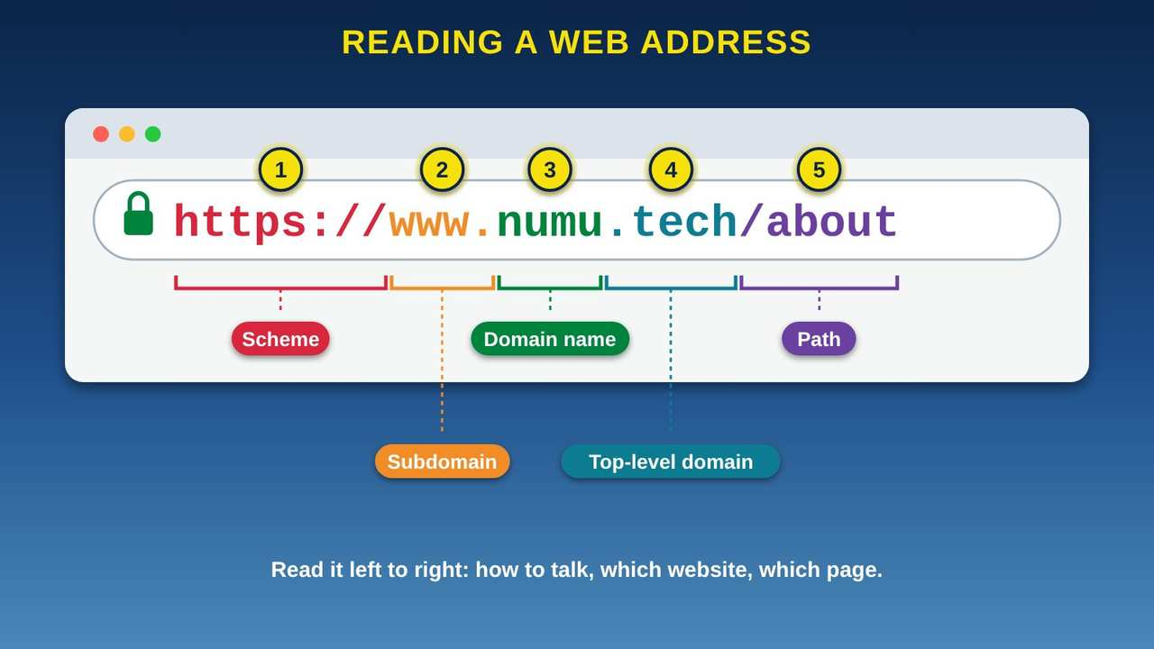
Reading a Web Address
Part 2 · Picture 4 of 6
Notes:
Reading a Web Address
What the picture shows: A browser address bar showing https://www.numu.tech/about with each part colored and labeled: scheme, subdomain, domain name, top-level domain, and path.
1. Scheme. https:// is the scheme. It tells the browser how to talk to the website. HTTPS stands for Hypertext Transfer Protocol Secure, and the "S" means secure: the conversation is scrambled so others on the network cannot read it.
2. Subdomain. www is a subdomain, a section of a website's name. Many sites work with or without it.
3. Domain name. numu is the name the website's owner registered. Domain names are easy for people to remember, unlike the number addresses computers use.
4. Top-level domain. .tech is the top-level domain, the last part of the name. Others include .com, .org, .gov, and .edu.
5. Path. /about points to a specific page on the website, like a room inside a building.

Slide 10
Planning a website for your program or business
1
Choose the name
Pick something short and easy to say on the radio. Check that it is free at a registrar, and register it in the organization's name, not a staff member's.

Slide 11
Planning a website for your program or business (continued)
2
Write down the renewal date
Domain names are rented for one or more years. Put the renewal date and the account login in a safe, shared place so the name is never lost when staff change.
3
Pick a web host
Many hosts offer simple website builders. Ask about the yearly cost, backups, and whether HTTPS is included.

Slide 12
Planning a website for your program or business (continued)
4
Plan the pages
Start with the basics people ask for: hours, location, phone, upcoming events, and how to get help.
5
Keep it current
Name one person to update the site each month. An out-of-date calendar sends people to events that already happened.

Slide 13
PART 3
Browser Page Example
A real page, piece by piece: the parts of your browser and the three kinds of text that build every page.
2 pictures to explore

Slide 14
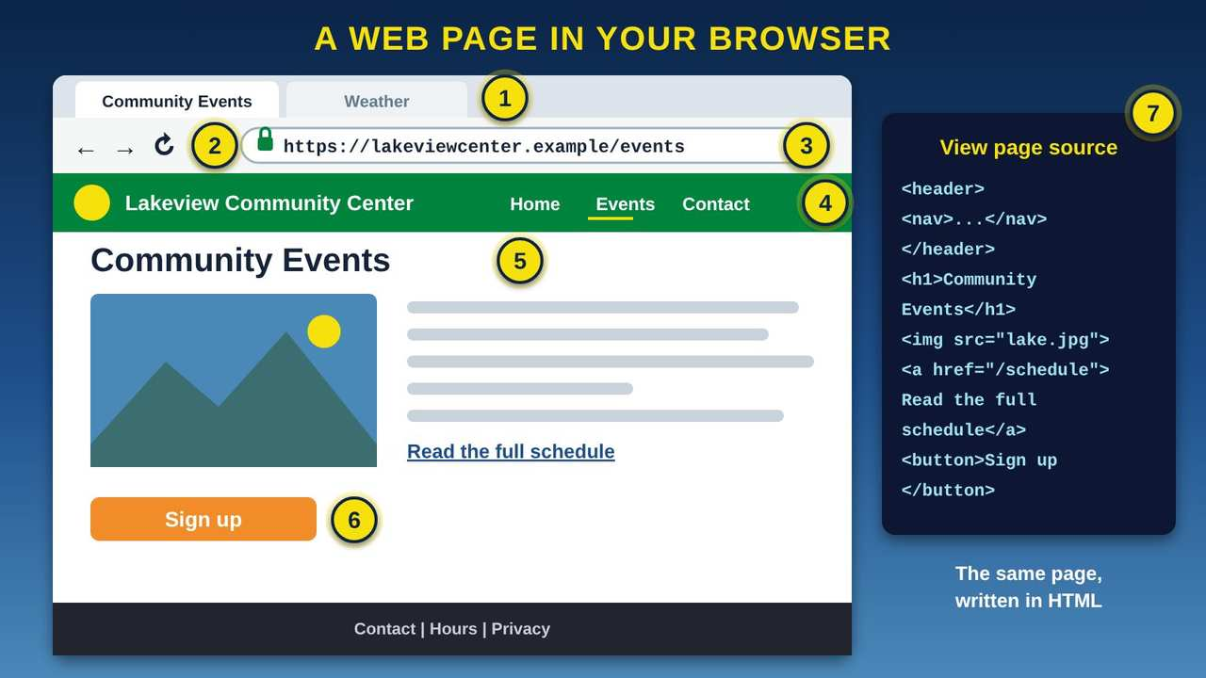
A Web Page in Your Browser
Part 3 · Picture 5 of 6
Notes:
A Web Page in Your Browser
What the picture shows: A browser window showing tabs, back and reload buttons, an address bar with a padlock and https address, and a community center page with a menu, heading, picture, link, button, and footer. A side panel shows the same page as HTML code.
1. Tabs. Each tab is its own page. You can keep several pages open and switch between them, like folders on a desk.
2. Back, forward, and reload. The arrows take you to the page you saw before or after. The circle arrow, reload, asks the server for the page again, which helps if it did not load right.
3. The address bar and padlock. The address bar shows the page's full address, called a URL (Uniform Resource Locator). The padlock and https mean the connection is encrypted with HTTPS (Hypertext Transfer Protocol Secure), so others cannot read it. It does not prove the site is honest.
4. The menu. The menu at the top is a list of links to the site's main pages. On a phone it often hides behind a button with three lines.
5. Headings, pictures, and text. Headings, pictures, and paragraphs are written in HTML (HyperText Markup Language). CSS (Cascading Style Sheets) sets the colors and layout you see.
6. Links and buttons. Underlined words are links to another page. Buttons do something when you click them, often with JavaScript, a programming language that makes pages respond.
7. View the source. Most computer browsers let you right-click a page and choose View page source to see its HTML. Every page on the web is built from text like this.

Slide 15
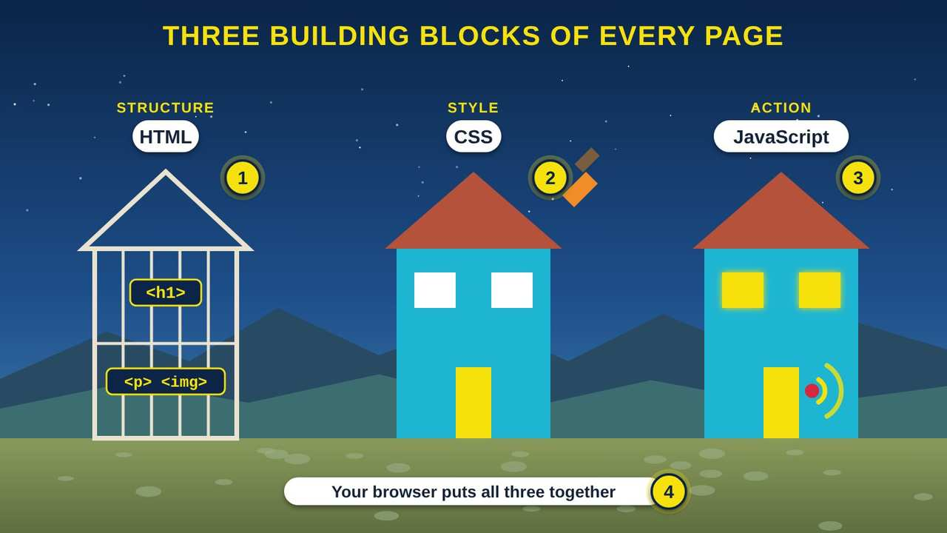
Three Building Blocks of Every Page
Part 3 · Picture 6 of 6
Notes:
Three Building Blocks of Every Page
What the picture shows: Three houses: a bare wooden frame labeled HTML structure, a painted house labeled CSS style, and a house with glowing lights and a ringing doorbell labeled JavaScript action.
1. HTML: the frame. HTML (HyperText Markup Language) is the structure of the page: the headings, paragraphs, pictures, and links. It is like the frame and walls of a house. Tags such as for a heading and for a paragraph mark each part.
2. CSS: the paint. CSS (Cascading Style Sheets) controls how the page looks: colors, fonts, spacing, and layout. It is like the paint, furniture, and decorations. The same HTML can look very different with different CSS.
3. JavaScript: the wiring. JavaScript, often shortened to JS, is a programming language that makes the page respond when you do something, like opening a menu, playing a video, or checking a form before you send it. It is like the electrical wiring that runs the lights and the doorbell.
4. Your browser builds it. Your browser reads all three and paints the finished page on your screen in a moment. On most computers you can right-click a page and choose "View page source" to see its HTML.

Slide 16
Try it at home
Use any browser on a phone or computer:
1
Open a website you trust and find the padlock next to the address. Tap or click it to see the connection details.
2
Copy the full web address and paste it into a note. Circle the scheme, the domain name, the top-level domain, and the path.

Slide 17
Try it at home (continued)
3
Type a page that does not exist on purpose, such as numu.tech/no-such-page, and look for the 404 message.
4
On a computer, right-click a page and choose View page source. Find one heading tag, such as .
5
Open two tabs and use the back and forward arrows to move between pages.

Slide 18



Remember
A web address says how, which site, and which page
DNS turns names into numbers
HTML builds it, CSS styles it, JavaScript makes it move
Notes:
A web address says how, which site, and which page
DNS turns names into numbers
HTML builds it, CSS styles it, JavaScript makes it move

Slide 19

Check what you learned: question 1 of 5
The community center's website disappeared, and the name now shows an ad page. What most likely happened?
A
B
Nobody renewed the domain name
The HTML (HyperText Markup Language) was spelled wrong
Notes:
The community center's website disappeared, and the name now shows an ad page. What most likely happened?
Answer: A. Nobody renewed the domain name
Domain names are rented for one or more years. If no one renews, the name can lapse and someone else can take it.

Slide 20
Answer: question 1 of 5
The community center's website disappeared, and the name now shows an ad page. What most likely happened?
A
Nobody renewed the domain name
✓ Correct
The HTML (HyperText Markup Language) was spelled wrong
B
Why: Domain names are rented for one or more years. If no one renews, the name can lapse and someone else can take it.
Notes:
The community center's website disappeared, and the name now shows an ad page. What most likely happened?
Answer: A. Nobody renewed the domain name
Domain names are rented for one or more years. If no one renews, the name can lapse and someone else can take it.

Slide 21

Check what you learned: question 2 of 5
What does DNS (the Domain Name System) do?
A
B
Locks the website
Turns a name like numu.tech into an IP (Internet Protocol) address
Notes:
What does DNS (the Domain Name System) do?
Answer: B. Turns a name like numu.tech into an IP (Internet Protocol) address
DNS is the internet's address book. It finds the number for the name you typed.

Slide 22
Answer: question 2 of 5
What does DNS (the Domain Name System) do?
A
Locks the website
Turns a name like numu.tech into an IP (Internet Protocol) address
B
✓ Correct
Why: DNS is the internet's address book. It finds the number for the name you typed.
Notes:
What does DNS (the Domain Name System) do?
Answer: B. Turns a name like numu.tech into an IP (Internet Protocol) address
DNS is the internet's address book. It finds the number for the name you typed.

Slide 23


Check what you learned: question 3 of 5
A page says 404. What happened?
A
B
The page was not found
The page loaded fine
Notes:
A page says 404. What happened?
Answer: A. The page was not found
404 means the server could not find that page. The address may be mistyped or the page may have moved.

Slide 24
Answer: question 3 of 5
A page says 404. What happened?
A
The page was not found
✓ Correct
B
The page loaded fine
Why: 404 means the server could not find that page. The address may be mistyped or the page may have moved.
Notes:
A page says 404. What happened?
Answer: A. The page was not found
404 means the server could not find that page. The address may be mistyped or the page may have moved.

Slide 25
Check what you learned: question 4 of 5
What does the padlock next to the address mean?
A
B
The website is guaranteed honest
The connection is private
Notes:
What does the padlock next to the address mean?
Answer: B. The connection is private
HTTPS (Hypertext Transfer Protocol Secure) keeps the conversation private. It does not prove who runs the site, so still check before sharing personal information.

Slide 26
Answer: question 4 of 5
What does the padlock next to the address mean?
A
The website is guaranteed honest
B
The connection is private
✓ Correct
Why: HTTPS (Hypertext Transfer Protocol Secure) keeps the conversation private. It does not prove who runs the site, so still check before sharing personal information.
Notes:
What does the padlock next to the address mean?
Answer: B. The connection is private
HTTPS (Hypertext Transfer Protocol Secure) keeps the conversation private. It does not prove who runs the site, so still check before sharing personal information.

Slide 27
Check what you learned: question 5 of 5
Which part of a web page sets its colors and layout?
A
B
CSS (Cascading Style Sheets)
The domain name
Notes:
Which part of a web page sets its colors and layout?
Answer: A. CSS (Cascading Style Sheets)
HTML (HyperText Markup Language) gives the page its structure, CSS (Cascading Style Sheets) styles it, and JavaScript makes it respond.

Slide 28
Answer: question 5 of 5
Which part of a web page sets its colors and layout?
A
CSS (Cascading Style Sheets)
✓ Correct
B
The domain name
Why: HTML (HyperText Markup Language) gives the page its structure, CSS (Cascading Style Sheets) styles it, and JavaScript makes it respond.
Notes:
Which part of a web page sets its colors and layout?
Answer: A. CSS (Cascading Style Sheets)
HTML (HyperText Markup Language) gives the page its structure, CSS (Cascading Style Sheets) styles it, and JavaScript makes it respond.

Slide 29
Words to know
URL
Uniform Resource Locator. A full web address, such as https://www.numu.tech/resources.
TLD
Top-Level Domain. The last part of a web name, such as .com, .org, .gov, or .tech.
DNS
Domain Name System. The internet's phone book: it turns a name like numu.tech into a numeric IP address.
HTTP / HTTPS
HyperText Transfer Protocol (Secure). The rules a browser and a web server use to ask for and send pages. The S means the conversation is locked.

Slide 30
Words to know (continued)
HTML
HyperText Markup Language. The text that tells a browser what is on a page: headings, paragraphs, pictures, and links.
CSS
Cascading Style Sheets. The part of a web page that sets colors, fonts, and layout.
JS
JavaScript. The programming language that makes web pages interactive.
IP, IPv4, IPv6
Internet Protocol, versions 4 and 6. The addressing system every device uses. IPv4 looks like 192.0.2.1; IPv6 looks like 2001:db8::1.

Slide 31
Words to know (continued)
ISP
Internet Service Provider. The company or tribal utility that connects your home to the internet.
Domain name
The easy-to-remember name of a website, such as numu.tech. You rent it from a registrar for one or more years.
ICANN
Internet Corporation for Assigned Names and Numbers. The nonprofit that keeps the list of top-level domains such as .com and .org.
Registrar
A company that registers domain names and keeps the records of who is using each name.

Slide 32
Words to know (continued)
Web host
A company or computer that stores a website's files and sends them to visitors. Putting your files there is called hosting.
Web server
A computer that stores website files, plus the software that sends pages to browsers when they ask.
Browser
The app you use to visit websites, such as Chrome, Edge, Firefox, or Safari.
404
The message a server sends when it cannot find the page you asked for.

Slide 33
Learn more
MDN: How the web works
Mozilla's free, openly licensed beginner guide.
https://developer.mozilla.org/en-US/docs/Learn_web_development/Getting_started/Web_standards/How_the_web_works
MDN: What is a domain name?
How names, registrars, and top-level domains work.
https://developer.mozilla.org/en-US/docs/Learn_web_development/Howto/Web_mechanics/What_is_a_domain_name
MDN: What is a URL?
Every part of a web address, explained.
https://developer.mozilla.org/en-US/docs/Learn_web_development/Howto/Web_mechanics/What_is_a_URL

Slide 34
Learn more (continued)
Cloudflare: What is DNS?
The address book of the internet, step by step.
https://www.cloudflare.com/learning/dns/what-is-dns/
Code.org: HTTP and HTML (video 5)
A short video on how pages are requested and built.
https://code.org/videos

Slide 35
Teaching this class: lesson plan (45 minutes)
5 min
Start here: read the story. Ask: what website would you want for a program or business here?
10 min
Website: DNS and the request. Have two volunteers act out the browser and the server.
12 min
Domain: renting a name and hosting, then read a web address together. Hand out the planning steps.
10 min
Browser Page Example: open a real page and point out each part, then view its source.
8 min
Practice and quiz together and the three Remember cards.
Notes:
TEACHING THIS CLASS (45 minutes)
Lesson plan:
- 5 min: Start here: read the story. Ask: what website would you want for a program or business here?
- 10 min: Website: DNS and the request. Have two volunteers act out the browser and the server.
- 12 min: Domain: renting a name and hosting, then read a web address together. Hand out the planning steps.
- 10 min: Browser Page Example: open a real page and point out each part, then view its source.
- 8 min: Practice and quiz together and the three Remember cards.
What you need:
- Projector or large TV for the slides
- Printed handouts
- A computer with a browser for a live demonstration
- Optional: sticky notes for the address-reading activity
Talk about it:
- What information do people here have trouble finding online?
- Who should own a program's website name, and how do you keep it from being lost?
- How can you tell if a website is the real one before you type personal information?
The picture slides have every numbered detail in their speaker notes.
STORY: The Lakeview Community Center wants a website so families can see the events calendar from home. The director has three questions: What name should we use, and who do we pay for it? Where do the pages live? And what happens when someone types our address and presses Enter? In about a second, the visitor's browser reads the address, finds the right computer, asks for the page, and builds it on the screen. This class answers the director's questions one picture at a time.

Slide 36
Teaching this class: materials and discussion
What you need
Projector or large TV for the slides
Printed handouts
A computer with a browser for a live demonstration
Optional: sticky notes for the address-reading activity
Talk about it
What information do people here have trouble finding online?
Who should own a program's website name, and how do you keep it from being lost?
How can you tell if a website is the real one before you type personal information?
Notes:
TEACHING THIS CLASS (45 minutes)
Lesson plan:
- 5 min: Start here: read the story. Ask: what website would you want for a program or business here?
- 10 min: Website: DNS and the request. Have two volunteers act out the browser and the server.
- 12 min: Domain: renting a name and hosting, then read a web address together. Hand out the planning steps.
- 10 min: Browser Page Example: open a real page and point out each part, then view its source.
- 8 min: Practice and quiz together and the three Remember cards.
What you need:
- Projector or large TV for the slides
- Printed handouts
- A computer with a browser for a live demonstration
- Optional: sticky notes for the address-reading activity
Talk about it:
- What information do people here have trouble finding online?
- Who should own a program's website name, and how do you keep it from being lost?
- How can you tell if a website is the real one before you type personal information?
The picture slides have every numbered detail in their speaker notes.
STORY: The Lakeview Community Center wants a website so families can see the events calendar from home. The director has three questions: What name should we use, and who do we pay for it? Where do the pages live? And what happens when someone types our address and presses Enter? In about a second, the visitor's browser reads the address, finds the right computer, asks for the page, and builds it on the screen. This class answers the director's questions one picture at a time.

Slide 37
Free from the Numu Communications Learning Center, www.numu.tech/resources.
Free to use and adapt; please keep this credit.
Questions? info@numu.tech · +1-888-686-5830

Slide 38
References
Cloudflare. (n.d.-a). What is DNS? Cloudflare Learning Center. https://www.cloudflare.com/learning/dns/what-is-dns/
Cloudflare. (n.d.-b). What is HTTPS? Cloudflare Learning Center. https://www.cloudflare.com/learning/ssl/what-is-https/
Code.org. (n.d.). How the Internet works [Video series]. https://code.org/videos
MDN contributors. (n.d.-a). How the web works. MDN Web Docs. https://developer.mozilla.org/en-US/docs/Learn_web_development/Getting_started/Web_standards/How_the_web_works
MDN contributors. (n.d.-b). HTTP response status codes. MDN Web Docs. https://developer.mozilla.org/en-US/docs/Web/HTTP/Reference/Status
MDN contributors. (n.d.-c). HTTPS. MDN Web Docs. https://developer.mozilla.org/en-US/docs/Glossary/HTTPS
MDN contributors. (n.d.-d). What is a domain name? MDN Web Docs. https://developer.mozilla.org/en-US/docs/Learn_web_development/Howto/Web_mechanics/What_is_a_domain_name
MDN contributors. (n.d.-e). What is a URL? MDN Web Docs. https://developer.mozilla.org/en-US/docs/Learn_web_development/Howto/Web_mechanics/What_is_a_URL
MDN contributors. (n.d.-f). What is a web server? MDN Web Docs. https://developer.mozilla.org/en-US/docs/Learn_web_development/Howto/Web_mechanics/What_is_a_web_server
MDN contributors. (n.d.-g). What is JavaScript? MDN Web Docs. https://developer.mozilla.org/en-US/docs/Learn_web_development/Core/Scripting/What_is_JavaScript

