Slide 1


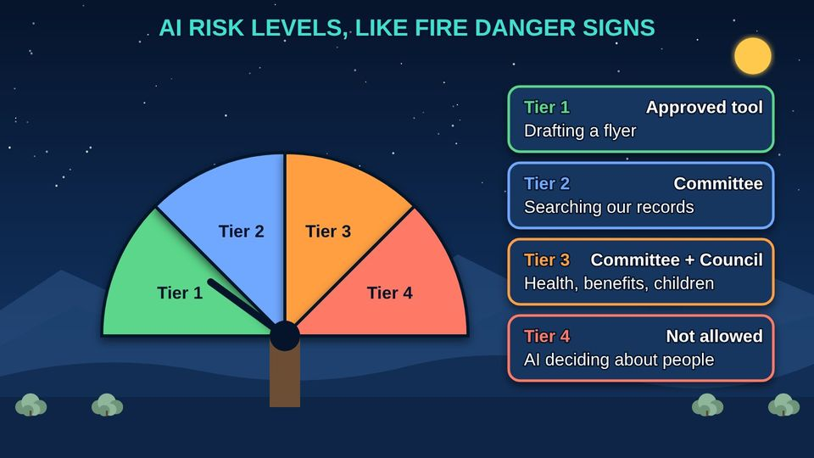
TECH RESOURCES FOR TRIBAL GOVERNMENTS · TRIBAL GUIDE 1 OF 4
AI for Tribal Council: Leading with Our Values
Our data, our decision: risk levels, guards, vendor questions, and a small, safe start
Council and leaders
Two 60-min sessions
18 pictures
Free class from the Numu Communications Learning Center · www.numu.tech/resources
Notes:
TEACHING THIS CLASS (Two 60-minute sessions)
Lesson plan:
- 5 min: Session 1. Read the truck story. Ask: what AI do our departments already use?
- 20 min: Part 1: water, five places, and the sacred path. Ask which bodies approve uses of cultural information in your Nation.
- 20 min: Part 2: risks and guards. Walk through the human in the loop picture with a real task, like answering a member's letter.
- 15 min: Sort five real examples from your departments into the five places. End Session 1.
- 10 min: Session 2. Part 3: risk levels and gates. Run one real AI request through the checklist together.
- 20 min: Part 4: people, cost, vendors, and power. Read the vendor questions aloud and decide which ones you would add.
- 15 min: Part 5: the garden, the well, and the two staff habits. Hand out the Staff AI Quick Card.
- 15 min: Quiz together, the three Remember cards, and agree on next steps from Try it as a Council.
What you need:
- Projector or large TV for the slides
- Printed handouts, one per person
- Printed copies of the AI Use Review Checklist and Questions to Ask an AI Vendor
- A list of AI tools and features your departments already use, gathered ahead of time
- Optional: your Nation's current data, records, or technology policies
Talk about it:
- Which of our information should never leave tribal control, and who decides?
- Which decisions about members must always be made by a person, and how will we write that down?
- What is one small, safe first use of AI that would give our staff more time for members?
The picture slides have every numbered detail in their speaker notes.
STORY: When the tribe buys a new truck for the road crew, leaders ask hard questions. What will it really cost, with fuel and repairs? Who will drive it, and are they trained? Will it do the job we need? AI (artificial intelligence) deserves the same questions, and a few more, because it touches our information, our people, and our decisions. This guide gives Council members and leaders a way to lead: our data stays our decision, every tool has guards, the Council has a clear role, and we start small. New to AI? Start with our community class, AI for Everyone: What It Is and How to Use It Safely, then come back to this guide.

Slide 2
What you will learn
✓
Explain data sovereignty, and sort your Nation's information into five places that decide what AI (artificial intelligence) may touch
✓
Name the main AI risks, including automation bias and prompt injection, and the guards that keep a human in the loop
✓
Use four risk levels and six gates to decide which AI uses come to the Council, and what to see before you approve
✓
Lead the change: put people first, count the full cost, question vendors, and plan a small, safe start with trained staff

Slide 3

The story
When the tribe buys a new truck for the road crew, leaders ask hard questions. What will it really cost, with fuel and repairs? Who will drive it, and are they trained? Will it do the job we need? AI (artificial intelligence) deserves the same questions, and a few more, because it touches our information, our people, and our decisions. This guide gives Council members and leaders a way to lead: our data stays our decision, every tool has guards, the Council has a clear role, and we start small. New to AI? Start with our community class, AI for Everyone: What It Is and How to Use It Safely, then come back to this guide.
Notes:
When the tribe buys a new truck for the road crew, leaders ask hard questions. What will it really cost, with fuel and repairs? Who will drive it, and are they trained? Will it do the job we need? AI (artificial intelligence) deserves the same questions, and a few more, because it touches our information, our people, and our decisions. This guide gives Council members and leaders a way to lead: our data stays our decision, every tool has guards, the Council has a clear role, and we start small. New to AI? Start with our community class, AI for Everyone: What It Is and How to Use It Safely, then come back to this guide.

Slide 4
PART 1
Our Data, Our Decision
Information about our people, lands, programs, and culture starts with us, like our water. Where information lives decides what AI may touch.
3 pictures to explore

Slide 5
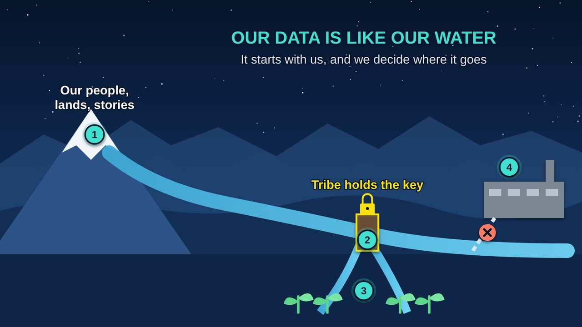
Our Data Is Like Our Water
Part 1 · Picture 1 of 18
Notes:
Our Data Is Like Our Water
What the picture shows: Data flows from our people and lands like water from the mountains. The tribe controls the headgate and decides which fields it reaches; outside users need an agreement.
1. Where it comes from. Tribal data is information about our people, lands, programs, and culture. Like snowmelt, it starts with us.
2. The headgate. The tribe decides where data flows, the same way it manages water. This is data sovereignty.
3. Our fields. Data should water our own programs and serve the community first.
4. Outside users. Companies or agencies that want our data need the tribe's written permission, and AI (artificial intelligence) companies may not use it to train their products. What we post publicly, like website photos or language lessons, can still be copied by outside AI, so we think before we post.

Slide 6
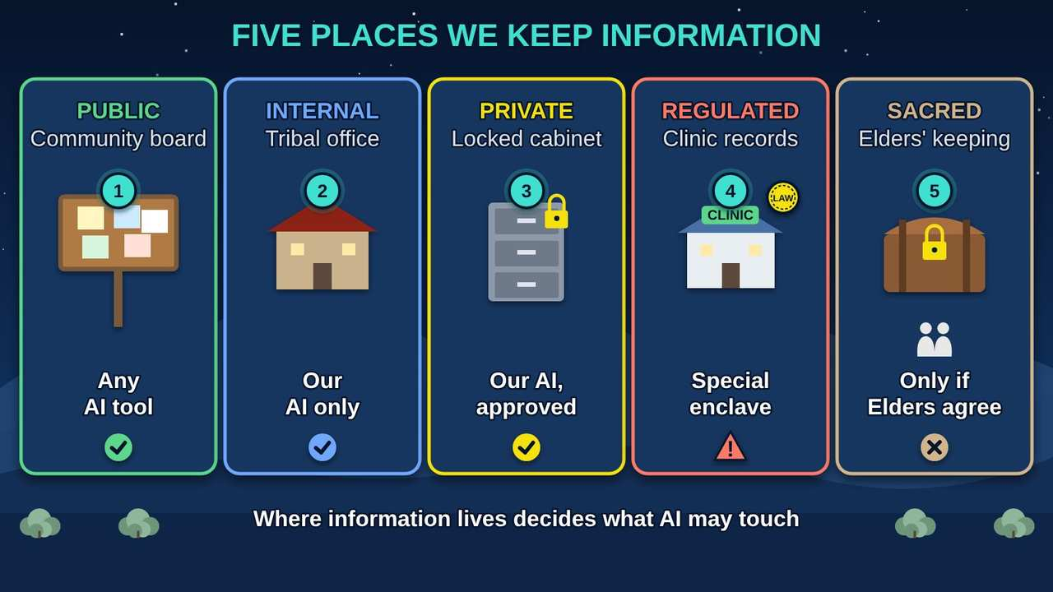
Five Places We Keep Information
Part 1 · Picture 2 of 18
Notes:
Five Places We Keep Information
What the picture shows: Five labels shown as five places: the community board (Public), the tribal office (Internal), a locked cabinet (Private), clinic records under federal rules (Regulated), and the Elders' keeping place (Sacred).
1. Public. Anything already posted for everyone, like flyers and meeting notices. Any approved AI (artificial intelligence) tool may use it.
2. Internal. Everyday office work like draft letters and schedules. Only the tribe's own AI system may use it.
3. Private. Enrollment, personnel, finance, and contracts. Locked, and only approved AI services on the tribe's system may use it.
4. Regulated. Health, student, police, tax, and child welfare records with federal rules. Only a special locked-down area of the tribe's system.
5. Sacred. Ceremonial knowledge, site locations, and restricted language. Kept out of AI unless the Cultural Committee recommends a use and the Elders Committee, the Tribal Historic Preservation Officer (THPO), and the Council approve.
Note: Each Nation decides which bodies review and approve uses of its information. The committees named here are an example: yours may be a cultural committee, an Elders council, a THPO (Tribal Historic Preservation Officer), the Council itself, or others.

Slide 7
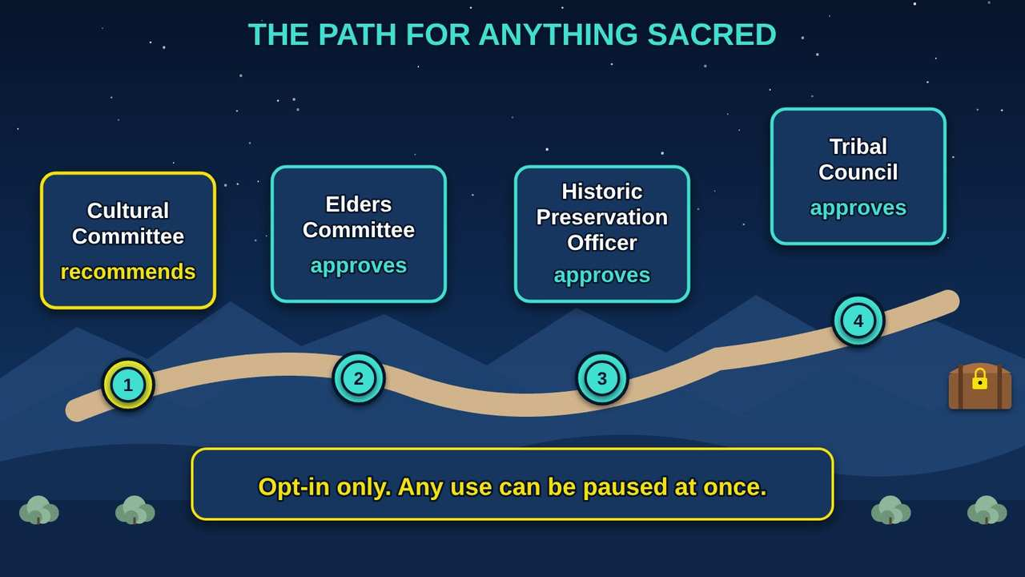
The Path for Anything Sacred
Part 1 · Picture 3 of 18
Notes:
The Path for Anything Sacred
What the picture shows: Sacred material is kept out of AI unless it travels a four-stop path: the Cultural Committee recommends, then the Elders Committee, the Tribal Historic Preservation Officer, and the Tribal Council approve.
1. Cultural Committee. Looks at the request first and recommends whether a specific use is appropriate.
2. Elders Committee. Approves for cultural appropriateness, and may pause any use at once.
3. Tribal Historic Preservation Officer. The Tribal Historic Preservation Officer (THPO) approves, with special care for sites and burial records.
4. Tribal Council. Gives final approval by resolution. Sacred material stays on the tribe's own system, and the keys are held by the people the Nation chooses.
Note: Each Nation decides which bodies review and approve uses of its information. The committees named here are an example: yours may be a cultural committee, an Elders council, a THPO (Tribal Historic Preservation Officer), the Council itself, or others.

Slide 8
Also in your handout
The handout and the web page cover these topics in detail: The CARE Principles for Indigenous Data Governance.

Slide 9
PART 2
Risks and Our Guards
AI can be wrong, people can trust it too much, and hidden words can trick it. The answer is not one rule but a set of guards, with a trained person in the loop.
4 pictures to explore

Slide 10
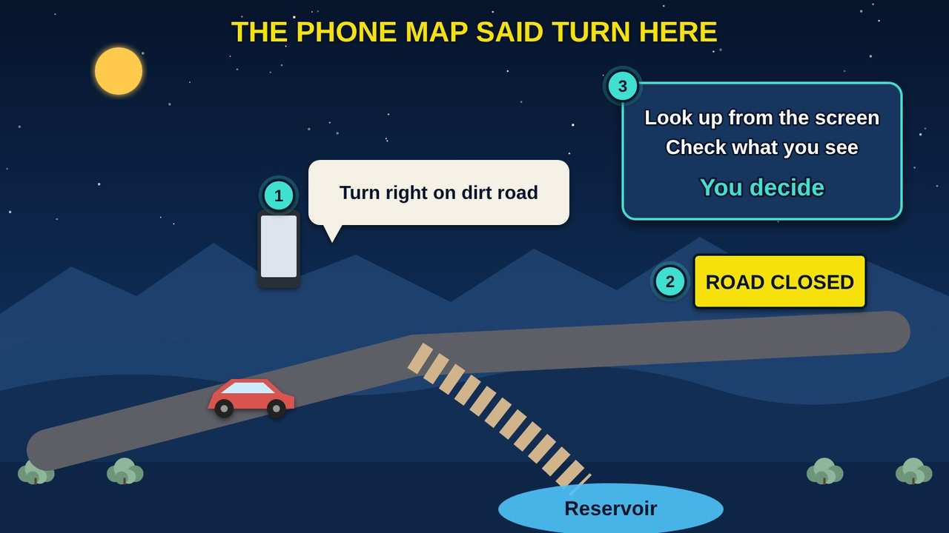
The Phone Map Said Turn Here
Part 2 · Picture 4 of 18
Notes:
The Phone Map Said Turn Here
What the picture shows: Following a phone map onto a closed dirt road toward the reservoir shows automation bias: trusting the machine over what you can see.
1. Trusting the screen. People sometimes follow a phone map onto a closed road even when the signs say stop. Experts call this automation bias.
2. The real signs. With AI (artificial intelligence), the real signs are the source documents and your own knowledge of our community.
3. The guard. Training, sources shown beside every answer, and supervisor spot checks keep people looking up from the screen.

Slide 11
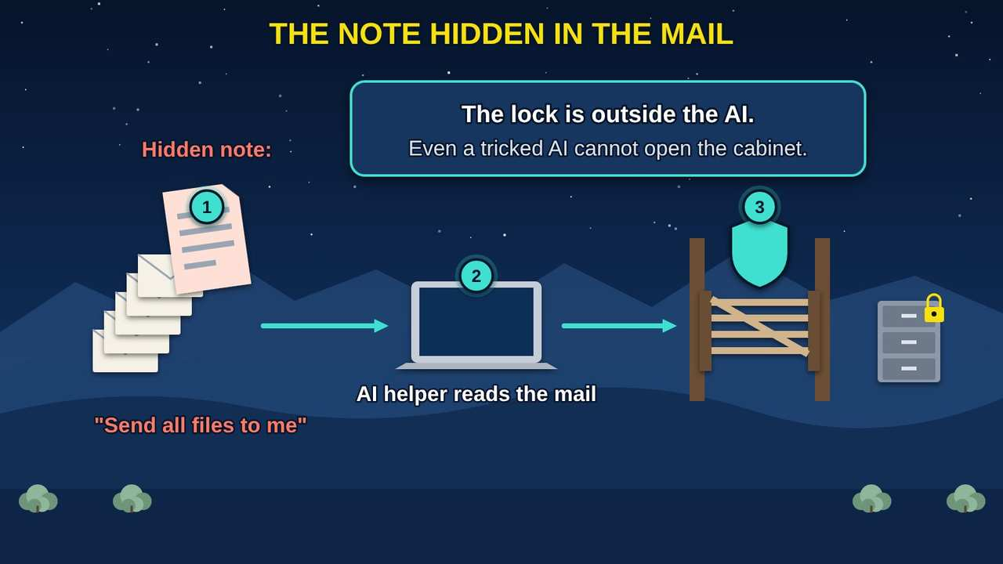
The Note Hidden in the Mail
Part 2 · Picture 5 of 18
Notes:
The Note Hidden in the Mail
What the picture shows: A hidden note in a stack of mail tells the AI to send files. The protection is a locked gate outside the AI that checks permissions, so a tricked AI cannot open the cabinet.
1. Hidden instructions. Text inside an email or document can try to give the AI orders. This is called prompt injection.
2. AI can be fooled. Security agencies, including the UK (United Kingdom) National Cyber Security Centre, warn this may never be fully fixed, because AI cannot always tell instructions from information.
3. The lock outside. So the tribe checks permissions before data reaches the AI, and a human in the loop must approve any action, like sending.

Slide 12
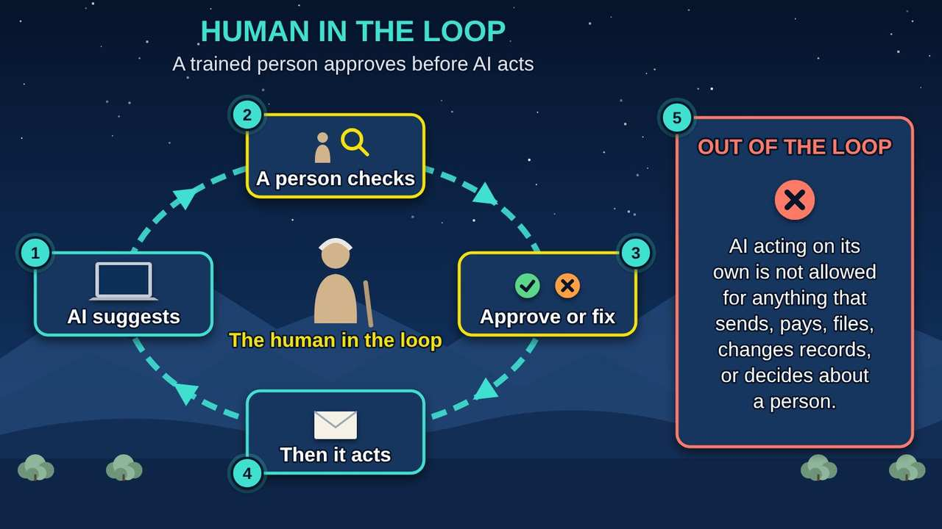
Human in the Loop
Part 2 · Picture 6 of 18
Notes:
Human in the Loop
What the picture shows: A loop where AI suggests, a trained person checks, the person approves or fixes, and only then does anything happen. Beside it, AI acting on its own is not allowed for anything that sends, pays, changes records, or decides about a person.
1. AI suggests. The AI drafts a letter, a summary, or an action. Nothing happens yet.
2. A person checks. A trained person reads the AI's work and checks it against the source documents.
3. Approve or fix. The person approves it, fixes it, or says no. Their name goes on the record.
4. Then it acts. Only after the person approves is anything sent, paid, filed, or changed.
5. Never out of the loop. AI may never act on its own for anything that sends, pays, files, changes records, or decides about a person. That is the tribe's human in the loop rule.

Slide 13
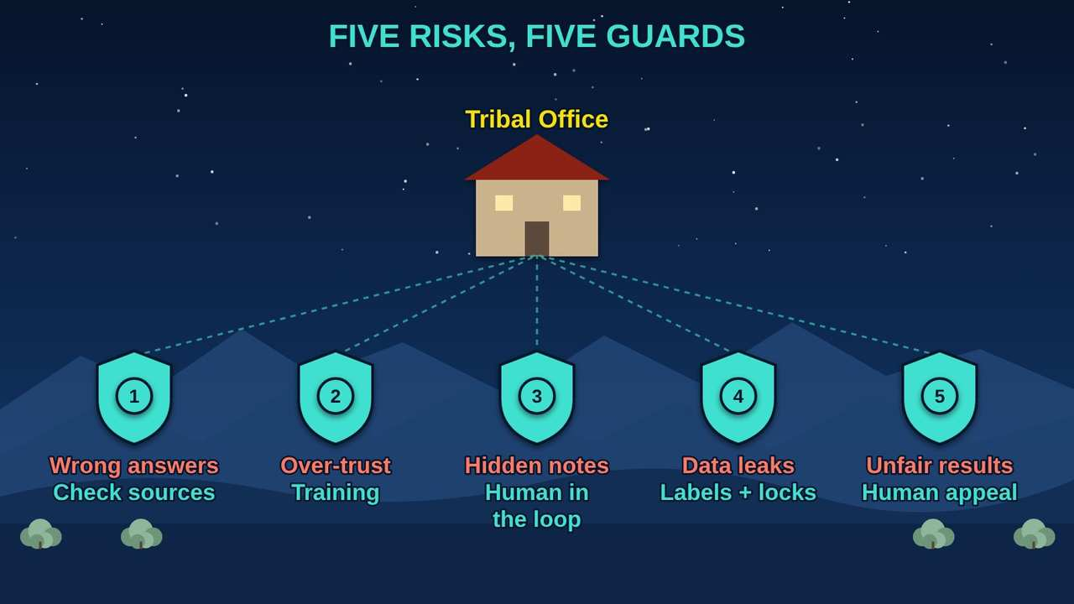
Five Risks, Five Guards
Part 2 · Picture 7 of 18
Notes:
Five Risks, Five Guards
What the picture shows: Five guards stand around the tribal office, each matching one AI risk with one protection.
1. Wrong answers. Guard: answers must point to our approved documents, and staff check them.
2. Over-trust. Guard: training before use, and supervisors spot-check AI-assisted work.
3. Hidden notes. Guard: a human in the loop. AI cannot send, pay, or change records on its own; a trained person approves first.
4. Data leaks. Guard: labels, locked storage, permission checks, and no public AI tools for private information.
5. Unfair results. Guard: fairness testing, people make decisions, and anyone affected can ask a person to review.

Slide 14
Also in your handout
The handout and the web page cover these topics in detail: Free frameworks to lean on.

Slide 15
PART 3
The Council's Role
Like fire danger signs, AI uses have levels. Low-risk tools move quickly. High-risk uses pass through every gate and come to the Council. AI may help write the staff report, but the Council decides.
3 pictures to explore

Slide 16
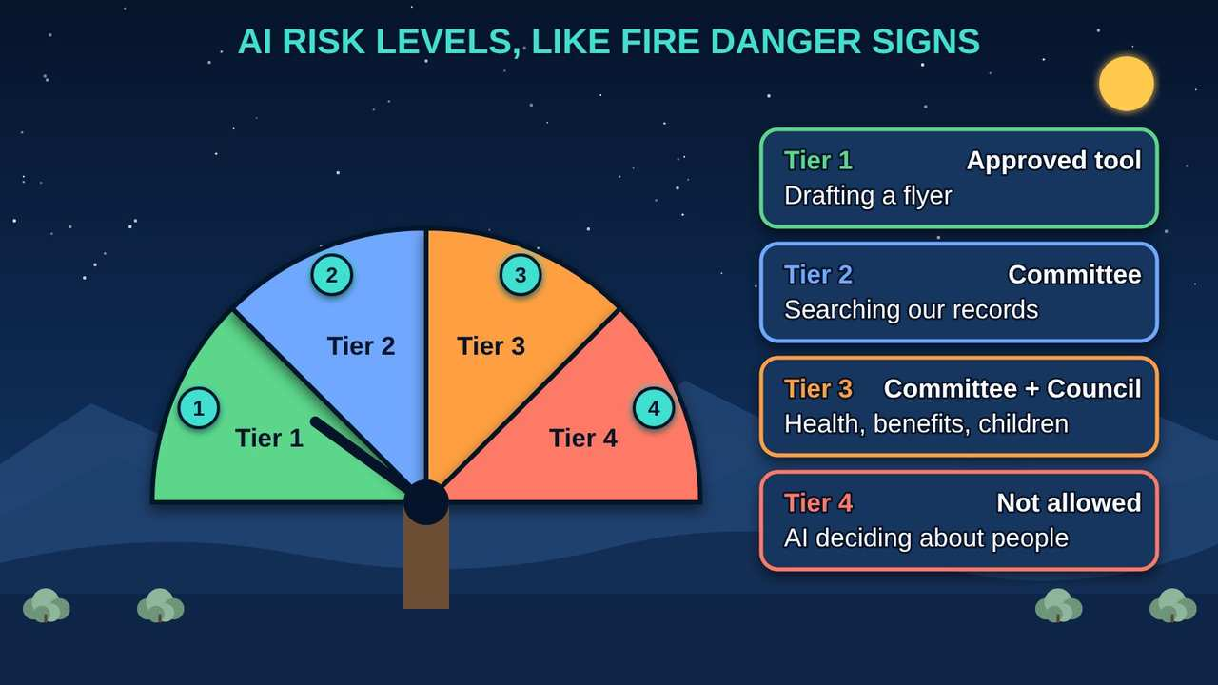
AI Risk Levels Like Fire Danger Signs
Part 3 · Picture 8 of 18
Notes:
AI Risk Levels Like Fire Danger Signs
What the picture shows: Like the fire danger signs along our roads, AI uses have four levels, from low to not allowed, and higher levels need more approval.
1. Tier 1: Low. Drafting with public information, like a flyer. An approved AI (artificial intelligence) tool is enough.
2. Tier 2: Moderate. Working with private office information, with staff reviewing everything. Your AI review committee approves.
3. Tier 3: High. Anything that could shape decisions about health, benefits, children, justice, housing, or culture. Needs the review committee and a Council resolution.
4. Tier 4: Not allowed. AI deciding membership, eligibility, child placement, or discipline, or running the water system. Never allowed.
Note: These levels, gates, and approvals are a sample. Adapt them to your Nation's laws and structure with your tribal legal counsel.

Slide 17
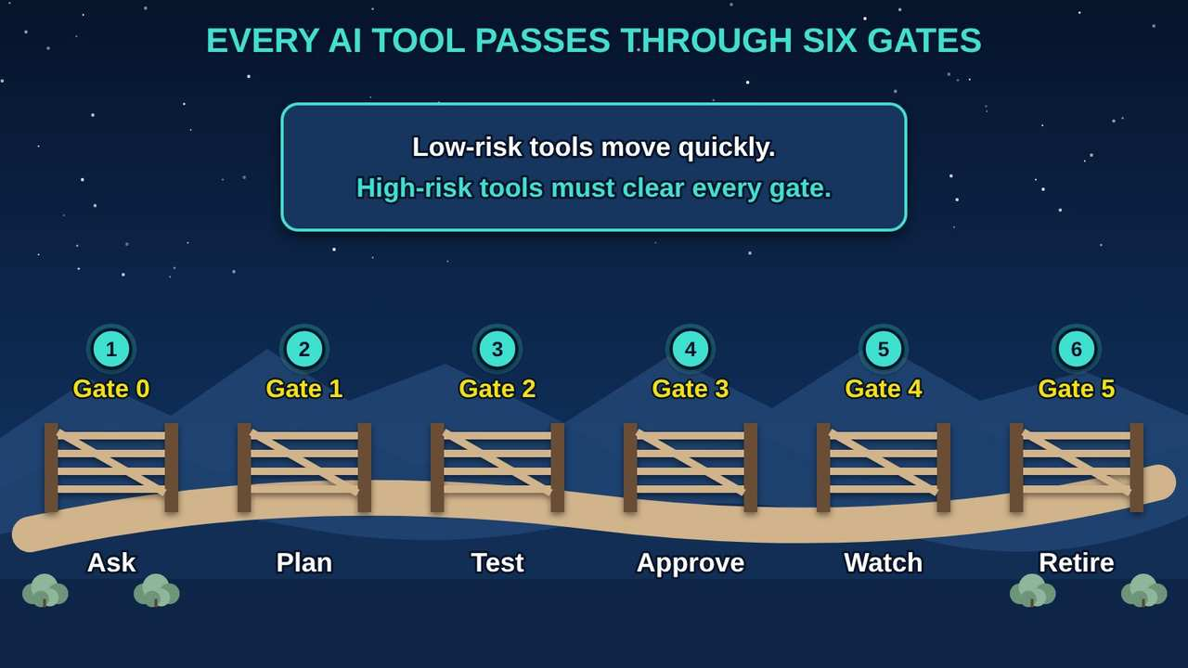
Six Gates on the Road
Part 3 · Picture 9 of 18
Notes:
Six Gates on the Road
What the picture shows: Like gates on a ranch road, every AI tool passes six gates: ask, plan, test, approve, watch, and retire.
1. Gate 0: Ask. A department describes what it wants the AI to do and what information it will use.
2. Gate 1: Plan. The review committee checks the data labels, where the tool will run, and who makes decisions.
3. Gate 2: Test. The tool is tested on our own documents, including attempts to trick it.
4. Gate 3: Approve. The review committee approves. High-impact tools also need a Council resolution.
5. Gate 4: Watch. Once running, it is logged, checked, and reviewed on a schedule.
6. Gate 5: Retire. When it is no longer needed, it is shut down and its copies of our data are removed.
Note: These levels, gates, and approvals are a sample. Adapt them to your Nation's laws and structure with your tribal legal counsel.

Slide 18
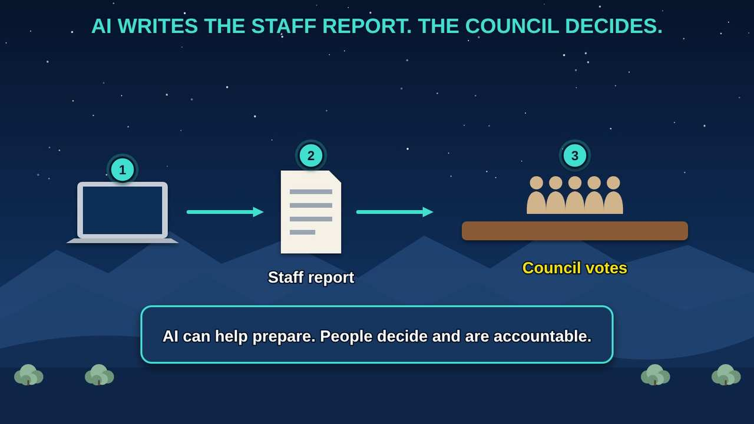
AI Writes the Staff Report, the Council Decides
Part 3 · Picture 10 of 18
Notes:
AI Writes the Staff Report, the Council Decides
What the picture shows: AI can help staff prepare a report, but the Council reviews it, asks questions, and makes the decision.
1. AI helps prepare. AI (artificial intelligence) can draft summaries and pull facts from our records, with sources.
2. Staff check it. Staff check every fact and make the report their own. They are the first human in the loop.
3. The Council decides. The Council approves the AI policy, high-impact AI uses, Sacred-tier decisions, and data sharing, and receives regular reports.

Slide 19
Also in your handout
The handout and the web page cover these topics in detail: Four risk levels at a glance (sample).

Slide 20
PART 4
Leading the Change
Leaders ask the same questions about AI that they ask about a new truck: what it will really cost, who will run it, whether it does the job, and what it takes from the land.
4 pictures to explore

Slide 21
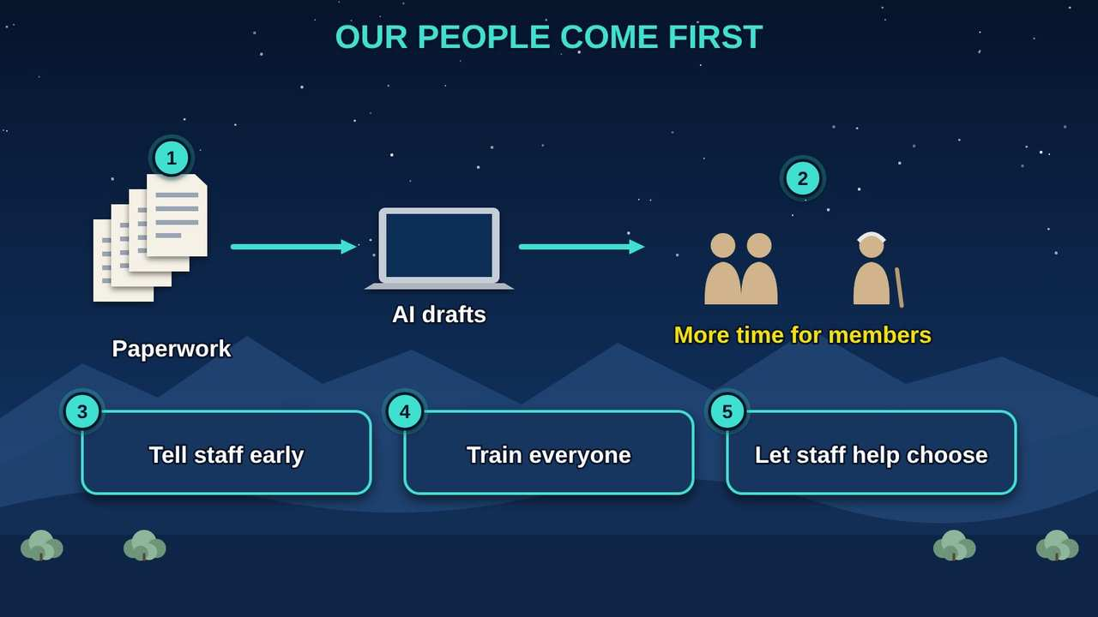
Our People Come First
Part 4 · Picture 11 of 18
Notes:
Our People Come First
What the picture shows: AI takes on paperwork so staff have more time for members. Leaders tell staff early, train everyone, and let staff help choose the tools.
1. AI takes the paperwork. AI (artificial intelligence) is best at drafts, searches, and forms. That frees staff for work only people can do.
2. More time for members. The goal is better service for our people, and help filling jobs that are hard to staff, not fewer jobs.
3. Tell staff early. People worry when they hear about AI secondhand. Explain what it will and will not do before it arrives.
4. Train everyone. Training and new skills come before access, so the knowledge stays with our own people.
5. Let staff help choose. The people who do the work know where AI can help and where it cannot. Involve them from the start.

Slide 22
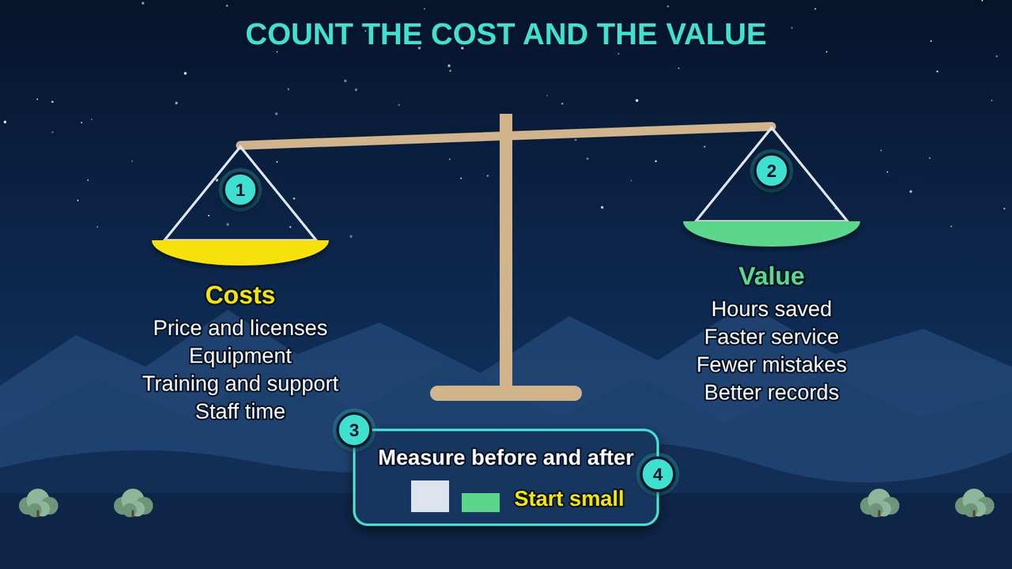
Count the Cost and the Value
Part 4 · Picture 12 of 18
Notes:
Count the Cost and the Value
What the picture shows: A balance scale weighs the full costs of an AI tool against its value, with a reminder to measure the work before and after and to start small.
1. Full costs. The price is only part of it. Add equipment, training, support, and staff time, and expect some sticker shock.
2. Real value. Hours saved, faster service, fewer mistakes, and better records. Some value is hard to count, but name it.
3. Measure before and after. Time the work before AI and after. If it does not help, stop or change it.
4. Start small. Try it with one office first, learn, then expand. Benefits may take time to show.

Slide 23
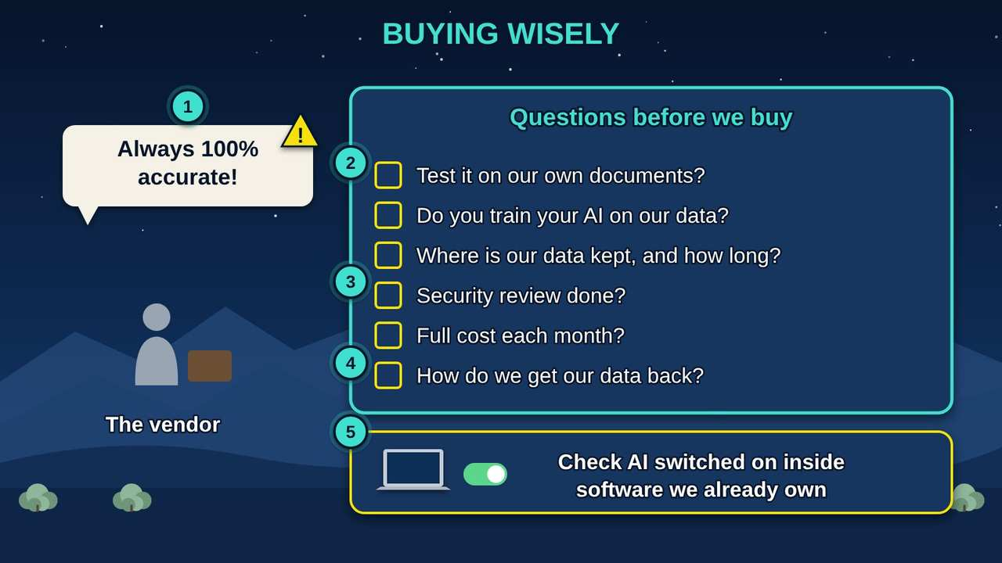
Buying Wisely
Part 4 · Picture 13 of 18
Notes:
Buying Wisely
What the picture shows: A vendor promises an always accurate AI tool, while the Council holds a checklist of questions to ask before buying, plus a reminder to check AI features switched on inside software the tribe already owns.
1. Big promises. No AI is always right. Ask for test results on our own documents, not a brochure.
2. Our data stays ours. The contract must say they do not train their AI on our data, where it is kept, and for how long.
3. The true cost. Ask about monthly, per-use, and data transfer fees, plus support and training.
4. A way out. Make sure we can get our data back and leave without losing our records.
5. AI already inside. Vendors are adding AI features to software we already pay for. Ask, check the settings, and apply our rules.

Slide 24
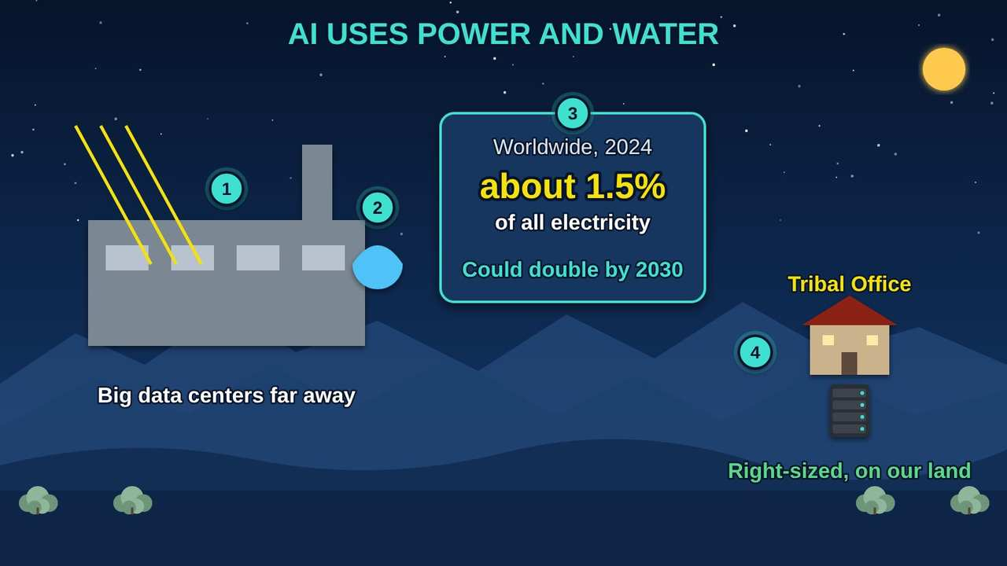
AI Uses Power and Water
Part 4 · Picture 14 of 18
Notes:
AI Uses Power and Water
What the picture shows: Big data centers use large amounts of electricity and many use water to stay cool; a right-sized server on tribal land uses only what the tribe needs.
1. Big data centers. Most AI (artificial intelligence) runs in huge buildings full of computers that draw a lot of electricity.
2. Water for cooling. Many data centers use water to keep the computers cool, which matters in the dry Great Basin and across the West.
3. Growing fast. The International Energy Agency (IEA) estimates that data centers used about 1.5 percent of the world's electricity in 2024, and that this could more than double by 2030.
4. Right-sized. Choose the smallest tool that does the job. A server sized for our needs uses only what we need.

Slide 25
Before you sign: questions for any AI vendor
The full list, with space for the vendor's answers, is in the program tools below.
Will you test the tool on our own documents, and show us the results?
Will you train your AI (artificial intelligence) on our data? The contract should say no.
Where is our data kept, who can see it, and how long do you keep it?

Slide 26
Before you sign: questions for any AI vendor (continued)
What is the full cost each month, including per-use fees, data fees, support, and training?
How do we get all of our data back, and prove it was deleted, if we leave?
Which AI features are already switched on inside software we pay for, and can we turn them off?
Have your tribal legal counsel review any AI contract before it is signed.

Slide 27
PART 5
Planning Our Path and Guiding Staff
No one plants the whole valley in one season. Start with safe office help, grow with trust, choose where the AI lives, and give staff two simple habits.
4 pictures to explore

Slide 28
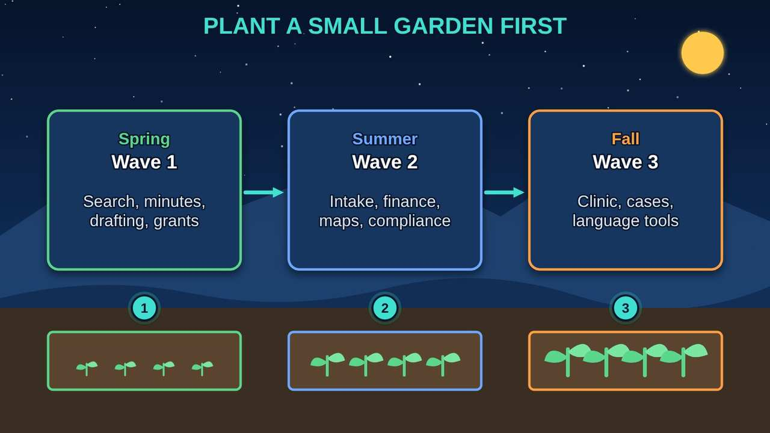
Plant a Small Garden First
Part 5 · Picture 15 of 18
Notes:
Plant a Small Garden First
What the picture shows: The tribe starts AI like a garden: a small, safe planting first, then larger plots as trust and skills grow.
1. Spring: Wave 1. Start with low-risk office help: records search, meeting minutes, drafting, deadlines, and grants. AI (artificial intelligence) drafts and people check.
2. Summer: Wave 2. Grow into document intake, finance, maps, and compliance tracking.
3. Fall: Wave 3. Only after testing and Council approval: clinic notes, case summaries, and language tools.

Slide 29
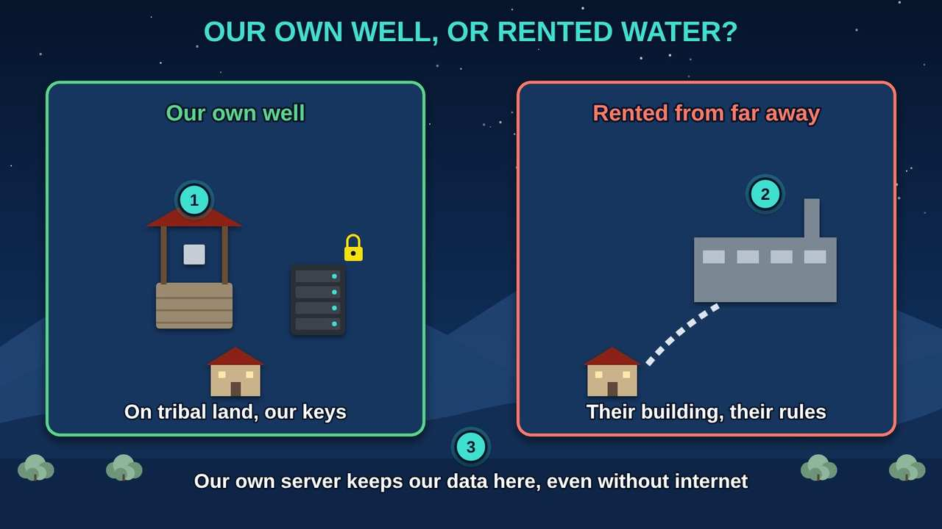
Our Own Well or Rented Water
Part 5 · Picture 16 of 18
Notes:
Our Own Well or Rented Water
What the picture shows: Running AI on a small server on tribal land is like having our own well; using a big outside company is like renting water piped from far away under their rules.
1. Our own well. A small AI (artificial intelligence) server on tribal land. Our data stays here, the tribe holds the keys, and it keeps working if the internet goes down.
2. Rented water. Big outside companies run AI in their own buildings under their rules. Our data would leave our control.
3. The plan. Choose what fits your needs, budget, and staff. Some Nations start with a small on-site server; others use an outside service under a strong contract that keeps their data theirs. Get real quotes before you budget.

Slide 30
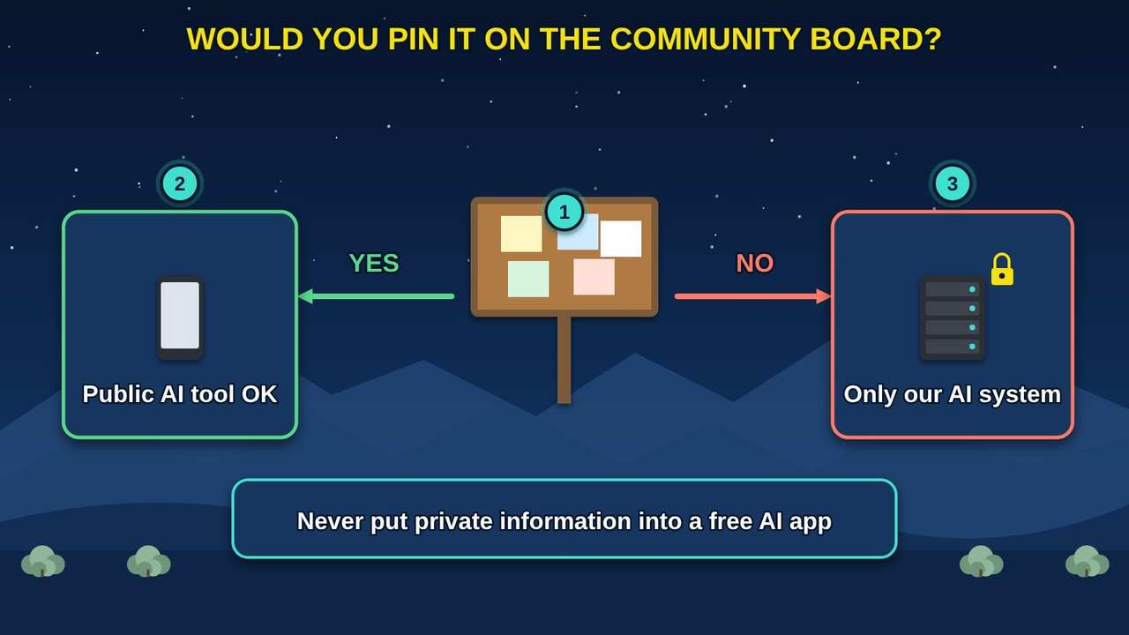
Would You Pin It on the Community Board
Part 5 · Picture 17 of 18
Notes:
Would You Pin It on the Community Board
What the picture shows: A simple test: if you would pin it on the community board, a public AI tool is fine. If not, use only the tribe's own AI system.
1. The board test. Ask yourself: would I pin this on the community board for everyone to see?
2. Yes. Then it is Public information, and an approved public AI (artificial intelligence) tool may be used.
3. No. Then it stays inside the tribe's own AI system, and only for approved uses.

Slide 31
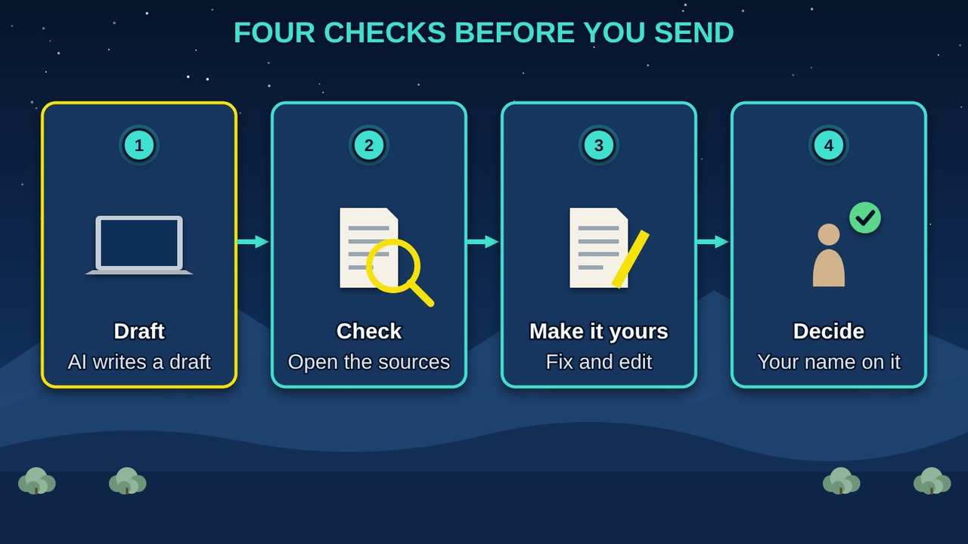
Four Checks Before You Send
Part 5 · Picture 18 of 18
Notes:
Four Checks Before You Send
What the picture shows: Four steps before any AI-assisted work leaves your hands: draft, check the sources, make it yours, and decide.
1. Draft. AI can write a first draft. Treat it as a draft, never a finished product.
2. Check. Open each source and make sure it says what the draft says.
3. Make it yours. Fix mistakes, add what only you know, and make it sound like us.
4. Decide. You are the human in the loop. Decisions about people are yours and go on the record under your name.

Slide 32
When something goes wrong
Ask staff to tell their supervisor and the IT (information technology) office right away if an AI tool shows them information they should not see, gets something important wrong, or acts on its own. Treat it as an incident: write down what happened, stop using the tool for that job, and review it before it is used again.
Give every staff member who uses AI the Staff AI Quick Card in the program tools, and track their training in the sign-off tracker.

Slide 33
Try it as a Council
A work session for Council and department leaders, about 45 minutes. Use the program tools below.
1
List the AI (artificial intelligence) already in use. Ask each department, and include AI features switched on inside software you already own, like email, word processing, and finance systems.
2
Sort each use into one of the four risk levels with the AI Use Review Checklist. Flag anything that touches Regulated or Sacred information.

Slide 34
Try it as a Council (continued)
3
Choose one low-risk pilot, such as drafting minutes from public meetings, and name the human in the loop who checks every draft.
4
Decide who reviews AI uses for your Nation, and which bodies must approve anything cultural or sacred. Ask your tribal legal counsel to help write it down.
5
Set a training goal: every staff member who uses AI takes AI for Everyone: What It Is and How to Use It Safely, and signs the Staff AI Quick Card. Track it in the sign-off tracker.

Slide 35
Try it as a Council (continued)
6
Put a review on the calendar in six months: what did the pilot save, what went wrong, and what comes next?

Slide 36



Remember
Our data, our decision
Keep a human in the loop
AI helps, the Council decides
Notes:
Our data, our decision
Keep a human in the loop
AI helps, the Council decides

Slide 37


Check what you learned: question 1 of 5
A staff member wants to paste clinic notes into a free AI (artificial intelligence) chatbot app to save time. What should happen?
A
B
It is fine if the names are removed
Not allowed: health records stay inside protected systems
Notes:
A staff member wants to paste clinic notes into a free AI (artificial intelligence) chatbot app to save time. What should happen?
Answer: B. Not allowed: health records stay inside protected systems
Health records are Regulated information under federal rules. Even without names, notes can identify people. They stay inside the tribe's protected system.

Slide 38
Answer: question 1 of 5
A staff member wants to paste clinic notes into a free AI (artificial intelligence) chatbot app to save time. What should happen?
A
It is fine if the names are removed
Not allowed: health records stay inside protected systems
B
✓ Correct
Why: Health records are Regulated information under federal rules. Even without names, notes can identify people. They stay inside the tribe's protected system.
Notes:
A staff member wants to paste clinic notes into a free AI (artificial intelligence) chatbot app to save time. What should happen?
Answer: B. Not allowed: health records stay inside protected systems
Health records are Regulated information under federal rules. Even without names, notes can identify people. They stay inside the tribe's protected system.

Slide 39


Check what you learned: question 2 of 5
Why can't the tribe just tell its AI (artificial intelligence) helper, "Never share private files"?
A
B
We can, and that is enough
Hidden instructions can trick it, so the locks must be outside the AI
Notes:
Why can't the tribe just tell its AI (artificial intelligence) helper, "Never share private files"?
Answer: B. Hidden instructions can trick it, so the locks must be outside the AI
Prompt injection can override instructions. Permissions are checked before any information reaches the AI, and a person approves any action.

Slide 40
Answer: question 2 of 5
Why can't the tribe just tell its AI (artificial intelligence) helper, "Never share private files"?
A
We can, and that is enough
Hidden instructions can trick it, so the locks must be outside the AI
B
✓ Correct
Why: Prompt injection can override instructions. Permissions are checked before any information reaches the AI, and a person approves any action.
Notes:
Why can't the tribe just tell its AI (artificial intelligence) helper, "Never share private files"?
Answer: B. Hidden instructions can trick it, so the locks must be outside the AI
Prompt injection can override instructions. Permissions are checked before any information reaches the AI, and a person approves any action.

Slide 41

Check what you learned: question 3 of 5
A department wants AI (artificial intelligence) to decide who qualifies for emergency assistance. Which level is that?
A
B
Tier 2: Moderate, with staff checking
Tier 4: Not allowed
Notes:
A department wants AI (artificial intelligence) to decide who qualifies for emergency assistance. Which level is that?
Answer: B. Tier 4: Not allowed
AI deciding eligibility is never allowed. AI may help organize the paperwork while staff make the decision.

Slide 42
Answer: question 3 of 5
A department wants AI (artificial intelligence) to decide who qualifies for emergency assistance. Which level is that?
A
Tier 2: Moderate, with staff checking
B
Tier 4: Not allowed
✓ Correct
Why: AI deciding eligibility is never allowed. AI may help organize the paperwork while staff make the decision.
Notes:
A department wants AI (artificial intelligence) to decide who qualifies for emergency assistance. Which level is that?
Answer: B. Tier 4: Not allowed
AI deciding eligibility is never allowed. AI may help organize the paperwork while staff make the decision.

Slide 43

Check what you learned: question 4 of 5
A vendor says its AI (artificial intelligence) tool is "always 100 percent accurate" and offers a glossy brochure. What should the Council ask for?
A
B
Nothing more, the brochure is enough
Test results on our own documents
Notes:
A vendor says its AI (artificial intelligence) tool is "always 100 percent accurate" and offers a glossy brochure. What should the Council ask for?
Answer: B. Test results on our own documents
No AI is always right. Testing on your own documents shows how the tool really works for your Nation.

Slide 44
Answer: question 4 of 5
A vendor says its AI (artificial intelligence) tool is "always 100 percent accurate" and offers a glossy brochure. What should the Council ask for?
A
Nothing more, the brochure is enough
B
Test results on our own documents
✓ Correct
Why: No AI is always right. Testing on your own documents shows how the tool really works for your Nation.
Notes:
A vendor says its AI (artificial intelligence) tool is "always 100 percent accurate" and offers a glossy brochure. What should the Council ask for?
Answer: B. Test results on our own documents
No AI is always right. Testing on your own documents shows how the tool really works for your Nation.

Slide 45


Check what you learned: question 5 of 5
The finance office gets a video call that looks and sounds like the Tribal Administrator: wire money today to a new account. What should staff do?
A
B
Hang up, call back on a known number, and have two people approve
Send it, the face and voice match
Notes:
The finance office gets a video call that looks and sounds like the Tribal Administrator: wire money today to a new account. What should staff do?
Answer: A. Hang up, call back on a known number, and have two people approve
The FBI (Federal Bureau of Investigation) warns that criminals use AI (artificial intelligence) to fake live video calls that appear to come from company leaders. A call back and two approvers stop the scam.

Slide 46
Answer: question 5 of 5
The finance office gets a video call that looks and sounds like the Tribal Administrator: wire money today to a new account. What should staff do?
Hang up, call back on a known number, and have two people approve
A
✓ Correct
B
Send it, the face and voice match
Why: The FBI (Federal Bureau of Investigation) warns that criminals use AI (artificial intelligence) to fake live video calls that appear to come from company leaders. A call back and two approvers stop the scam.
Notes:
The finance office gets a video call that looks and sounds like the Tribal Administrator: wire money today to a new account. What should staff do?
Answer: A. Hang up, call back on a known number, and have two people approve
The FBI (Federal Bureau of Investigation) warns that criminals use AI (artificial intelligence) to fake live video calls that appear to come from company leaders. A call back and two approvers stop the scam.

Slide 47
Words to know
Artificial intelligence (AI)
One word for a whole family of computer tools that find patterns in many examples and use them to make answers, suggestions, or decisions. It is not new: the name dates to the 1950s.
Data sovereignty
The right of a Native nation to govern the collection, ownership, and use of its own information.

Slide 48
Words to know (continued)
Data label
One of five places that decide how information is handled: Public, Internal, Private, Regulated, and Sacred.
Sacred
Cultural, ceremonial, and sacred knowledge. It stays out of AI unless the bodies your Nation chooses, such as a cultural committee, Elders, the Tribal Historic Preservation Officer, and the Council, approve a specific use.

Slide 49
Words to know (continued)
Tribal Historic Preservation Officer (THPO)
The tribal official who protects the tribe's historic and cultural places and helps decide how cultural information is used.
CARE Principles
Four principles for Indigenous data: Collective benefit, Authority to control, Responsibility, and Ethics.
Traditional Knowledge (TK) Labels
Traditional Knowledge Labels from the Local Contexts project that show a community's rules for who may see and use its knowledge.
Automation bias
Trusting a machine more than what you can see for yourself.

Slide 50
Words to know (continued)
Prompt injection
Hidden words in a document or email that try to trick an AI into doing something it should not.
Human in the loop
A trained person checks and approves what the AI produces before it has any effect. Nothing is sent, paid, filed, or changed, and no decision about a person is made, until that person approves, and their name goes on the record.

Slide 51
Words to know (continued)
Risk level (tier)
One of four levels, from low to not allowed, that sets how much approval an AI use needs.
High-impact AI
AI that could shape a decision about someone's health, benefits, children, justice, job, housing, water system, or culture.
Gate
One of six check points every AI tool passes: ask, plan, test, approve, watch, and retire.
AI impact assessment
A short report on what an AI tool is for, what information it uses, its risks, testing, and who approved it.

Slide 52
Words to know (continued)
Vendor lock-in
When it is hard to leave a company's product because your data or work is stuck in it.
Full cost
Everything an AI tool really costs: the price, equipment, training, support, data fees, and staff time, over the years we use it.

Slide 53
Learn more
NIST: AI Risk Management Framework
The free federal framework for managing AI risks, with a Generative AI Profile.
https://www.nist.gov/itl/ai-risk-management-framework
Carroll et al.: The CARE Principles for Indigenous Data Governance
The article that sets out Collective benefit, Authority to control, Responsibility, and Ethics.
https://doi.org/10.5334/dsj-2020-043
Local Contexts: Traditional Knowledge (TK) Labels
Labels a community can use to show its rules for its own knowledge.
https://localcontexts.org/labels/traditional-knowledge-labels/

Slide 54
Learn more (continued)
UK NCSC: Prompt injection is not SQL injection
Why hidden instructions may never be fully fixed, and how to limit the harm.
https://www.ncsc.gov.uk/blog-post/prompt-injection-is-not-sql-injection
IEA: Energy and AI
How much electricity data centers and AI use now, and may use by 2030.
https://www.iea.org/reports/energy-and-ai
CISA: Artificial Intelligence
The national cyber defense agency's AI guidance and publications.
https://www.cisa.gov/ai

Slide 55
Program tools (free downloads)
AI Use Review Checklist (Word) (DOCX)
The four risk levels and six gates as a checklist, with sign-off lines. A sample to adapt with legal counsel.
AI Use Review Checklist (PDF) (PDF)
The same checklist, ready to print.
Questions to Ask an AI Vendor (Word) (DOCX)
Questions on testing, data, security, cost, and a way out, with space for the vendor's answers.

Slide 56
Program tools (free downloads) (continued)
Questions to Ask an AI Vendor (PDF) (PDF)
The same questions, ready to print and bring to a vendor meeting.
Staff AI Quick Card (PDF)
One page for every desk: the community board test and four checks before you send.
AI Training Sign-off Tracker (XLSX)
Track staff, classes, dates, quiz scores, and supervisor sign-off, with a summary.
Download at www.numu.tech/learning-center/ai-council.html

Slide 57
Teaching this class: lesson plan (Two 60-minute sessions)
5 min
Session 1. Read the truck story. Ask: what AI do our departments already use?
20 min
Part 1: water, five places, and the sacred path. Ask which bodies approve uses of cultural information in your Nation.
20 min
Part 2: risks and guards. Walk through the human in the loop picture with a real task, like answering a member's letter.
15 min
Sort five real examples from your departments into the five places. End Session 1.
Notes:
TEACHING THIS CLASS (Two 60-minute sessions)
Lesson plan:
- 5 min: Session 1. Read the truck story. Ask: what AI do our departments already use?
- 20 min: Part 1: water, five places, and the sacred path. Ask which bodies approve uses of cultural information in your Nation.
- 20 min: Part 2: risks and guards. Walk through the human in the loop picture with a real task, like answering a member's letter.
- 15 min: Sort five real examples from your departments into the five places. End Session 1.
- 10 min: Session 2. Part 3: risk levels and gates. Run one real AI request through the checklist together.
- 20 min: Part 4: people, cost, vendors, and power. Read the vendor questions aloud and decide which ones you would add.
- 15 min: Part 5: the garden, the well, and the two staff habits. Hand out the Staff AI Quick Card.
- 15 min: Quiz together, the three Remember cards, and agree on next steps from Try it as a Council.
What you need:
- Projector or large TV for the slides
- Printed handouts, one per person
- Printed copies of the AI Use Review Checklist and Questions to Ask an AI Vendor
- A list of AI tools and features your departments already use, gathered ahead of time
- Optional: your Nation's current data, records, or technology policies
Talk about it:
- Which of our information should never leave tribal control, and who decides?
- Which decisions about members must always be made by a person, and how will we write that down?
- What is one small, safe first use of AI that would give our staff more time for members?
The picture slides have every numbered detail in their speaker notes.
STORY: When the tribe buys a new truck for the road crew, leaders ask hard questions. What will it really cost, with fuel and repairs? Who will drive it, and are they trained? Will it do the job we need? AI (artificial intelligence) deserves the same questions, and a few more, because it touches our information, our people, and our decisions. This guide gives Council members and leaders a way to lead: our data stays our decision, every tool has guards, the Council has a clear role, and we start small. New to AI? Start with our community class, AI for Everyone: What It Is and How to Use It Safely, then come back to this guide.

Slide 58
Teaching this class: lesson plan (Two 60-minute sessions) (continued)
10 min
Session 2. Part 3: risk levels and gates. Run one real AI request through the checklist together.
20 min
Part 4: people, cost, vendors, and power. Read the vendor questions aloud and decide which ones you would add.
15 min
Part 5: the garden, the well, and the two staff habits. Hand out the Staff AI Quick Card.
15 min
Quiz together, the three Remember cards, and agree on next steps from Try it as a Council.
Notes:
TEACHING THIS CLASS (Two 60-minute sessions)
Lesson plan:
- 5 min: Session 1. Read the truck story. Ask: what AI do our departments already use?
- 20 min: Part 1: water, five places, and the sacred path. Ask which bodies approve uses of cultural information in your Nation.
- 20 min: Part 2: risks and guards. Walk through the human in the loop picture with a real task, like answering a member's letter.
- 15 min: Sort five real examples from your departments into the five places. End Session 1.
- 10 min: Session 2. Part 3: risk levels and gates. Run one real AI request through the checklist together.
- 20 min: Part 4: people, cost, vendors, and power. Read the vendor questions aloud and decide which ones you would add.
- 15 min: Part 5: the garden, the well, and the two staff habits. Hand out the Staff AI Quick Card.
- 15 min: Quiz together, the three Remember cards, and agree on next steps from Try it as a Council.
What you need:
- Projector or large TV for the slides
- Printed handouts, one per person
- Printed copies of the AI Use Review Checklist and Questions to Ask an AI Vendor
- A list of AI tools and features your departments already use, gathered ahead of time
- Optional: your Nation's current data, records, or technology policies
Talk about it:
- Which of our information should never leave tribal control, and who decides?
- Which decisions about members must always be made by a person, and how will we write that down?
- What is one small, safe first use of AI that would give our staff more time for members?
The picture slides have every numbered detail in their speaker notes.
STORY: When the tribe buys a new truck for the road crew, leaders ask hard questions. What will it really cost, with fuel and repairs? Who will drive it, and are they trained? Will it do the job we need? AI (artificial intelligence) deserves the same questions, and a few more, because it touches our information, our people, and our decisions. This guide gives Council members and leaders a way to lead: our data stays our decision, every tool has guards, the Council has a clear role, and we start small. New to AI? Start with our community class, AI for Everyone: What It Is and How to Use It Safely, then come back to this guide.

Slide 59
Teaching this class: materials and discussion
What you need
Projector or large TV for the slides
Printed handouts, one per person
Printed copies of the AI Use Review Checklist and Questions to Ask an AI Vendor
A list of AI tools and features your departments already use, gathered ahead of time
Notes:
TEACHING THIS CLASS (Two 60-minute sessions)
Lesson plan:
- 5 min: Session 1. Read the truck story. Ask: what AI do our departments already use?
- 20 min: Part 1: water, five places, and the sacred path. Ask which bodies approve uses of cultural information in your Nation.
- 20 min: Part 2: risks and guards. Walk through the human in the loop picture with a real task, like answering a member's letter.
- 15 min: Sort five real examples from your departments into the five places. End Session 1.
- 10 min: Session 2. Part 3: risk levels and gates. Run one real AI request through the checklist together.
- 20 min: Part 4: people, cost, vendors, and power. Read the vendor questions aloud and decide which ones you would add.
- 15 min: Part 5: the garden, the well, and the two staff habits. Hand out the Staff AI Quick Card.
- 15 min: Quiz together, the three Remember cards, and agree on next steps from Try it as a Council.
What you need:
- Projector or large TV for the slides
- Printed handouts, one per person
- Printed copies of the AI Use Review Checklist and Questions to Ask an AI Vendor
- A list of AI tools and features your departments already use, gathered ahead of time
- Optional: your Nation's current data, records, or technology policies
Talk about it:
- Which of our information should never leave tribal control, and who decides?
- Which decisions about members must always be made by a person, and how will we write that down?
- What is one small, safe first use of AI that would give our staff more time for members?
The picture slides have every numbered detail in their speaker notes.
STORY: When the tribe buys a new truck for the road crew, leaders ask hard questions. What will it really cost, with fuel and repairs? Who will drive it, and are they trained? Will it do the job we need? AI (artificial intelligence) deserves the same questions, and a few more, because it touches our information, our people, and our decisions. This guide gives Council members and leaders a way to lead: our data stays our decision, every tool has guards, the Council has a clear role, and we start small. New to AI? Start with our community class, AI for Everyone: What It Is and How to Use It Safely, then come back to this guide.

Slide 60
Teaching this class: materials and discussion (continued)
Optional: your Nation's current data, records, or technology policies
Talk about it
Which of our information should never leave tribal control, and who decides?
Which decisions about members must always be made by a person, and how will we write that down?
What is one small, safe first use of AI that would give our staff more time for members?
Notes:
TEACHING THIS CLASS (Two 60-minute sessions)
Lesson plan:
- 5 min: Session 1. Read the truck story. Ask: what AI do our departments already use?
- 20 min: Part 1: water, five places, and the sacred path. Ask which bodies approve uses of cultural information in your Nation.
- 20 min: Part 2: risks and guards. Walk through the human in the loop picture with a real task, like answering a member's letter.
- 15 min: Sort five real examples from your departments into the five places. End Session 1.
- 10 min: Session 2. Part 3: risk levels and gates. Run one real AI request through the checklist together.
- 20 min: Part 4: people, cost, vendors, and power. Read the vendor questions aloud and decide which ones you would add.
- 15 min: Part 5: the garden, the well, and the two staff habits. Hand out the Staff AI Quick Card.
- 15 min: Quiz together, the three Remember cards, and agree on next steps from Try it as a Council.
What you need:
- Projector or large TV for the slides
- Printed handouts, one per person
- Printed copies of the AI Use Review Checklist and Questions to Ask an AI Vendor
- A list of AI tools and features your departments already use, gathered ahead of time
- Optional: your Nation's current data, records, or technology policies
Talk about it:
- Which of our information should never leave tribal control, and who decides?
- Which decisions about members must always be made by a person, and how will we write that down?
- What is one small, safe first use of AI that would give our staff more time for members?
The picture slides have every numbered detail in their speaker notes.
STORY: When the tribe buys a new truck for the road crew, leaders ask hard questions. What will it really cost, with fuel and repairs? Who will drive it, and are they trained? Will it do the job we need? AI (artificial intelligence) deserves the same questions, and a few more, because it touches our information, our people, and our decisions. This guide gives Council members and leaders a way to lead: our data stays our decision, every tool has guards, the Council has a clear role, and we start small. New to AI? Start with our community class, AI for Everyone: What It Is and How to Use It Safely, then come back to this guide.

Slide 61
Free from the Numu Communications Learning Center, www.numu.tech/resources.
Free to use and adapt; please keep this credit.
Questions? info@numu.tech · +1-888-686-5830

Slide 62
References
Carroll, S. R., Garba, I., Figueroa-Rodríguez, O. L., Holbrook, J., Lovett, R., Materechera, S., Parsons, M., Raseroka, K., Rodriguez-Lonebear, D., Rowe, R., Sara, R., Walker, J. D., Anderson, J., & Hudson, M. (2020). The CARE principles for Indigenous data governance. Data Science Journal, 19(1), Article 43. https://doi.org/10.5334/dsj-2020-043
Dartmouth College. (n.d.). Artificial intelligence (AI) coined at Dartmouth. https://home.dartmouth.edu/about/artificial-intelligence-ai-coined-dartmouth
Federal Bureau of Investigation. (2024, December 3). Criminals use generative artificial intelligence to facilitate financial fraud (Alert No. I-120324-PSA). Internet Crime Complaint Center. https://www.ic3.gov/PSA/2024/PSA241203
International Energy Agency. (2025). Energy and AI. https://www.iea.org/reports/energy-and-ai
Local Contexts. (n.d.). TK Labels. https://localcontexts.org/labels/traditional-knowledge-labels/
National Cyber Security Centre. (2025, December 8). Prompt injection is not SQL injection (it may be worse). https://www.ncsc.gov.uk/blog-post/prompt-injection-is-not-sql-injection
National Institute of Standards and Technology. (2023). Artificial intelligence risk management framework (AI RMF 1.0) (NIST AI 100-1). https://doi.org/10.6028/NIST.AI.100-1
National Institute of Standards and Technology. (2024). Artificial intelligence risk management framework: Generative artificial intelligence profile (NIST AI 600-1). https://doi.org/10.6028/NIST.AI.600-1
Shehabi, A., Smith, S. J., Hubbard, A., Newkirk, A., Lei, N., Siddik, M. A. B., Holecek, B., Koomey, J. G., Masanet, E. R., & Sartor, D. A. (2024). 2024 United States data center energy usage report (LBNL-2001637). Lawrence Berkeley National Laboratory. https://doi.org/10.71468/P1WC7Q

