Slide 1


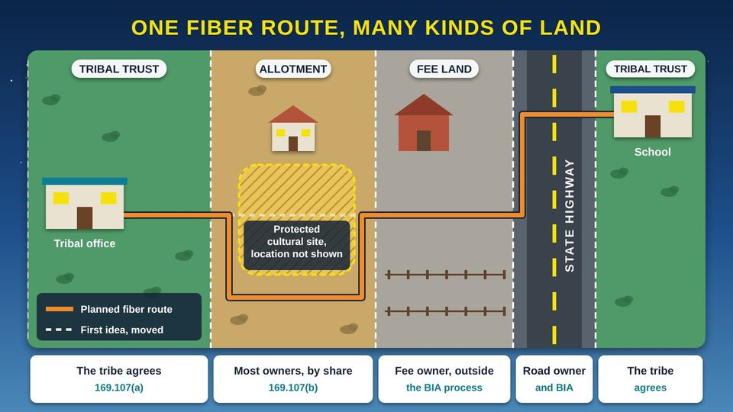
TECH RESOURCES FOR TRIBAL GOVERNMENTS · TRIBAL GUIDE 3 OF 4
The BIA Right-of-Way Process for Broadband
Land status, consent, the application, BIA deadlines, and life after the grant
Tribal staff and leaders
60 min
6 pictures
Free class from the Numu Communications Learning Center · www.numu.tech/resources
Notes:
TEACHING THIS CLASS (90-minute staff training)
Lesson plan:
- 10 min: Open with the planning office story and the Read this first callout. Name who covers realty, planning, the utility, legal counsel, and Council updates, and who is the main contact with the BIA Agency realty office.
- 15 min: Part 1: explore the route map and the Which Permission picture. On your own map, color each tract by land status and mark drops and tower sites.
- 15 min: Part 2: explore the allotment picture. Work a consent tally for a sample allotment: owners, shares signed, and whether a majority interest is reached.
- 15 min: Part 3: walk the twelve steps. In the Timeline sheet, give each step an owner and a target date, and review the escalation ladder.
- 10 min: Part 4: changes and records. Decide who files service line agreements within 30 days and who keeps the dated project file.
- 20 min: Do the team activity on one real route. Write the list of questions for the Agency and for tribal legal counsel.
- 5 min: Run the quiz with a show of hands, review the Remember cards, and set the date of the first Agency meeting.
What you need:
- Projector or large TV for the pictures
- The ROW Readiness Checklist, printed, one per person
- A large printed map of one planned route, or your GIS (Geographic Information System) map on screen
- The ROW Project Tracker open on a laptop
- Current Title Status Reports for two or three tracts, if the Agency can provide them; keep owner information private
- A printed copy of 25 CFR Part 169 from eCFR
Talk about it:
- Which tracts on our routes are allotments with many owners, and how will we reach every owner respectfully and in plain language?
- What conditions should our tribe attach to rights-of-way, and should we require a tribal conformance statement?
- Who will keep our project dates, and what will we do the day after a BIA deadline passes without an answer?
The picture slides have every numbered detail in their speaker notes.
STORY: Picture the tribal planning office on a spring morning. The funding came through, the fiber is on order, and a crew is ready to dig. Then someone unrolls the map. The route leaves the tribal office on tribal trust land, crosses an allotment shared by dozens of relatives, cuts across a ranch held in fee, and follows the state highway to the school. Each piece of land has its own rules and its own people who must say yes. This guide walks your team through the BIA (Bureau of Indian Affairs) right-of-way process one piece at a time, so the crew can dig with every permission in hand.

Slide 2
What you will learn
✓
Identify which land on a broadband route is covered by 25 CFR (Code of Federal Regulations) Part 169, and choose the right permission for each piece: a right-of-way, a service line agreement, or a business lease
✓
Explain who must consent on tribal land and on allotted land, how a majority interest works, and the options for payment, bonds, and insurance

Slide 3
What you will learn (continued)
✓
Put together a complete application and track the BIA (Bureau of Indian Affairs) review deadlines and the steps to take if one is missed
✓
Manage a grant after approval: changes, service line filings, compliance, and records at the LTRO (Land Title and Records Office)

Slide 4

The story
Picture the tribal planning office on a spring morning. The funding came through, the fiber is on order, and a crew is ready to dig. Then someone unrolls the map. The route leaves the tribal office on tribal trust land, crosses an allotment shared by dozens of relatives, cuts across a ranch held in fee, and follows the state highway to the school. Each piece of land has its own rules and its own people who must say yes. This guide walks your team through the BIA (Bureau of Indian Affairs) right-of-way process one piece at a time, so the crew can dig with every permission in hand.
Notes:
Picture the tribal planning office on a spring morning. The funding came through, the fiber is on order, and a crew is ready to dig. Then someone unrolls the map. The route leaves the tribal office on tribal trust land, crosses an allotment shared by dozens of relatives, cuts across a ranch held in fee, and follows the state highway to the school. Each piece of land has its own rules and its own people who must say yes. This guide walks your team through the BIA (Bureau of Indian Affairs) right-of-way process one piece at a time, so the crew can dig with every permission in hand.

Slide 5
PART 1
What a Right-of-Way Is, and Where It Applies
A right-of-way is permission to cross land for one purpose, like a fiber line. This part shows which land the federal rule covers, which kind of permission fits each piece of a network, and how tribal authority carries through. Please note: this guide is general information, not legal advice. Work with your BIA (Bureau of Indian Affairs) Agency realty office and your tribal legal counsel, and check the current rules on eCFR (the Electronic Code of Federal Regulations) before you act.
2 pictures to explore

Slide 6
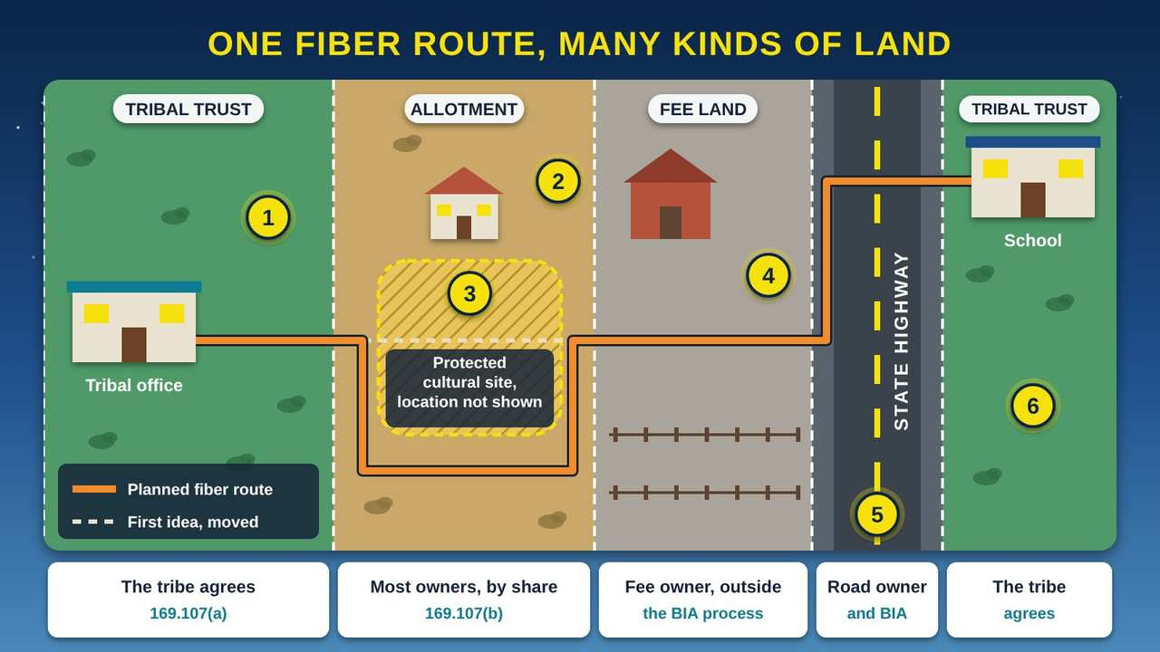
One Fiber Route, Many Kinds of Land
Part 1 · Picture 1 of 6
Notes:
One Fiber Route, Many Kinds of Land
What the picture shows: A map of a planned fiber route from a tribal office to a school. It crosses tribal trust land, an allotment with a family home, a fee-land ranch, and a state highway, then reaches tribal trust land again. The route bends around a generic protected cultural site. A strip under the map shows who must agree for each piece of land.
1. Tribal trust land. The United States holds this land in trust for the tribe. A right-of-way (ROW) across it is covered by 25 CFR (Code of Federal Regulations) Part 169 and needs the tribe's consent through a tribal authorization. Conditions the tribe sets become conditions of the grant (25 CFR 169.107(a)).
2. An allotment. This is individually owned Indian land, held in trust or restricted status, often by many relatives who each own an undivided share. Part 169 covers it (169.2). You must notify every owner and get written consent from the owners of the majority interest (169.107(b)).
3. A protected cultural site. The first idea ran straight through a protected cultural site, so the route was moved around it. The Bureau of Indian Affairs (BIA) must confirm the project follows federal environmental, historic-preservation, and cultural-resource laws (169.123(a)). Maps you share should never show where a site really is.
4. Fee land. This ranch is fee land, owned outright and not held in trust. Part 169 does not cover it, and the Bureau of Indian Affairs (BIA) will not make your grant depend on rights from fee owners (169.3(b)). Work out permission with the fee owner separately, with help from your legal counsel.
5. A state highway. A state highway usually sits in a right-of-way that someone else already holds. Ask the road owner, often the state transportation department, and your Bureau of Indian Affairs (BIA) Agency what permission you need to place fiber along it. Put this on your plan from day one.
6. Tract by tract. The school sits on tribal trust land again, but it is a different tract. Every piece of land the route crosses is its own tract, with its own owners and its own record. List every tract and its land status before you apply.

Slide 7
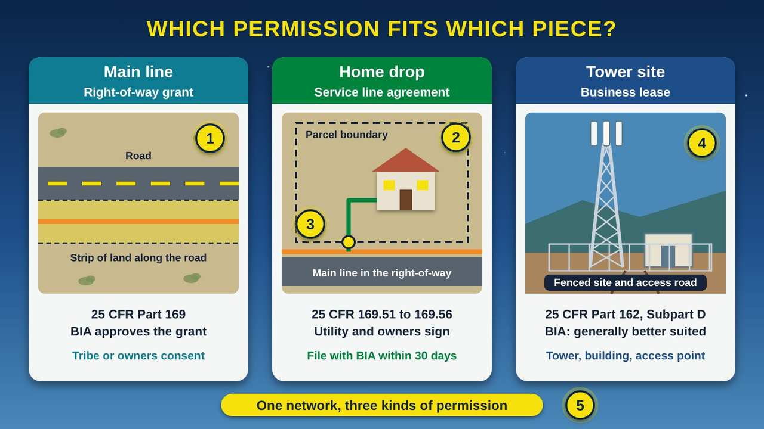
Which Permission Fits Which Piece?
Part 1 · Picture 2 of 6
Notes:
Which Permission Fits Which Piece?
What the picture shows: Three panels. The first shows a main fiber line in a strip of land along a road, needing a right-of-way grant. The second shows a fiber drop from the main line to a house, with the parcel boundary and connection point marked, needing a service line agreement. The third shows a fenced tower site with an equipment building, better suited to a business lease.
1. Main lines need a right-of-way. The main fiber line runs in a strip of land along the road. On tribal or individually owned Indian land, that strip needs a right-of-way (ROW) grant from the Bureau of Indian Affairs (BIA) under 25 CFR (Code of Federal Regulations) Part 169. Part 169 lists telecommunications and fiber lines as covered uses (169.5).
2. A home drop is a service line. A service line runs from a main or distribution line to a house, business, or other building. The rule says this includes telephone and internet lines (169.51). It uses a simpler service line agreement, signed by the utility and the landowners, instead of a full right-of-way (169.52).
3. The connection point and plat. The agreement should cover the services, how damage will be prevented, and how the land will be restored (169.53). Within 30 days, file the signed copy with the Bureau of Indian Affairs (BIA), with a plat or drawing that shows the parcel boundary and this connection point (169.56).
4. Tower sites fit a lease. A tower site is a fenced area the company uses all the time, not just a strip to pass through. The Bureau of Indian Affairs (BIA) says tower sites, buildings, and access points are generally better suited to a business lease under 25 CFR Part 162, Subpart D.
5. Plan all three together. Most broadband projects need all three. Also check what already exists: a use already allowed by a lease, a grazing permit, or a tribal land assignment does not need a new right-of-way (169.4(b)(2)).

Slide 8
Read this first: general information, not legal advice
This guide explains the federal right-of-way rules in plain language. It is general information, not legal advice, and it does not replace the rules themselves.
Work with your BIA (Bureau of Indian Affairs) Agency realty office and your tribal legal counsel on every project. Rules and policies change, so check the current 25 CFR (Code of Federal Regulations) Part 169 on eCFR (the Electronic Code of Federal Regulations, at ecfr.gov) before you act.

Slide 9
Read this first: general information, not legal advice (continued)
This guide describes the rule for grants made on or after April 21, 2016. For older grants, only the procedural parts of the current rule apply (25 CFR 169.7).

Slide 10
Also in your handout
The handout and the web page cover these topics in detail: What the rule says a right-of-way is; Which land does Part 169 cover?; Which permission fits which piece of the network?; Tribal authority carries through.

Slide 11
PART 2
Consent and Compensation
Every right-of-way on trust land starts with consent. On allotted land, that can mean finding and talking with many owners. This part covers who must agree, how payment works, and the bond and insurance rules.
1 picture to explore

Slide 12
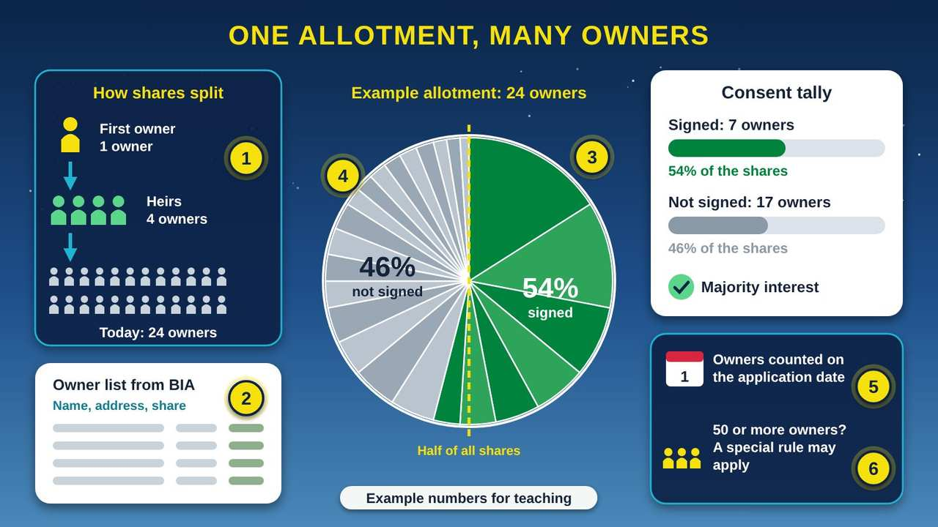
One Allotment, Many Owners
Part 2 · Picture 3 of 6
Notes:
One Allotment, Many Owners
What the picture shows: On the left, one allotment owner becomes 4 heirs and then 24 owners, with a sample owner list from BIA. In the center, a pie chart shows 24 owners' shares: 7 owners holding 54% have signed, and 17 owners holding 46% have not, with a dashed line marking half. On the right, a consent tally shows the majority interest is reached, with notes on the count date and the rule for 50 or more owners.
1. Why so many owners. When an allotment owner passes on, the land is often split among heirs as undivided shares. After a few generations, one allotment can have dozens of owners, each holding a small share of the whole. This is called fractionation.
2. Ask BIA for the owner list. You may survey with the landowners' consent; you do not need approval from the Bureau of Indian Affairs (BIA) to survey (25 CFR 169.101). On written request, BIA will give you the owners' names, addresses, and ownership shares so you can negotiate (169.106).
3. Majority by share, not by headcount. For individually owned land, you must notify every owner and get written consent from the owners of the majority interest (169.107(b)). Here 7 owners hold 54% of the shares, so they are a majority interest, even though most owners did not sign.
4. Owners who did not sign. Owners who do not consent are still paid. They receive fair market value unless an exception applies (169.112(d)). Fee interests, shares no longer held in trust, are not counted toward consent (169.3(c)).
5. The count date. The Bureau of Indian Affairs (BIA) counts owners from its records as of the date you apply (169.107(c)). Owners change as people pass on and estates close, so get a fresh owner list close to your application date.
6. Fifty or more owners. The Bureau of Indian Affairs (BIA) may grant a right-of-way without consent only if four conditions are all met, including 60 days' notice to owners and a 30-day window to object (169.107(b)(1)). Getting consent counts as impracticable when there are 50 or more co-owners (169.107(b)(2)).

Slide 13
Getting consent, step by step
1
Get consent to survey
2
Ask BIA for owner information
3
Tribal land: get a tribal authorization
4
Allotted land: notify everyone, then count shares
5
Check who may sign
6
Know the no-consent exception
Notes:
1. Get consent to survey. You need the landowners' consent to survey, but not BIA approval (25 CFR 169.101).
2. Ask BIA for owner information. Send BIA a written request. BIA will give you the owners' names, addresses, and ownership shares so you can negotiate (169.106).
3. Tribal land: get a tribal authorization. The tribe consents by tribal authorization, plus a written agreement if the tribe requires one. The tribe's conditions become grant conditions (169.107(a)).
4. Allotted land: notify everyone, then count shares. Give notice to all owners and get written consent from the owners of the majority interest, meaning more than half of the shares, not more than half of the people (169.107(b)). BIA counts owners from its records as of your application date (169.107(c)).
5. Check who may sign. The rules say who may consent for an owner (169.108) and how life estates are handled (169.109). Ask the Agency about minors, estates in probate, and owners who cannot be found.
6. Know the no-consent exception. BIA may grant a right-of-way across allotted land without consent only if four conditions are all met, including 60 days' notice to owners and a 30-day window to object (169.107(b)(1)). Consent counts as impracticable when there are 50 or more co-owners (169.107(b)(2)).

Slide 14
Bonds, security, and insurance (25 CFR 169.103)
Plan for security (a bond or similar). It is required unless waived or exempt (169.103).
Do not plan on a cash bond. Cash bonds are not accepted (169.103(j)).
Carry insurance that names the landowners and the United States as additional insureds (169.103(b)).

Slide 15
Bonds, security, and insurance (25 CFR 169.103) (continued)
On tribal land, BIA defers to the tribe on waivers (169.103(f)).
On allotted land, ask about a waiver if the majority owners request one, or if you are a tribal utility or a utility cooperative (169.103(f)).
If your government is barred by law from posting security, ask about the exemption in 169.103(k).

Slide 16
Also in your handout
The handout and the web page cover these topics in detail: Compensation: what the rules allow; A tribal utility has extra options.

Slide 17
PART 3
The Application and BIA Review
With consent in hand, you put the package together. BIA's review clock starts only when the package is complete, so a complete package is the fastest path.
1 picture to explore

Slide 18
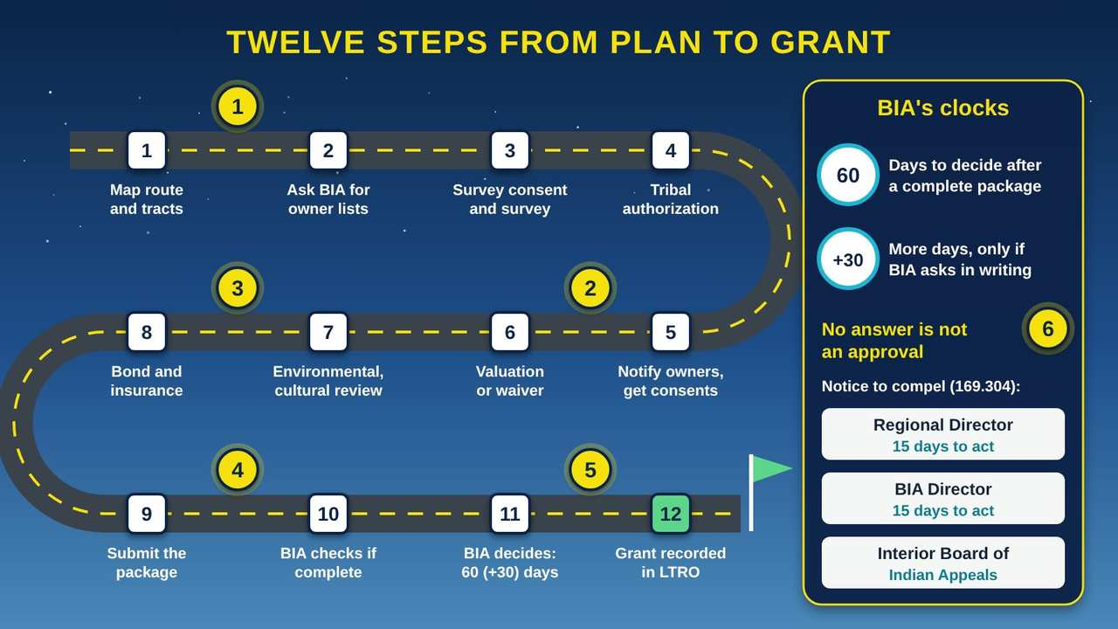
Twelve Steps from Plan to Grant
Part 3 · Picture 4 of 6
Notes:
Twelve Steps from Plan to Grant
What the picture shows: A winding road with twelve numbered stops: map the route and tracts, ask BIA for owner lists, survey, tribal authorization, owner consents, valuation, environmental and cultural review, bond and insurance, submit, completeness check, BIA decision in 60 plus 30 days, and the grant recorded in the LTRO. A side panel shows BIA's 60-day and 30-day clocks and the escalation ladder: Regional Director, BIA Director, then the Interior Board of Indian Appeals.
1. Steps 1 to 4: before you apply. Map the route and list every tract. Ask the Bureau of Indian Affairs (BIA) in writing for owner lists (25 CFR 169.106). Get landowner consent to survey; BIA approval is not needed to survey (169.101). For tribal land, the tribe acts by tribal authorization (169.107(a)).
2. Steps 5 and 6: consent and payment. Notify every owner of allotted land and gather written consent from the majority interest (169.107(b)). Settle compensation: a negotiated amount, fair market value, or a waiver the rules allow (169.110 and 169.112).
3. Steps 7 and 8: reviews and security. Environmental and cultural review documents are part of a complete package (169.123(b)). Line up the bond or other security and insurance, or a waiver or exemption that fits (169.103). Start these early, because they can take the longest.
4. Steps 9 and 10: submit and check. Send the package with everything 169.102 lists. There is no required form, but the Bureau of Indian Affairs (BIA) offers an optional one and a checklist. BIA must promptly tell you whether the package is complete (169.123(b)).
5. Steps 11 and 12: the decision. Within 60 days of a complete package, the Bureau of Indian Affairs (BIA) must grant, deny, return it, or ask for more time; if it asks, it must decide within 30 days of that letter (169.123(b)). BIA must grant unless it has a compelling reason not to (169.124). The grant takes effect when approved and is recorded in the Land Title and Records Office (LTRO) (169.301 to 169.302).
6. If the clock runs out. A missed deadline does not mean your right-of-way is approved. Send a written notice to compel to the Regional Director, who has 15 days to act; then to the Bureau of Indian Affairs (BIA) Director, who has 15 days; then you may appeal to the Interior Board of Indian Appeals (169.304).

Slide 19
What goes in the application (25 CFR 169.102)
There is no required form (169.102(c)). BIA publishes an optional form (OMB 1076-0181, an Office of Management and Budget control number) and a checklist. A complete package includes:
The tracts the right-of-way crosses
The purpose (for example, a buried fiber line)
The duration you are asking for
A legal description of the right-of-way

Slide 20
What goes in the application (25 CFR 169.102) (continued)
A map of definite location (the surveyed route)
Security: a bond or other security, or a waiver or exemption
Proof that you gave notice to the landowners
The consents (tribal authorization, owners' written consents)
A valuation, or a waiver of valuation
Environmental and archaeological reports
A tribal conformance statement, if the tribe requires one

Slide 21
BIA's clocks, and what to do if one runs out
1
BIA checks the package
2
60 days to decide
3
30 more days, only in writing
4
A strong standard
5
Silence is not approval
6
Escalate in writing
7
Grant recorded
Notes:
1. BIA checks the package. BIA must promptly tell you whether the package is complete (169.123(b)). Write down the date you get that answer.
2. 60 days to decide. Within 60 days of a complete package, BIA must grant, deny, return the package, or ask for more time (169.123(b)).
3. 30 more days, only in writing. If BIA asks for more time, it must decide within 30 days of that letter (169.123(b)).
4. A strong standard. BIA must grant the right-of-way unless it finds a compelling reason not to (169.124).
5. Silence is not approval. A missed deadline does not mean the right-of-way is deemed approved. Do not start building.
6. Escalate in writing. Send a written notice to compel to the Regional Director, who has 15 days to act. If there is still no decision, send one to the BIA Director, who has 15 days. Then you may appeal to the IBIA (Interior Board of Indian Appeals) (169.304).
7. Grant recorded. The grant takes effect on the date BIA approves it and is recorded in the LTRO (Land Title and Records Office) (169.301 to 169.302).

Slide 22
Also in your handout
The handout and the web page cover these topics in detail: Environmental and cultural review; Mail or email? Ask first.

Slide 23
PART 4
After the Grant, and Speeding Things Up
A grant is the start of a long relationship with the land and its owners. This part covers changes, home drops, compliance, records, and what you can do to keep things moving.
2 pictures to explore

Slide 24
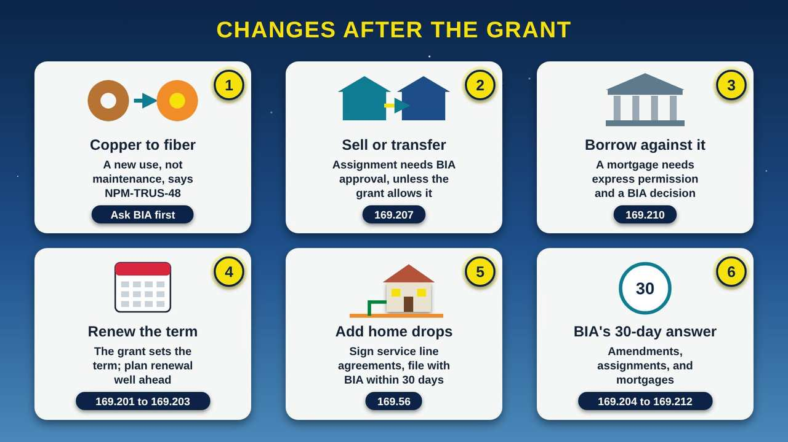
Changes After the Grant
Part 4 · Picture 5 of 6
Notes:
Changes After the Grant
What the picture shows: Six cards show changes after a right-of-way grant: switching copper to fiber, selling or transferring the grant, borrowing against it, renewing the term, adding home drops, and BIA's 30-day decision on amendments, assignments, and mortgages. Each card shows the related rule section.
1. Copper to fiber is a change of use. The Bureau of Indian Affairs (BIA) policy memo NPM-TRUS-48 (National Policy Memorandum) treats switching a line from copper to fiber as a new use, not maintenance. Before you upgrade inside an old right-of-way, ask your BIA Agency what approval you need, such as an amendment.
2. Selling or transferring the grant. Passing a right-of-way to another company is an assignment. It needs Bureau of Indian Affairs (BIA) approval unless the grant itself expressly allows assignment without it (25 CFR 169.207).
3. Using the grant for a loan. A lender may want the right-of-way as security for a loan. A mortgage of a right-of-way requires express permission (169.210), and the Bureau of Indian Affairs (BIA) decides on it.
4. How long the grant lasts. The grant lasts as long as it says. On tribal land, the Bureau of Indian Affairs (BIA) defers to the term the tribe sets. On allotted land, 50 years total, including renewals, is generally reasonable for uses other than oil and gas (169.201). Renewals follow 169.202 and 169.203.
5. New homes along the line. Each new home drop needs a service line agreement signed before construction by the right people: on tribal land, the tribe or the authorized occupants or users; on allotted land, the owners or the authorized occupants or users (169.54). File each one with the Bureau of Indian Affairs (BIA) within 30 days (169.56).
6. A 30-day answer. For amendments, assignments, and mortgages, the Bureau of Indian Affairs (BIA) has 30 days to decide (169.204 to 169.212). Put each request date on your tracker so you know when the answer is due.

Slide 25
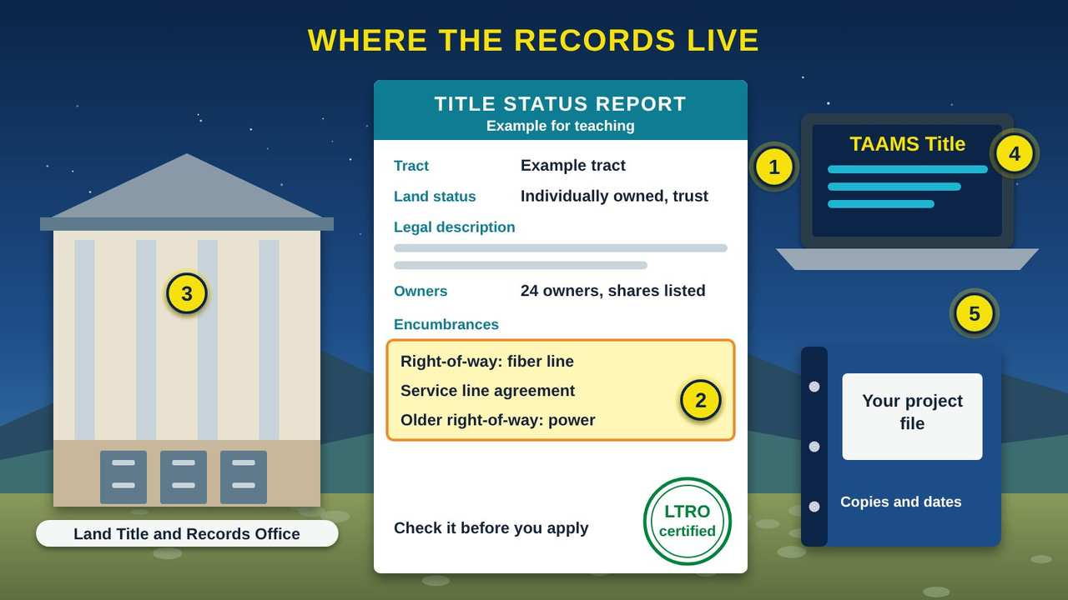
Where the Records Live
Part 4 · Picture 6 of 6
Notes:
Where the Records Live
What the picture shows: A Land Title and Records Office building with filing cabinets, a sample Title Status Report showing tract, land status, legal description, owners, and an encumbrances box listing a fiber right-of-way, a service line agreement, and an older power right-of-way, a laptop showing TAAMS Title, and a project binder labeled Your project file.
1. The Title Status Report. A Title Status Report (TSR) shows a tract's legal description, its owners, and its encumbrances, including rights-of-way. The Land Title and Records Office (LTRO) certifies it. Ask your Bureau of Indian Affairs (BIA) Agency realty office for current TSRs for every tract on your route.
2. Encumbrances. An encumbrance is anything already recorded against the land, such as an older power line right-of-way. Checking this list early shows what is already there, who holds it, and whether an existing grant or lease already covers part of your plan.
3. The Land Title and Records Office. The Land Title and Records Office (LTRO) records title documents for trust land. Your approved right-of-way grant is recorded there (25 CFR 169.301 to 169.302), and so are filed service line agreements (169.56). The Bureau of Indian Affairs (BIA) has 18 LTROs across the country.
4. TAAMS. The LTRO keeps title records in TAAMS (Trust Asset and Accounting Management System) Title. This is the federal system behind the owner lists and Title Status Reports (TSRs) that you receive.
5. Keep your own file. Keep a copy of every request, letter, and grant, with the date you sent or received it. The Government Accountability Office (GAO) found that only 5% of processed rights-of-way it reviewed (52 of 1,146) had all key dates recorded. Your own dates are your best tool if you need to escalate.

Slide 26
Service lines: home drops done right
1
Sign before you build
2
Cover the basics
3
Draw a plat
4
File within 30 days
Notes:
1. Sign before you build. The utility and the landowners sign the agreement (169.52). Before construction, get signatures from the tribe or the authorized occupants or users on tribal land (the tribe must also sign if it asks), or from the owners or the authorized occupants or users on allotted land (169.54).
2. Cover the basics. Say what services you will provide, how you will prevent damage, and how you will restore the land (169.53). No valuation is required (169.55).
3. Draw a plat. Attach a plat or drawing that shows the parcel boundary and the connection point (169.56).
4. File within 30 days. File the signed copy with BIA within 30 days so it can be recorded in the LTRO (169.56). Filing, not BIA approval, is what keeps a drop outside the full right-of-way process (169.4(b)(3)). To be safe, count the 30 days from the day the agreement is signed.

Slide 27
Common pitfalls to avoid
Starting construction before the grant is approved, or treating a missed deadline as approval
Forgetting fee land, which sits outside the BIA process, and state or county roads, where you must also ask the road owner
Counting owners instead of shares when you tally consent
Using an old owner list; BIA counts owners as of your application date

Slide 28
Common pitfalls to avoid (continued)
Sending an incomplete package, so the 60-day clock never starts
Planning on a cash bond, which is not accepted
Treating a copper-to-fiber upgrade as routine maintenance
Putting a tower site in a right-of-way instead of asking about a business lease
Missing the 30-day filing for service line agreements
Not keeping your own dated record of every letter and request

Slide 29
Also in your handout
The handout and the web page cover these topics in detail: Grant terms and later changes; Compliance and enforcement; Speeding things up.

Slide 30
Questions to ask your BIA Agency realty office
How do you want the package submitted: mail, email, or both? Who is our contact?
Is NPM-TRUS-48 still in effect, or has a newer memo replaced it?
Can one application cover all the tracts on this route that touch each other?
How do we get current Title Status Reports and owner lists for each tract?

Slide 31
Questions to ask your BIA Agency realty office (continued)
Which environmental and cultural reviews will you need for this route, and can an existing categorical exclusion be used?
What bond, insurance, or waiver will you accept for our project?
How should we file service line agreements, and how do we get proof of filing?

Slide 32
One more reminder
This guide is general information, not legal advice. Confirm every step with your BIA Agency realty office and your tribal legal counsel, and read the current 25 CFR Part 169 on eCFR before you act.

Slide 33
Try it with your team: map one route
About 30 minutes with a map of one planned route, the ROW Project Tracker, and the ROW Readiness Checklist.
1
Pick one planned route, such as the tribal office to the school. Draw it on a printed map or in your GIS (Geographic Information System) software.

Slide 34
Try it with your team: map one route (continued)
2
Ask your BIA Agency realty office how to get Title Status Reports for each tract the route crosses, and mark each tract's land status: tribal trust, allotment, BIA land, fee land, or road.
3
Enter each tract on the Tracts sheet of the tracker. Write who must consent: the tribe by tribal authorization, the majority interest of allotment owners, or someone outside the BIA process.

Slide 35
Try it with your team: map one route (continued)
4
For each allotment, write the number of owners. Flag any with 50 or more owners to discuss with the Agency.
5
Mark every home or building that will need a service line agreement, and any tower site that may need a business lease.
6
List your questions for the Agency and your tribal legal counsel, and set a date to meet.

Slide 36



Remember
Each tract has its own rules and owners
Allotted land needs consent of the majority interest
A missed BIA deadline is not an approval
Notes:
Each tract has its own rules and owners
Allotted land needs consent of the majority interest
A missed BIA deadline is not an approval

Slide 37


Check what you learned: question 1 of 5
Your fiber route crosses tribal trust land, an allotment, and a ranch held in fee. Which pieces does the BIA (Bureau of Indian Affairs) right-of-way process cover?
A
B
C
All three pieces
The tribal trust land and the allotment
Only the tribal trust land
Notes:
Your fiber route crosses tribal trust land, an allotment, and a ranch held in fee. Which pieces does the BIA (Bureau of Indian Affairs) right-of-way process cover?
Answer: B. The tribal trust land and the allotment
Part 169 covers tribal land and individually owned Indian land (169.2). Fee land is outside it, and BIA will not make your grant depend on fee owners (169.3(b)), so you work that out with the fee owner separately.

Slide 38
Answer: question 1 of 5
Your fiber route crosses tribal trust land, an allotment, and a ranch held in fee. Which pieces does the BIA (Bureau of Indian Affairs) right-of-way process cover?
A
All three pieces
B
The tribal trust land and the allotment
✓ Correct
C
Only the tribal trust land
Why: Part 169 covers tribal land and individually owned Indian land (169.2). Fee land is outside it, and BIA will not make your grant depend on fee owners (169.3(b)), so you work that out with the fee owner separately.
Notes:
Your fiber route crosses tribal trust land, an allotment, and a ranch held in fee. Which pieces does the BIA (Bureau of Indian Affairs) right-of-way process cover?
Answer: B. The tribal trust land and the allotment
Part 169 covers tribal land and individually owned Indian land (169.2). Fee land is outside it, and BIA will not make your grant depend on fee owners (169.3(b)), so you work that out with the fee owner separately.

Slide 39
Check what you learned: question 2 of 5
An allotment on your route has 40 owners. You have notified all of them, and 12 owners holding 55% of the shares have signed. Is that enough consent?
A
B
C
Yes, they hold the majority interest
No, every owner must sign
No, more than 20 of the 40 owners must sign
Notes:
An allotment on your route has 40 owners. You have notified all of them, and 12 owners holding 55% of the shares have signed. Is that enough consent?
Answer: A. Yes, they hold the majority interest
On individually owned land you need written consent from the owners of the majority interest, counted by shares, after notice to all owners (169.107(b)). The owners who did not sign are still paid fair market value unless an exception applies.

Slide 40
Answer: question 2 of 5
An allotment on your route has 40 owners. You have notified all of them, and 12 owners holding 55% of the shares have signed. Is that enough consent?
A
Yes, they hold the majority interest
✓ Correct
B
No, every owner must sign
C
No, more than 20 of the 40 owners must sign
Why: On individually owned land you need written consent from the owners of the majority interest, counted by shares, after notice to all owners (169.107(b)). The owners who did not sign are still paid fair market value unless an exception applies.
Notes:
An allotment on your route has 40 owners. You have notified all of them, and 12 owners holding 55% of the shares have signed. Is that enough consent?
Answer: A. Yes, they hold the majority interest
On individually owned land you need written consent from the owners of the majority interest, counted by shares, after notice to all owners (169.107(b)). The owners who did not sign are still paid fair market value unless an exception applies.

Slide 41


Check what you learned: question 3 of 5
BIA said your package was complete 75 days ago. You have no decision and no letter asking for more time. What should you do?
A
B
C
Start building, because it is now approved
Send a written notice to compel to the Regional Director
Withdraw and start a new application
Notes:
BIA said your package was complete 75 days ago. You have no decision and no letter asking for more time. What should you do?
Answer: B. Send a written notice to compel to the Regional Director
A missed deadline is not an approval. Under 25 CFR (Code of Federal Regulations) 169.304, you send a notice to compel to the Regional Director, then the BIA (Bureau of Indian Affairs) Director, then you may appeal to the Interior Board of Indian Appeals.

Slide 42
Answer: question 3 of 5
BIA said your package was complete 75 days ago. You have no decision and no letter asking for more time. What should you do?
A
Start building, because it is now approved
B
Send a written notice to compel to the Regional Director
✓ Correct
C
Withdraw and start a new application
Why: A missed deadline is not an approval. Under 25 CFR (Code of Federal Regulations) 169.304, you send a notice to compel to the Regional Director, then the BIA (Bureau of Indian Affairs) Director, then you may appeal to the Interior Board of Indian Appeals.
Notes:
BIA said your package was complete 75 days ago. You have no decision and no letter asking for more time. What should you do?
Answer: B. Send a written notice to compel to the Regional Director
A missed deadline is not an approval. Under 25 CFR (Code of Federal Regulations) 169.304, you send a notice to compel to the Regional Director, then the BIA (Bureau of Indian Affairs) Director, then you may appeal to the Interior Board of Indian Appeals.

Slide 43

Check what you learned: question 4 of 5
Last week your crew connected 12 homes on allotments, each with a signed service line agreement. What still needs to happen?
A
B
C
Wait for BIA (Bureau of Indian Affairs) approval of each drop
File each signed agreement and plat with BIA within 30 days
Nothing; service lines are not covered
Notes:
Last week your crew connected 12 homes on allotments, each with a signed service line agreement. What still needs to happen?
Answer: B. File each signed agreement and plat with BIA within 30 days
Service lines do not need BIA approval, but each signed agreement, with a plat showing the parcel boundary and connection point, must be filed with BIA within 30 days so it can be recorded (169.56).

Slide 44
Answer: question 4 of 5
Last week your crew connected 12 homes on allotments, each with a signed service line agreement. What still needs to happen?
A
Wait for BIA (Bureau of Indian Affairs) approval of each drop
B
File each signed agreement and plat with BIA within 30 days
✓ Correct
C
Nothing; service lines are not covered
Why: Service lines do not need BIA approval, but each signed agreement, with a plat showing the parcel boundary and connection point, must be filed with BIA within 30 days so it can be recorded (169.56).
Notes:
Last week your crew connected 12 homes on allotments, each with a signed service line agreement. What still needs to happen?
Answer: B. File each signed agreement and plat with BIA within 30 days
Service lines do not need BIA approval, but each signed agreement, with a plat showing the parcel boundary and connection point, must be filed with BIA within 30 days so it can be recorded (169.56).

Slide 45
Check what you learned: question 5 of 5
Your utility wants to pull out an old copper line in an existing right-of-way and put in fiber. How should you treat it?
A
B
As routine maintenance; no one needs to know
As a change in use; ask the BIA (Bureau of Indian Affairs) Agency what approval is needed
Notes:
Your utility wants to pull out an old copper line in an existing right-of-way and put in fiber. How should you treat it?
Answer: B. As a change in use; ask the BIA (Bureau of Indian Affairs) Agency what approval is needed
BIA's policy memo NPM-TRUS-48 (National Policy Memorandum) treats a switch from copper to fiber as a new use, not maintenance. Ask the Agency before you start, and plan for an amendment if needed.

Slide 46
Answer: question 5 of 5
Your utility wants to pull out an old copper line in an existing right-of-way and put in fiber. How should you treat it?
A
As routine maintenance; no one needs to know
As a change in use; ask the BIA (Bureau of Indian Affairs) Agency what approval is needed
B
✓ Correct
Why: BIA's policy memo NPM-TRUS-48 (National Policy Memorandum) treats a switch from copper to fiber as a new use, not maintenance. Ask the Agency before you start, and plan for an amendment if needed.
Notes:
Your utility wants to pull out an old copper line in an existing right-of-way and put in fiber. How should you treat it?
Answer: B. As a change in use; ask the BIA (Bureau of Indian Affairs) Agency what approval is needed
BIA's policy memo NPM-TRUS-48 (National Policy Memorandum) treats a switch from copper to fiber as a new use, not maintenance. Ask the Agency before you start, and plan for an amendment if needed.

Slide 47
Words to know
ROW
Right-of-way. A legal right to go over or across tribal land, individually owned Indian land, or BIA (Bureau of Indian Affairs) land for a specific purpose, such as a fiber line.
BIA
Bureau of Indian Affairs. The federal agency in the U.S. Department of the Interior that reviews and grants rights-of-way across trust and restricted land.
CFR
Code of Federal Regulations. The official set of federal rules. The right-of-way rules are Title 25, Part 169, written 25 CFR Part 169.
eCFR
Electronic Code of Federal Regulations. The free government website, ecfr.gov, that shows the current federal rules.

Slide 48
Words to know (continued)
Tribal land
Land, or an undivided share of land, held in trust or restricted status for a tribe.
Allotment
Individually owned Indian land. Land held in trust or restricted status for one or more individual Indian owners.
Fee land
Land owned outright, not held in trust or restricted status. The BIA right-of-way rule does not cover it.
Fractionation
When ownership of an allotment is split into smaller and smaller undivided shares as it passes to heirs over generations.

Slide 49
Words to know (continued)
Majority interest
Owners who together hold more than half of the shares in a tract. It is counted by shares, not by number of people.
Tribal authorization
A tribal resolution, ordinance, or other official tribal document that approves an action, such as consent to a right-of-way.
Service line
A line from a main or distribution line to a house, business, or other building, including telephone and internet drops.
Business lease
A lease under 25 CFR (Code of Federal Regulations) Part 162, Subpart D. BIA (Bureau of Indian Affairs) says it generally fits tower sites, buildings, and access points better than a right-of-way.

Slide 50
Words to know (continued)
Fair market value
The amount the right to use the land would be worth in an open market, found through an accepted valuation method.
LTRO
Land Title and Records Office. The BIA (Bureau of Indian Affairs) office that records title documents for trust land and certifies Title Status Reports.
TSR
Title Status Report. A certified report showing a tract's legal description, owners, and encumbrances, including rights-of-way.
TAAMS
Trust Asset and Accounting Management System. The federal computer system where title records for trust land are kept.

Slide 51
Words to know (continued)
NEPA
National Environmental Policy Act. A federal law that requires agencies to study the environmental effects of actions they approve, such as a right-of-way grant.
Categorical exclusion
A kind of action an agency has found does not normally have significant environmental effects, so it needs less NEPA (National Environmental Policy Act) paperwork, unless extraordinary circumstances exist.

Slide 52
Learn more
eCFR: 25 CFR Part 169, Rights-of-Way on Indian Land
The current rule, updated as it changes. Always check it before you act.
https://www.ecfr.gov/current/title-25/chapter-I/subchapter-H/part-169
BIA: Apply for broadband right-of-way in Indian Country
BIA's page for broadband applicants, with the optional form and checklist.
https://www.bia.gov/service/broadband-access/apply-broadband-right-of-way
BIA: 52 IAM 9-H, Rights-of-way on Indian lands handbook
The handbook BIA staff use to process rights-of-way.
https://www.bia.gov/policy-forms/handbooks/52-iam-9-h-rights-way-row-indian-lands-handbook

Slide 53
Learn more (continued)
BIA: NPM-TRUS-48, streamlining broadband rights-of-way
The 2025 policy memo with faster review targets. Ask whether it is still in effect.
https://www.bia.gov/sites/default/files/dup/assets/public/raca/national_policy_memoranda/pdf/npm-trus-48_streamlining-rows-broadband_final_signed_508.pdf
NTIA: Newly adopted NEPA categorical exclusions
The 30 categorical exclusions for broadband work, and when they cannot be used.
https://broadbandusa.ntia.gov/funding-programs/policies-waivers/Notice_of_Newly_Adopted_NEPA_Categorical_Exclusions
GAO: Timely delivery of BIA real estate services
The 2023 GAO report on delays, records, and staffing in BIA realty.
https://www.gao.gov/assets/d24105875.pdf

Slide 54
Program tools (free downloads)
ROW Readiness Checklist (DOCX)
Every application element, consent, review, and bond, with 25 CFR section numbers and space for notes. Editable Word file.
ROW Readiness Checklist (PDF)
The same checklist, ready to print for a planning meeting.

Slide 55
Program tools (free downloads) (continued)
ROW Project Tracker (XLSX)
Track tracts and consent shares, BIA deadlines and escalation dates, and 30-day service line filings. Dates are calculated for you.
Service Line Agreement Starter (DOCX)
A plain-language outline of what 25 CFR 169.53 to 169.56 require. A sample to adapt with tribal legal counsel, not a legal form.
Download at www.numu.tech/learning-center/bia-row.html

Slide 56
Teaching this class: lesson plan (90-minute staff training)
10 min
Open with the planning office story and the Read this first callout. Name who covers realty, planning, the utility, legal counsel, and Council updates, and who is the main contact with the BIA Agency realty office.
15 min
Part 1: explore the route map and the Which Permission picture. On your own map, color each tract by land status and mark drops and tower sites.
15 min
Part 2: explore the allotment picture. Work a consent tally for a sample allotment: owners, shares signed, and whether a majority interest is reached.
Notes:
TEACHING THIS CLASS (90-minute staff training)
Lesson plan:
- 10 min: Open with the planning office story and the Read this first callout. Name who covers realty, planning, the utility, legal counsel, and Council updates, and who is the main contact with the BIA Agency realty office.
- 15 min: Part 1: explore the route map and the Which Permission picture. On your own map, color each tract by land status and mark drops and tower sites.
- 15 min: Part 2: explore the allotment picture. Work a consent tally for a sample allotment: owners, shares signed, and whether a majority interest is reached.
- 15 min: Part 3: walk the twelve steps. In the Timeline sheet, give each step an owner and a target date, and review the escalation ladder.
- 10 min: Part 4: changes and records. Decide who files service line agreements within 30 days and who keeps the dated project file.
- 20 min: Do the team activity on one real route. Write the list of questions for the Agency and for tribal legal counsel.
- 5 min: Run the quiz with a show of hands, review the Remember cards, and set the date of the first Agency meeting.
What you need:
- Projector or large TV for the pictures
- The ROW Readiness Checklist, printed, one per person
- A large printed map of one planned route, or your GIS (Geographic Information System) map on screen
- The ROW Project Tracker open on a laptop
- Current Title Status Reports for two or three tracts, if the Agency can provide them; keep owner information private
- A printed copy of 25 CFR Part 169 from eCFR
Talk about it:
- Which tracts on our routes are allotments with many owners, and how will we reach every owner respectfully and in plain language?
- What conditions should our tribe attach to rights-of-way, and should we require a tribal conformance statement?
- Who will keep our project dates, and what will we do the day after a BIA deadline passes without an answer?
The picture slides have every numbered detail in their speaker notes.
STORY: Picture the tribal planning office on a spring morning. The funding came through, the fiber is on order, and a crew is ready to dig. Then someone unrolls the map. The route leaves the tribal office on tribal trust land, crosses an allotment shared by dozens of relatives, cuts across a ranch held in fee, and follows the state highway to the school. Each piece of land has its own rules and its own people who must say yes. This guide walks your team through the BIA (Bureau of Indian Affairs) right-of-way process one piece at a time, so the crew can dig with every permission in hand.

Slide 57
Teaching this class: lesson plan (90-minute staff training) (continued)
15 min
Part 3: walk the twelve steps. In the Timeline sheet, give each step an owner and a target date, and review the escalation ladder.
10 min
Part 4: changes and records. Decide who files service line agreements within 30 days and who keeps the dated project file.
20 min
Do the team activity on one real route. Write the list of questions for the Agency and for tribal legal counsel.
5 min
Run the quiz with a show of hands, review the Remember cards, and set the date of the first Agency meeting.
Notes:
TEACHING THIS CLASS (90-minute staff training)
Lesson plan:
- 10 min: Open with the planning office story and the Read this first callout. Name who covers realty, planning, the utility, legal counsel, and Council updates, and who is the main contact with the BIA Agency realty office.
- 15 min: Part 1: explore the route map and the Which Permission picture. On your own map, color each tract by land status and mark drops and tower sites.
- 15 min: Part 2: explore the allotment picture. Work a consent tally for a sample allotment: owners, shares signed, and whether a majority interest is reached.
- 15 min: Part 3: walk the twelve steps. In the Timeline sheet, give each step an owner and a target date, and review the escalation ladder.
- 10 min: Part 4: changes and records. Decide who files service line agreements within 30 days and who keeps the dated project file.
- 20 min: Do the team activity on one real route. Write the list of questions for the Agency and for tribal legal counsel.
- 5 min: Run the quiz with a show of hands, review the Remember cards, and set the date of the first Agency meeting.
What you need:
- Projector or large TV for the pictures
- The ROW Readiness Checklist, printed, one per person
- A large printed map of one planned route, or your GIS (Geographic Information System) map on screen
- The ROW Project Tracker open on a laptop
- Current Title Status Reports for two or three tracts, if the Agency can provide them; keep owner information private
- A printed copy of 25 CFR Part 169 from eCFR
Talk about it:
- Which tracts on our routes are allotments with many owners, and how will we reach every owner respectfully and in plain language?
- What conditions should our tribe attach to rights-of-way, and should we require a tribal conformance statement?
- Who will keep our project dates, and what will we do the day after a BIA deadline passes without an answer?
The picture slides have every numbered detail in their speaker notes.
STORY: Picture the tribal planning office on a spring morning. The funding came through, the fiber is on order, and a crew is ready to dig. Then someone unrolls the map. The route leaves the tribal office on tribal trust land, crosses an allotment shared by dozens of relatives, cuts across a ranch held in fee, and follows the state highway to the school. Each piece of land has its own rules and its own people who must say yes. This guide walks your team through the BIA (Bureau of Indian Affairs) right-of-way process one piece at a time, so the crew can dig with every permission in hand.

Slide 58
Teaching this class: materials and discussion
What you need
Projector or large TV for the pictures
The ROW Readiness Checklist, printed, one per person
A large printed map of one planned route, or your GIS (Geographic Information System) map on screen
The ROW Project Tracker open on a laptop
Current Title Status Reports for two or three tracts, if the Agency can provide them; keep owner information private
Notes:
TEACHING THIS CLASS (90-minute staff training)
Lesson plan:
- 10 min: Open with the planning office story and the Read this first callout. Name who covers realty, planning, the utility, legal counsel, and Council updates, and who is the main contact with the BIA Agency realty office.
- 15 min: Part 1: explore the route map and the Which Permission picture. On your own map, color each tract by land status and mark drops and tower sites.
- 15 min: Part 2: explore the allotment picture. Work a consent tally for a sample allotment: owners, shares signed, and whether a majority interest is reached.
- 15 min: Part 3: walk the twelve steps. In the Timeline sheet, give each step an owner and a target date, and review the escalation ladder.
- 10 min: Part 4: changes and records. Decide who files service line agreements within 30 days and who keeps the dated project file.
- 20 min: Do the team activity on one real route. Write the list of questions for the Agency and for tribal legal counsel.
- 5 min: Run the quiz with a show of hands, review the Remember cards, and set the date of the first Agency meeting.
What you need:
- Projector or large TV for the pictures
- The ROW Readiness Checklist, printed, one per person
- A large printed map of one planned route, or your GIS (Geographic Information System) map on screen
- The ROW Project Tracker open on a laptop
- Current Title Status Reports for two or three tracts, if the Agency can provide them; keep owner information private
- A printed copy of 25 CFR Part 169 from eCFR
Talk about it:
- Which tracts on our routes are allotments with many owners, and how will we reach every owner respectfully and in plain language?
- What conditions should our tribe attach to rights-of-way, and should we require a tribal conformance statement?
- Who will keep our project dates, and what will we do the day after a BIA deadline passes without an answer?
The picture slides have every numbered detail in their speaker notes.
STORY: Picture the tribal planning office on a spring morning. The funding came through, the fiber is on order, and a crew is ready to dig. Then someone unrolls the map. The route leaves the tribal office on tribal trust land, crosses an allotment shared by dozens of relatives, cuts across a ranch held in fee, and follows the state highway to the school. Each piece of land has its own rules and its own people who must say yes. This guide walks your team through the BIA (Bureau of Indian Affairs) right-of-way process one piece at a time, so the crew can dig with every permission in hand.

Slide 59
Teaching this class: materials and discussion (continued)
A printed copy of 25 CFR Part 169 from eCFR
Talk about it
Which tracts on our routes are allotments with many owners, and how will we reach every owner respectfully and in plain language?
What conditions should our tribe attach to rights-of-way, and should we require a tribal conformance statement?
Who will keep our project dates, and what will we do the day after a BIA deadline passes without an answer?
Notes:
TEACHING THIS CLASS (90-minute staff training)
Lesson plan:
- 10 min: Open with the planning office story and the Read this first callout. Name who covers realty, planning, the utility, legal counsel, and Council updates, and who is the main contact with the BIA Agency realty office.
- 15 min: Part 1: explore the route map and the Which Permission picture. On your own map, color each tract by land status and mark drops and tower sites.
- 15 min: Part 2: explore the allotment picture. Work a consent tally for a sample allotment: owners, shares signed, and whether a majority interest is reached.
- 15 min: Part 3: walk the twelve steps. In the Timeline sheet, give each step an owner and a target date, and review the escalation ladder.
- 10 min: Part 4: changes and records. Decide who files service line agreements within 30 days and who keeps the dated project file.
- 20 min: Do the team activity on one real route. Write the list of questions for the Agency and for tribal legal counsel.
- 5 min: Run the quiz with a show of hands, review the Remember cards, and set the date of the first Agency meeting.
What you need:
- Projector or large TV for the pictures
- The ROW Readiness Checklist, printed, one per person
- A large printed map of one planned route, or your GIS (Geographic Information System) map on screen
- The ROW Project Tracker open on a laptop
- Current Title Status Reports for two or three tracts, if the Agency can provide them; keep owner information private
- A printed copy of 25 CFR Part 169 from eCFR
Talk about it:
- Which tracts on our routes are allotments with many owners, and how will we reach every owner respectfully and in plain language?
- What conditions should our tribe attach to rights-of-way, and should we require a tribal conformance statement?
- Who will keep our project dates, and what will we do the day after a BIA deadline passes without an answer?
The picture slides have every numbered detail in their speaker notes.
STORY: Picture the tribal planning office on a spring morning. The funding came through, the fiber is on order, and a crew is ready to dig. Then someone unrolls the map. The route leaves the tribal office on tribal trust land, crosses an allotment shared by dozens of relatives, cuts across a ranch held in fee, and follows the state highway to the school. Each piece of land has its own rules and its own people who must say yes. This guide walks your team through the BIA (Bureau of Indian Affairs) right-of-way process one piece at a time, so the crew can dig with every permission in hand.

Slide 60
Free from the Numu Communications Learning Center, www.numu.tech/resources.
Free to use and adapt; please keep this credit.
Questions? info@numu.tech · +1-888-686-5830

Slide 61
References
Bureau of Indian Affairs. (n.d.). Apply for broadband right-of-way in Indian Country. https://www.bia.gov/service/broadband-access/apply-broadband-right-of-way
Bureau of Indian Affairs. (2022a). 51 IAM 1-H: Land titles and records handbook. https://www.bia.gov/sites/default/files/dup/assets/public/raca/handbook/pdf/51-iam-1-h_ltro-handbook_final_signed_508.pdf
Bureau of Indian Affairs. (2022b). 52 IAM 9-H: Rights-of-way (ROW) on Indian lands handbook. https://www.bia.gov/policy-forms/handbooks/52-iam-9-h-rights-way-row-indian-lands-handbook
Bureau of Indian Affairs. (2025). NPM-TRUS-48: Streamlining the rights-of-way application processes for broadband infrastructure projects across Indian trust and restricted land. https://www.bia.gov/sites/default/files/dup/assets/public/raca/national_policy_memoranda/pdf/npm-trus-48_streamlining-rows-broadband_final_signed_508.pdf
National Telecommunications and Information Administration. (2022, August 9). NTIA and BIA sign agreement to streamline environmental permitting for high-speed internet projects on tribal lands. https://broadbandusa.ntia.gov/news/latest-news/ntia-and-bia-sign-agreement-streamline-environmental-permitting-high-speed
National Telecommunications and Information Administration. (2024). Notice of newly adopted NEPA categorical exclusions. https://broadbandusa.ntia.gov/funding-programs/policies-waivers/Notice_of_Newly_Adopted_NEPA_Categorical_Exclusions
Rights-of-Way on Indian Land, 25 C.F.R. pt. 169 (2026). https://www.ecfr.gov/current/title-25/chapter-I/subchapter-H/part-169
Rights-of-Way on Indian Land, 80 Fed. Reg. 72492 (November 19, 2015). https://www.federalregister.gov/documents/2015/11/19/2015-28548/rights-of-way-on-indian-land
Rights-of-Way on Indian Land, 81 Fed. Reg. 14976 (March 21, 2016). https://www.gpo.gov/fdsys/pkg/FR-2016-03-21/html/2016-06269.htm
Rights-of-Way on Indian Land; Bond Exemption, 84 Fed. Reg. 42806 (August 19, 2019). https://www.govinfo.gov/content/pkg/FR-2019-08-19/html/2019-17781.htm
U.S. Department of the Interior. (2025, September 8). Interior cuts red tape, expedites broadband infrastructure development in tribal communities [Press release]. https://www.doi.gov/pressreleases/interior-cuts-red-tape-expedites-broadband-infrastructure-development-tribal
U.S. Government Accountability Office. (2022). Tribal broadband: National strategy and coordination framework needed to increase access (GAO-22-104421). https://www.gao.gov/products/gao-22-104421

Slide 62
References (continued)
U.S. Government Accountability Office. (2023). Tribal issues: Bureau of Indian Affairs should take additional steps to improve timely delivery of real estate services (GAO-24-105875). https://www.gao.gov/assets/d24105875.pdf

