Slide 1


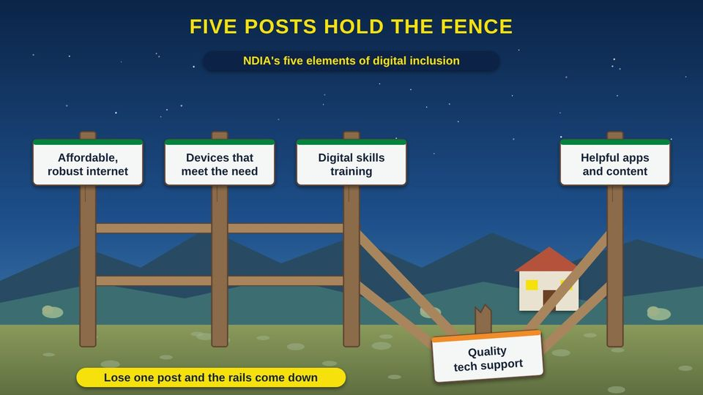
TECH RESOURCES FOR TRIBAL GOVERNMENTS · TRIBAL GUIDE 4 OF 4
Community Digital Equity Planning Guide
Plan, run, and pay for your Nation's own digital equity program
Tribal staff and leaders
90 min
6 pictures
Free class from the Numu Communications Learning Center · www.numu.tech/resources
Notes:
TEACHING THIS CLASS (90 minutes, or five 20-minute workshops)
Lesson plan:
- Before: Use the sign-in sheet from Program tools. Invite staff from the library, clinic, school, senior center, and planning, plus two or three community members with lived experience.
- 10 min: Open with the grandmother's story. Ask: what stories like this do you hear? Write them on sticky notes.
- 10 min: Part 1: explore the fence picture. Sort the sticky notes onto the five posts. Which post is weakest here? Share two numbers from the data table.
- 15 min: Part 2: the planning circle. Draft the wording for a Council resolution and list names for the core team. Look at the seven stars.
- 15 min: Part 3: the headgate picture and the CARE table. As a group, agree on three data rules. Read the survey's consent statement aloud and adjust it.
- 15 min: Part 4: the asset map. Do the activity on large paper: five assets and three barriers. Turn one barrier into a measurable objective.
- 15 min: Part 5: the navigator and funding pictures. Note the November 17, 2026 deadline. Decide who checks current notices.
- 10 min: Quiz with a show of hands, the three Remember cards, and next steps: who does what by when. Hand out the class evaluation.
What you need:
- Projector or large TV for the slides
- Printed handouts, one per person
- Printed copies of the Community Digital Needs Survey and the Class Sign-in and Evaluation Forms
- Large paper, markers, and sticky notes for the activity
- A printed map of your community for the asset map
- Optional: a copy of your Nation's data or research code, if you have one
Talk about it:
- Which of the five posts is weakest in our community, and how do we know?
- Who should own and hold our survey answers, and who should never see them?
- Whose voices are missing from our planning so far, and how will we reach them?
The picture slides have every numbered detail in their speaker notes.
STORY: At the community center, a grandmother holds up her phone. Her grandson set it up last summer, but he is away at school now, and the clinic wants her to see the doctor by video. Down the hall, a father is filling out a job application on his phone because the family laptop broke. Out on the ranch road, a family still has no service at all. In a town an hour away, a member who moved there for work wants to join the tribe's computer class but cannot make the drive. Every community has stories like these. A digital equity plan gathers them, finds the patterns, and turns them into a program the Nation runs for its own people. This guide walks your team through it, one step at a time, using free tools you can print and adapt.

Slide 2
What you will learn
✓
Explain the five elements of digital inclusion and why a tribal-led plan is an act of sovereignty
✓
Organize a lead office, a core team, and a coalition, and set data rules based on the CARE (Collective benefit, Authority to control, Responsibility, Ethics) Principles before any survey
✓
Write a digital equity plan with a vision, barriers, assets, and measurable objectives in five areas
✓
Run and pay for a program with digital navigators, devices, classes, and help enrolling in Lifeline, then measure and report back

Slide 3

The story
At the community center, a grandmother holds up her phone. Her grandson set it up last summer, but he is away at school now, and the clinic wants her to see the doctor by video. Down the hall, a father is filling out a job application on his phone because the family laptop broke. Out on the ranch road, a family still has no service at all. In a town an hour away, a member who moved there for work wants to join the tribe's computer class but cannot make the drive. Every community has stories like these. A digital equity plan gathers them, finds the patterns, and turns them into a program the Nation runs for its own people. This guide walks your team through it, one step at a time, using free tools you can print and adapt.
Notes:
At the community center, a grandmother holds up her phone. Her grandson set it up last summer, but he is away at school now, and the clinic wants her to see the doctor by video. Down the hall, a father is filling out a job application on his phone because the family laptop broke. Out on the ranch road, a family still has no service at all. In a town an hour away, a member who moved there for work wants to join the tribe's computer class but cannot make the drive. Every community has stories like these. A digital equity plan gathers them, finds the patterns, and turns them into a program the Nation runs for its own people. This guide walks your team through it, one step at a time, using free tools you can print and adapt.

Slide 4
PART 1
Why Digital Equity Matters for Our Nation
Digital equity is not only about cables and towers. It is about whether every member can see the doctor, apply for a job, take a class, and stay connected to family and culture.
1 picture to explore

Slide 5
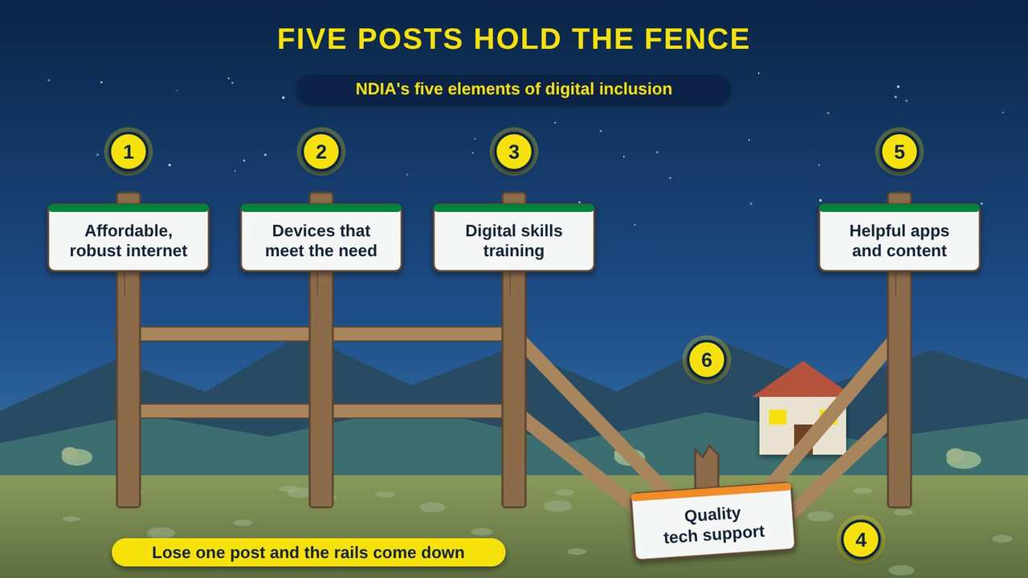
Five Posts Hold the Fence
Part 1 · Picture 1 of 6
Notes:
Five Posts Hold the Fence
What the picture shows: A wooden fence in front of a rural home. Five posts carry signs for the five elements of digital inclusion: affordable internet, devices that meet the need, digital skills training, quality tech support, and helpful apps and content. The tech support post is broken and lying on the ground, and the rails have fallen.
1. Affordable, robust internet. The NDIA (National Digital Inclusion Alliance) lists affordable, robust broadband first. A home connection has to be fast enough for school and video visits, and cheap enough that the family can keep paying for it.
2. Devices that meet the need. A phone is not enough for every job. Filling out a job application or doing homework is much easier on a laptop or tablet with a keyboard. Devices should fit the person and the task.
3. Digital skills training. People need a chance to learn: how to use email, keep accounts safe, and join a video call. Classes work best when they are local, patient, and taught by people the community trusts.
4. Quality tech support. When a password is lost or a laptop will not start, someone has to be there to help. Without support, a family can have internet and a device and still be stuck. This post is down in the picture, and the fence fails.
5. Helpful apps and content. Online services should help people take care of themselves and take part: telehealth, tribal services, school portals, and content in our own language and about our own community.
6. A household needs all five. NDIA calls this whole set digital inclusion. Digital equity is the goal: a condition where everyone has the technology they need to take full part in society, democracy, and the economy. A plan has to work on all five posts, not just one.

Slide 6
Also in your handout
The handout and the web page cover these topics in detail: Three words to start with; What the numbers say about Indian Country; A tribal-led plan is an act of sovereignty.

Slide 7
PART 2
Getting Organized
A plan needs a home, a team, and a mandate. These steps give your work the authority and the people it needs to last.
1 picture to explore

Slide 8
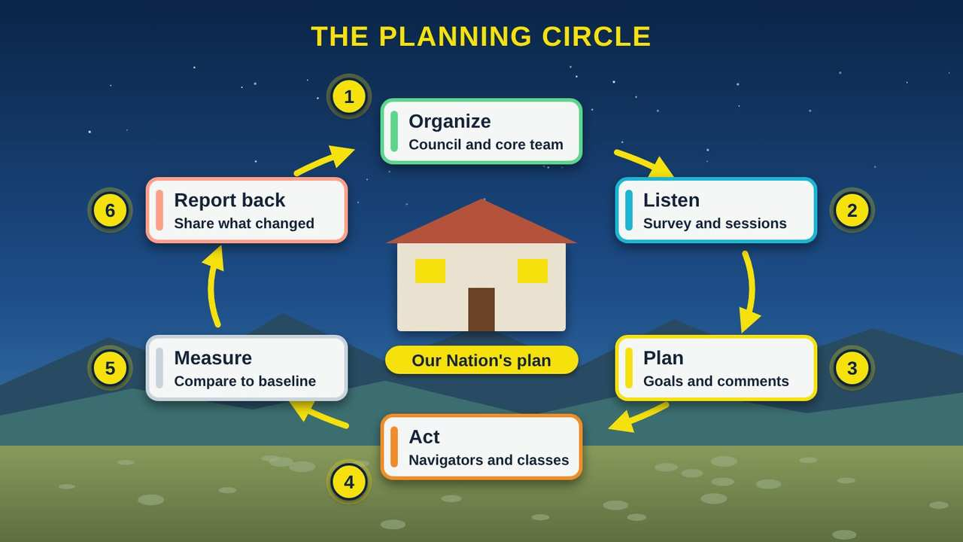
The Planning Circle
Part 2 · Picture 2 of 6
Notes:
The Planning Circle
What the picture shows: A tribal office sits at the center of a circle of six steps joined by arrows: organize, listen, plan, act, measure, and report back. The last step leads back to the first.
1. Organize. Start with a Council resolution that names a lead office and a core team. Put community members with lived experience on the team, such as an Elder, a parent, a student, and a veteran, not only staff.
2. Listen. Before writing anything, find out what people need. Use a household survey, listening sessions at different times and places, and an inventory of the community assets you already have. Agree on data rules first.
3. Plan. Write down a vision, the barriers people named, and measurable objectives in five areas. Share the draft for at least 30 days so the community can comment, and change it based on what you hear.
4. Act. Run the program: digital navigators, device access, digital skills classes, and help signing up for Lifeline and low-cost plans. Partners such as the library, clinic, and school help carry the load.
5. Measure. Track what you set out to change. Compare new numbers to your baseline, the starting numbers from your first survey, so you can show real progress to the Council, the community, and funders.
6. Report back. Take the results back to the people who gave their time and answers. Then start the circle again: what changed, what did we miss, and what should we do next?

Slide 9
Four steps to get organized
1
Pass a Council resolution
2
Choose a lead office and a coordinator
3
Build a core team with lived experience
4
Grow a coalition of partners
Notes:
1. Pass a Council resolution. Ask the Council to support a digital equity plan, name a lead office, and set a timeline. A resolution shows staff, partners, and funders that the work belongs to the Nation.
2. Choose a lead office and a coordinator. Pick an office that already serves many members, such as planning, education, the library, or the tribal technology office. Name one coordinator who keeps the work moving.
3. Build a core team with lived experience. Include people who know the barriers firsthand: an Elder, a parent, a young adult, a veteran, a person with a disability, and a fluent language speaker. Pay or give stipends to community members for their time when you can.
4. Grow a coalition of partners. Invite the library, clinic, school, tribal college, senior center, Head Start, housing, and workforce programs. NDIA's Digital Inclusion Coalition Guidebook, updated in July 2024 and drawn from 23 coalitions, has free advice on getting started.

Slide 10
Also in your handout
The handout and the web page cover these topics in detail: Three ways people can take part; Free support from NDIA; The seven stars.

Slide 11
PART 3
Data Sovereignty First, Then Listening
Before you ask a single survey question, agree on who owns the answers. Then listen widely and with respect, in ways that make it easy for people to take part.
1 picture to explore

Slide 12
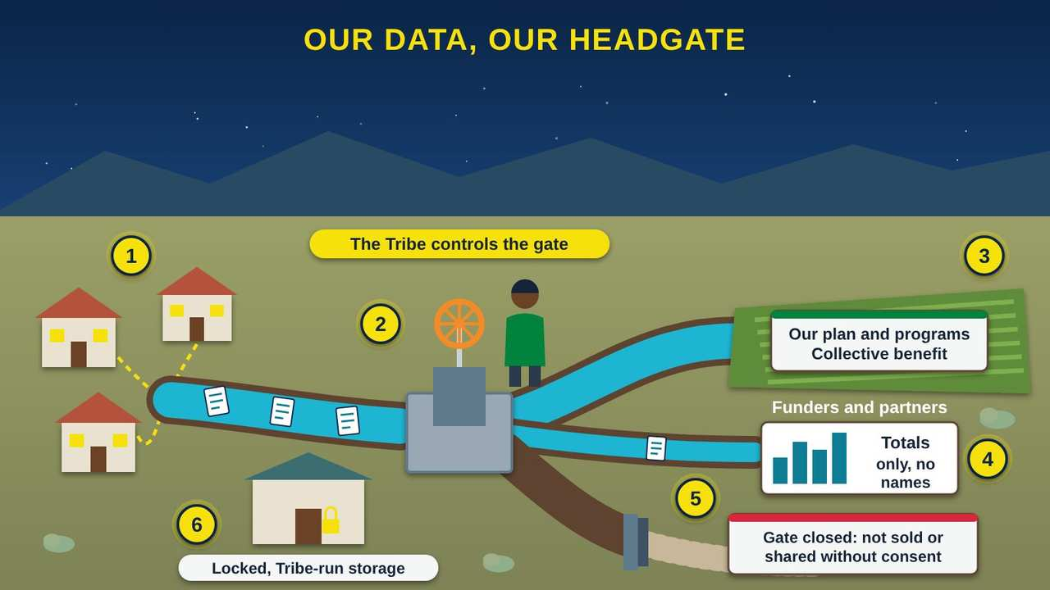
Our Data, Our Headgate
Part 3 · Picture 3 of 6
Notes:
Our Data, Our Headgate
What the picture shows: An irrigation ditch carries survey forms from homes to a headgate that a tribal staff member controls with a wheel. From the headgate, a large channel waters a field labeled Our plan and programs, a small channel carries totals only to a funders board, and a third channel is blocked by a closed gate marked not sold or shared without consent. A locked storage shed sits nearby.
1. Answers start at home. Each household decides whether to answer. A plain consent statement on the first page says why you are asking, who will see the answers, and that people can skip any question or stop at any time.
2. Authority to control. The A in the CARE Principles for Indigenous Data Governance stands for Authority to control. The Tribe owns the headgate: it decides where the answers go, who can use them, and for how long.
3. Collective benefit. The C stands for Collective benefit. Most of the flow goes to the fields: your own plan, programs, and grant applications that help the whole community.
4. Responsibility. The R stands for Responsibility. When funders or partners need data, send them totals and percentages only, never names. Report back to the community the same way.
5. Ethics. The E stands for Ethics. Some gates stay closed. Answers are never sold, and never shared outside the Tribe unless people agreed to it and the Tribe approves.
6. Locked storage. Before the first survey, write down where answers will be kept, who holds the key, and when paper forms will be destroyed. Keep names apart from answers, and use a code number instead.

Slide 13
Data rules to agree on before any survey
The Tribe owns all survey answers and program records. Put this in writing, including in any agreement with a university, consultant, or vendor.
A plain consent statement opens every survey: why you are asking, who will see the answers, and that people can skip questions or stop.
Names and contact information are kept apart from answers. Use code numbers.

Slide 14
Data rules to agree on before any survey (continued)
You know where answers are stored, who has the key or password, and when paper forms are shredded.
Only totals and percentages leave the Tribe. No names, addresses, or small groups that could identify a household.
Results go back to the community before, or at the same time as, they go to anyone else.
The Council or its delegate approves the rules, and any later request to use the data.

Slide 15
Listening to the community
1
Make an asset inventory
2
Run a household survey
3
Hold paid listening sessions
4
Talk with partners one by one
5
Share back what you heard
Notes:
1. Make an asset inventory. List the places, people, programs, and funding that already help people get online. Use the Community Asset Inventory spreadsheet and NDIA's free asset mapping templates.
2. Run a household survey. Use the Community Digital Needs Survey. Offer it on paper, in large print, online, by phone, and read aloud, and in your language. NDIA's toolkit recommends surveys in multiple languages and formats.
3. Hold paid listening sessions. Meet at several times and places, in person and by phone or video. Offer childcare, rides, and a meal, and pay participants for their time, as NDIA's toolkit recommends.
4. Talk with partners one by one. Ask the library, clinic, school, senior center, and housing office what they see every day, and what they could offer.
5. Share back what you heard. Before writing the plan, tell the community what you heard and ask, did we get it right?

Slide 16
Also in your handout
The handout and the web page cover these topics in detail: The CARE Principles for Indigenous Data Governance; Reach the people a plan can miss.

Slide 17
PART 4
Writing the Plan
Your plan names what you already have, what stands in the way, and what you will change. Start with your assets: they are the strengths your program will build on.
1 picture to explore

Slide 18
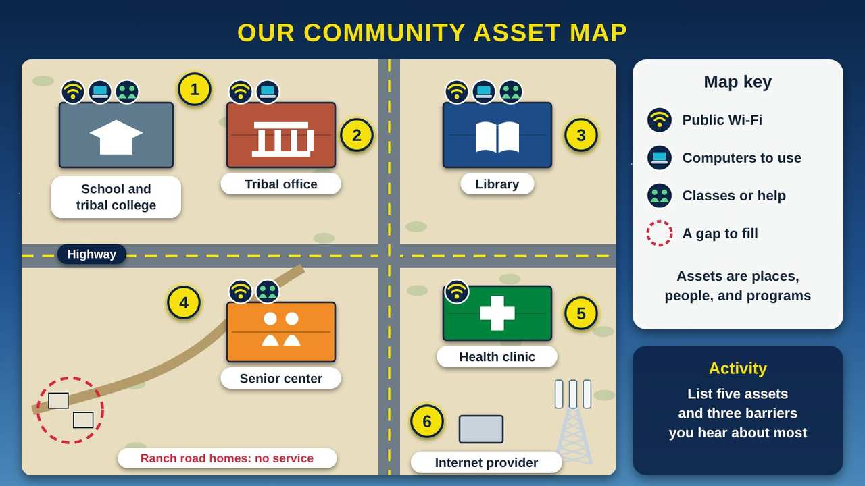
Our Community Asset Map
Part 4 · Picture 4 of 6
Notes:
Our Community Asset Map
What the picture shows: A map of a small community at a crossroads. Buildings for the tribal office, library, health clinic, senior center, school and tribal college, and an internet provider with a tower each carry badges for public Wi-Fi, computers, or classes. A dashed red circle marks ranch road homes with no service. A map key and an activity box sit on the right.
1. School and tribal college. Schools and tribal colleges have computer labs, teachers, and students who can serve as helpers. Ask about evening and summer use of labs.
2. Tribal office. The tribal office is often the first place people go for help. Note its public Wi-Fi, any computers people can use, its hours, and who to contact. Your lead office for the plan may be here.
3. Library. Libraries are strong partners: public computers, Wi-Fi, and staff who already help people online every day. Many can host classes and digital navigator hours.
4. Senior center. Elders gather here. It is a good place for patient, one-on-one help and small classes, at times that fit the lunch schedule and the van rides.
5. Health clinic. The clinic sees why telehealth matters. Ask what keeps patients from video visits, and whether the clinic could offer a private room with a good connection.
6. Internet provider. List every provider, what they charge, and where they do and do not reach, like the homes out on the ranch road. Providers can share information, but the National Digital Inclusion Alliance (NDIA) toolkit advises keeping them out of the group that makes decisions about your plan.

Slide 19
The parts of a tribal digital equity plan
This outline follows the order of NDIA's State Digital Equity Plan Toolkit, adapted for a Nation. The Digital Equity Plan Template in Program tools has prompts and examples for each part.
1
Introduction and vision
2
Collaboration and community engagement
3
Barriers and assets
4
Objectives and impact
5
Implementation
Notes:
1. Introduction and vision. Who you are, why this plan matters, and the change you want to see in one or two sentences. Include the Council resolution.
2. Collaboration and community engagement. Who was on the core team and coalition, how you listened, how many people took part, and your data rules.
3. Barriers and assets. What your survey and listening sessions found, in people's own words, and the asset map of places, people, programs, and funding.
4. Objectives and impact. Measurable objectives in five areas, each with a baseline, a target, a measure, a timeline, and a lead. Explain how meeting them helps jobs, education, health, civic life, and tribal services.
5. Implementation. The strategies, partners, budget, and timeline, plus how you will measure progress and report back.

Slide 20
Before the Council adopts the plan
Post the draft for public comment for at least 30 days, as NDIA's toolkit recommends, in print and online.
Hold at least one comment session in person and one by phone or video, at different times of day.

Slide 21
Before the Council adopts the plan (continued)
Offer the draft in large print and share a short summary in your language.
Keep a log of every comment and what you changed because of it.
Bring the final plan and the comment log to the Council for adoption.

Slide 22
Also in your handout
The handout and the web page cover these topics in detail: Objectives in five areas; Make every objective measurable; Crosswalk to federal plan requirements.

Slide 23
PART 5
Running the Program and Paying for It
A plan becomes real when people get help. Here is how to staff a program with digital navigators, offer devices and classes, fund it in 2026, and show what changed.
2 pictures to explore

Slide 24
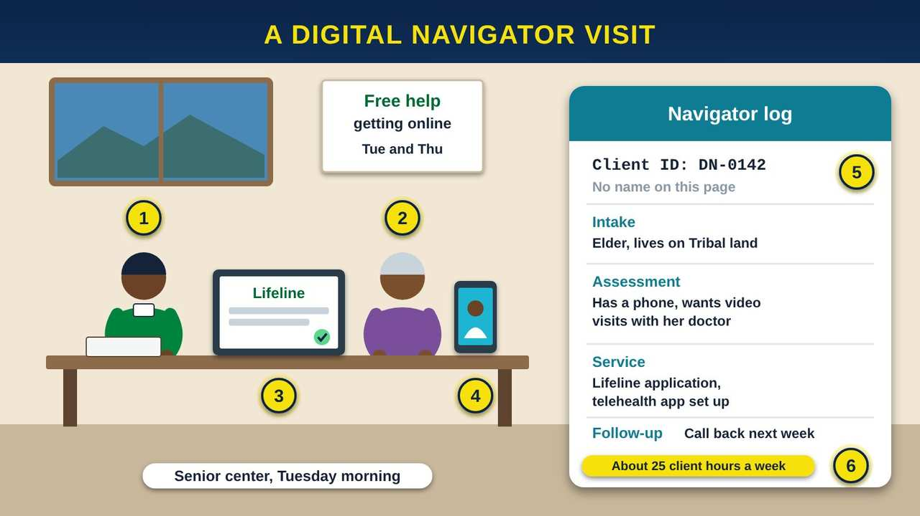
A Digital Navigator Visit
Part 5 · Picture 5 of 6
Notes:
A Digital Navigator Visit
What the picture shows: At a senior center table, a digital navigator sits beside an Elder. A laptop shows a Lifeline application with a green check, and a phone on a stand shows a video call with a doctor. A navigator log on the right uses a client ID instead of a name and lists intake, assessment, service, and follow-up.
1. The digital navigator. NDIA (National Digital Inclusion Alliance) describes digital navigators as trusted guides who give community members ongoing, one-on-one help with affordable internet, the right device, and digital skills. A navigator from the community, who knows people and speaks their language, is often trusted most.
2. The Elder sets the goal. The visit starts with what she wants: to see her doctor by video without driving two hours. The navigator listens first, then works on that goal step by step, at her pace.
3. Lifeline. Lifeline is a federal discount on phone or internet service: up to $9.25 a month, or up to $34.25 a month on Tribal lands. Households at or below 135% of the federal poverty guidelines, or in a qualifying program, can apply at lifelinesupport.org. Tribal Link Up can also take up to $100 off installation.
4. Telehealth. After the Lifeline step, the navigator helps her install the clinic's app, test the camera and sound, and practice a call. Doing it once together builds confidence for the real visit.
5. Unique client IDs. NDIA's 2025 Digital Navigator Program Toolkit advises tracking each visit in four steps: intake, assessment, service, and follow-up. Use a client ID number instead of a name on the log, and keep the list that links IDs to names locked away.
6. How many navigators?. NDIA's toolkit says one full-time navigator gives about 25 client hours a week. Pay ranges from $17 to $42 an hour, about $25 on average, or $40,000 to $65,000 a year. Plan three to six months to build a referral network.

Slide 25
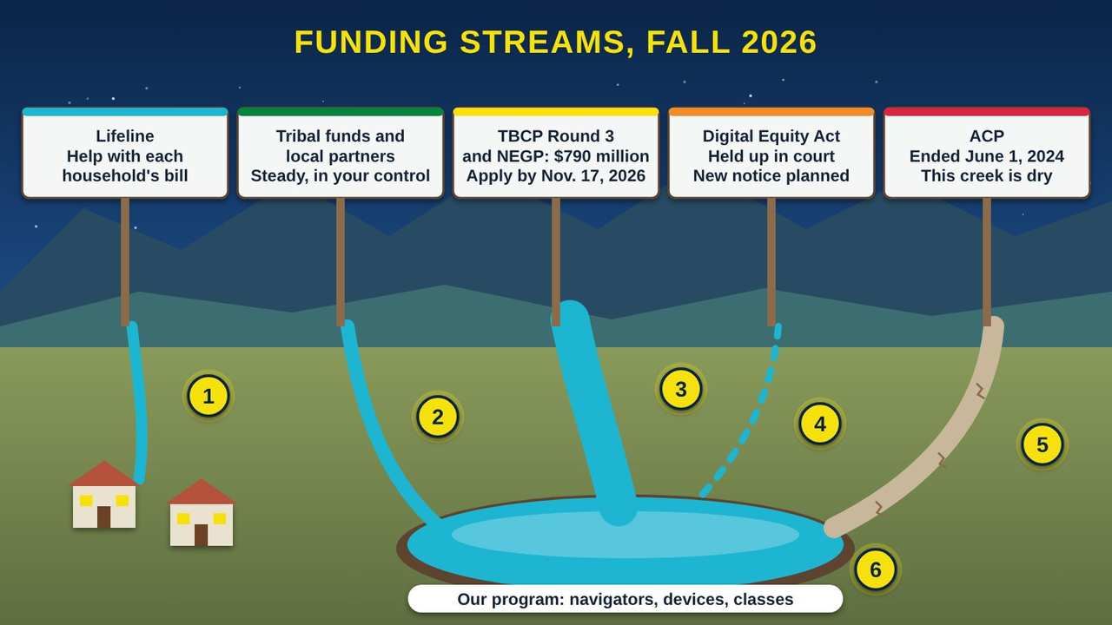
Funding Streams, Fall 2026
Part 5 · Picture 6 of 6
Notes:
Funding Streams, Fall 2026
What the picture shows: Five creeks run down from the mountains, each with a sign. Lifeline flows straight to homes. Tribal funds and partners and a large river for TBCP Round 3 and NEGP fill a reservoir labeled Our program. A dashed trickle for the Digital Equity Act is held up in court. The ACP creek is a dry, cracked bed.
1. Lifeline flows to households. Lifeline does not pay for your program. It lowers each qualifying household's own phone or internet bill, by up to $34.25 a month on Tribal lands. Your navigators help people apply at lifelinesupport.org.
2. Tribal funds and partners. Tribal funds, in-kind help from the library, clinic, and school, and local partners are small streams, but they are steady and in your control. They keep a program running between grants.
3. TBCP Round 3 and NEGP. In June 2026, NTIA (the National Telecommunications and Information Administration) opened Tribal Broadband Connectivity Program Round 3 and the Native Entities Grant Program, $790 million combined. Use-and-adoption awards run $500,000 to $2.5 million. Applications are due November 17, 2026.
4. Digital Equity Act. The Digital Equity Act grants were terminated in May 2025. In July 2026 a federal court struck down one part of the law and kept the rest, but the ruling did not restore individual grants. NTIA plans a new notice for the Competitive program, targeted for December 2026.
5. ACP has ended. The Affordable Connectivity Program (ACP) ended on June 1, 2024, after more than 23 million households had enrolled. Its Tribal benefit was up to $75 a month. Families who lost it may need help finding Lifeline or a low-cost plan.
6. Keep more than one stream. A reservoir fed by one creek runs dry in a drought. Build your program on several sources, keep careful records, and report results, so you are ready when the next notice opens.

Slide 26
Starting a navigator program
1
Hire from the community
2
Set up the log
3
Build a referral network
4
Set hours where people already are
Notes:
1. Hire from the community. Look for patience, trust, and good listening first. Technical skills can be taught, for example through NDIA's 8-hour navigator training.
2. Set up the log. Use the Digital Navigator Toolkit spreadsheet. Track intake, assessment, service, and follow-up, with a unique client ID for each person and no names on the log.
3. Build a referral network. List where to send people for devices, repairs, classes, benefits, and health and job services. NDIA's toolkit says this takes three to six months.
4. Set hours where people already are. Senior center, library, clinic, tribal office, and outlying communities, on a regular schedule.

Slide 27
Funding and legal status change quickly
This guide is current as of October 2026. Check current notices from NTIA (the National Telecommunications and Information Administration), the FCC (Federal Communications Commission), and NDIA before you apply or make plans.

Slide 28
Measure, report back, and keep it going
1
Measure against your baseline
2
Report back to the community first
3
Report to the Council and funders
4
Plan for the long run
Notes:
1. Measure against your baseline. Every 6 or 12 months, compare your navigator log, class sign-ins, evaluations, and a repeat survey to your starting numbers.
2. Report back to the community first. Share results at a community meeting, in the newsletter, and on the radio before or when you send them to funders. Tell the stories as well as the numbers.
3. Report to the Council and funders. Use totals only, with no names. Show progress on each objective and what you changed because of what you learned.
4. Plan for the long run. Put core staff in the tribal budget when you can, keep several funding streams, train backups for each role, and update the plan every few years.

Slide 29
Also in your handout
The handout and the web page cover these topics in detail: Four kinds of help your program can offer; Ready-made classes for your skills program; The 2026 funding landscape.

Slide 30
Your first planning session
Do this with two or three coworkers or community members. It takes about 20 minutes and gives you a head start on the Community Asset Inventory.
1
List five community assets: places, people, or programs that already help people get online. Think of the library, the clinic, a patient grandchild, a tribal college class.

Slide 31
Your first planning session (continued)
2
Write down the three barriers you hear about most. Use the words people use, such as "too expensive," "no signal out our way," or "I don't know who to ask."
3
For each barrier, name which of the five fence posts it belongs to: internet, devices, skills, support, or helpful apps and content.

Slide 32
Your first planning session (continued)
4
Name three groups whose voices you have not heard yet, and one way to reach each.
5
Write one draft data rule for your survey, such as "Only totals leave the Tribe."
6
Pick a date to bring your list to your supervisor or the Council, and write it down.

Slide 33



Remember
A household needs all five posts
Our data, our consent, our control
Listen first, act, then report back
Notes:
A household needs all five posts
Our data, our consent, our control
Listen first, act, then report back

Slide 34


Check what you learned: question 1 of 5
A university offers to run your household survey for free, keep the answers, and publish a study. What fits the CARE (Collective benefit, Authority to control, Responsibility, Ethics) Principles?
A
B
C
Agree only with a written agreement, approved by the Council, that the Tribe owns and controls the answers
Say yes, since it saves money and they are experts
Let them run it, then ask for a copy of the report
Notes:
A university offers to run your household survey for free, keep the answers, and publish a study. What fits the CARE (Collective benefit, Authority to control, Responsibility, Ethics) Principles?
Answer: A. Agree only with a written agreement, approved by the Council, that the Tribe owns and controls the answers
Under the CARE Principles, the Tribe should own and control its data, so any partner needs a written agreement first.

Slide 35
Answer: question 1 of 5
A university offers to run your household survey for free, keep the answers, and publish a study. What fits the CARE (Collective benefit, Authority to control, Responsibility, Ethics) Principles?
Agree only with a written agreement, approved by the Council, that the Tribe owns and controls the answers
A
✓ Correct
B
Say yes, since it saves money and they are experts
Let them run it, then ask for a copy of the report
C
Why: Under the CARE Principles, the Tribe should own and control its data, so any partner needs a written agreement first.
Notes:
A university offers to run your household survey for free, keep the answers, and publish a study. What fits the CARE (Collective benefit, Authority to control, Responsibility, Ethics) Principles?
Answer: A. Agree only with a written agreement, approved by the Council, that the Tribe owns and controls the answers
Under the CARE Principles, the Tribe should own and control its data, so any partner needs a written agreement first.

Slide 36


Check what you learned: question 2 of 5
Your first listening session was on a weekday evening, and only staff came. What is the best next step?
A
B
C
Post the draft plan online and count no comments as agreement
Ask the internet provider to run the next meetings
Hold more sessions at different times and places, with childcare, rides, and payment for participants
Notes:
Your first listening session was on a weekday evening, and only staff came. What is the best next step?
Answer: C. Hold more sessions at different times and places, with childcare, rides, and payment for participants
NDIA's (National Digital Inclusion Alliance) toolkit recommends meetings at several times and in different formats, with childcare and transportation help, and paying participants. It also advises keeping providers out of the partnership tier.

Slide 37
Answer: question 2 of 5
Your first listening session was on a weekday evening, and only staff came. What is the best next step?
Post the draft plan online and count no comments as agreement
A
B
Ask the internet provider to run the next meetings
Hold more sessions at different times and places, with childcare, rides, and payment for participants
C
✓ Correct
Why: NDIA's (National Digital Inclusion Alliance) toolkit recommends meetings at several times and in different formats, with childcare and transportation help, and paying participants. It also advises keeping providers out of the partnership tier.
Notes:
Your first listening session was on a weekday evening, and only staff came. What is the best next step?
Answer: C. Hold more sessions at different times and places, with childcare, rides, and payment for participants
NDIA's (National Digital Inclusion Alliance) toolkit recommends meetings at several times and in different formats, with childcare and transportation help, and paying participants. It also advises keeping providers out of the partnership tier.

Slide 38


Check what you learned: question 3 of 5
A family got a free laptop at an event, but it sits in the box because no one showed them how to set it up. Which posts of the fence are missing?
A
B
C
Affordable internet
Digital skills training and tech support
None, because they have a device
Notes:
A family got a free laptop at an event, but it sits in the box because no one showed them how to set it up. Which posts of the fence are missing?
Answer: B. Digital skills training and tech support
A device alone is not enough. Training and support, two of NDIA's (National Digital Inclusion Alliance) five elements of digital inclusion, help the family actually use it.

Slide 39
Answer: question 3 of 5
A family got a free laptop at an event, but it sits in the box because no one showed them how to set it up. Which posts of the fence are missing?
A
Affordable internet
B
Digital skills training and tech support
✓ Correct
C
None, because they have a device
Why: A device alone is not enough. Training and support, two of NDIA's (National Digital Inclusion Alliance) five elements of digital inclusion, help the family actually use it.
Notes:
A family got a free laptop at an event, but it sits in the box because no one showed them how to set it up. Which posts of the fence are missing?
Answer: B. Digital skills training and tech support
A device alone is not enough. Training and support, two of NDIA's (National Digital Inclusion Alliance) five elements of digital inclusion, help the family actually use it.

Slide 40

Check what you learned: question 4 of 5
Which of these is a measurable objective for your plan?
A
B
C
Help more people get online
Make our community more digital
Raise the share of surveyed households with home internet from our 2026 baseline to 75% by 2028
Notes:
Which of these is a measurable objective for your plan?
Answer: C. Raise the share of surveyed households with home internet from our 2026 baseline to 75% by 2028
A measurable objective has a baseline, a target, and a date, so anyone can check whether you met it.

Slide 41
Answer: question 4 of 5
Which of these is a measurable objective for your plan?
A
Help more people get online
B
Make our community more digital
Raise the share of surveyed households with home internet from our 2026 baseline to 75% by 2028
C
✓ Correct
Why: A measurable objective has a baseline, a target, and a date, so anyone can check whether you met it.
Notes:
Which of these is a measurable objective for your plan?
Answer: C. Raise the share of surveyed households with home internet from our 2026 baseline to 75% by 2028
A measurable objective has a baseline, a target, and a date, so anyone can check whether you met it.

Slide 42


Check what you learned: question 5 of 5
Your Tribe is applying for a TBCP (Tribal Broadband Connectivity Program) Round 3 use-and-adoption award. Which device plan fits the rules?
A
B
C
A new smartphone for every member
One laptop or tablet per household, for adults 18 and older who complete a class
Three laptops per household, with no training needed
Notes:
Your Tribe is applying for a TBCP (Tribal Broadband Connectivity Program) Round 3 use-and-adoption award. Which device plan fits the rules?
Answer: B. One laptop or tablet per household, for adults 18 and older who complete a class
Round 3 allows devices with limits: no smartphones, one per household, and only for adults 18 and older who complete training.

Slide 43
Answer: question 5 of 5
Your Tribe is applying for a TBCP (Tribal Broadband Connectivity Program) Round 3 use-and-adoption award. Which device plan fits the rules?
A
A new smartphone for every member
One laptop or tablet per household, for adults 18 and older who complete a class
B
✓ Correct
Three laptops per household, with no training needed
C
Why: Round 3 allows devices with limits: no smartphones, one per household, and only for adults 18 and older who complete training.
Notes:
Your Tribe is applying for a TBCP (Tribal Broadband Connectivity Program) Round 3 use-and-adoption award. Which device plan fits the rules?
Answer: B. One laptop or tablet per household, for adults 18 and older who complete a class
Round 3 allows devices with limits: no smartphones, one per household, and only for adults 18 and older who complete training.

Slide 44
Words to know
Digital inclusion
The activities that make sure everyone can get and use technology: affordable internet, devices, skills training, tech support, and helpful apps and content.
Digital equity
The goal: a condition where everyone has the technology they need to take full part in society, democracy, and the economy.
Digital literacy
The skills to find, use, judge, and share information with a phone, computer, or the internet.
Digital navigator
A trusted guide who gives ongoing, one-on-one help with affordable internet, devices, and digital skills.

Slide 45
Words to know (continued)
Digital sovereignty
A Nation's right to decide how technology, networks, and data serve its people.
Data sovereignty
A Nation's right to own and control data about its people, lands, and resources.
CARE Principles
Collective benefit, Authority to control, Responsibility, and Ethics. Principles for Indigenous data governance.
Covered populations
Groups named in the Digital Equity Act as facing the biggest barriers, such as aging individuals, veterans, and rural residents.

Slide 46
Words to know (continued)
Asset map
A list or map of the places, people, programs, and funding a community already has to help people get online.
Baseline
Your starting number, such as the share of households with home internet in your first survey. Progress is measured against it.
Coalition
A group of partners, such as the library, clinic, and school, working together on a shared goal.
NDIA
National Digital Inclusion Alliance. A national nonprofit that supports community digital inclusion programs.

Slide 47
Words to know (continued)
NTIA
National Telecommunications and Information Administration. The federal agency that runs tribal broadband and digital equity grants.
TBCP
Tribal Broadband Connectivity Program. NTIA grants for internet service and adoption on tribal lands.
NEGP
Native Entities Grant Program. An NTIA grant program, opened in 2026, for digital inclusion that serves members of Native entities.
Lifeline
A Federal Communications Commission program that lowers the monthly phone or internet bill for qualifying households, with a larger discount on Tribal lands.

Slide 48
Words to know (continued)
Tribal Link Up
A Lifeline benefit that takes up to $100 off the cost of starting service on Tribal lands.
ACP
Affordable Connectivity Program. A federal internet discount that ended on June 1, 2024.
Telehealth
Seeing a doctor, nurse, or counselor by video or phone instead of in person.

Slide 49
Learn more
NDIA: Definitions
Digital inclusion, digital equity, and digital navigators, defined.
https://www.digitalinclusion.org/definitions/
NDIA: Seven Star Communities
Recognition for tribal digital inclusion work, built with AMERIND.
https://www.digitalinclusion.org/seven-star-communities/
NDIA: 2025 Digital Navigator Program Toolkit
Staffing, training, tracking, and program standards for navigators.
https://www.digitalinclusion.org/wp-content/uploads/2025/05/2025-Digital-Navigator-Program-Toolkit.pdf

Slide 50
Learn more (continued)
NDIA: Asset mapping
A guide to mapping community assets, with free templates.
https://www.digitalinclusion.org/asset-mapping/
FCC: Lifeline support for affordable communications
Who qualifies for Lifeline and Tribal Link Up, and how to apply.
https://www.fcc.gov/lifeline-consumer
NTIA: New funding opportunities on tribal lands
The June 2026 announcement of TBCP Round 3 and the Native Entities Grant Program.
https://ntia.gov/press-release/2026/ntia-announces-two-new-funding-opportunities-expand-broadband-connectivity-tribal-lands

Slide 51
Program tools (free downloads)
Digital Equity Plan Template (DOCX)
A section-by-section plan with prompts, examples, an objectives table, and a federal crosswalk.
Community Digital Needs Survey (Word) (DOCX)
A 20-question, plain-language household survey with a consent statement. Edit it for your community.
Community Digital Needs Survey (PDF) (PDF)
The same survey in large print, ready to copy and hand out.

Slide 52
Program tools (free downloads) (continued)
Community Asset Inventory (XLSX)
Sheets for places, people and programs, and funding, with example rows.
Digital Navigator Toolkit (XLSX)
Intake, assessment, service, and follow-up log with client IDs and an automatic summary.
Class Sign-in and Evaluation Forms (Word) (DOCX)
A sign-in sheet and a one-page class evaluation for any Learning Center class.
Class Sign-in and Evaluation Forms (PDF) (PDF)
The same forms, ready to print.
Download at www.numu.tech/learning-center/digital-equity.html

Slide 53
Teaching this class: lesson plan (90 minutes, or five 20-minute workshops)
Before
Use the sign-in sheet from Program tools. Invite staff from the library, clinic, school, senior center, and planning, plus two or three community members with lived experience.
10 min
Open with the grandmother's story. Ask: what stories like this do you hear? Write them on sticky notes.
10 min
Part 1: explore the fence picture. Sort the sticky notes onto the five posts. Which post is weakest here? Share two numbers from the data table.
15 min
Part 2: the planning circle. Draft the wording for a Council resolution and list names for the core team. Look at the seven stars.
Notes:
TEACHING THIS CLASS (90 minutes, or five 20-minute workshops)
Lesson plan:
- Before: Use the sign-in sheet from Program tools. Invite staff from the library, clinic, school, senior center, and planning, plus two or three community members with lived experience.
- 10 min: Open with the grandmother's story. Ask: what stories like this do you hear? Write them on sticky notes.
- 10 min: Part 1: explore the fence picture. Sort the sticky notes onto the five posts. Which post is weakest here? Share two numbers from the data table.
- 15 min: Part 2: the planning circle. Draft the wording for a Council resolution and list names for the core team. Look at the seven stars.
- 15 min: Part 3: the headgate picture and the CARE table. As a group, agree on three data rules. Read the survey's consent statement aloud and adjust it.
- 15 min: Part 4: the asset map. Do the activity on large paper: five assets and three barriers. Turn one barrier into a measurable objective.
- 15 min: Part 5: the navigator and funding pictures. Note the November 17, 2026 deadline. Decide who checks current notices.
- 10 min: Quiz with a show of hands, the three Remember cards, and next steps: who does what by when. Hand out the class evaluation.
What you need:
- Projector or large TV for the slides
- Printed handouts, one per person
- Printed copies of the Community Digital Needs Survey and the Class Sign-in and Evaluation Forms
- Large paper, markers, and sticky notes for the activity
- A printed map of your community for the asset map
- Optional: a copy of your Nation's data or research code, if you have one
Talk about it:
- Which of the five posts is weakest in our community, and how do we know?
- Who should own and hold our survey answers, and who should never see them?
- Whose voices are missing from our planning so far, and how will we reach them?
The picture slides have every numbered detail in their speaker notes.
STORY: At the community center, a grandmother holds up her phone. Her grandson set it up last summer, but he is away at school now, and the clinic wants her to see the doctor by video. Down the hall, a father is filling out a job application on his phone because the family laptop broke. Out on the ranch road, a family still has no service at all. In a town an hour away, a member who moved there for work wants to join the tribe's computer class but cannot make the drive. Every community has stories like these. A digital equity plan gathers them, finds the patterns, and turns them into a program the Nation runs for its own people. This guide walks your team through it, one step at a time, using free tools you can print and adapt.

Slide 54
Teaching this class: lesson plan (90 minutes, or five 20-minute workshops) (continued)
15 min
Part 3: the headgate picture and the CARE table. As a group, agree on three data rules. Read the survey's consent statement aloud and adjust it.
15 min
Part 4: the asset map. Do the activity on large paper: five assets and three barriers. Turn one barrier into a measurable objective.
15 min
Part 5: the navigator and funding pictures. Note the November 17, 2026 deadline. Decide who checks current notices.
10 min
Quiz with a show of hands, the three Remember cards, and next steps: who does what by when. Hand out the class evaluation.
Notes:
TEACHING THIS CLASS (90 minutes, or five 20-minute workshops)
Lesson plan:
- Before: Use the sign-in sheet from Program tools. Invite staff from the library, clinic, school, senior center, and planning, plus two or three community members with lived experience.
- 10 min: Open with the grandmother's story. Ask: what stories like this do you hear? Write them on sticky notes.
- 10 min: Part 1: explore the fence picture. Sort the sticky notes onto the five posts. Which post is weakest here? Share two numbers from the data table.
- 15 min: Part 2: the planning circle. Draft the wording for a Council resolution and list names for the core team. Look at the seven stars.
- 15 min: Part 3: the headgate picture and the CARE table. As a group, agree on three data rules. Read the survey's consent statement aloud and adjust it.
- 15 min: Part 4: the asset map. Do the activity on large paper: five assets and three barriers. Turn one barrier into a measurable objective.
- 15 min: Part 5: the navigator and funding pictures. Note the November 17, 2026 deadline. Decide who checks current notices.
- 10 min: Quiz with a show of hands, the three Remember cards, and next steps: who does what by when. Hand out the class evaluation.
What you need:
- Projector or large TV for the slides
- Printed handouts, one per person
- Printed copies of the Community Digital Needs Survey and the Class Sign-in and Evaluation Forms
- Large paper, markers, and sticky notes for the activity
- A printed map of your community for the asset map
- Optional: a copy of your Nation's data or research code, if you have one
Talk about it:
- Which of the five posts is weakest in our community, and how do we know?
- Who should own and hold our survey answers, and who should never see them?
- Whose voices are missing from our planning so far, and how will we reach them?
The picture slides have every numbered detail in their speaker notes.
STORY: At the community center, a grandmother holds up her phone. Her grandson set it up last summer, but he is away at school now, and the clinic wants her to see the doctor by video. Down the hall, a father is filling out a job application on his phone because the family laptop broke. Out on the ranch road, a family still has no service at all. In a town an hour away, a member who moved there for work wants to join the tribe's computer class but cannot make the drive. Every community has stories like these. A digital equity plan gathers them, finds the patterns, and turns them into a program the Nation runs for its own people. This guide walks your team through it, one step at a time, using free tools you can print and adapt.

Slide 55
Teaching this class: materials and discussion
What you need
Projector or large TV for the slides
Printed handouts, one per person
Printed copies of the Community Digital Needs Survey and the Class Sign-in and Evaluation Forms
Large paper, markers, and sticky notes for the activity
A printed map of your community for the asset map
Notes:
TEACHING THIS CLASS (90 minutes, or five 20-minute workshops)
Lesson plan:
- Before: Use the sign-in sheet from Program tools. Invite staff from the library, clinic, school, senior center, and planning, plus two or three community members with lived experience.
- 10 min: Open with the grandmother's story. Ask: what stories like this do you hear? Write them on sticky notes.
- 10 min: Part 1: explore the fence picture. Sort the sticky notes onto the five posts. Which post is weakest here? Share two numbers from the data table.
- 15 min: Part 2: the planning circle. Draft the wording for a Council resolution and list names for the core team. Look at the seven stars.
- 15 min: Part 3: the headgate picture and the CARE table. As a group, agree on three data rules. Read the survey's consent statement aloud and adjust it.
- 15 min: Part 4: the asset map. Do the activity on large paper: five assets and three barriers. Turn one barrier into a measurable objective.
- 15 min: Part 5: the navigator and funding pictures. Note the November 17, 2026 deadline. Decide who checks current notices.
- 10 min: Quiz with a show of hands, the three Remember cards, and next steps: who does what by when. Hand out the class evaluation.
What you need:
- Projector or large TV for the slides
- Printed handouts, one per person
- Printed copies of the Community Digital Needs Survey and the Class Sign-in and Evaluation Forms
- Large paper, markers, and sticky notes for the activity
- A printed map of your community for the asset map
- Optional: a copy of your Nation's data or research code, if you have one
Talk about it:
- Which of the five posts is weakest in our community, and how do we know?
- Who should own and hold our survey answers, and who should never see them?
- Whose voices are missing from our planning so far, and how will we reach them?
The picture slides have every numbered detail in their speaker notes.
STORY: At the community center, a grandmother holds up her phone. Her grandson set it up last summer, but he is away at school now, and the clinic wants her to see the doctor by video. Down the hall, a father is filling out a job application on his phone because the family laptop broke. Out on the ranch road, a family still has no service at all. In a town an hour away, a member who moved there for work wants to join the tribe's computer class but cannot make the drive. Every community has stories like these. A digital equity plan gathers them, finds the patterns, and turns them into a program the Nation runs for its own people. This guide walks your team through it, one step at a time, using free tools you can print and adapt.

Slide 56
Teaching this class: materials and discussion (continued)
Optional: a copy of your Nation's data or research code, if you have one
Talk about it
Which of the five posts is weakest in our community, and how do we know?
Who should own and hold our survey answers, and who should never see them?
Whose voices are missing from our planning so far, and how will we reach them?
Notes:
TEACHING THIS CLASS (90 minutes, or five 20-minute workshops)
Lesson plan:
- Before: Use the sign-in sheet from Program tools. Invite staff from the library, clinic, school, senior center, and planning, plus two or three community members with lived experience.
- 10 min: Open with the grandmother's story. Ask: what stories like this do you hear? Write them on sticky notes.
- 10 min: Part 1: explore the fence picture. Sort the sticky notes onto the five posts. Which post is weakest here? Share two numbers from the data table.
- 15 min: Part 2: the planning circle. Draft the wording for a Council resolution and list names for the core team. Look at the seven stars.
- 15 min: Part 3: the headgate picture and the CARE table. As a group, agree on three data rules. Read the survey's consent statement aloud and adjust it.
- 15 min: Part 4: the asset map. Do the activity on large paper: five assets and three barriers. Turn one barrier into a measurable objective.
- 15 min: Part 5: the navigator and funding pictures. Note the November 17, 2026 deadline. Decide who checks current notices.
- 10 min: Quiz with a show of hands, the three Remember cards, and next steps: who does what by when. Hand out the class evaluation.
What you need:
- Projector or large TV for the slides
- Printed handouts, one per person
- Printed copies of the Community Digital Needs Survey and the Class Sign-in and Evaluation Forms
- Large paper, markers, and sticky notes for the activity
- A printed map of your community for the asset map
- Optional: a copy of your Nation's data or research code, if you have one
Talk about it:
- Which of the five posts is weakest in our community, and how do we know?
- Who should own and hold our survey answers, and who should never see them?
- Whose voices are missing from our planning so far, and how will we reach them?
The picture slides have every numbered detail in their speaker notes.
STORY: At the community center, a grandmother holds up her phone. Her grandson set it up last summer, but he is away at school now, and the clinic wants her to see the doctor by video. Down the hall, a father is filling out a job application on his phone because the family laptop broke. Out on the ranch road, a family still has no service at all. In a town an hour away, a member who moved there for work wants to join the tribe's computer class but cannot make the drive. Every community has stories like these. A digital equity plan gathers them, finds the patterns, and turns them into a program the Nation runs for its own people. This guide walks your team through it, one step at a time, using free tools you can print and adapt.

Slide 57
Free from the Numu Communications Learning Center, www.numu.tech/resources.
Free to use and adapt; please keep this credit.
Questions? info@numu.tech · +1-888-686-5830

Slide 58
References
Benton Institute for Broadband & Society. (2026a, July 16). Court rules the Digital Equity Act's race provision unconstitutional, but severable. https://www.benton.org/blog/court-rules-digital-equity-acts-race-provision-unconstitutional-severable
Benton Institute for Broadband & Society. (2026b, August 19). NDIA and government offer joint status report in Digital Equity Act case. https://www.benton.org/blog/ndia-and-government-offer-joint-status-report-digital-equity-act-case
Benton Institute for Broadband & Society. (2026c, June 25). NTIA opens Native Entities Grant Program competition. https://www.benton.org/blog/ntia-opens-native-entities-grant-program-competition
Carroll, S. R., Garba, I., Figueroa-Rodríguez, O. L., Holbrook, J., Lovett, R., Materechera, S., Parsons, M., Raseroka, K., Rodriguez-Lonebear, D., Rowe, R., Sara, R., Walker, J. D., Anderson, J., & Hudson, M. (2020). The CARE principles for Indigenous data governance. Data Science Journal, 19(1), Article 43. https://doi.org/10.5334/dsj-2020-043
Federal Communications Commission. (n.d.). Lifeline support for affordable communications. https://www.fcc.gov/lifeline-consumer
Federal Communications Commission. (2024, May 31). FCC brings Affordable Connectivity Program to a close [Press release]. https://docs.fcc.gov/public/attachments/DOC-402930A1.pdf
Howard, B., & Morris, T. (2019). Tribal technology assessment: The state of internet service on tribal lands. American Indian Policy Institute, Arizona State University. https://tnpi.asu.edu/tribal-technology-assessment-state-internet-service-tribal-lands
Mejía, D. (2024, June 18). American Indian and Alaska Natives in tribal areas have among lowest rates of high-speed internet access. U.S. Census Bureau. https://www.census.gov/library/stories/2024/06/broadband-access-tribal-areas.html
National Digital Inclusion Alliance. (n.d.-a). Asset mapping. https://www.digitalinclusion.org/asset-mapping/
National Digital Inclusion Alliance. (n.d.-b). Definitions. https://www.digitalinclusion.org/definitions/
National Digital Inclusion Alliance. (n.d.-c). Seven Star Communities. https://www.digitalinclusion.org/seven-star-communities/
National Digital Inclusion Alliance. (2022). State digital equity plan toolkit. https://www.digitalinclusion.org/wp-content/uploads/2025/11/State-Digital-Equity-Plan-Toolkit_FNL.pdf
National Digital Inclusion Alliance. (2024). Digital inclusion coalition guidebook. https://www.digitalinclusion.org/resource/digital-inclusion-coalition-guidebook/

Slide 59
References (continued)
National Digital Inclusion Alliance. (2025). 2025 digital navigator program toolkit. https://www.digitalinclusion.org/wp-content/uploads/2025/05/2025-Digital-Navigator-Program-Toolkit.pdf
National Telecommunications and Information Administration. (2024). New NTIA data show 13 million more internet users in the U.S. in 2023 than 2021. https://www.ntia.gov/blog/2024/new-ntia-data-show-13-million-more-internet-users-us-2023-2021
National Telecommunications and Information Administration. (2025, November 12). NTIA announces Tribal Broadband Connectivity Program reforms [Press release]. https://www.ntia.gov/press-release/2025/ntia-announces-tribal-broadband-program-reforms-maximize-tribal-connectivity-and-reduce-red-tape
National Telecommunications and Information Administration. (2026, June 17). NTIA announces two new funding opportunities to expand broadband connectivity on tribal lands [Press release]. https://ntia.gov/press-release/2026/ntia-announces-two-new-funding-opportunities-expand-broadband-connectivity-tribal-lands
Pechtol, C. L. (2025). Tribal broadband deployment: Federal funding and considerations for Congress (CRS Report No. R48563). Congressional Research Service. https://www.congress.gov/crs_external_products/R/PDF/R48563/R48563.2.pdf
State Digital Equity Plans, 47 U.S.C. § 1723 (2021). https://www.law.cornell.edu/uscode/text/47/1723

