Slide 1


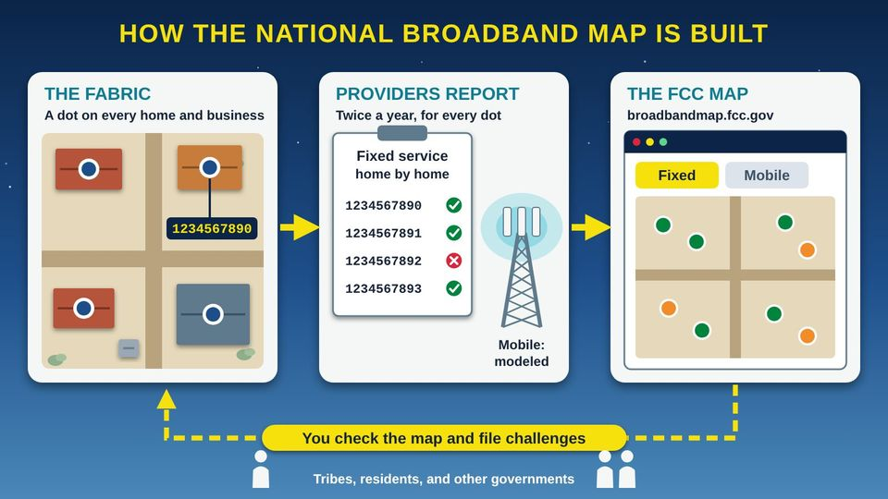
TECH RESOURCES FOR TRIBAL GOVERNMENTS · TRIBAL GUIDE 2 OF 4
The FCC Broadband Map and How to Challenge It
How the national map is made, why tribal lands are often wrong, and how your Tribe can fix it
Tribal staff and leaders
60 min
6 pictures
Free class from the Numu Communications Learning Center · www.numu.tech/resources
Notes:
TEACHING THIS CLASS (two 60-minute staff sessions)
Lesson plan:
- Session 1: The National Broadband Map, the BDC, and Tribal Data Issues. Goal: every staff member can find and judge a location.
- 15 min: The National Broadband Map: have each pair find the tribal office on the map.
- 10 min: The Broadband Data Collection (BDC): what counts as a location. Write down the office's Location ID.
- 15 min: Tribal Data Issues: explore the mistakes picture. Each pair checks three homes they know and marks any mistakes.
- Session 2: Challenging the Map and Keeping It Right. Goal: staff can file a challenge and the team has a plan.
- 20 min: Challenging the Map: walk through an individual location challenge on screen, stopping before you submit. Review the bulk steps.
- 15 min: Keeping It Right: fill in the tracker's Calendar sheet for the next twelve months with names next to each date.
- 10 min: Practice and quiz together, then assign owners for the household check.
What you need:
- Projector or large TV, and a laptop with internet
- One laptop per two staff members, with broadbandmap.fcc.gov open
- Printed Household Map Check Worksheets, five per person
- The Map Challenge Tracker open on a shared computer
- Your Tribe's address or housing list, and GIS layers if you have them
- A phone with the FCC Mobile Speed Test app installed
Talk about it:
- Which homes in our community are most likely to be missing or misplaced on the map, and why?
- Who should hold the information we collect door to door, and what will we share with the FCC?
- What would we need from Council, and from partners, to file a bulk challenge this year?
The picture slides have every numbered detail in their speaker notes.
STORY: Picture the tribal housing office on a Monday morning. A grant application is due, and it asks how many homes have no internet. Someone pulls up the FCC (Federal Communications Commission) map. A dot sits on the Smiths' storage shed instead of their house. Three new homes past the cattle guard have no dot at all. A company says fast internet is available on a road where everyone knows there is no line. Funding programs start from this map, so every mistake matters. The good news: Tribes can check the map and file challenges to fix it. This guide shows your staff how, step by step.

Slide 2
What you will learn
✓
Explain how the FCC (Federal Communications Commission) National Broadband Map is built from provider filings and the Fabric of locations
✓
Spot the map mistakes common on tribal lands, such as homes with no address, dots on sheds, missing homes, and service that is not really there
✓
File location and availability challenges, and plan a bulk challenge as a Tribal government
✓
Keep your community's map right year after year with a filing calendar, a tracker, and Council support

Slide 3

The story
Picture the tribal housing office on a Monday morning. A grant application is due, and it asks how many homes have no internet. Someone pulls up the FCC (Federal Communications Commission) map. A dot sits on the Smiths' storage shed instead of their house. Three new homes past the cattle guard have no dot at all. A company says fast internet is available on a road where everyone knows there is no line. Funding programs start from this map, so every mistake matters. The good news: Tribes can check the map and file challenges to fix it. This guide shows your staff how, step by step.
Notes:
Picture the tribal housing office on a Monday morning. A grant application is due, and it asks how many homes have no internet. Someone pulls up the FCC (Federal Communications Commission) map. A dot sits on the Smiths' storage shed instead of their house. Three new homes past the cattle guard have no dot at all. A company says fast internet is available on a road where everyone knows there is no line. Funding programs start from this map, so every mistake matters. The good news: Tribes can check the map and file challenges to fix it. This guide shows your staff how, step by step.

Slide 4
PART 1
The National Broadband Map
What the FCC (Federal Communications Commission) map shows, where its data comes from, and how to find your Tribal area on it.
1 picture to explore

Slide 5
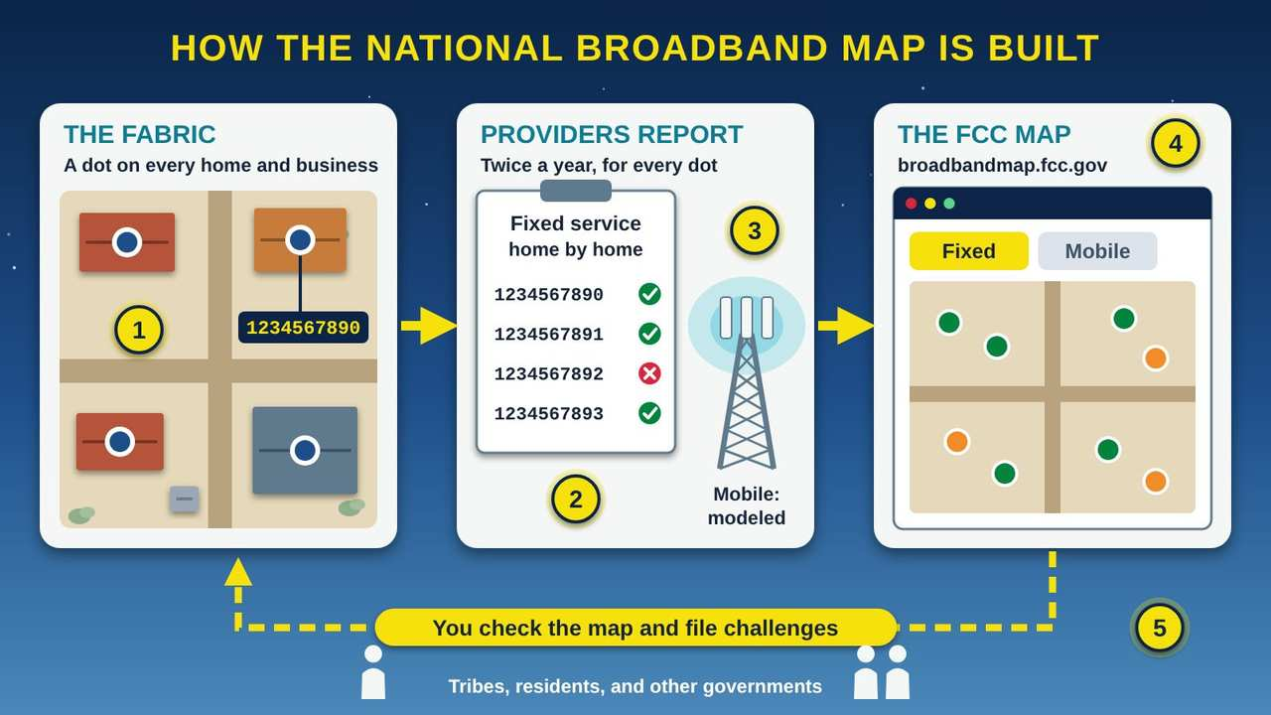
How the National Broadband Map Is Built
Part 1 · Picture 1 of 6
Notes:
How the National Broadband Map Is Built
What the picture shows: Three panels joined by arrows. The Fabric shows homes and an apartment building from above, each with a blue location dot and one ID tag. Providers report fixed service for each location ID twice a year, and a cell tower shows modeled coverage. The FCC map on the web has Fixed and Mobile tabs. A dashed arrow loops back: you check the map and file challenges.
1. The Fabric: a dot on every location. The Fabric is a dataset of every place in the United States where home or business internet is, or could be, installed. CostQuest Associates builds it for the FCC (Federal Communications Commission). Each place is a dot with its own Location ID number.
2. Fixed providers report every dot. Internet providers file twice a year: by March 1 for service as of December 31, and by September 1 for service as of June 30. A fixed provider says, location by location, which dots it serves or could serve. A Tribe that runs its own internet network must file too.
3. Mobile coverage is a computer model. Cell companies do not check every road. They use computer models (called propagation models) to predict where 3G, 4G LTE (Long-Term Evolution), and 5G signals reach outdoors. The map does not show service inside buildings.
4. The FCC publishes the map. The FCC puts it all together at broadbandmap.fcc.gov. The map opens on the Fixed tab, and mobile coverage is on its own Mobile tab. Tools on the site can show a Tribal area and compare it to non-Tribal areas.
5. You check it and challenge it. The law that created this map, the Broadband DATA Act (Broadband Deployment Accuracy and Technological Availability Act), lets the public challenge it. Tribal governments, residents, and others can file when a dot or a provider's claim is wrong.

Slide 6
Before you start
This guide is general information, not legal advice. FCC rules and forms change often. Check the FCC BDC (Broadband Data Collection) Help Center before you file, and talk with tribal legal counsel before your Council adopts a resolution.

Slide 7
See your Tribal area on the map
1
Open the map
2
Open Area Summary
3
Compare
4
Save what you see
Notes:
1. Open the map. Go to broadbandmap.fcc.gov. It opens on the Fixed tab.
2. Open Area Summary. Use the Area Summary tool and choose "Tribal area" as the type of area. Pick your reservation or tribal land.
3. Compare. Use the Area Comparison tool to compare Tribal and non-Tribal areas, for example tribal land and the county around it.
4. Save what you see. Take dated screenshots. The map now keeps only the four most recent data versions, about two years, so your own copies are your history.

Slide 8
Also in your handout
The handout and the web page cover these topics in detail: The pieces of the map; Fixed and mobile are reported differently.

Slide 9
PART 2
The Broadband Data Collection (BDC)
Twice a year, providers report service location by location against the Fabric, the FCC's list of every place broadband could be installed.
1 picture to explore

Slide 10
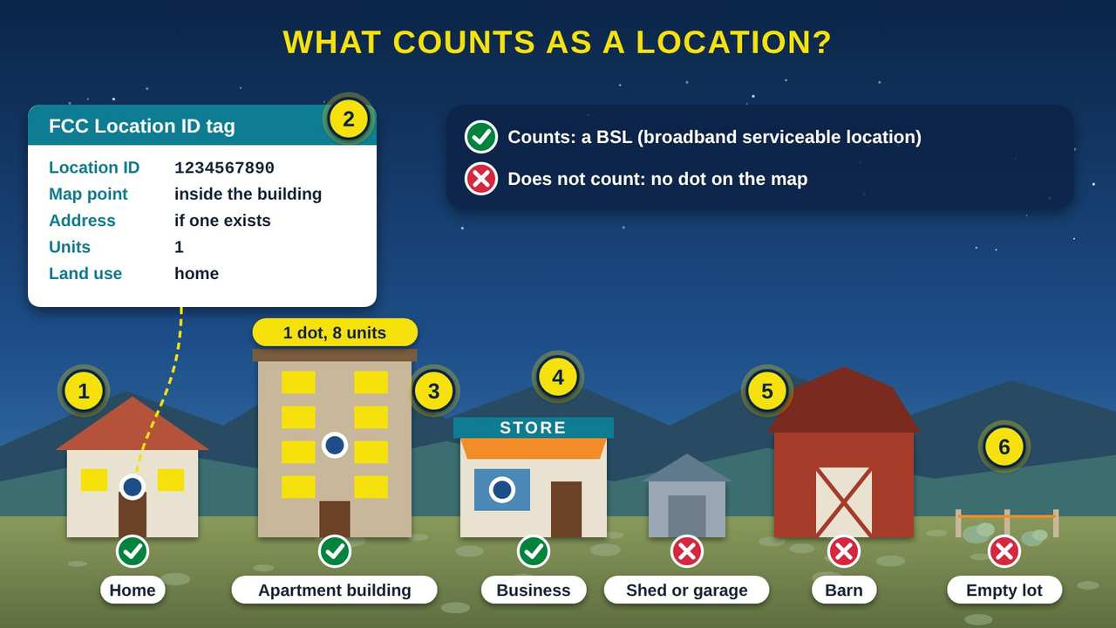
What Counts as a Location (BSL)?
Part 2 · Picture 2 of 6
Notes:
What Counts as a Location (BSL)?
What the picture shows: A row of buildings on the high desert. A home, an apartment building, and a store each have one blue location dot and a green check. A shed, a barn, and an empty lot have red X marks. A tag shows what the FCC keeps for each location: an ID number, a map point, an address if one exists, units, and land use.
1. A home counts. A BSL (broadband serviceable location) is a home or business where home-style internet service is, or can be, installed. On the map, each one is a single dot placed inside the building.
2. Every location has an ID tag. Each BSL has a unique FCC (Federal Communications Commission) Location ID, a map point, an address if one exists, a count of units, and a land-use type. IDs stay the same within one version of the Fabric but can change in the next version, so always write down the version with the ID.
3. An apartment building is usually one dot. An apartment building is usually one BSL with a unit count, not one dot per apartment. A building with 8 homes may show one dot and the number 8.
4. A business counts. Businesses that could buy everyday internet service count as BSLs too. Most community anchor institutions, such as schools and libraries, are not BSLs.
5. Sheds, garages, and barns do not count. Garages, sheds, and barns are not BSLs. If the map puts the dot on your shed instead of the house, that is a mistake you can fix.
6. Empty lots do not count. An empty lot is not a BSL, and neither is a home that cannot be lived in. A new home counts once it is built. Do not ask the FCC to add a lot where nobody lives yet.

Slide 11
Also in your handout
The handout and the web page cover these topics in detail: What counts as a BSL (broadband serviceable location); What the FCC keeps for each location; If your Tribe runs its own network.

Slide 12
PART 3
Tribal Data Issues
Homes with no address, homes that are missing, and service that is shown but not real: why tribal lands are so often wrong on the map.
1 picture to explore

Slide 13
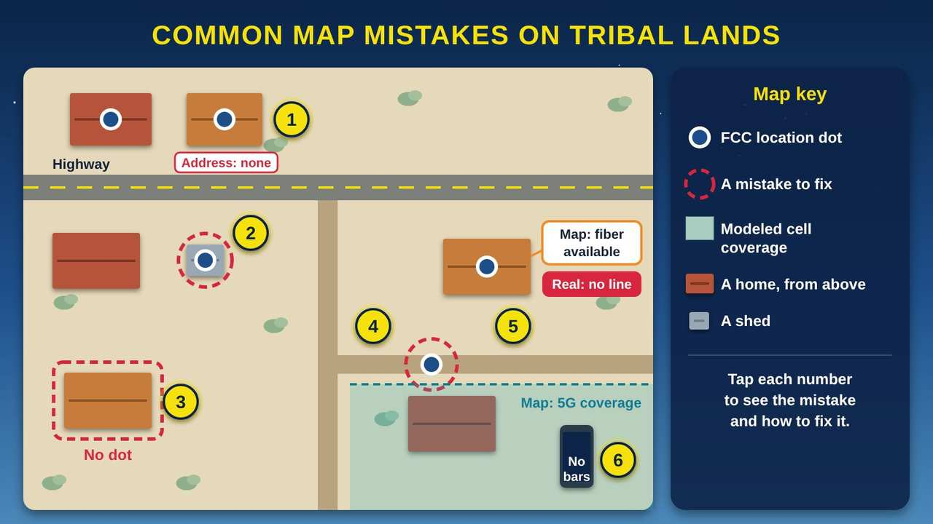
Common Map Mistakes on Tribal Lands
Part 3 · Picture 3 of 6
Notes:
Common Map Mistakes on Tribal Lands
What the picture shows: A view from above of a rural tribal housing area with a highway and dirt roads. Numbered mistakes: a home with no street address, a location dot on a shed, a home with no dot, a dot on a dirt road, a provider claiming fiber where there is no line, and a shaded 5G coverage area where a phone shows no bars. A key on the right explains the symbols.
1. A home with no street address. Many homes on tribal lands have no street address, and some roads have no names. The map can miss these homes or place them badly. The Native Nations Communications Task Force told the FCC (Federal Communications Commission) that maps should be based on actual reports from Tribes.
2. The dot is on the shed. Here the dot sits on a shed, not the house. Sheds do not count. Fix it with a location challenge for incorrect placement, or in a bulk file use the code for the wrong building on the parcel.
3. A home with no dot. This home is missing from the map. If it is not on the map, it is not counted when internet funding is planned. Use Add a New Location and drag the pin onto the house.
4. The dot is on the road. This dot landed on a dirt road, not a building. That is a placement mistake. Move it onto the right home with a location challenge.
5. A provider claims service it does not offer. The map says fiber is available here, but no line reaches this house. The GAO (Government Accountability Office) found in 2018 that older FCC data overstated internet access on tribal lands. File an availability challenge against that provider.
6. Modeled cell coverage that is not real. Cell companies predict coverage with computer models, so the map can show 5G where your phone has no bars. Speed tests with the FCC Mobile Speed Test app are your evidence for a mobile challenge.

Slide 14
Also in your handout
The handout and the web page cover these topics in detail: What the record shows; Common mistakes and how to fix each one; Tribal data sovereignty.

Slide 15
PART 4
Challenging the Map
How to fix the map, one home at a time or in bulk as a Tribal government.
2 pictures to explore

Slide 16
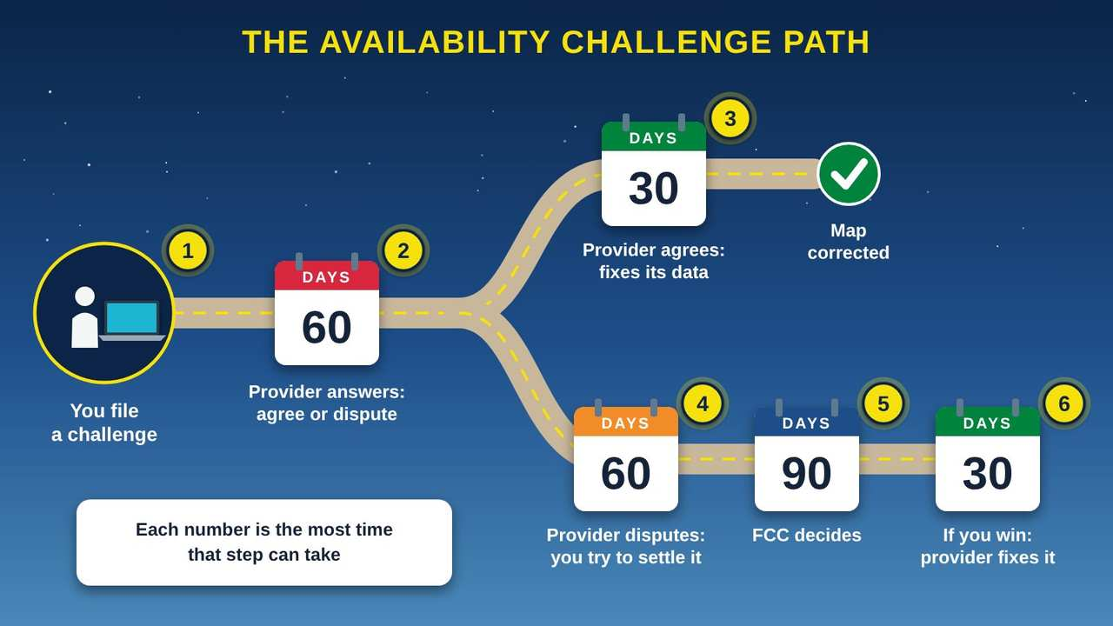
The Availability Challenge Path
Part 4 · Picture 4 of 6
Notes:
The Availability Challenge Path
What the picture shows: A road drawn as a timeline. You file a challenge. The provider has 60 days to agree or dispute. If it agrees, the road goes up to 30 days to fix and a green check for a corrected map. If it disputes, the road goes down to 60 days to settle, then 90 days for the FCC to decide, then 30 days for the provider to fix it if you win.
1. You file. Anyone can file a fixed availability challenge: residents, Tribal governments, and others. You pick the provider, the reason, and attach your proof, such as a screenshot or an email from the company.
2. The provider has 60 days. The provider gets 60 days to agree (concede) or dispute (rebut) your challenge. Mark the due date on your tracker.
3. If the provider agrees. If the provider agrees, it has 30 days to fix its data. Check the map after that and write down the result.
4. If the provider disputes. If the provider disputes your challenge, you and the provider have 60 days to try to settle it. Keep every email and note every phone call.
5. The FCC decides. If you cannot settle it, the FCC (Federal Communications Commission) decides within 90 days.
6. If you win. If the FCC decides for you, the provider has 30 days to fix its data. Then check the map again with the next update.

Slide 17
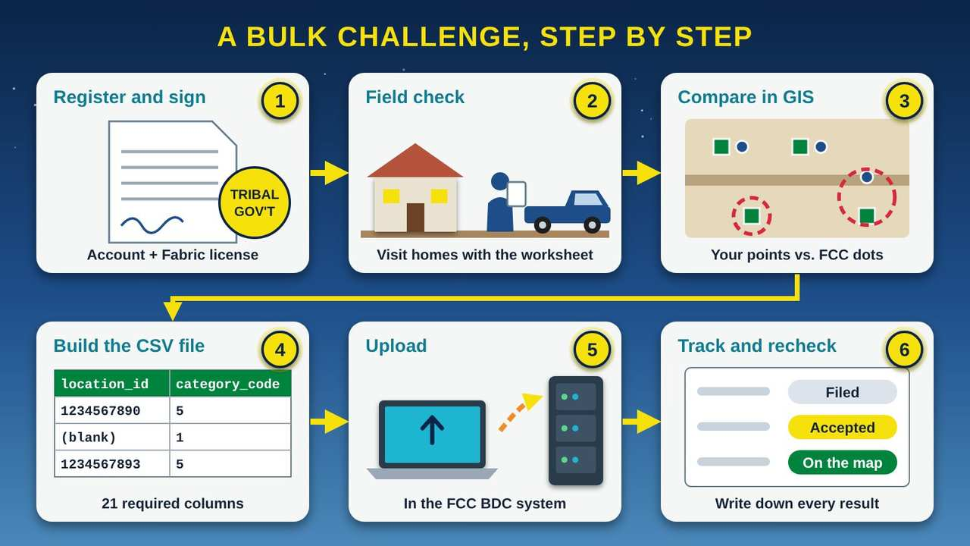
A Bulk Challenge, Step by Step
Part 4 · Picture 5 of 6
Notes:
A Bulk Challenge, Step by Step
What the picture shows: Six panels in order: register and sign the Fabric license, check homes in the field with a clipboard and pickup, compare your own address points to FCC dots in GIS software, build a CSV file with location_id and category_code columns, upload it to the FCC system, and track each location from filed to accepted to on the map.
1. Register and sign the license. Register in the FCC BDC (Broadband Data Collection) system as a Tribal governmental entity and sign the CostQuest license. A Tribe that registers this way automatically gets a free Tier 2 license made for Tribal entities, which opens the full Fabric data.
2. Check homes in the field. Visit homes with the Household Map Check Worksheet. Write down the address or "no address," GPS (Global Positioning System) coordinates, and whether the dot is on the right building. Ask permission before you use what people tell you.
3. Compare in GIS. In GIS (geographic information system) software, lay your own address points over the FCC Fabric dots. Look for homes with no dot, dots on the wrong building, and dots on roads. Do not add empty lots.
4. Build the CSV file. A bulk Fabric challenge is a CSV (comma-separated values) file with 21 required columns, such as location_id, category_code, bsl_lacks_address_flag, latitude, and longitude. Code 1 means a missing location, and code 5 means the dot is on the wrong building on the parcel.
5. Upload it. Upload the file in the BDC system. Use the FCC's sample template and match its column headers exactly. A Tribal government must show clear and convincing evidence, a strong, well-documented case.
6. Track and recheck. Write down each location, the date filed, and the result in the Map Challenge Tracker. Accepted fixes appear in a later map version, so check each new version and keep your records.

Slide 18
File an individual availability challenge
1
Find the home
2
Start the challenge
3
Choose challenge or feedback
4
Pick the provider
5
Pick a reason
6
Add proof
7
Certify and submit
Notes:
1. Find the home. Go to broadbandmap.fcc.gov, stay on the Fixed tab, and search for the address or click the location.
2. Start the challenge. Click Availability Challenge. Enter your name, email, and filer type, then verify your email.
3. Choose challenge or feedback. Choose a formal challenge, or send feedback only if you have no proof yet.
4. Pick the provider. Choose the provider and the technology you are challenging.
5. Pick a reason. Choose one of the 10 reasons, such as no service offered, cannot connect within 10 business days, an extra installation fee, or the advertised speed is not available. Describe what happened.
6. Add proof. Upload screenshots, emails, or letters from the provider.
7. Certify and submit. Confirm the information is true and submit. Write the date in your tracker so you can watch the provider's 60-day window.

Slide 19
File a location challenge, or add a missing home
1
Click the location
2
Start the challenge
3
Pick the type
4
To add a missing home
5
Address or no address
6
Certify
Notes:
1. Click the location. On the map, click the dot that is wrong.
2. Start the challenge. Click Location Challenge and enter your contact details.
3. Pick the type. Choose one: address or unit count, remove a location, building type, incorrect placement, or add a new location.
4. To add a missing home. Click the structure and choose Add a New Location. Drag the pin onto the building, not onto a road and not onto a building that already has a dot.
5. Address or no address. Enter the address, or check "no address" if the home does not have one.
6. Certify. Confirm the information is true and submit.

Slide 20
Plan a bulk challenge as a Tribal government
A bulk challenge lets your Tribe fix many locations at once. It takes planning, a GIS (geographic information system) person, and good records.
1
Get Council approval
2
Register as a governmental entity
Notes:
1. Get Council approval. Ask Council to authorize staff to register and file. The Council briefing in the Program tools includes a sample resolution.
2. Register as a governmental entity. Create an account in the BDC system as a Tribal governmental entity.
3. Sign the Fabric license. The full Fabric dataset is free but requires a CostQuest license. A Tribe that registers as a Tribal governmental entity automatically gets a Tier 2 license made for Tribal entities. A Tribal ISP (internet service provider) may first receive the generic agreement.
4. Check homes in the field. Use the Household Map Check Worksheet. Record GPS coordinates at each home.
5. Compare in GIS. Lay your address points over the Fabric points. Flag homes with no dot, dots on the wrong building, and dots on roads.
6. Build the CSV file. Use the FCC's bulk Fabric template. The CSV (comma-separated values) file has 21 required header fields, including location_id, category_code, bsl_lacks_address_flag, latitude, and longitude. There are 8 category codes; for example, 1 means a missing location and 5 means the wrong building on the parcel.
7. Upload and track. Upload the file in the BDC system. Record every location and result in the Map Challenge Tracker.

Slide 21
Plan a bulk challenge as a Tribal government (continued)
3
Sign the Fabric license
4
Check homes in the field
5
Compare in GIS
6
Build the CSV file
7
Upload and track
Notes:
1. Get Council approval. Ask Council to authorize staff to register and file. The Council briefing in the Program tools includes a sample resolution.
2. Register as a governmental entity. Create an account in the BDC system as a Tribal governmental entity.
3. Sign the Fabric license. The full Fabric dataset is free but requires a CostQuest license. A Tribe that registers as a Tribal governmental entity automatically gets a Tier 2 license made for Tribal entities. A Tribal ISP (internet service provider) may first receive the generic agreement.
4. Check homes in the field. Use the Household Map Check Worksheet. Record GPS coordinates at each home.
5. Compare in GIS. Lay your address points over the Fabric points. Flag homes with no dot, dots on the wrong building, and dots on roads.
6. Build the CSV file. Use the FCC's bulk Fabric template. The CSV (comma-separated values) file has 21 required header fields, including location_id, category_code, bsl_lacks_address_flag, latitude, and longitude. There are 8 category codes; for example, 1 means a missing location and 5 means the wrong building on the parcel.
7. Upload and track. Upload the file in the BDC system. Record every location and result in the Map Challenge Tracker.

Slide 22
GIS and CSV tips for bulk Fabric challenges
Compare your own address points with the Fabric points in GIS before you build the file.
Flag any Fabric point that sits on a road.
Use code 5 (wrong building on the parcel), not code 1 (missing location), when the dot is on the wrong building.
Do not ask to add empty lots.

Slide 23
GIS and CSV tips for bulk Fabric challenges (continued)
Add a location with latitude and longitude only (no address) only where the area truly lacks addresses, and set the no-address flag.
For a bulk fixed availability challenge, follow the separate bulk fixed spec and match its headers exactly.
Keep the Fabric version with every Location ID, because IDs can change between versions.
Save a copy of every file you upload and every response you get.

Slide 24
Test mobile coverage
1
Get the app
2
Pick the mode
3
Use cellular data
4
Test at the right time
5
Know the bar
6
Go bulk if you have many tests
Notes:
1. Get the app. Install the FCC Mobile Speed Test app on an iPhone (iOS) or Android phone.
2. Pick the mode. Choose Outdoor mode, or In-Vehicle mode while someone else drives.
3. Use cellular data. Turn Wi-Fi off so the test uses cellular data.
4. Test at the right time. Run tests between 6:00 a.m. and 10:00 p.m.
5. Know the bar. A test fails if it is below 5/1 Mbps (megabits per second, download/upload) for 4G LTE, or below 7/1 or 35/3 Mbps for 5G. Tests are grouped in hexagons of about 1 square kilometer.
6. Go bulk if you have many tests. Tribal governments can file bulk mobile challenges: a JSON (JavaScript Object Notation) file, a description of your methods, and certification by a qualified engineer or official. Tests from iPhones (iOS devices) cannot be used in a bulk mobile challenge. The provider has 60 days to respond.

Slide 25
Also in your handout
The handout and the web page cover these topics in detail: Three kinds of challenges; How strong your proof must be; Timelines at a glance; Not every problem is a challenge; Where to find the bulk file formats.

Slide 26
PART 5
Keeping It Right
A yearly routine, the 2026 rule changes, and how the map ties to funding.
1 picture to explore

Slide 27
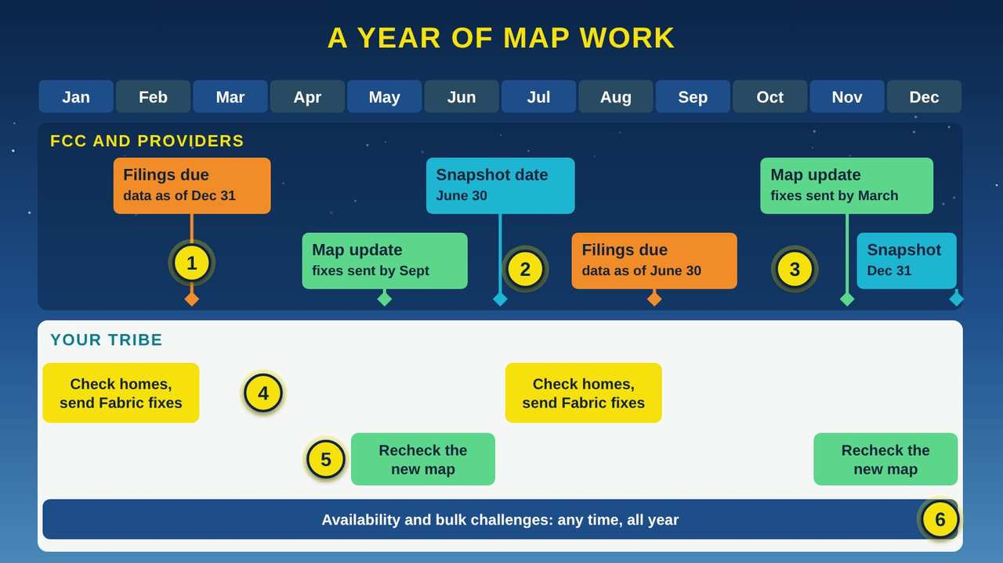
A Year of Map Work
Part 5 · Picture 6 of 6
Notes:
A Year of Map Work
What the picture shows: A twelve-month calendar with two lanes. In the FCC and providers lane, flags mark provider filings due March 1 and September 1, snapshot dates June 30 and December 31, and map updates around May and November. In the Your Tribe lane, bars show checking homes and sending Fabric fixes before early March and early September, rechecking each new map, and filing availability challenges any time.
1. Provider filings are due twice a year. Internet providers file by March 1, showing service as of December 31, and by September 1, showing service as of June 30. If your Tribe runs its own internet network, it must file on the same schedule.
2. Snapshot dates. Each filing is a snapshot of one day: December 31 or June 30. For 2026, the snapshot was June 30, 2026, and the filing window ran July 1 to September 1, 2026.
3. The map updates every six months. Map location data updates every six months. Accepted Fabric fixes filed by early March usually appear by November, and fixes filed by early September usually appear the next May.
4. Check homes and send Fabric fixes. Plan field checks so your Fabric fixes go in before early March and early September. Fabric challenges are reviewed on a rolling basis, so you can also send them any time.
5. Recheck each new map. When a new version comes out, check your locations again. Location IDs can change between Fabric versions, and the map now shows only the four most recent data versions, about two years.
6. Availability challenges, any time. You can file availability challenges, and bulk fixed challenges, all year. Bulk fixed challenges have no deadline but apply only to the most recent snapshot date.

Slide 28
Keep it right: a short routine
Name one staff lead for the map and one backup.
Keep a master list of homes with GPS coordinates, even where there are no street addresses.
Save the Fabric version with every Location ID.
Recheck your locations each time a new map version comes out.

Slide 29
Keep it right: a short routine (continued)
Recheck locations you won in a challenge, since providers can now ask to restore them.
Watch for final FCC rules on the pending proposals, and ask ONAP (the FCC's Office of Native Affairs and Policy) about consultation and training.
Report progress to Council twice a year.

Slide 30
Also in your handout
The handout and the web page cover these topics in detail: A yearly mapping calendar; What changed in 2026; How the map connects to BEAD funding; Help from the FCC.

Slide 31
Try it: check three homes you know
About 20 minutes with a computer or phone. Choose three homes you know well, such as your own, a relative's, and the tribal office. Members who live off the reservation, in nearby towns such as Winnemucca, can check their homes the same way.
1
Go to broadbandmap.fcc.gov and search for the first home's address. If it has no address, zoom in on the map and find the building.

Slide 32
Try it: check three homes you know (continued)
2
Look at the dot. Is it on the right building, or on a shed, a road, or the neighbor's house? Is there a dot at all?
3
Click the dot and write down the Location ID and the providers listed on the Fixed tab.
4
Compare that list with what you know. Does each provider really offer service there? Is anyone missing?

Slide 33
Try it: check three homes you know (continued)
5
Switch to the Mobile tab and compare the coverage shown with what your phone gets at that home.
6
Repeat for the other two homes. Write any mistakes on the Household Map Check Worksheet and bring them to your staff lead.

Slide 34



Remember
Every home deserves its own dot on the map
Your Tribe's own records are your best evidence
Recheck every six months; IDs can change
Notes:
Every home deserves its own dot on the map
Your Tribe's own records are your best evidence
Recheck every six months; IDs can change

Slide 35


Check what you learned: question 1 of 5
On the map, the dot for your aunt's home sits on her storage shed, about 50 feet from the house. What should you file?
A
B
C
A location challenge for incorrect placement
A location challenge to remove a location
An availability challenge against her provider
Notes:
On the map, the dot for your aunt's home sits on her storage shed, about 50 feet from the house. What should you file?
Answer: A. A location challenge for incorrect placement
The home is a real location, but its dot is on the wrong building. Incorrect placement moves the dot onto the house. Removing it would take the home off the map.

Slide 36
Answer: question 1 of 5
On the map, the dot for your aunt's home sits on her storage shed, about 50 feet from the house. What should you file?
A
A location challenge for incorrect placement
✓ Correct
B
A location challenge to remove a location
An availability challenge against her provider
C
Why: The home is a real location, but its dot is on the wrong building. Incorrect placement moves the dot onto the house. Removing it would take the home off the map.
Notes:
On the map, the dot for your aunt's home sits on her storage shed, about 50 feet from the house. What should you file?
Answer: A. A location challenge for incorrect placement
The home is a real location, but its dot is on the wrong building. Incorrect placement moves the dot onto the house. Removing it would take the home off the map.

Slide 37

Check what you learned: question 2 of 5
Your Tribe files a challenge saying a company does not offer the fiber service the map shows on Willow Road. What happens next?
A
B
The FCC (Federal Communications Commission) fixes the map the next day
The provider has 60 days to agree or dispute
Notes:
Your Tribe files a challenge saying a company does not offer the fiber service the map shows on Willow Road. What happens next?
Answer: B. The provider has 60 days to agree or dispute
In an availability challenge, the provider gets 60 days to concede or rebut. If it disputes, both sides get 60 days to settle before the FCC decides.

Slide 38
Answer: question 2 of 5
Your Tribe files a challenge saying a company does not offer the fiber service the map shows on Willow Road. What happens next?
The FCC (Federal Communications Commission) fixes the map the next day
A
B
The provider has 60 days to agree or dispute
✓ Correct
Why: In an availability challenge, the provider gets 60 days to concede or rebut. If it disputes, both sides get 60 days to settle before the FCC decides.
Notes:
Your Tribe files a challenge saying a company does not offer the fiber service the map shows on Willow Road. What happens next?
Answer: B. The provider has 60 days to agree or dispute
In an availability challenge, the provider gets 60 days to concede or rebut. If it disputes, both sides get 60 days to settle before the FCC decides.

Slide 39

Check what you learned: question 3 of 5
Housing staff found 120 homes missing from the map. What should they do first to file them all at once?
A
B
C
Register in the BDC (Broadband Data Collection) system as a Tribal governmental entity and get the Fabric license
Mail a letter to each internet provider
Have one person file 120 location challenges from home
Notes:
Housing staff found 120 homes missing from the map. What should they do first to file them all at once?
Answer: A. Register in the BDC (Broadband Data Collection) system as a Tribal governmental entity and get the Fabric license
A bulk Fabric challenge starts with registering as a Tribal governmental entity, which comes with a Tier 2 Fabric license. Then staff build one CSV (comma-separated values) file for all the homes.

Slide 40
Answer: question 3 of 5
Housing staff found 120 homes missing from the map. What should they do first to file them all at once?
Register in the BDC (Broadband Data Collection) system as a Tribal governmental entity and get the Fabric license
A
✓ Correct
B
Mail a letter to each internet provider
C
Have one person file 120 location challenges from home
Why: A bulk Fabric challenge starts with registering as a Tribal governmental entity, which comes with a Tier 2 Fabric license. Then staff build one CSV (comma-separated values) file for all the homes.
Notes:
Housing staff found 120 homes missing from the map. What should they do first to file them all at once?
Answer: A. Register in the BDC (Broadband Data Collection) system as a Tribal governmental entity and get the Fabric license
A bulk Fabric challenge starts with registering as a Tribal governmental entity, which comes with a Tier 2 Fabric license. Then staff build one CSV (comma-separated values) file for all the homes.

Slide 41
Check what you learned: question 4 of 5
A program manager wants to use the Fabric address list to mail a newsletter to every home on the reservation. What is the right answer?
A
B
No, the license does not allow mailing lists or marketing
Yes, it is public FCC (Federal Communications Commission) data
Notes:
A program manager wants to use the Fabric address list to mail a newsletter to every home on the reservation. What is the right answer?
Answer: A. No, the license does not allow mailing lists or marketing
The full Fabric data is free, but its CostQuest license does not allow mailing lists or marketing. Use your Tribe's own records for outreach.

Slide 42
Answer: question 4 of 5
A program manager wants to use the Fabric address list to mail a newsletter to every home on the reservation. What is the right answer?
No, the license does not allow mailing lists or marketing
A
✓ Correct
Yes, it is public FCC (Federal Communications Commission) data
B
Why: The full Fabric data is free, but its CostQuest license does not allow mailing lists or marketing. Use your Tribe's own records for outreach.
Notes:
A program manager wants to use the Fabric address list to mail a newsletter to every home on the reservation. What is the right answer?
Answer: A. No, the license does not allow mailing lists or marketing
The full Fabric data is free, but its CostQuest license does not allow mailing lists or marketing. Use your Tribe's own records for outreach.

Slide 43
Check what you learned: question 5 of 5
You are driving the back roads to gather evidence that the map overstates cell coverage. Which plan works?
A
B
Run the FCC Mobile Speed Test app in In-Vehicle mode on cellular data between 6 a.m. and 10 p.m.
Run any speed test website at home on Wi-Fi after 10 p.m.
Notes:
You are driving the back roads to gather evidence that the map overstates cell coverage. Which plan works?
Answer: A. Run the FCC Mobile Speed Test app in In-Vehicle mode on cellular data between 6 a.m. and 10 p.m.
Mobile challenges use the FCC (Federal Communications Commission) Mobile Speed Test app, on cellular data rather than Wi-Fi, in Outdoor or In-Vehicle mode, from 6 a.m. to 10 p.m.

Slide 44
Answer: question 5 of 5
You are driving the back roads to gather evidence that the map overstates cell coverage. Which plan works?
Run the FCC Mobile Speed Test app in In-Vehicle mode on cellular data between 6 a.m. and 10 p.m.
A
✓ Correct
Run any speed test website at home on Wi-Fi after 10 p.m.
B
Why: Mobile challenges use the FCC (Federal Communications Commission) Mobile Speed Test app, on cellular data rather than Wi-Fi, in Outdoor or In-Vehicle mode, from 6 a.m. to 10 p.m.
Notes:
You are driving the back roads to gather evidence that the map overstates cell coverage. Which plan works?
Answer: A. Run the FCC Mobile Speed Test app in In-Vehicle mode on cellular data between 6 a.m. and 10 p.m.
Mobile challenges use the FCC (Federal Communications Commission) Mobile Speed Test app, on cellular data rather than Wi-Fi, in Outdoor or In-Vehicle mode, from 6 a.m. to 10 p.m.

Slide 45
Words to know
FCC
Federal Communications Commission. The U.S. agency that runs the National Broadband Map and decides map challenges.
BDC
Broadband Data Collection. The FCC program and online system where providers file their data and where challenges are filed.
Broadband DATA Act
Broadband Deployment Accuracy and Technological Availability Act. The 2020 law that told the FCC to build a more accurate map and a way to challenge it.
National Broadband Map
The FCC's public map at broadbandmap.fcc.gov that shows reported fixed and mobile internet service.

Slide 46
Words to know (continued)
Fabric
The FCC's dataset of every location where fixed internet is or could be installed, built by CostQuest Associates.
BSL
Broadband serviceable location. A home or business where everyday internet service is, or can be, installed. Each is one dot on the map.
Location ID
The unique FCC number for one BSL. It stays the same within one Fabric version but can change in the next.
Location challenge
Also called a Fabric challenge. A request to add, remove, move, or correct a location on the map.

Slide 47
Words to know (continued)
Availability challenge
A request to correct a provider's claim that it offers service at a location.
Bulk challenge
One file that challenges many locations at once, often filed by a Tribal, state, or local government.
Crowdsource data
Information the public sends the FCC without a formal challenge, such as a missing provider. The provider does not have to respond.
Clear and convincing evidence
The proof standard for government and bulk challengers: a strong, well-documented case.

Slide 48
Words to know (continued)
Propagation model
A computer model that predicts where a cell signal reaches. Mobile coverage on the map comes from these models.
GIS
Geographic information system. Software for making and comparing maps, such as your address points and the FCC's dots.
CSV
Comma-separated values. A simple spreadsheet file format used for bulk challenges.
BEAD
Broadband Equity, Access, and Deployment. A federal grant program for internet service that started from the National Broadband Map.

Slide 49
Learn more
FCC: National Broadband Map
Look up any home, file challenges, and compare Tribal areas.
https://broadbandmap.fcc.gov
FCC BDC Help Center: FAQs for government entities
How Tribal and local governments register and file.
https://help.bdc.fcc.gov/hc/en-us/articles/9535892839195-FAQs-for-Government-Entities
FCC BDC Help Center: How to submit a location challenge
Step-by-step help for fixing a single location.
https://help.bdc.fcc.gov/hc/en-us/articles/10475216120475-How-to-Submit-a-Location-Challenge

Slide 50
Learn more (continued)
FCC BDC Help Center: How to format a bulk Fabric challenge
Column headers, codes, and tips for bulk files.
https://help.bdc.fcc.gov/hc/en-us/articles/8103890293275-How-to-Format-a-Bulk-Fabric-Challenge
FCC: ONAP's mission and priorities
The FCC's Office of Native Affairs and Policy, for consultation and training.
https://www.fcc.gov/onaps-mission-and-priorities
GAO: Tribal broadband report (GAO-22-104421)
The federal review of internet gaps on tribal lands.
https://www.gao.gov/products/gao-22-104421

Slide 51
Program tools (free downloads)
Household Map Check Worksheet (print) (PDF)
A door-to-door form to check each home's dot, ID, providers, and speed, with a consent line. Ready to print.
Household Map Check Worksheet (edit) (DOCX)
The same worksheet in Word, so you can add your Tribe's name and adapt it.

Slide 52
Program tools (free downloads) (continued)
Map Challenge Tracker (XLSX)
Track locations to fix, availability challenges with automatic 60-day due dates, and the filing calendar.
Council Briefing: Why Our Map Matters (DOCX)
A two-page plain briefing for Council, with a sample resolution to adapt with tribal legal counsel.
Download at www.numu.tech/learning-center/fcc-map.html

Slide 53
Teaching this class: lesson plan (two 60-minute staff sessions)
Session 1
The National Broadband Map, the BDC, and Tribal Data Issues. Goal: every staff member can find and judge a location.
15 min
The National Broadband Map: have each pair find the tribal office on the map.
10 min
The Broadband Data Collection (BDC): what counts as a location. Write down the office's Location ID.
15 min
Tribal Data Issues: explore the mistakes picture. Each pair checks three homes they know and marks any mistakes.
Notes:
TEACHING THIS CLASS (two 60-minute staff sessions)
Lesson plan:
- Session 1: The National Broadband Map, the BDC, and Tribal Data Issues. Goal: every staff member can find and judge a location.
- 15 min: The National Broadband Map: have each pair find the tribal office on the map.
- 10 min: The Broadband Data Collection (BDC): what counts as a location. Write down the office's Location ID.
- 15 min: Tribal Data Issues: explore the mistakes picture. Each pair checks three homes they know and marks any mistakes.
- Session 2: Challenging the Map and Keeping It Right. Goal: staff can file a challenge and the team has a plan.
- 20 min: Challenging the Map: walk through an individual location challenge on screen, stopping before you submit. Review the bulk steps.
- 15 min: Keeping It Right: fill in the tracker's Calendar sheet for the next twelve months with names next to each date.
- 10 min: Practice and quiz together, then assign owners for the household check.
What you need:
- Projector or large TV, and a laptop with internet
- One laptop per two staff members, with broadbandmap.fcc.gov open
- Printed Household Map Check Worksheets, five per person
- The Map Challenge Tracker open on a shared computer
- Your Tribe's address or housing list, and GIS layers if you have them
- A phone with the FCC Mobile Speed Test app installed
Talk about it:
- Which homes in our community are most likely to be missing or misplaced on the map, and why?
- Who should hold the information we collect door to door, and what will we share with the FCC?
- What would we need from Council, and from partners, to file a bulk challenge this year?
The picture slides have every numbered detail in their speaker notes.
STORY: Picture the tribal housing office on a Monday morning. A grant application is due, and it asks how many homes have no internet. Someone pulls up the FCC (Federal Communications Commission) map. A dot sits on the Smiths' storage shed instead of their house. Three new homes past the cattle guard have no dot at all. A company says fast internet is available on a road where everyone knows there is no line. Funding programs start from this map, so every mistake matters. The good news: Tribes can check the map and file challenges to fix it. This guide shows your staff how, step by step.

Slide 54
Teaching this class: lesson plan (two 60-minute staff sessions) (continued)
Session 2
Challenging the Map and Keeping It Right. Goal: staff can file a challenge and the team has a plan.
20 min
Challenging the Map: walk through an individual location challenge on screen, stopping before you submit. Review the bulk steps.
15 min
Keeping It Right: fill in the tracker's Calendar sheet for the next twelve months with names next to each date.
10 min
Practice and quiz together, then assign owners for the household check.
Notes:
TEACHING THIS CLASS (two 60-minute staff sessions)
Lesson plan:
- Session 1: The National Broadband Map, the BDC, and Tribal Data Issues. Goal: every staff member can find and judge a location.
- 15 min: The National Broadband Map: have each pair find the tribal office on the map.
- 10 min: The Broadband Data Collection (BDC): what counts as a location. Write down the office's Location ID.
- 15 min: Tribal Data Issues: explore the mistakes picture. Each pair checks three homes they know and marks any mistakes.
- Session 2: Challenging the Map and Keeping It Right. Goal: staff can file a challenge and the team has a plan.
- 20 min: Challenging the Map: walk through an individual location challenge on screen, stopping before you submit. Review the bulk steps.
- 15 min: Keeping It Right: fill in the tracker's Calendar sheet for the next twelve months with names next to each date.
- 10 min: Practice and quiz together, then assign owners for the household check.
What you need:
- Projector or large TV, and a laptop with internet
- One laptop per two staff members, with broadbandmap.fcc.gov open
- Printed Household Map Check Worksheets, five per person
- The Map Challenge Tracker open on a shared computer
- Your Tribe's address or housing list, and GIS layers if you have them
- A phone with the FCC Mobile Speed Test app installed
Talk about it:
- Which homes in our community are most likely to be missing or misplaced on the map, and why?
- Who should hold the information we collect door to door, and what will we share with the FCC?
- What would we need from Council, and from partners, to file a bulk challenge this year?
The picture slides have every numbered detail in their speaker notes.
STORY: Picture the tribal housing office on a Monday morning. A grant application is due, and it asks how many homes have no internet. Someone pulls up the FCC (Federal Communications Commission) map. A dot sits on the Smiths' storage shed instead of their house. Three new homes past the cattle guard have no dot at all. A company says fast internet is available on a road where everyone knows there is no line. Funding programs start from this map, so every mistake matters. The good news: Tribes can check the map and file challenges to fix it. This guide shows your staff how, step by step.

Slide 55
Teaching this class: materials and discussion
What you need
Projector or large TV, and a laptop with internet
One laptop per two staff members, with broadbandmap.fcc.gov open
Printed Household Map Check Worksheets, five per person
The Map Challenge Tracker open on a shared computer
Your Tribe's address or housing list, and GIS layers if you have them
A phone with the FCC Mobile Speed Test app installed
Notes:
TEACHING THIS CLASS (two 60-minute staff sessions)
Lesson plan:
- Session 1: The National Broadband Map, the BDC, and Tribal Data Issues. Goal: every staff member can find and judge a location.
- 15 min: The National Broadband Map: have each pair find the tribal office on the map.
- 10 min: The Broadband Data Collection (BDC): what counts as a location. Write down the office's Location ID.
- 15 min: Tribal Data Issues: explore the mistakes picture. Each pair checks three homes they know and marks any mistakes.
- Session 2: Challenging the Map and Keeping It Right. Goal: staff can file a challenge and the team has a plan.
- 20 min: Challenging the Map: walk through an individual location challenge on screen, stopping before you submit. Review the bulk steps.
- 15 min: Keeping It Right: fill in the tracker's Calendar sheet for the next twelve months with names next to each date.
- 10 min: Practice and quiz together, then assign owners for the household check.
What you need:
- Projector or large TV, and a laptop with internet
- One laptop per two staff members, with broadbandmap.fcc.gov open
- Printed Household Map Check Worksheets, five per person
- The Map Challenge Tracker open on a shared computer
- Your Tribe's address or housing list, and GIS layers if you have them
- A phone with the FCC Mobile Speed Test app installed
Talk about it:
- Which homes in our community are most likely to be missing or misplaced on the map, and why?
- Who should hold the information we collect door to door, and what will we share with the FCC?
- What would we need from Council, and from partners, to file a bulk challenge this year?
The picture slides have every numbered detail in their speaker notes.
STORY: Picture the tribal housing office on a Monday morning. A grant application is due, and it asks how many homes have no internet. Someone pulls up the FCC (Federal Communications Commission) map. A dot sits on the Smiths' storage shed instead of their house. Three new homes past the cattle guard have no dot at all. A company says fast internet is available on a road where everyone knows there is no line. Funding programs start from this map, so every mistake matters. The good news: Tribes can check the map and file challenges to fix it. This guide shows your staff how, step by step.

Slide 56
Teaching this class: materials and discussion (continued)
Talk about it
Which homes in our community are most likely to be missing or misplaced on the map, and why?
Who should hold the information we collect door to door, and what will we share with the FCC?
What would we need from Council, and from partners, to file a bulk challenge this year?
Notes:
TEACHING THIS CLASS (two 60-minute staff sessions)
Lesson plan:
- Session 1: The National Broadband Map, the BDC, and Tribal Data Issues. Goal: every staff member can find and judge a location.
- 15 min: The National Broadband Map: have each pair find the tribal office on the map.
- 10 min: The Broadband Data Collection (BDC): what counts as a location. Write down the office's Location ID.
- 15 min: Tribal Data Issues: explore the mistakes picture. Each pair checks three homes they know and marks any mistakes.
- Session 2: Challenging the Map and Keeping It Right. Goal: staff can file a challenge and the team has a plan.
- 20 min: Challenging the Map: walk through an individual location challenge on screen, stopping before you submit. Review the bulk steps.
- 15 min: Keeping It Right: fill in the tracker's Calendar sheet for the next twelve months with names next to each date.
- 10 min: Practice and quiz together, then assign owners for the household check.
What you need:
- Projector or large TV, and a laptop with internet
- One laptop per two staff members, with broadbandmap.fcc.gov open
- Printed Household Map Check Worksheets, five per person
- The Map Challenge Tracker open on a shared computer
- Your Tribe's address or housing list, and GIS layers if you have them
- A phone with the FCC Mobile Speed Test app installed
Talk about it:
- Which homes in our community are most likely to be missing or misplaced on the map, and why?
- Who should hold the information we collect door to door, and what will we share with the FCC?
- What would we need from Council, and from partners, to file a bulk challenge this year?
The picture slides have every numbered detail in their speaker notes.
STORY: Picture the tribal housing office on a Monday morning. A grant application is due, and it asks how many homes have no internet. Someone pulls up the FCC (Federal Communications Commission) map. A dot sits on the Smiths' storage shed instead of their house. Three new homes past the cattle guard have no dot at all. A company says fast internet is available on a road where everyone knows there is no line. Funding programs start from this map, so every mistake matters. The good news: Tribes can check the map and file challenges to fix it. This guide shows your staff how, step by step.

Slide 57
Free from the Numu Communications Learning Center, www.numu.tech/resources.
Free to use and adapt; please keep this credit.
Questions? info@numu.tech · +1-888-686-5830

Slide 58
References
Benton Institute for Broadband & Society. (2026, May 4). The FCC is proposing changes in how it maps the digital divide. https://www.benton.org/blog/fcc-proposing-changes-how-it-maps-digital-divide
Broadband DATA Act, Pub. L. No. 116-130, 134 Stat. 228 (2020). https://www.congress.gov/116/plaws/publ130/PLAW-116publ130.pdf
Data verification, 47 C.F.R. § 1.7006 (2026). https://www.ecfr.gov/current/title-47/chapter-I/subchapter-A/part-1/subpart-V/section-1.7006
Federal Communications Commission. (n.d.-a). About the Fabric: What a broadband serviceable location (BSL) is and is not. BDC Help Center. https://help.bdc.fcc.gov/hc/en-us/articles/16842264428059-About-the-Fabric-What-a-Broadband-Serviceable-Location-BSL-Is-and-Is-Not
Federal Communications Commission. (n.d.-b). Bulk mobile challenge process overview. BDC Help Center. https://help.bdc.fcc.gov/hc/en-us/articles/10482866475547-Bulk-Mobile-Challenge-Process-Overview
Federal Communications Commission. (n.d.-c). FAQs for government entities. BDC Help Center. https://help.bdc.fcc.gov/hc/en-us/articles/9535892839195-FAQs-for-Government-Entities
Federal Communications Commission. (n.d.-d). How to format a bulk Fabric challenge. BDC Help Center. https://help.bdc.fcc.gov/hc/en-us/articles/8103890293275-How-to-Format-a-Bulk-Fabric-Challenge
Federal Communications Commission. (n.d.-e). How to submit a location challenge. BDC Help Center. https://help.bdc.fcc.gov/hc/en-us/articles/10475216120475-How-to-Submit-a-Location-Challenge
Federal Communications Commission. (n.d.-f). How to submit an availability challenge. BDC Help Center. https://help.bdc.fcc.gov/hc/en-us/articles/10476040597787-How-to-Submit-an-Availability-Challenge
Federal Communications Commission. (n.d.-g). ONAP's mission and priorities. https://www.fcc.gov/onaps-mission-and-priorities
Federal Communications Commission. (2026a). Establishing the Digital Opportunity Data Collection; Modernizing the FCC Form 477 Data Program (Sixth Report and Order and Fifth Further Notice of Proposed Rulemaking, FCC 26-33). https://docs.fcc.gov/public/attachments/FCC-26-33A1.pdf
Federal Communications Commission. (2026b, June 26). Public notice (DA 26-630). https://docs.fcc.gov/public/attachments/DA-26-630A1.pdf
Federal Communications Commission. (2026c, April 29). Public notice: Coverage restoration process (DA 26-420). https://docs.fcc.gov/public/attachments/DA-26-420A1.pdf

Slide 59
References (continued)
National Telecommunications and Information Administration. (n.d.). BEAD challenge process policy notice. https://www.ntia.gov/sites/default/files/publications/bead_challenge_process_policy_notice_final.pdf
Native Nations Communications Task Force. (2019). Improving and increasing broadband deployment on Tribal lands. Federal Communications Commission. https://www.fcc.gov/sites/default/files/nnctf_tribal_broadband_report.pdf
U.S. Government Accountability Office. (2018). Broadband internet: FCC's data overstate access on tribal lands (GAO-18-630). https://www.gao.gov/products/gao-18-630
U.S. Government Accountability Office. (2022). Tribal broadband: National strategy and coordination framework needed to increase access (GAO-22-104421). https://www.gao.gov/products/gao-22-104421

